Slide 1
Exploring Factors of a Restaurant Success in Florence Via Predictive Modelling
Data Science Capstone Final Project
Iacopo Ghinassi

Slide 2
The Problem (and its solution)
Restaurant business is a driving economic force in a touristic city and, as such, competition might be high, given the potential high profit.
Data Science might help stakeholders that want to invest in such a business making the best decision in terms of what kind of restaurant might have more chances of success and which location inside the city might be the optimal one.
I employed machine learning in a case study of restaurants in Florence, Italy, to highlight the potentiality of such techniques in helping stakeholders making a smart data driven decision on some factors of success of restaurants in their city.

Slide 3
The Data and Problem Definition
. One of the driving force of nowadays data science is the availability of data.
. Identifying the right data for our problem can also further clarify the role of data science in suggesting solutions for the particular case.

Slide 4

Data Sources
Wikipedia:
The famous open encyclopedia is always a good source of information. In our case, we can obtain information about the demographic and the names of Florence’s neighborhoods via
https://it.wikipedia.org/wiki/Quartieri_di_Firenze.
Foursquare:
Foursquare is a company specializing in up-to date geographic information, including venues (e.g. restaurants) surrounding a given geographic area, their name, location and category
TripAdvisor:
The famous travel website contains user-generated reviews for many restaurants in many cities around the world. Such ratings can give us a measure of the success of existing businesses.
So, what kind of data are out there?

Slide 5
Problem definition
Predictive Modelling:
With enough examples of restaurants in Florence and their ratings, we can build
a machine learning model identifying statistical patterns between restaurants’ features and their success (in terms of rating obtained). Once the model is built and given a satisfactory performance on its behalf, we can interrogate it either to predict the success that a certain restaurant idea might have given the proposed characteristics and/or to highlight which features seem to be more relevant for the success of a restaurant in our context, therefore giving the stakeholders valuable suggestions about their future activity.
And what we can do with them?

Slide 6

We have the problem well formulated and we know what data are out there: how do we put this together?

Slide 7
A Recipe for Success
Obtain the data (scrape data from Wikipedia, TripAdvisor and send request to Foursquare API). Now we are going to have geolocated restaurants in Florence on one table and restaurants in Florence with associated ratings on another.
Merge the two tables. Now we have a single table with the above information.
Identify relevant features that might predict the rating for each restaurant:
Distance From city centre.
Inhabitants in the borough of the restaurant.
Density of population in the borough.
Area of the borough.
Category of the restaurant (e.g. Italian, Indian, Chinese cuisine).
Some more complicated feature engineering: apply k-means to find clusters of similar neighborhood according to which venues they contain and use the cluster associated to each restaurant as a feature, as well.

Slide 8
Now we have all the features and the ratings to predict. Let’s investigate them with some basic exploratory data analysis

Slide 9
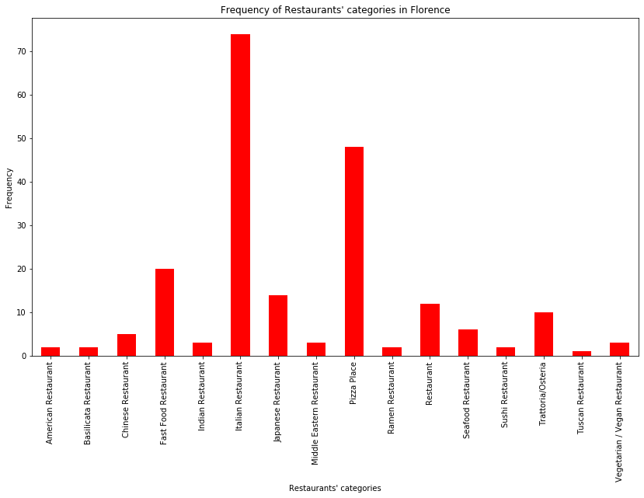
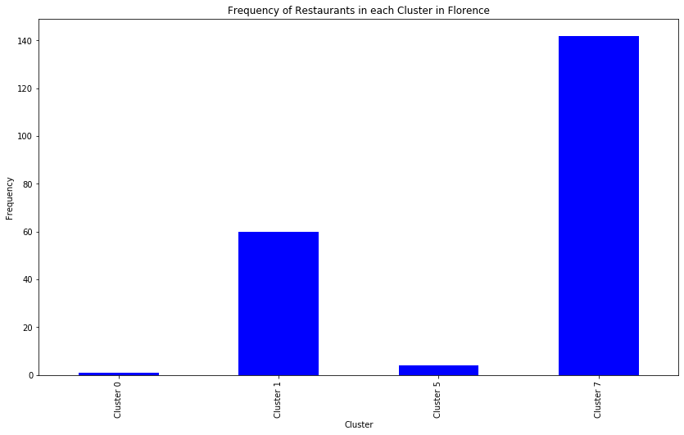
Distributions of Restaurant Categories (a), neighborhood clusters (b).
a)
b)

Slide 10
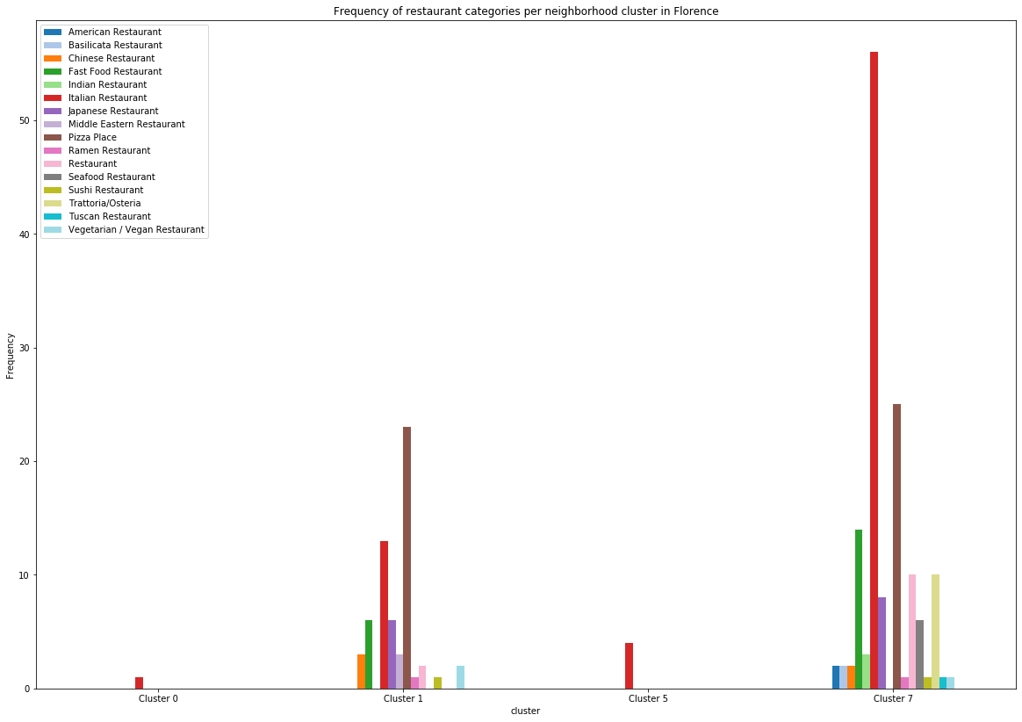
Distributions of Restaurant Categories in each neighborhood cluster

Slide 11
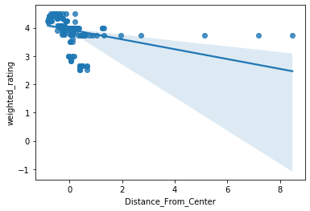
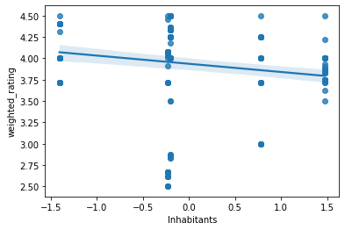
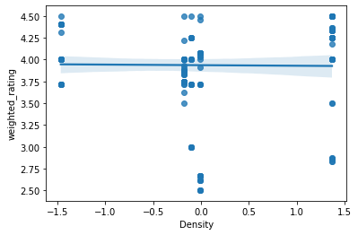
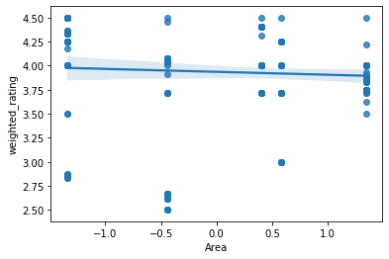
Relationship between our numerical features and relative ratings

Slide 12
From the exploratory data analysis we understood that certain restaurant categories/clusters are definitely underrepresented in our dataset.
Also, relationships between numerical features and ratings seem to be more complex than linear.

Slide 13
Modelling
Finally, let’s build our predictive models! We are going to fit a multiple linear regression and a regression tree to our features and ratings.

Slide 14
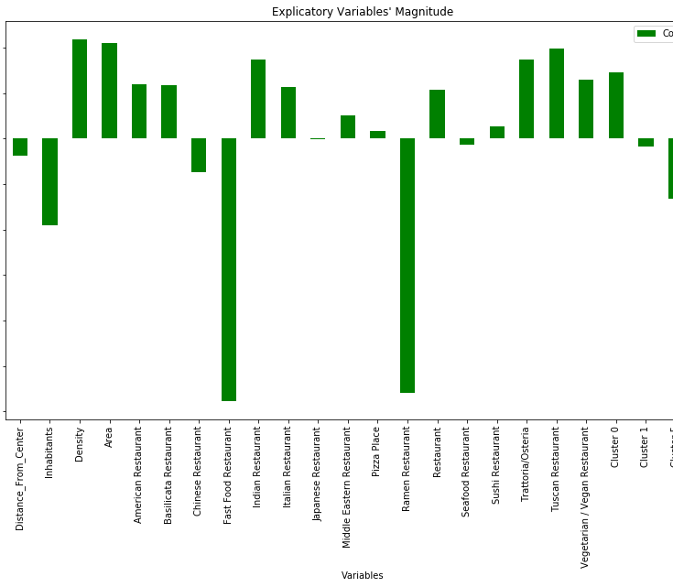
Multiple Linear Regression
The figure on the left shows which features seem more relevant for predicting rating according to the multiple linear regression model.
Important highlights include:
Fast-food restaurants do not seem to be particularly appreaciated in Florence, nor Ramen Restaurants.
Staying in a densely populated and large enough area might help your restaurant having success, probably because many people are available as potential customers but the competition is more distributed.
Indian, Italian, Tuscanian Restaurants and Trattorie (typical restaurants) seem to be appreciated type of restaurants.

Slide 15
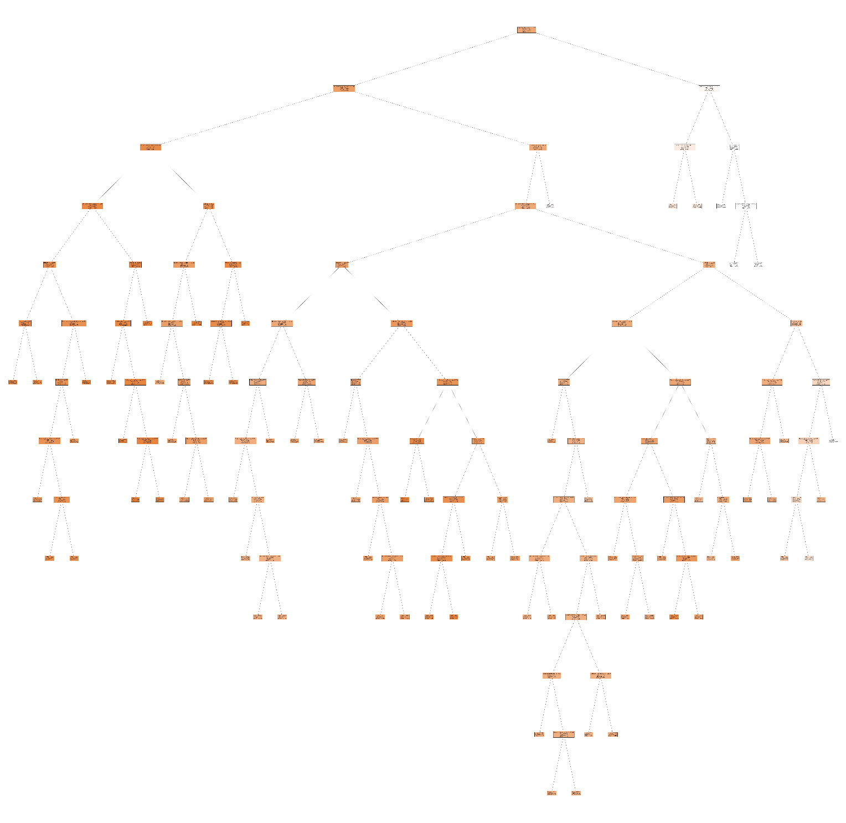
Regression Tree
The tree is very big and, as such, reading in the various boxes is very hard. By downloading the above image and zoom into it, however, the various factor leading to a prediction can be individuated. In particular, it can be seen how the decisions over dummy variables are represented as category<=0.5, meaning if is not that category. The results of the regression tree seems to confirm the ones from the multiple regression model in the importance it's given to the various features. In particular, the first split highlight once more and even more strongly that to have success in ratings in Florence you should not open a fast-food restaurant and the same applies to Ramen restaurants.

Slide 16
Finally, let’s say that a stakeholder already now the location and the type of restaurant she wants to open
We can predict the expected rating for the restaurant, let’s say an Indian Restaurant in the neighborhood of S.Ambrogio.
Prediction for the example restaurant with multiple linear regression model: 4.454758295479506
Prediction for the example restaurant with regression tree model: 4.250034838350056
Here, we go! Our stakeholder can expect customers to appreciate her idea.

Slide 17
Conclusion
We have seen a case study in which restaurants’ success was predicted via machine learning techniques. Along the way we found problems and interesting results. For the first ones, more data could be gathered and fed to the general pipeline, so as to tackle the problem of underrepresentation of certain categories. Notwithstanding this, the results seem likely to already generate value for the stakeholders.
Thank you!

