Slide 1

WVC 2026 · XXI WORKSHOP ON COMPUTER VISION
Maritime Search and Rescue
An Evaluation of Small-Object Detection in UAV Imagery
Ighor de Souza Ribeiro¹ Rigel Procópio Fernandes²
¹ CIAA ² DSAM
follow the slides
Notes:
[0:15] Good morning. I am Ighor, from CIAA, and this is joint work with Rigel, from DSAM. The QR code takes you to the slides. The question: with a lightweight detector already trained, how much can we gain by changing only the inference, in maritime search and rescue with UAVs?

Slide 2
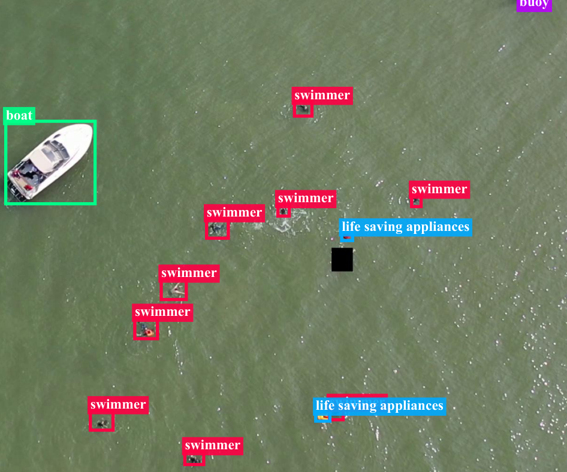
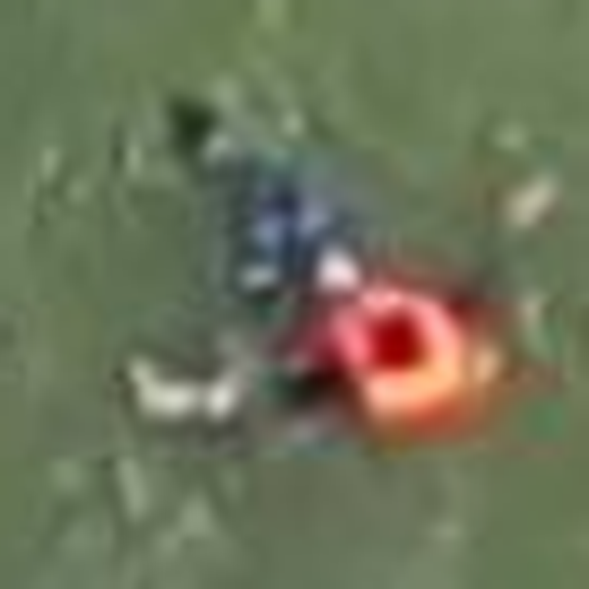


THE PROBLEM: TARGETS OF A FEW PIXELS
The same target, in fewer pixels
Original crop
Target at ~16 px
Target at ~9 px
Illustration: the same crop, resampled.
16 px
9.4 px
median target size at 1280 px
life-saving appliances
SeaDronesSee Object Detection v2, ground-truth labels (Fig. 1 of the paper)
Half of the targets fit inside a 16 × 16-pixel square
Notes:
[0:40] Seen from the UAV, a target is a handful of pixels on a sea surface that keeps changing. With the longer side at 1280 pixels, the median target size is 16 pixels: half of the objects fit in a 16 by 16 square. For life-saving appliances the median is 9.4 pixels. On the right, the same crop resampled, just to show how little information is left.

Slide 3
SEADRONESSEE: IMBALANCED CLASSES
8,930
1,547
3,750
training images
validation images
test images (official server)
Share of the training instances
Swimmer
64.22%
Jetski
4.03%
Life-saving appliances
1.60%
The rarest class is exactly the most critical one in SAR
Notes:
[0:30] The benchmark is SeaDronesSee Object Detection v2, with five classes. The test labels are not public: predictions go to the official server. And the imbalance is strong: swimmers are 64.22% of the training instances; life-saving appliances, 1.60%. A good aggregate AP can hide the rare class.

Slide 4
WHAT CHANGES: INFERENCE ONLY
varied
fixed
varied
varied
fixed
Image
YOLO26n
Head
Post-processing
Detections
640 · 800 · 1280 px
fixed weights
one-to-one
one-to-many
NMS · Soft-NMS
WBF · SAHI
boxes + classes
How we measure
COCO AP
ms/image
95% CI
local val and official test server
latency and forward passes per image
paired bootstrap and operating points
Same architecture: which inference gives the best accuracy–cost trade-off?
Notes:
[0:35] We do not propose a new architecture. We keep the YOLO26n weights fixed and vary only three things: input resolution, detection head and post-processing. We measure AP under the COCO protocol, on the local validation split and on the official server, plus latency, operating points and a paired bootstrap. There are two checkpoint lineages, 640 and 1280 pixels; the main results are at 1280.

Slide 5
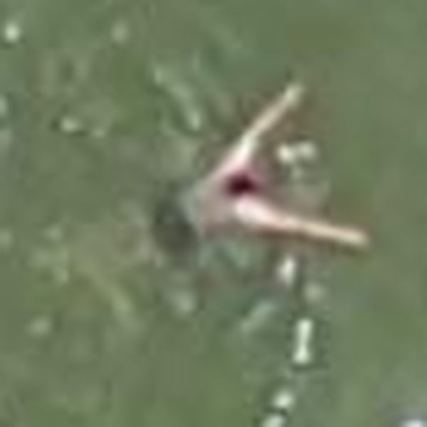
TWO HEADS, THE SAME WEIGHTS
One-to-one (default)
One-to-many
0.90
0.45
0.90
1 prediction per object
several candidates per object
no NMS
needs NMS
direct output
0.60
candidates → NMS → output
Illustrative boxes and confidences.
Same training, two inference paths: without NMS or with NMS
Notes:
[0:40] YOLO26n has two heads on the same weights. The one-to-one head, the library default, is trained to output a single prediction per object and needs no NMS. The one-to-many head produces several candidates per object, so something has to filter them: NMS. Since the weights are the same, the difference between them is only the inference path.

Slide 6
HARD-NMS VS. SOFT-NMS
Candidates
Hard-NMS (threshold 0.80)
Linear Soft-NMS
A 0.90
A 0.90
A 0.90
B 0.60
B 0.60
B 0.21
IoU(A, B) = 0.65
0.65 < 0.80: B stays intact
0.60 × (1 − 0.65) = 0.21
Hard-NMS: removes B if IoU ≥ threshold. Linear Soft-NMS: s ← s · (1 − IoU) when IoU ≥ 0.5. Illustrative example.
Hard-NMS is all or nothing; Soft-NMS lowers the confidence with the overlap
Notes:
[0:50] NMS decides what to do with overlapping boxes. Hard-NMS is all or nothing: above the IoU threshold the neighbour is removed; below it, the neighbour keeps its full confidence. We use a threshold of 0.80. In the example, an IoU of 0.65 is below 0.80, so the duplicate B survives with 0.60. Linear Soft-NMS does not discard: it multiplies the confidence by one minus IoU, from an IoU of 0.5 upwards. Here, 0.60 becomes 0.21. The box still exists, but it goes to the end of the ranking. The example is illustrative.

Slide 7
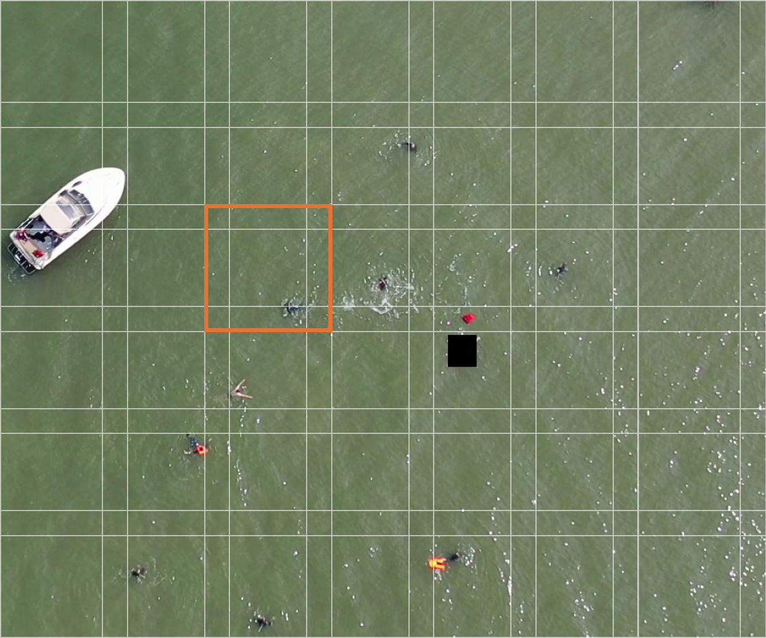
SAHI AND FLIP + WBF
Flip + WBF
image
WBF
mirror
weighted average
WBF averages overlapping boxes instead of discarding them.
SAHI: 640-px tiles at native resolution, overlap 0.20
Illustrative grid.
More forward passes per image: 2 for Flip + WBF, about 39 for SAHI
Notes:
[0:40] The two multi-pass alternatives. SAHI cuts the frame into overlapping 640-pixel tiles, at native resolution, and runs the detector on each one: the target gets larger, but it takes about 39 passes per image. Flip + WBF runs the image and its mirror and fuses the boxes by a weighted average instead of discarding them: two passes. The question is whether this extra cost pays off in AP.

Slide 8
RESULT: HEAD AND NMS AT 1280 PX
+1.25 AP
one-to-many head + Hard-NMS vs. one-to-one
+0.46 AP
Soft-NMS vs. Hard-NMS
95% CI [+0.37, +0.55]
The head with NMS beats the default; Soft-NMS adds a small but consistent gain
Notes:
[0:40] Measured result, at 1280 pixels, all with the same confidence threshold. The one-to-many head with Hard-NMS reaches 48.04 against 46.79 for the one-to-one head: plus 1.25 AP. Linear Soft-NMS adds 0.46, with a 95% confidence interval from 0.37 to 0.55. It is small but consistent, and it costs 27 versus 31 milliseconds per image, within the variation of the machine. The axis starts at zero on purpose.

Slide 9
AT THE OPERATING POINT
87.80%
best F1 (Soft-NMS); 86.23% Hard-NMS and 84.73% one-to-one
77.48 → 87.57%
precision at conf 0.25: Hard-NMS → Soft-NMS
At precision ≥ 0.90, Soft-NMS recovers 85.08% of the objects
Notes:
[0:35] In deployment there is a single threshold. Requiring a precision of at least 0.90, Soft-NMS recovers 85.08% of the objects, against 81.19% with Hard-NMS and 75.58% with the default head. At confidence 0.25 the recall is similar, but the precision of Hard-NMS drops to 77.48% against 87.57%. Reading this as duplicates that Soft-NMS demotes, as in the example, is a hypothesis. And these points were estimated on the validation split itself.

Slide 10
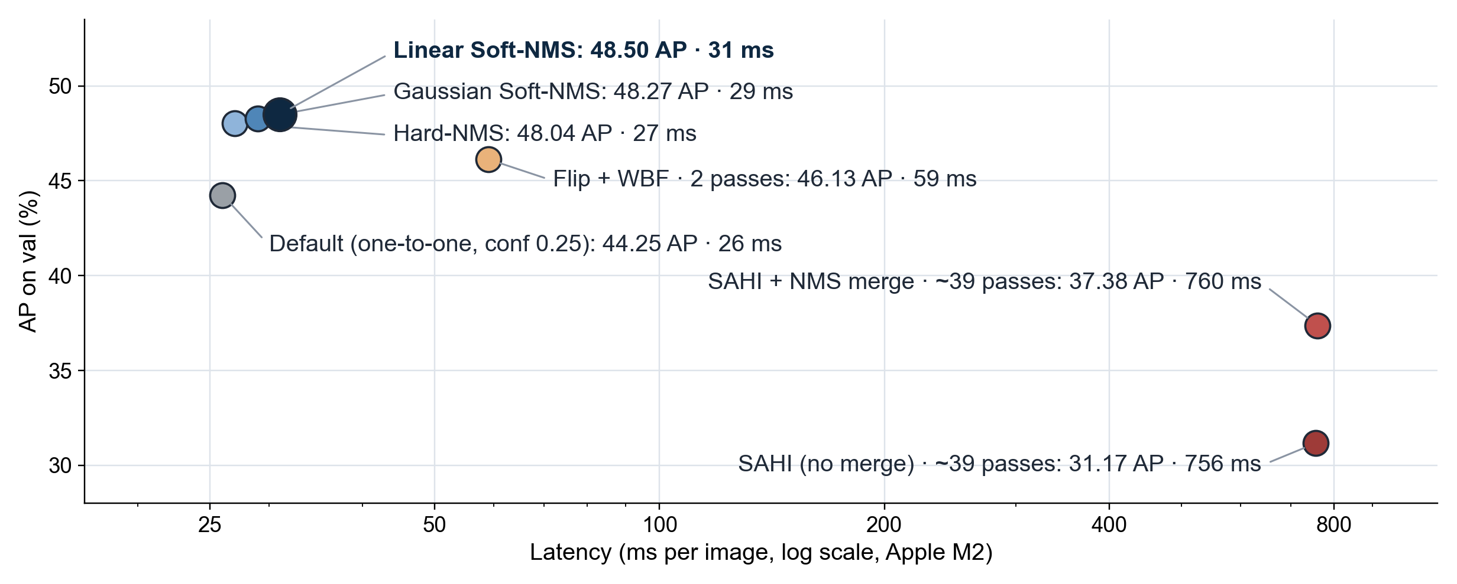
COST VS. ACCURACY
SAHI and WBF: more passes, more latency and lower AP
Notes:
[0:40] Here are the seven configurations at 1280 pixels: AP against latency, on a log scale. The single-pass ones sit together, between 26 and 31 milliseconds. Flip + WBF doubles the cost and stays below single-pass Hard-NMS. SAHI, with about 39 passes and 760 milliseconds, loses 11 to 17 points of AP relative to linear Soft-NMS. Latency was measured on a non-dedicated M2 laptop.

Slide 11
WHY DOES SAHI LOSE?
HYPOTHESIS
Training and single pass
SAHI tile
3840 × 2160 frame → 1280 px
640 × 640 crop at native resolution
≈ 3×
target as the detector learned it
the same target, ~3× larger
Consistent with: largest losses for large objects (APl) and boats. Not tested: SAHI without slicing-aided fine-tuning.
Hypothesis: in the tiles, objects appear about 3× larger than in training
Notes:
[0:35] Why does SAHI lose? This is a hypothesis, not a measured result. The checkpoint was trained with the 3840 by 2160 frames reduced to 1280. In a native-resolution tile, the same object appears about three times larger than what the detector learned to see. This is consistent with the largest losses being on large objects and on boats. But we did not do slicing-aided fine-tuning, so it is not tested.

Slide 12
PER-CLASS RESULT
18.26%
AP of life-saving appliances (Soft-NMS)
5 of 5
classes improve with Soft-NMS
Life-saving appliances remain the hardest class in every configuration
Notes:
[0:30] Per class, Soft-NMS improves all five, although only marginally for swimmers. And life-saving appliances remain the hardest class, at 18.26% AP, in every configuration. This is consistent with their median size of 9.4 pixels.

Slide 13
OFFICIAL SEADRONESSEE TEST SET
+4.11 AP
Linear Soft-NMS vs. Default
52.53
AP75 of the final configuration
On the official test set: 45.90 → 50.01 AP and 73.49 → 79.71 AP50
Notes:
[0:30] On the official server, with 3,750 images without public labels: Default, which is our baseline submission, scores 45.90 AP. Hard-NMS, 49.60. Linear Soft-NMS, 50.01, with an AP50 of 79.71 and an AP75 of 52.53. That is 4.11 points over Default. But where do these points come from?

Slide 14
WHERE DOES THE GAIN COME FROM?
Validation: 44.25 → 48.50 AP (+4.25 points)
2.54
1.25
0.46
confidence threshold
0.25 → 0.001
one-to-many head
+ Hard-NMS
Linear
Soft-NMS
protocol effect
Above conf 0.25 the detections are identical: AP integrates the whole precision–recall curve. On the test set, Soft-NMS adds +0.41, within the validation CI.
More than half of the gain is a protocol effect, not Soft-NMS
Notes:
[0:45] This is the slide I most want you to remember. On validation, the path from Default to the final configuration adds up to 4.25 points. 2.54 come only from lowering the confidence threshold from 0.25 to 0.001. That is a protocol effect: AP integrates the whole precision–recall curve, and the detections above 0.25 are identical; nothing improves in operation. Then 1.25 from the head with Hard-NMS and 0.46 from Soft-NMS. On the test set, Soft-NMS adds 0.41, within the validation confidence interval. The increments depend on the order in which the changes are applied.

Slide 15
LIMITATIONS
Constraint | Consequence
One training seed per checkpoint | Training variance not estimated
Latency on a non-dedicated laptop (Apple M2) | No measurement on embedded hardware
SAHI without slicing-aided fine-tuning | The negative result holds for this version
IoU 0.80 tuned on the 640-px lineage | Reused at 1280 px without re-tuning
Operating points estimated on val | No separate split to choose the threshold
Findings specific to YOLO26n on SeaDronesSee, under the tested protocol
Notes:
[0:35] Limitations, plainly. One seed per checkpoint: the bootstrap covers image sampling, not training variance. Latency was measured on a laptop, not on embedded hardware. SAHI was used without slicing-aided fine-tuning. The IoU of 0.80 was tuned on the 640 lineage and reused. And the operating points come from the validation split itself. Future work: repeated seeds, embedded hardware, SAHI with fine-tuning, temporal tracking, calibration and data-level interventions.

Slide 16
CONCLUSIONS
1
A single pass at 1280 px with Linear Soft-NMS is the best trade-off: 50.01 AP on the official test set
2
SAHI and WBF increase cost without improving AP
3
The protocol matters: 2.54 of the 4.25 points come from the confidence threshold alone
Still open: life-saving appliances, at 18.26% AP
Notes:
[0:35] Three conclusions. One: a single pass at 1280 pixels, with the one-to-many head and linear Soft-NMS, is the best trade-off we found, with 50.01 AP on the official test set. Two: SAHI and WBF cost more and do not improve AP. Three: the protocol matters; more than half of the gain over Default comes only from the confidence threshold. And what remains open is the class that matters most in SAR: life-saving appliances, at 18.26% AP.

Slide 17
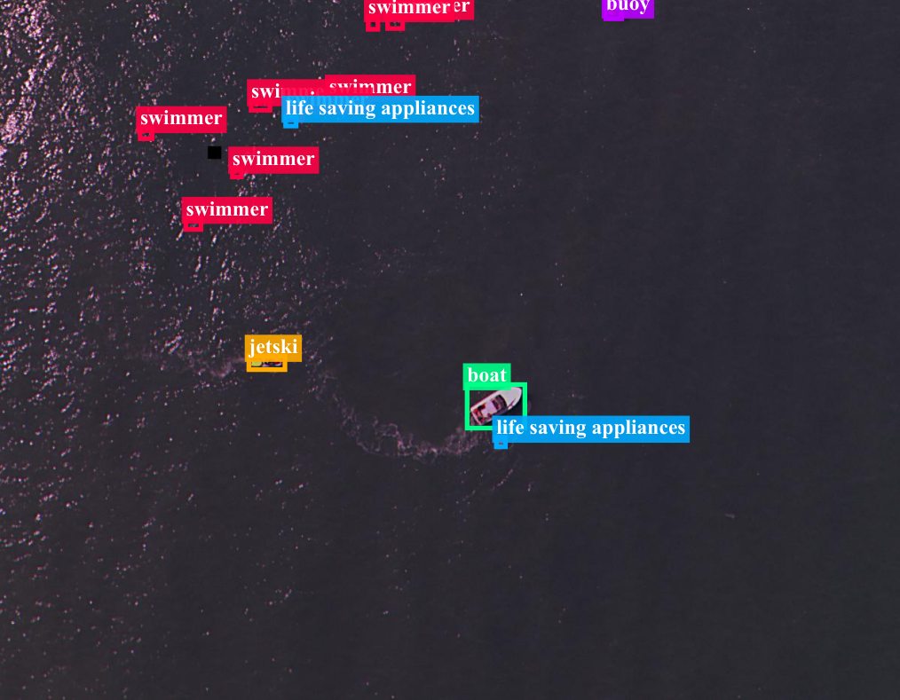

THANK YOU
Thank you!
Questions?
Ighor de Souza Ribeiro
ighoribeiropb@gmail.com
Code and parameters
github.com/IghorRibeiro/
yolo26n-seadronessee-postprocessing
Notes:
[0:05] Thank you. The code and all parameters are in the repository behind the QR code. I am happy to take questions.

Slide 18
BACKUP: CONFIGURATIONS AT 1280 PX (VAL)
Config | Passes | ms/img | AP | AP50 | AP75 | APs | APm | APl
Default (one-to-one, conf 0.25) | 1 | 26 | 44.25 | 74.98 | 43.67 | 40.59 | 45.69 | 61.28
Hard-NMS | 1 | 27 | 48.04 | 79.98 | 48.23 | 43.13 | 48.28 | 66.41
Linear Soft-NMS | 1 | 31 | 48.50 | 80.36 | 48.66 | 43.65 | 48.53 | 66.87
Gaussian Soft-NMS | 1 | 29 | 48.27 | 79.97 | 48.41 | 43.57 | 48.30 | 66.68
Flip + WBF | 2 | 59 | 46.13 | 79.45 | 44.15 | 40.16 | 47.15 | 65.18
SAHI (no merge) | 38.63 | 756 | 31.17 | 51.90 | 32.58 | 36.84 | 34.69 | 42.36
SAHI + NMS merge | 38.63 | 760 | 37.38 | 64.66 | 37.76 | 41.33 | 43.41 | 45.70
Latency: Apple M2, 8 GB, MPS, batch 1, 200 validation images, after 10 warm-up iterations, image decoding excluded.
Single pass: 26 to 31 ms per image; cost is set by the number of forward passes
Notes:
Backup: Table II of the paper.

Slide 19
BACKUP: HISTORICAL 640-PX CHECKPOINT (VAL)
Config | Input (px) | AP | AP50 | AP75
One-to-one | 640 | 39.09 | 70.55 | 37.19
One-to-many + Hard-NMS | 640 | 39.78 | 71.09 | 38.22
Native TTA | 640 | 37.73 | 68.30 | 36.15
MS-Flip + WBF | 640, 800 | 42.51 | 75.35 | 39.83
SAHI-640 | 640; tiles 640 | 37.93 | 66.82 | 37.49
SAHI-1024 | 640; tiles 1024 | 37.54 | 65.71 | 37.50
Full image + SAHI-640 + WBF | 640; tiles 640 | 37.63 | 66.52 | 36.45
Hard-NMS | 800 | 42.83 | 74.27 | 42.49
Linear Soft-NMS | 800 | 43.25 | 75.30 | 42.85
At 640 px too, TTA and SAHI do not beat full-image inference with NMS
Notes:
Backup: Table I of the paper. The same Default prediction with this checkpoint scores 36.49 AP on the official test set, 9.41 points below the 1280-pixel Default.

Slide 20
BACKUP: PER-CLASS AP AT 1280 PX (VAL)
Config | Swimmer | Boat | Jetski | Life-saving | Buoy
Hard-NMS | 37.86 | 72.20 | 56.71 | 17.92 | 55.50
Linear Soft-NMS | 37.88 | 72.82 | 57.21 | 18.26 | 56.32
Gaussian Soft-NMS | 37.56 | 72.51 | 57.09 | 18.24 | 55.95
Flip + WBF | 32.52 | 72.75 | 55.04 | 17.59 | 52.72
SAHI (no merge) | 28.14 | 43.34 | 31.51 | 14.87 | 38.00
SAHI + NMS merge | 33.11 | 50.97 | 39.38 | 17.70 | 45.73
With SAHI, the largest loss is on boats, the class with the largest boxes
Notes:
Backup: Table III of the paper. It supports the scale-mismatch hypothesis.

