Slide 1
Definite Mastery: Learning German Articles with React Native
Worked: Teo Spiri, Igli Kodra, Kujtim Alimehmeti, Amir Gjana

Slide 2
Table of contents
01
02
03
04
Introduction
Features
Benefits
Target Audience
05
Conclusion

Slide 3
Introduction
Learning a new language can be challenging, especially when it comes to grammar rules. One of the most important aspects of German grammar is the use of definite articles. To help learners master this concept, we have developed a React Native program that focuses specifically on teaching definite articles.
Our app features a user-friendly interface with a login page and a test-taking page. Users can create their own accounts also, and take quizzes to reinforce their knowledge of definite articles in German.

Slide 4
Features
Our app offers several key features to enhance the learning experience. First and foremost, users can create their own accounts and log in securely to access the app's content. This allows for personalized tracking of progress and achievements.
The main feature of our app is the test-taking page, which presents users with a series of questions related to definite articles in German. These questions are designed to gradually increase in difficulty, ensuring that users are challenged but not overwhelmed. The app provides immediate feedback on each question, allowing users to learn from their mistakes and improve their skills.

Slide 5
Benefits
Our app offers numerous benefits for learners of all levels. For beginners, it provides a clear and structured introduction to the concept of definite articles in German. For intermediate-level learners, it offers a valuable tool for practicing and reinforcing their understanding of this crucial grammar rule.
In addition, our app is designed to be engaging and fun, with colorful graphics and a user-friendly interface. This helps to keep learners motivated and interested in the learning process.

Slide 6
Target Audience
Our app is ideal for anyone who is learning German, whether they are complete beginners or more advanced learners. It is particularly useful for those who struggle with the concept of definite articles, as it provides a clear and structured approach to mastering this grammar rule.
The app is also suitable for learners of all ages, from children to adults. Its colorful graphics and playful design make it especially appealing to younger learners, while its comprehensive content and challenging quizzes make it valuable for more serious students.

Slide 7
Conclusion !
In conclusion, our React Native program is an innovative and effective tool for learning definite articles in German. With its user-friendly interface, challenging quizzes, and engaging design, it offers a comprehensive and enjoyable learning experience for learners of all levels.
We are committed to ongoing development and improvement of our app, and we look forward to helping more people master the complexities of German grammar through our program.

Slide 8
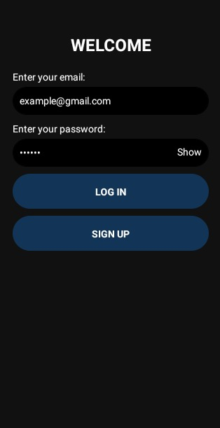
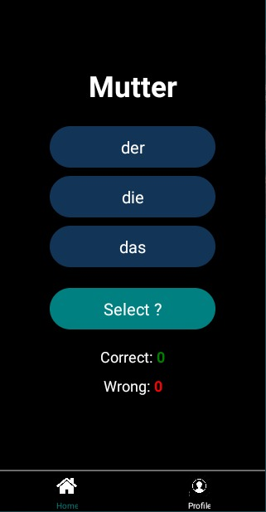
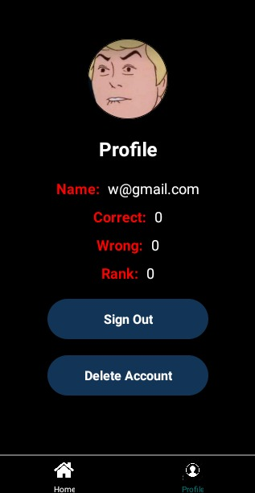
Application preview !
Login
Home Page
Profile Page

