Slide 1
Software-ontwerp: Tablr Iteration 2
Quinten Bruynseraede
Martijn Slaets
Tom De Backer
Ignace Bleukx

Slide 2
1. Design
Pattern:
Front Controller pattern
Every UI Object uses his reference to the communicationmanager to interact with the domain.
+ No direct access from UI Objects to the domain. ()
The domain can never be brought into an inconsistent state.
+ Centralized control (Controller)
+ Every object needs only one reference (Low coupling)
- A lot of methods in the communicationmanager class

Slide 3
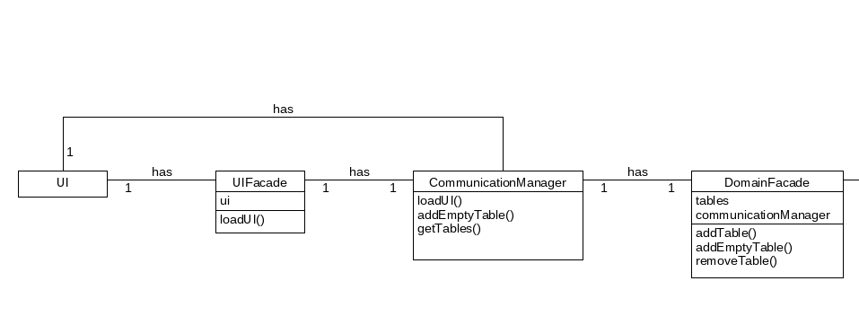
Class Diagram - 1

Slide 4
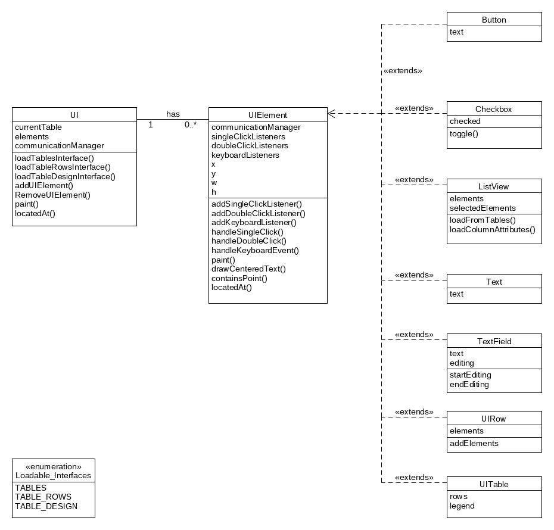
Class Diagram - 2

Slide 5
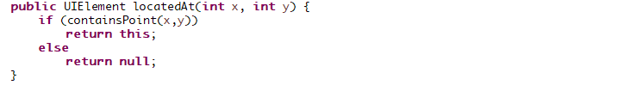
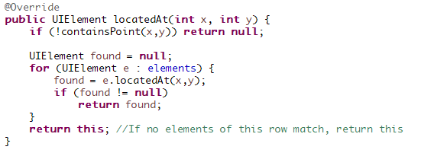


2. Design choices - Polymorphism
UIElement:
UIRow:

Slide 6

2. Design choices - Facades
Communicationmanager uses facades (indirection + high cohesion)

Slide 7
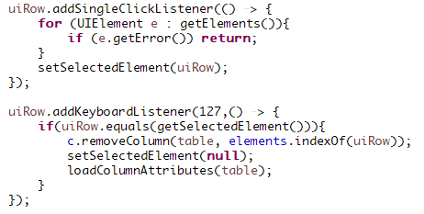
2. Design choices - Listeners
Low coupling

Slide 8
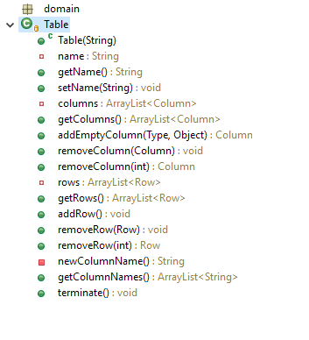
2. Design choices – Independent domain
Low Coupling

Slide 9
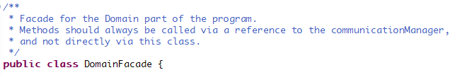
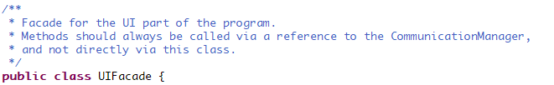
2. Design Choices – Pure fabriction

Slide 10
3. Extensibility
Communication Manager is the only link between UI and domain
→ easy to share domain across multiple UI intances
Validity of values checked on a single place
→ extensions or change in cell values easy to implement

Slide 11
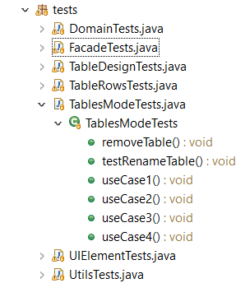
4. Testing Approach

Slide 12
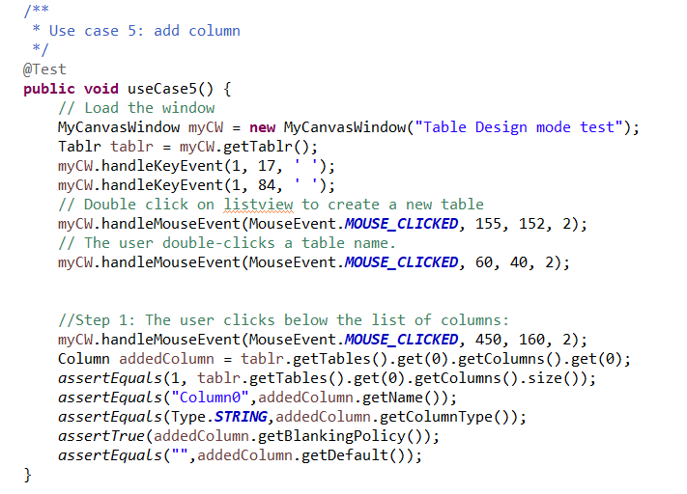
4. Testing approach – Mouse Events

Slide 13
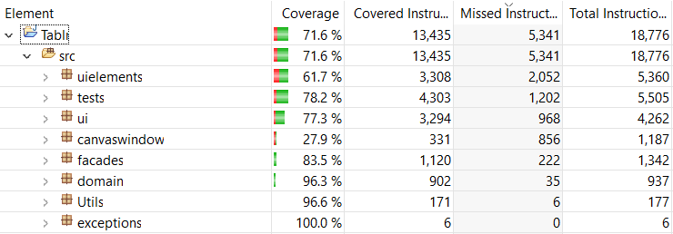
4. Testing Approach – Total Coverage

Slide 14
4. Testing Approach – Adjusted Coverage
79% tot nu toe
What is not tested?
Canvaswindow
Paint methods

Slide 15
Overview of project management
Domain Coordinator: Ignace
Testing Coordinator: Tom
Design Coordinator: Quinten & Martijn
Next iteration:
Domain Coordinator: Martijn
Testing Coordinator: Ignace
Design Coordinator: Tom & Quinten

Slide 16
Spent hours: Group work
Quinten Bruynseeraede: ~ 35 hours
Ignace Bleukx: ~ 35 hours
Tom De Backer: ~ 30 hours
Martijn Slaets: ~ 20 hours

Slide 17
Individual work
Quinten Bruynseeraede: ~ 19 hours
Ignace Bleukx: ~ 19 hours
Tom De Backer: ~ 9 hours
Martijn Slaets: ~ 9 hours

Slide 18
Study
Quinten Bruynseeraede: ~ 1 hour
Ignace Bleukx: ~ 1 hour
Tom De Backer: ~ 1 hour
Martijn Slaets: ~ 1 hour

Slide 19
Use cases

Slide 20
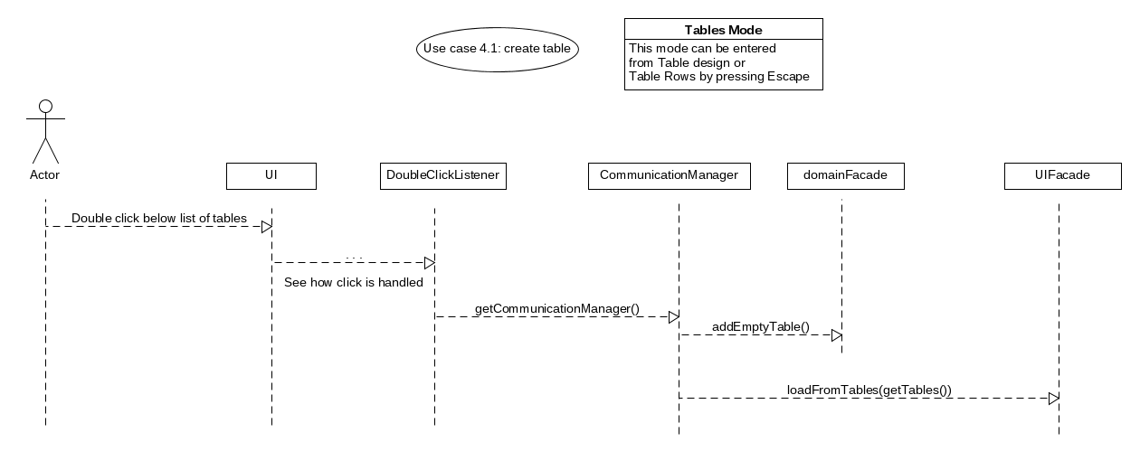
1. Adding a table

Slide 21
2. Edit a table name

Slide 22
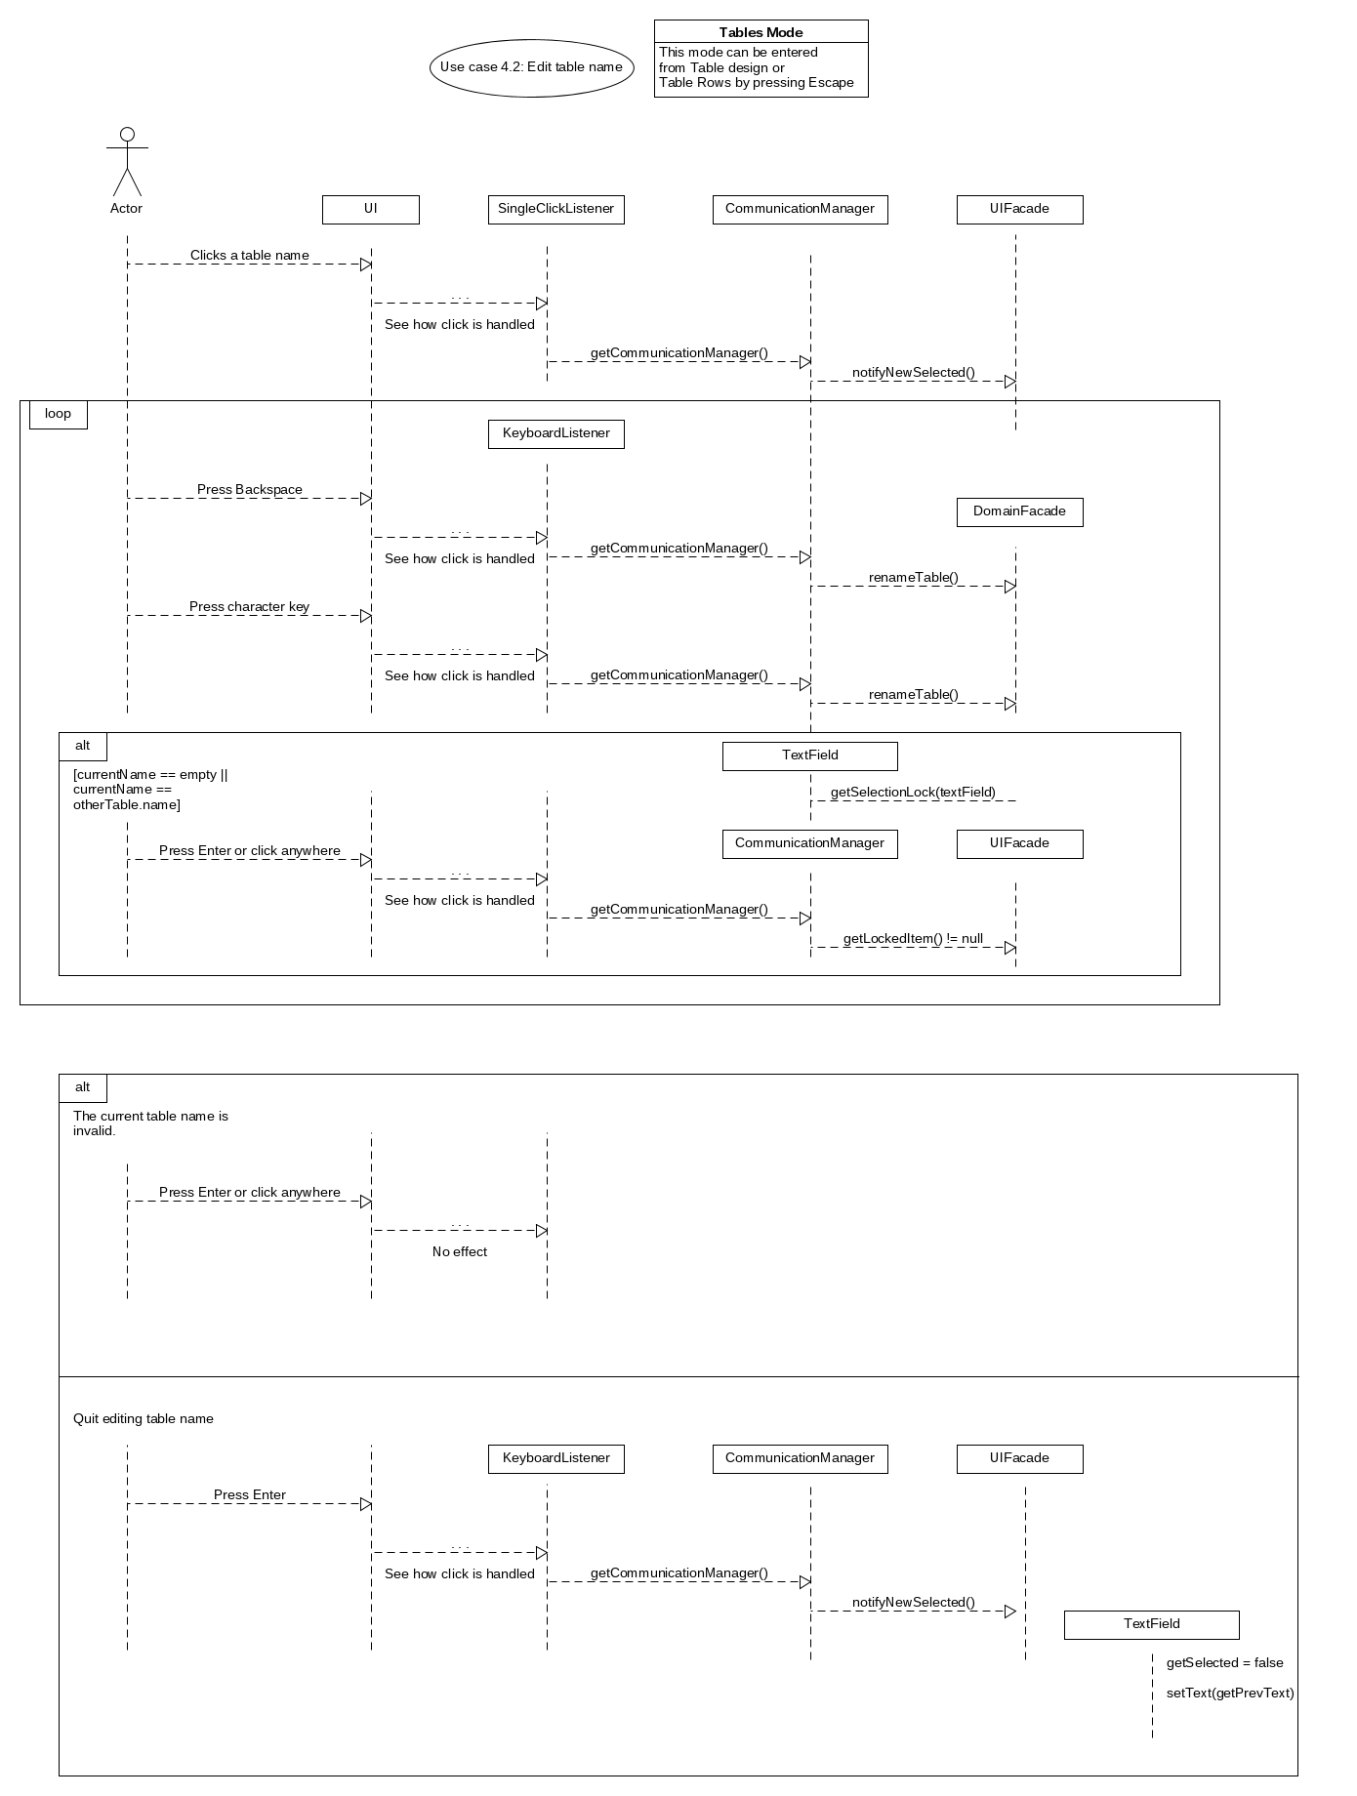

Slide 24
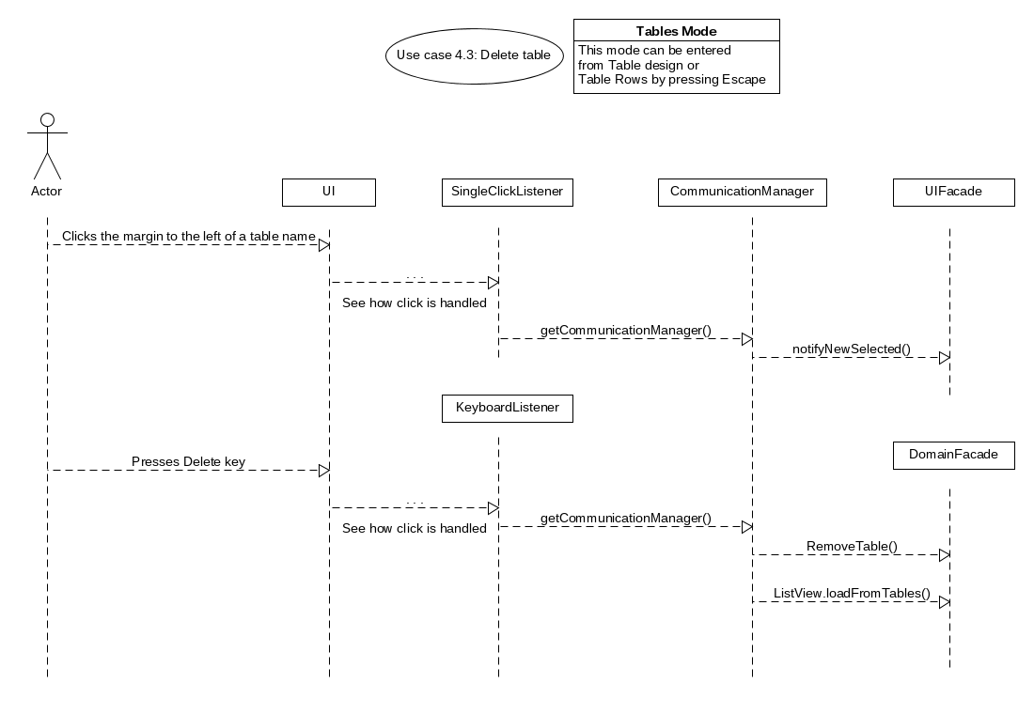
3. Delete table

Slide 25
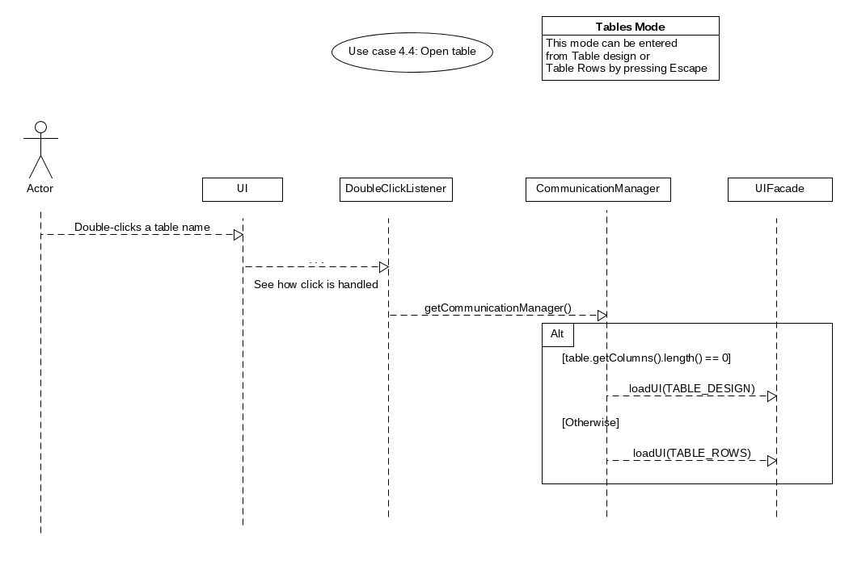
4. Open table

Slide 26
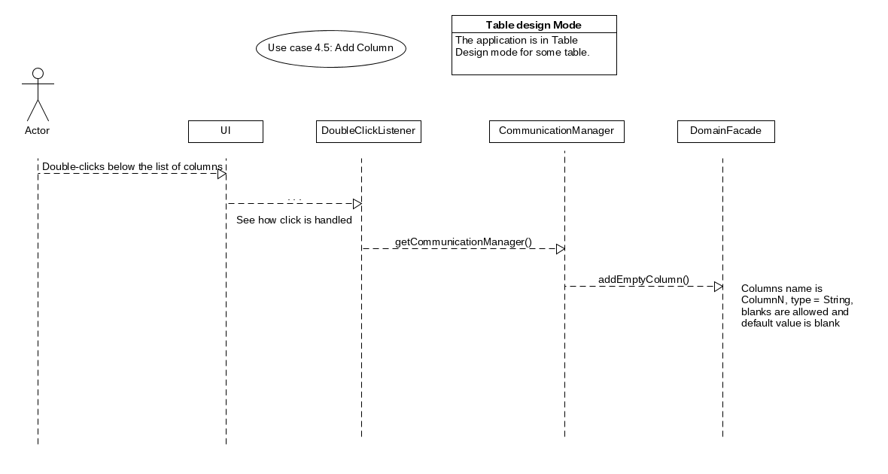
5. Add Column

Slide 27
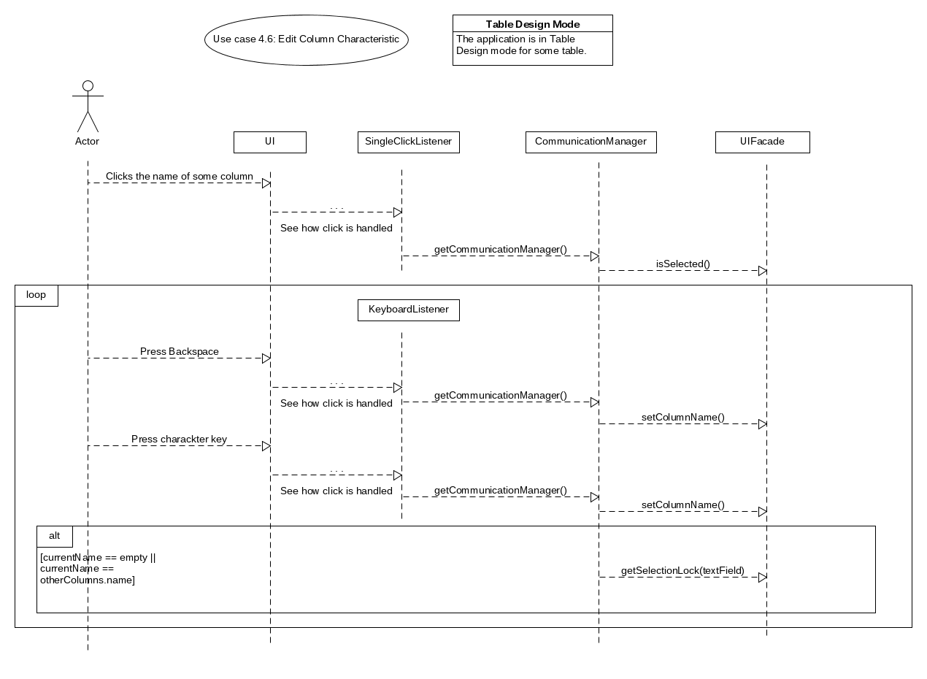
6. Edit Column Characteristic

Slide 28
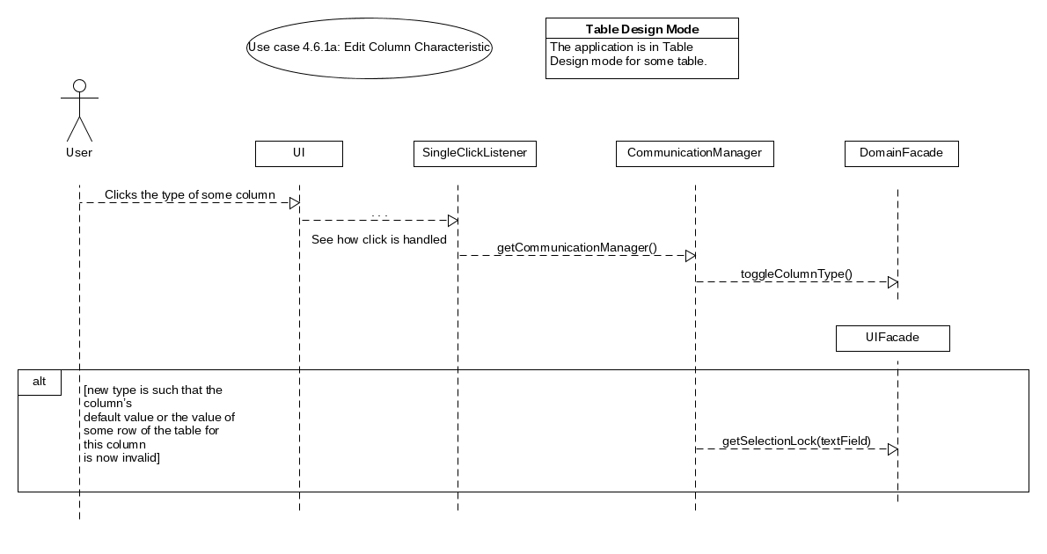
6. Edit Column Characteristic (a)

Slide 29
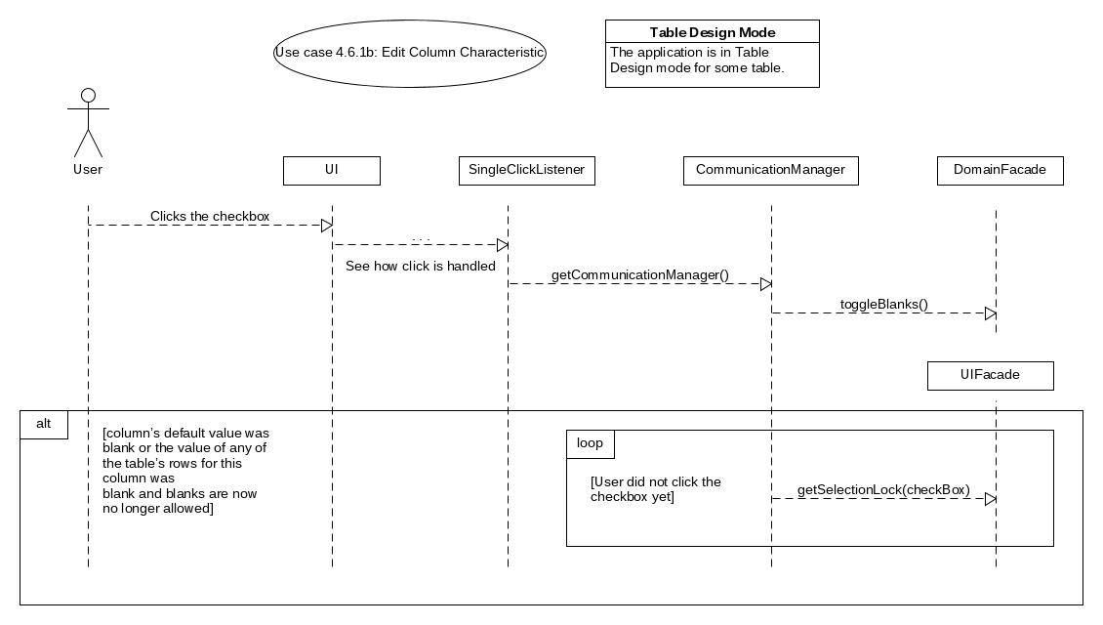
6. Edit Column Characteristic (b)

Slide 30
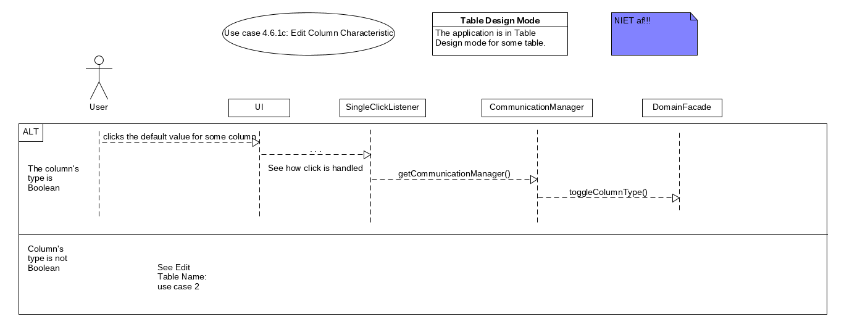
6. Edit Column Characteristic (c)

Slide 31
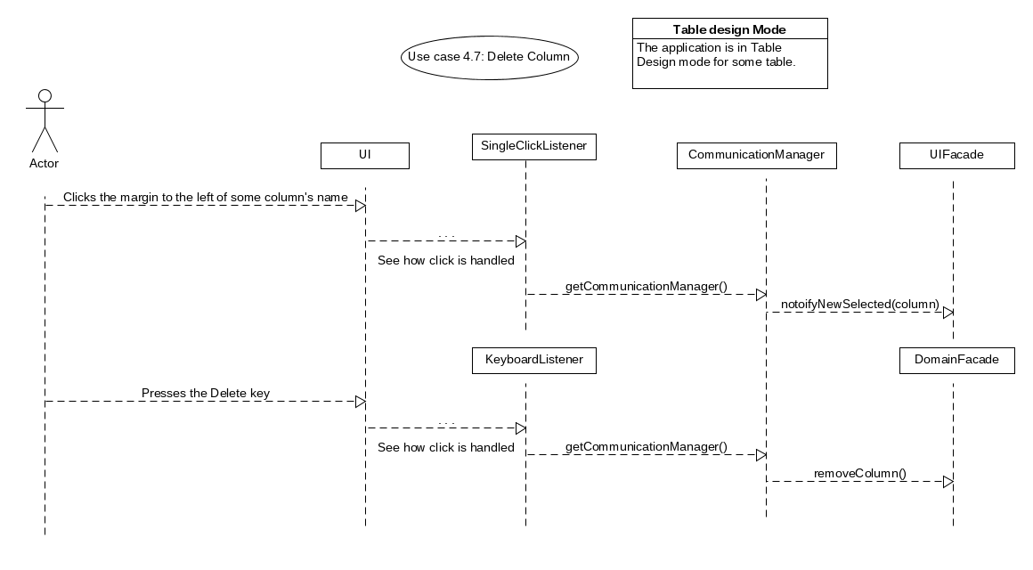
7. Delete Column

Slide 32
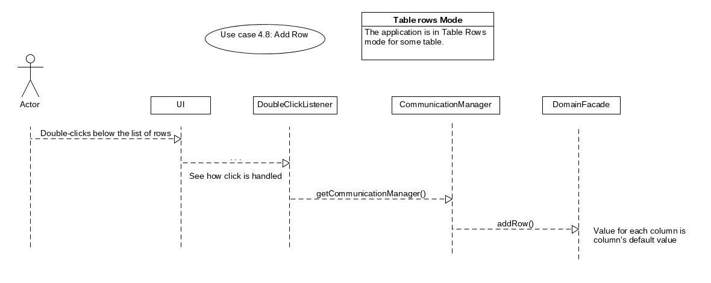
8. Add Row

Slide 33
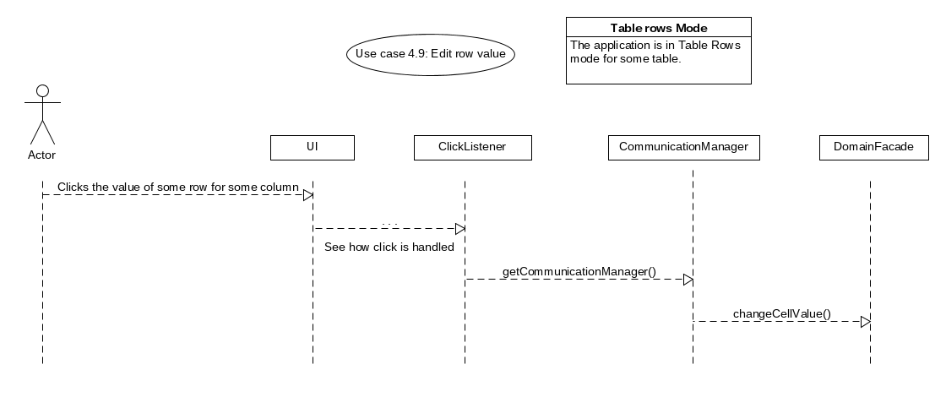
9. Edit Row Value

Slide 34
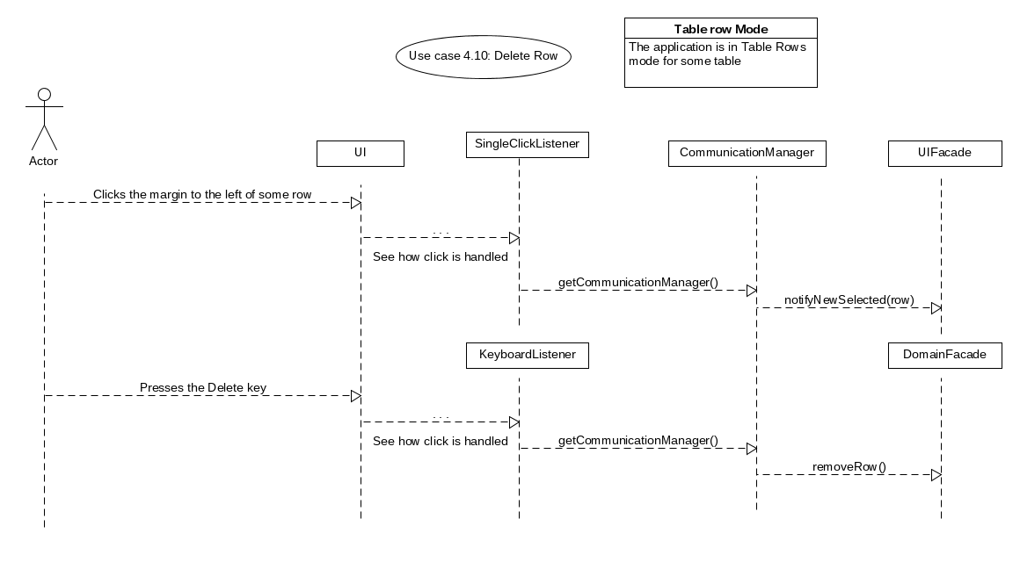
10. Delete Row

