Slide 1
Software-ontwerp: Tablr Iteration 2
Quinten Bruynseraede
Martijn Slaets
Tom De Backer
Ignace Bleukx

Slide 2
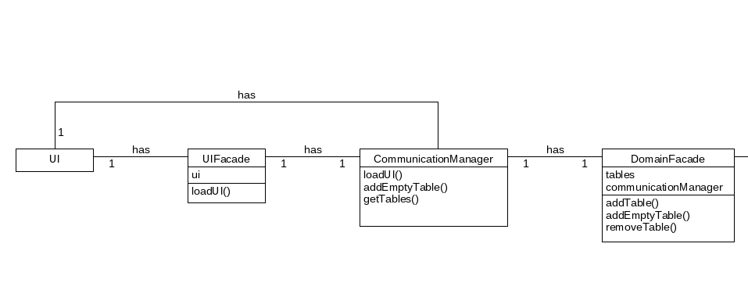
1. Design: then vs Now
Iteration 1:
CommunicationManager was used by every object to modify Domain or UI
CommunicationManager made use of UIFacade and DomainFacade

Slide 3
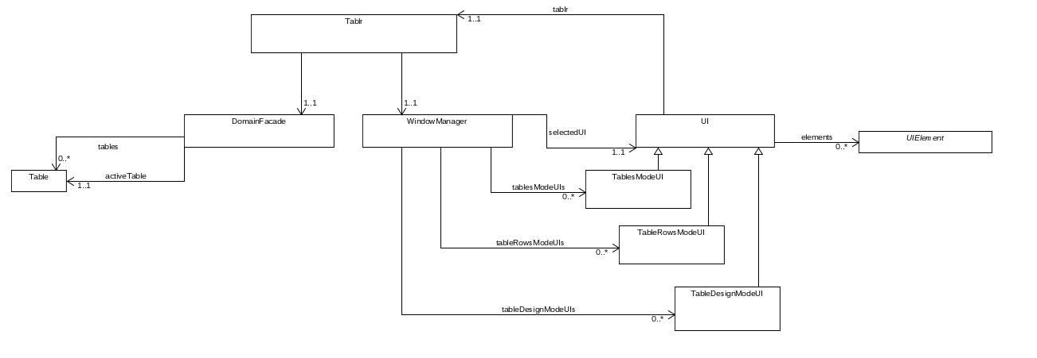
1. Design: then vs Now
Iteration 2:
All DomainElements and UIElements are free of references to 'Tablr'-specific Classes

Slide 4
1. Design: then vs Now
Iteration 1:
The loading of different UI's was handled in different UIElements
e.g. ListView.loadFromTables()

Slide 5
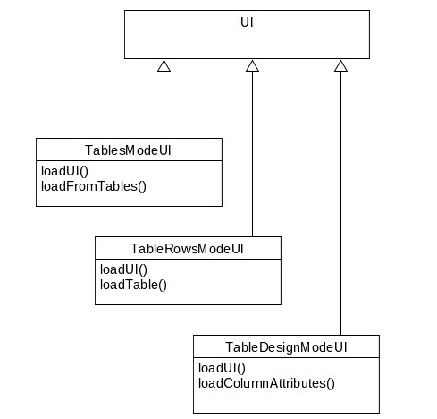
1. Design: then vs Now
Iteration 2:
Subwindows inherit from superclass UI
Method loadUI() to create the necessary components
All Tablr-logic is specified in the loading of a UI, not in UIElements

Slide 6

1. Design: then vs Now
Iteration 2: extensive use of Listeners to specify behaviour of UIElements

Slide 7
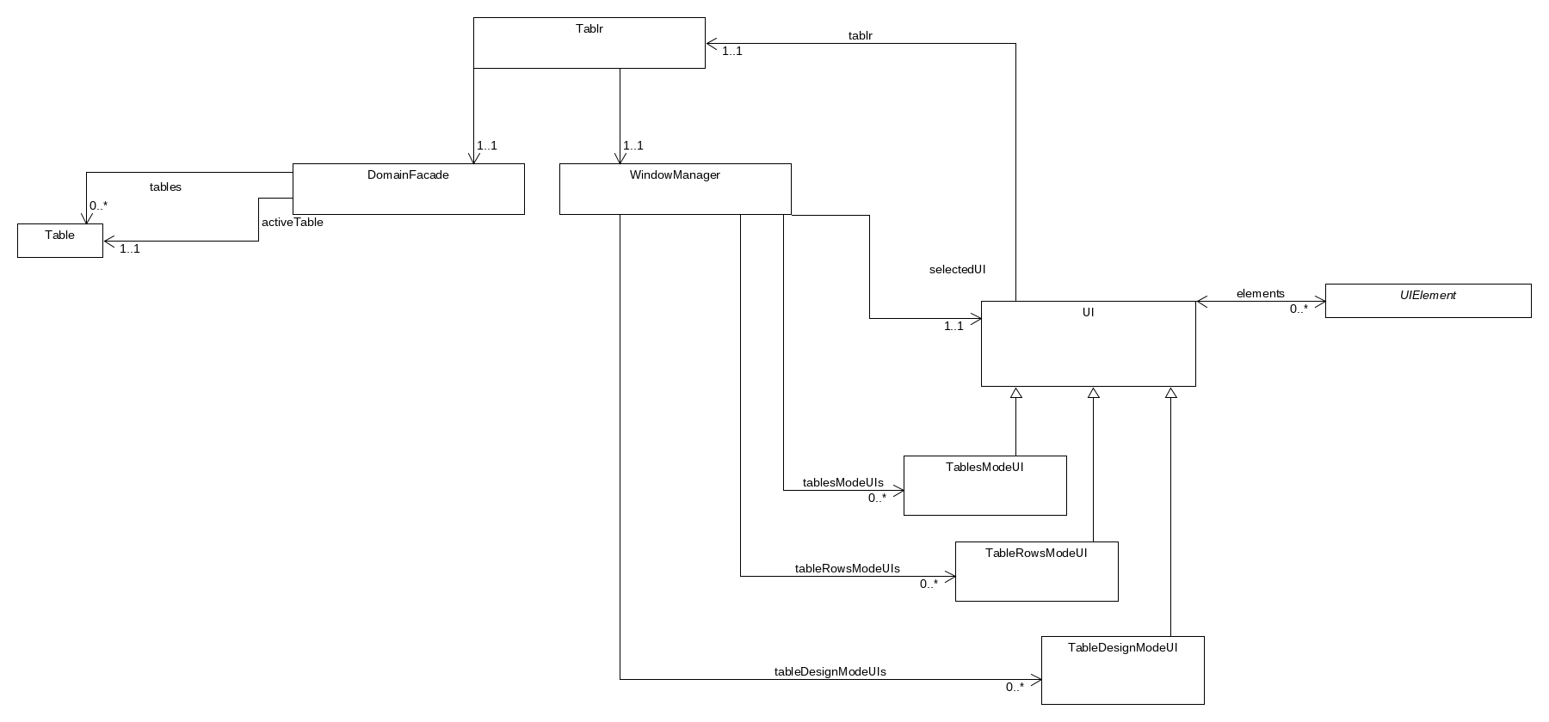
1. Design: class diagram

Slide 8
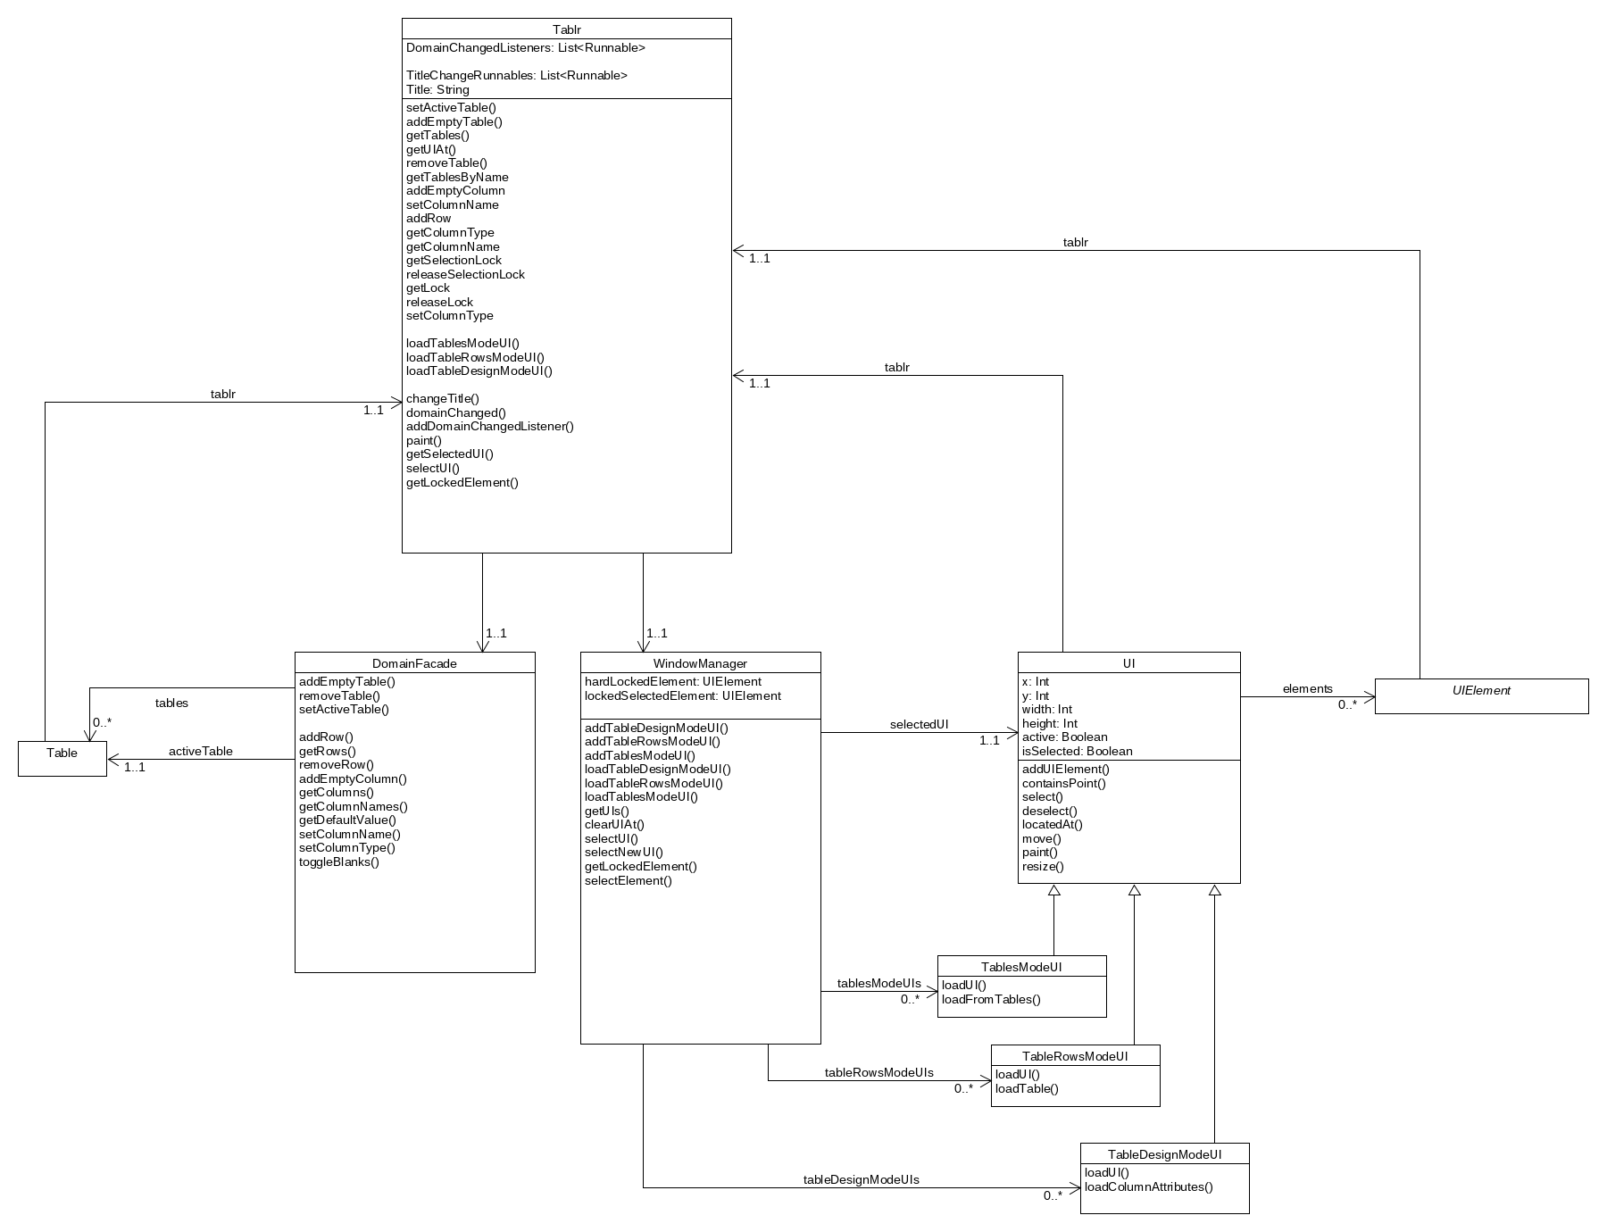

Slide 9
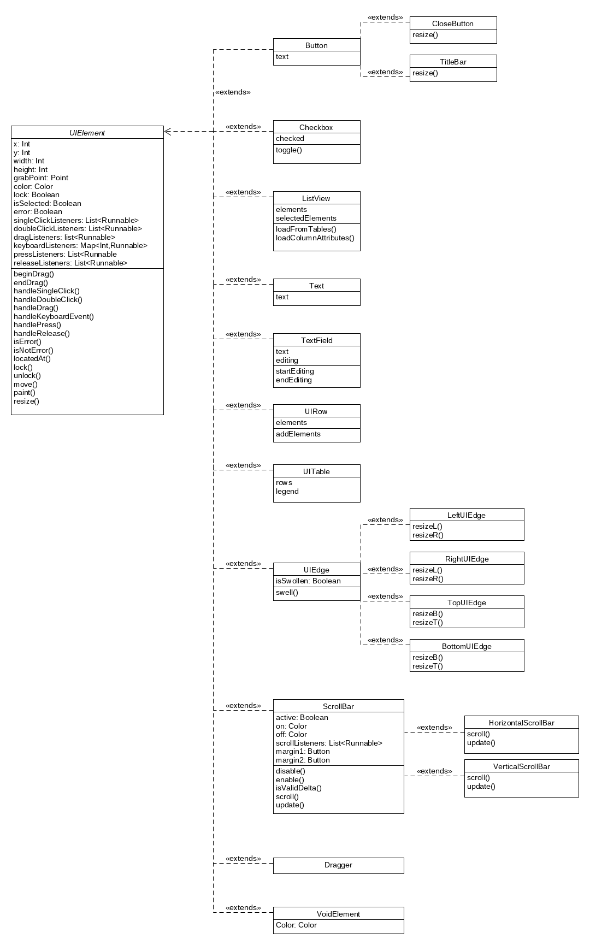
1. Design: UI elements

Slide 11
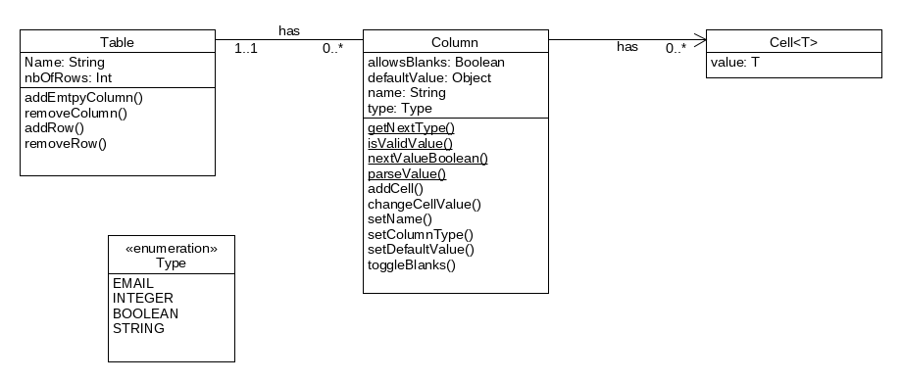
1. Design: Domain

Slide 12
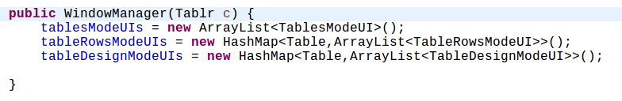
1. Design: handling subwindows
WindowManager holds all UI's/Subwindows

Slide 13
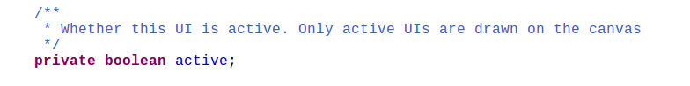
1. Design: handling subwindows
WindowManager holds all UI's/Subwindows
Opening/Closing means activating/deactivating

Slide 14
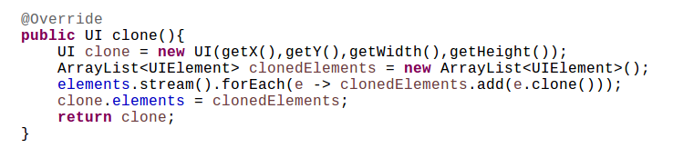
1. Design: handling subwindows
Opening a subwindow multiple times means cloning an existing UI at different coordinates
Cloning is reference-based, so changes in clones are always reflected in the original window, etc.

Slide 15
3. Extensibility
All program logic is contained in the loadUI method of UI's, can be modified in one place.
UI and Domain stand on their own, collect all actions in List<Runnable>. Additional concepts can always follow this logic.

Slide 16
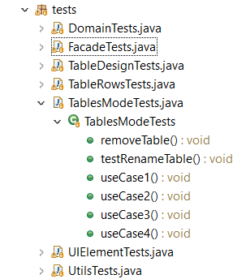
4. Testing Approach
Start by testing all Use Cases (55% coverage)
Improve coverage with focused testing of remaining parts

Slide 17
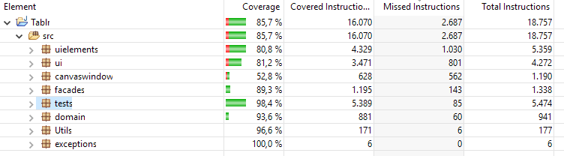
4. Testing Approach – Total Coverage

Slide 18
4. Testing Approach
Missed instructions: 2687
Our code
CanvasWindow
Coverage without CanvasWindow and paint(): 92.4%
paint()

Slide 19
Overview of project management
This iteration:
Domain Coordinator: Martijn
Testing Coordinator: Ignace
Design Coordinator: Tom & Quinten
Next iteration:
Domain Coordinator: Quinten
Testing Coordinator: Martijn
Design Coordinator: Ignace & Tom

Slide 20
Spent hours: Group work
Quinten Bruynseraede: ~ 15 hours
Ignace Bleukx: ~ 25 hours
Tom De Backer: ~ 25 hours
Martijn Slaets: ~ 15 hours

Slide 21
Individual work
Quinten Bruynseraede: ~ 25 hours
Ignace Bleukx: ~ 50 hours
Tom De Backer: ~ 35 hours
Martijn Slaets: ~ 30 hours

Slide 22
Study
Quinten Bruynseraede: ~ 2 hour
Ignace Bleukx: ~ 2 hour
Tom De Backer: ~ 2 hour
Martijn Slaets: ~ 2 hour

Slide 23
Use cases
Find UIElement that needs to act upon input
Invoke its singleClickHandler() / keyEventHandler()
Modifies UIElement
Uses a Tablr reference to modify Domain if necessary
Notify other UIElements if Domain changed

Slide 24
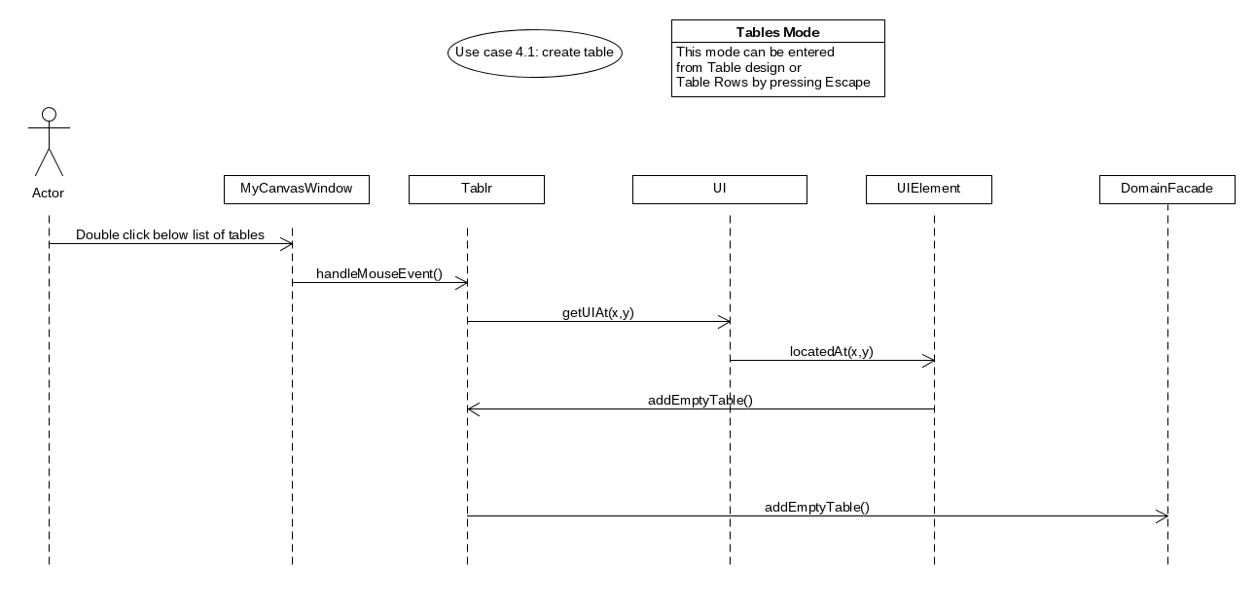
1. Adding a table

Slide 25
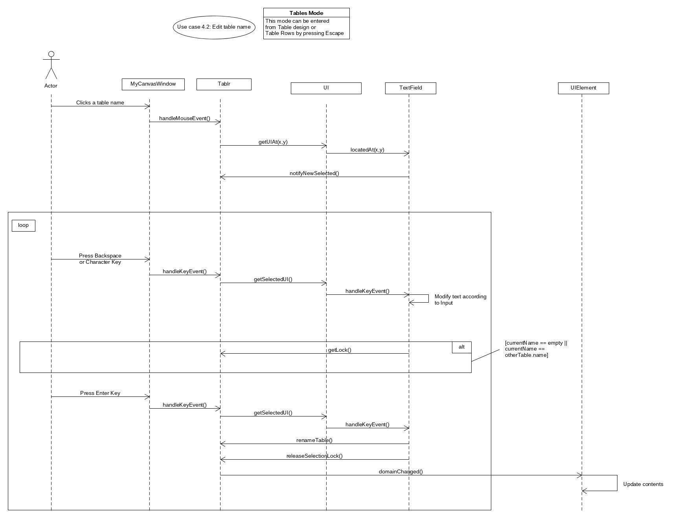
2. Edit a table name

Slide 26
2. Edit a table name (continued)

Slide 27
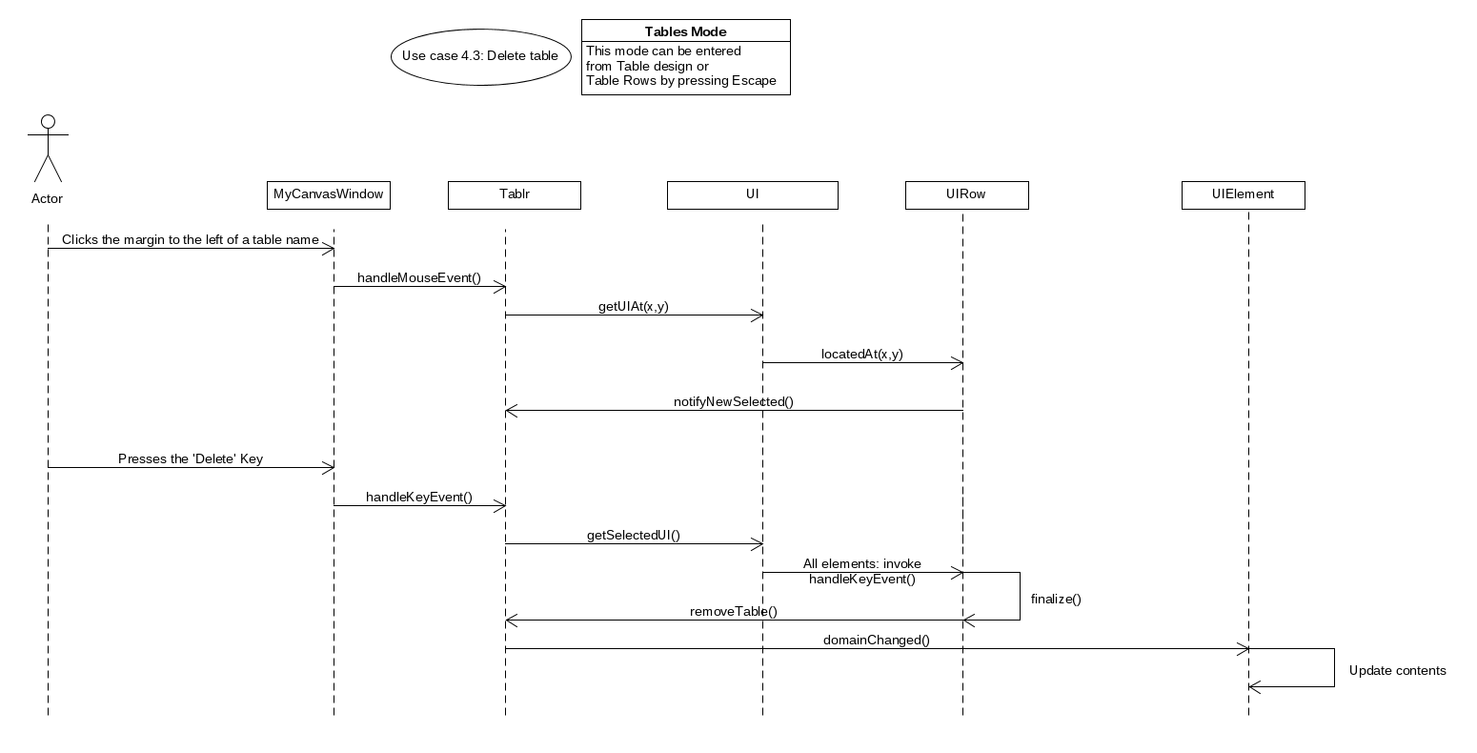
3. Delete table

Slide 28
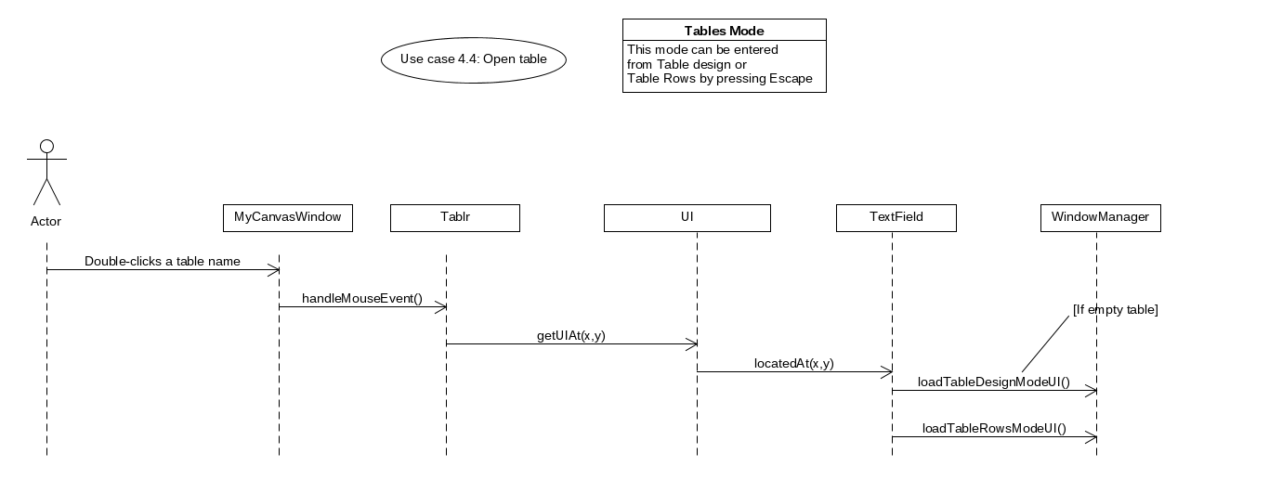
4. Open a Table

Slide 29
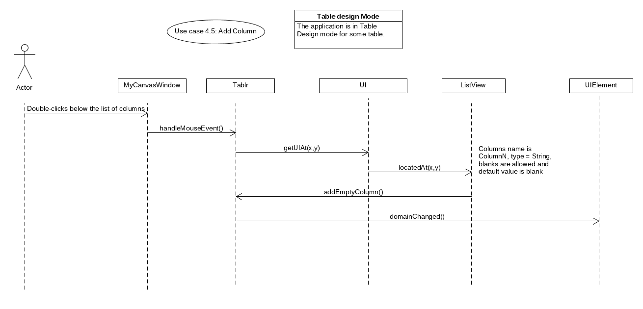
5. Add Column

Slide 30
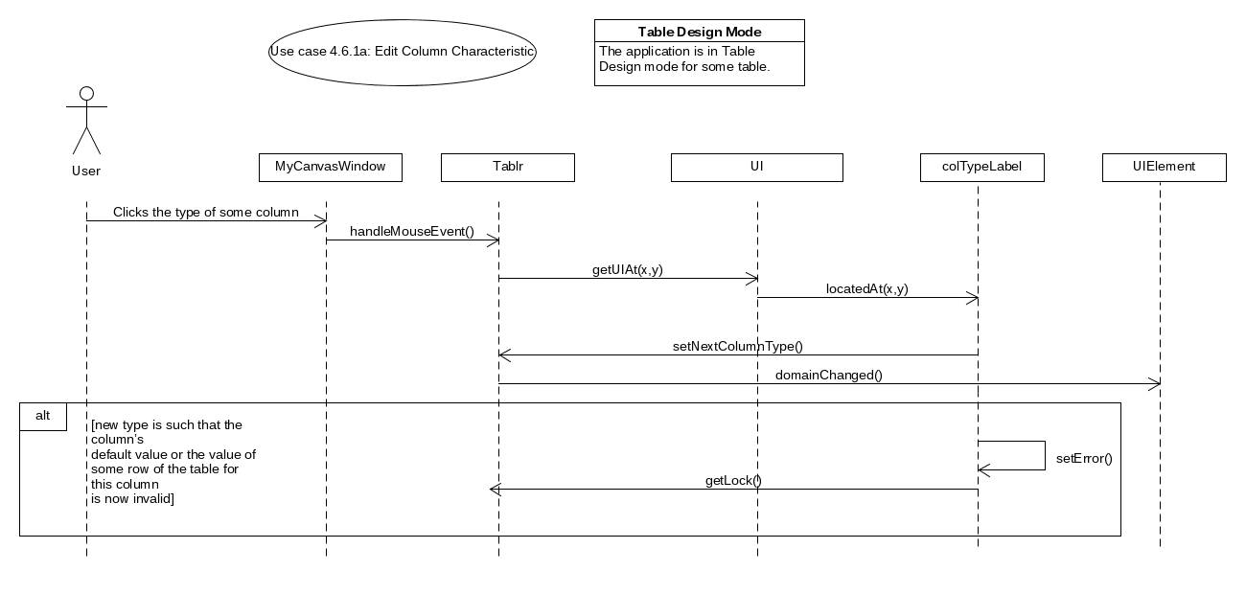
6. Edit Column Characteristic (a)

Slide 31
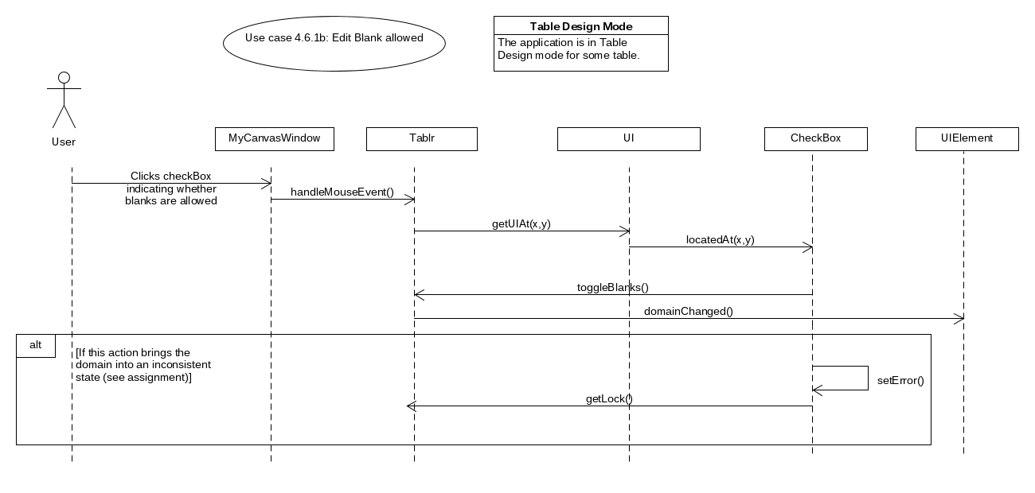
6. Edit Column Characteristic (b)

Slide 32
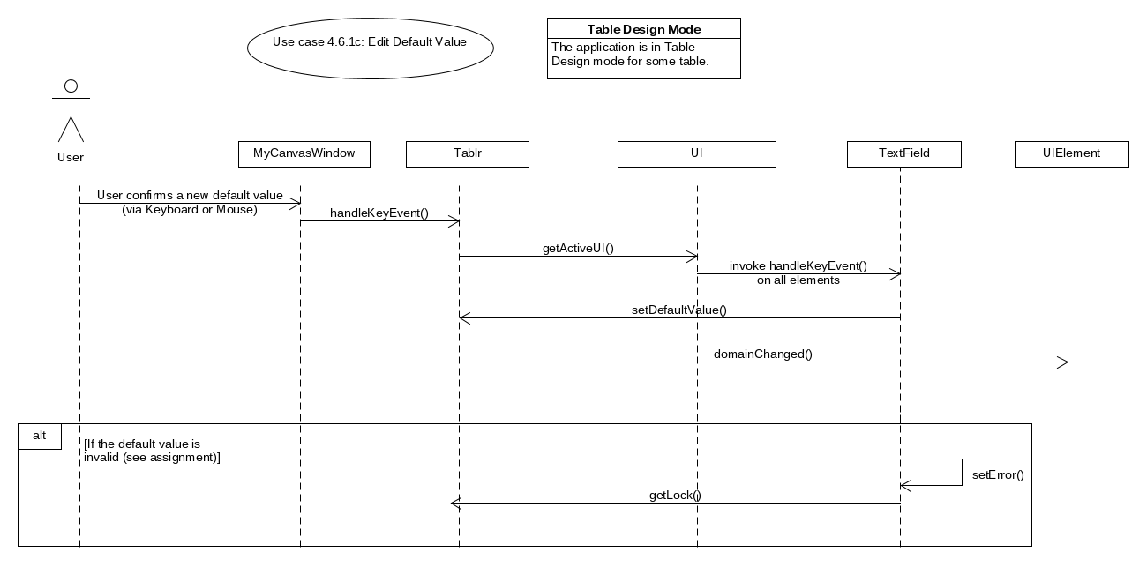
6. Edit Column Characteristic (c)

Slide 33
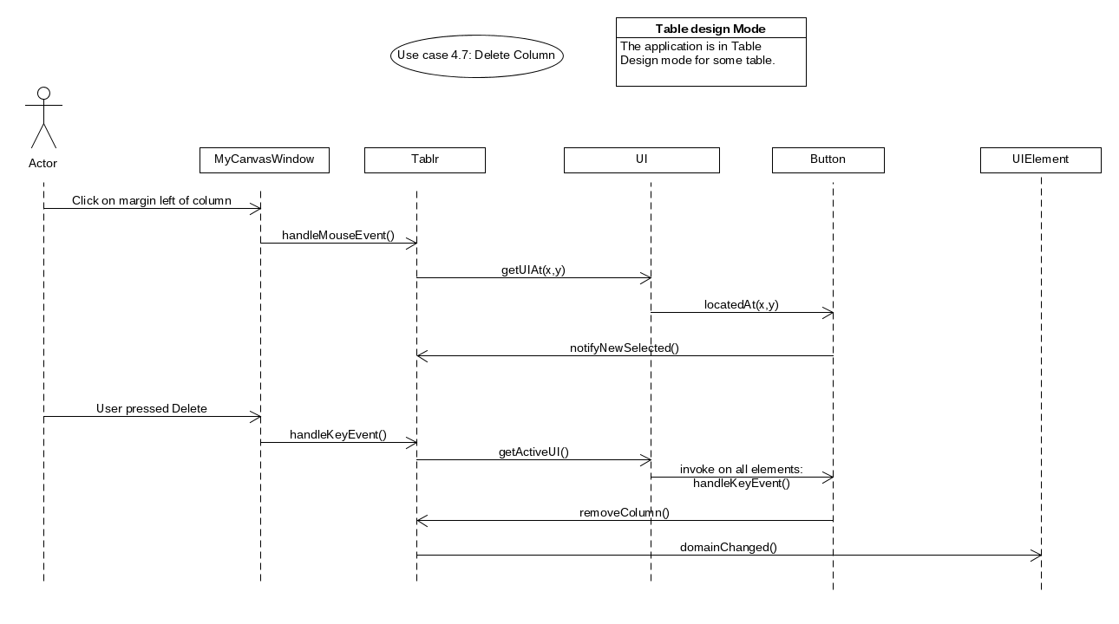
7. Delete Column

Slide 34
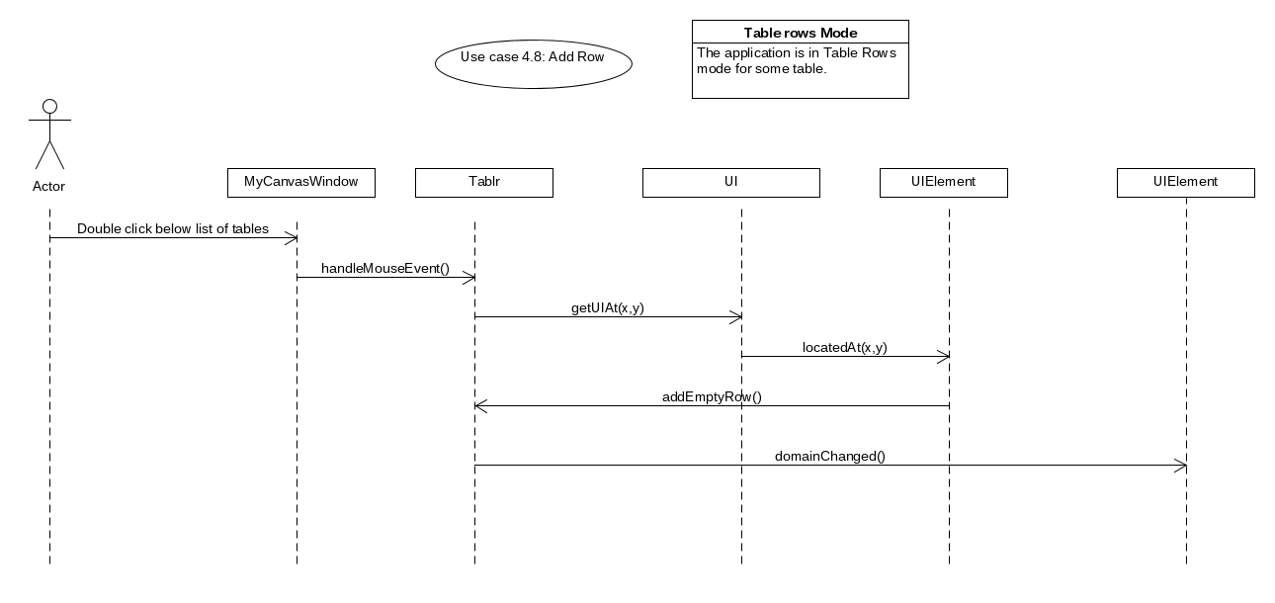
8. Add Row

Slide 35
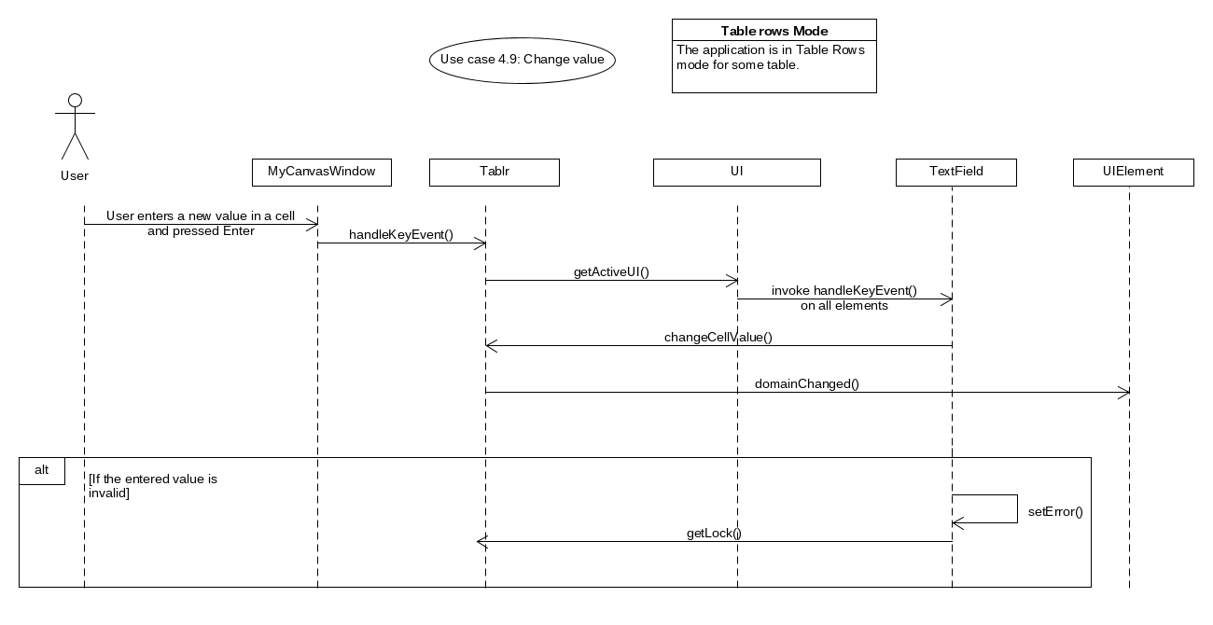
9. Edit Row Value

Slide 36
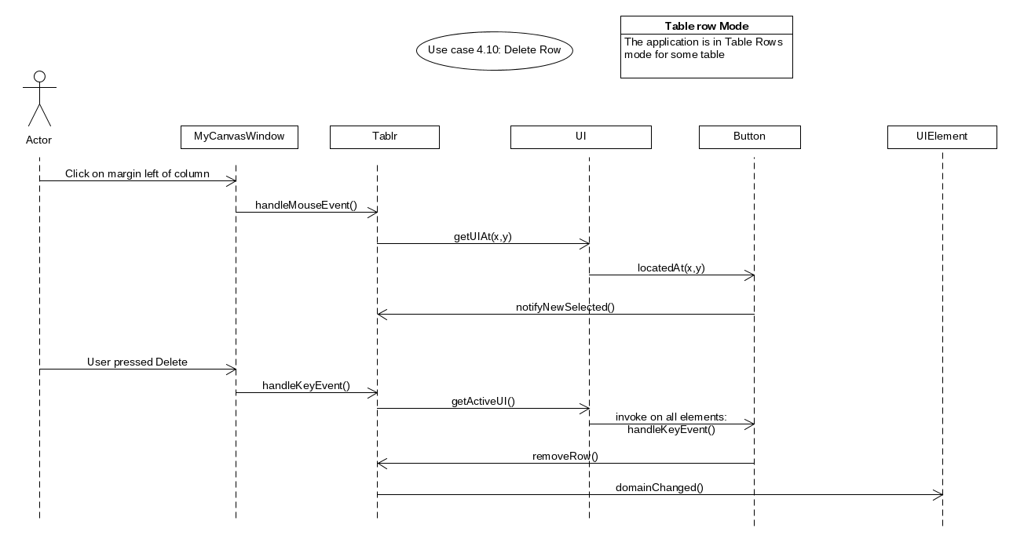
10. Delete Row

