Slide 1
Software-ontwerp:Tablr Iteration 1
Quinten Bruynseraede
Martijn Slaets
Tom De Backer
Ignace Bleukx

Slide 2
1. Design
Pattern:
Front Controller pattern
Every UI Object uses his reference to the communicationmanager to interact with the domain.
+ No direct access from UI Objects to the domain. ()
The domain can never be brought into an inconsistent state.
+ Centralized control (Controller)
+ Every object needs only one reference (Low coupling)
- A lot of methods in the communicationmanager class

Slide 3
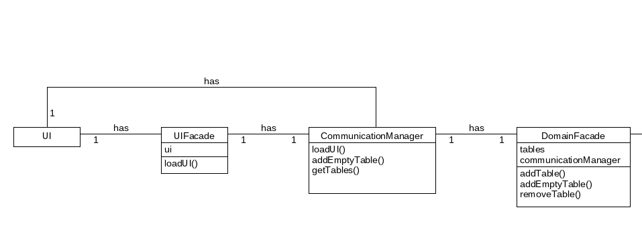
Class Diagram - 1

Slide 4
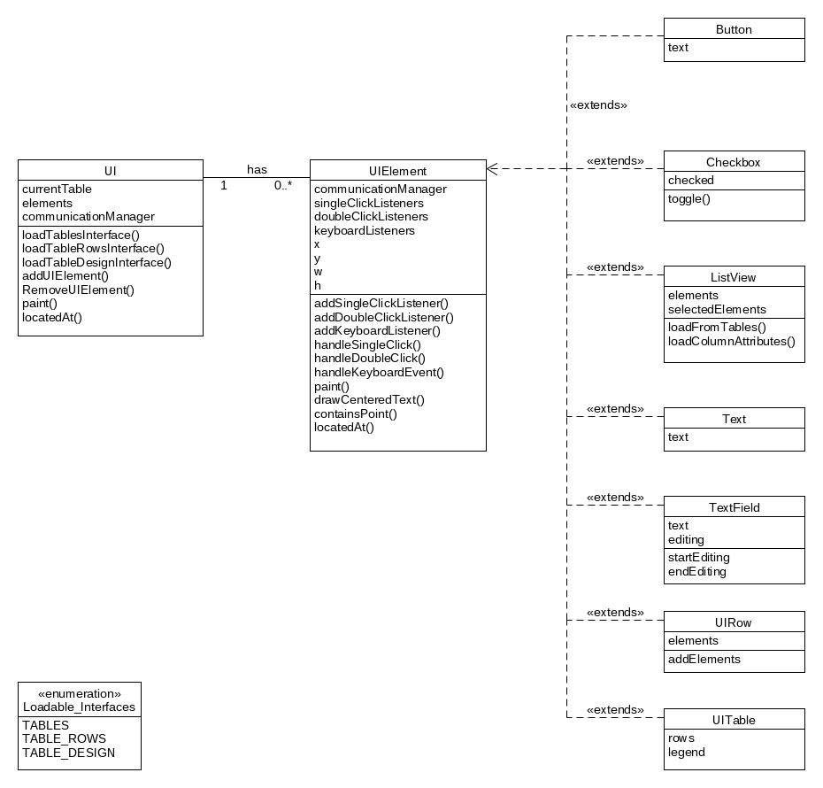
Class Diagram - 2

Slide 5
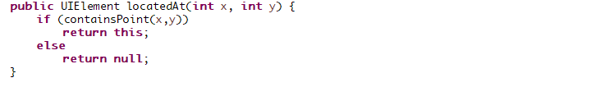
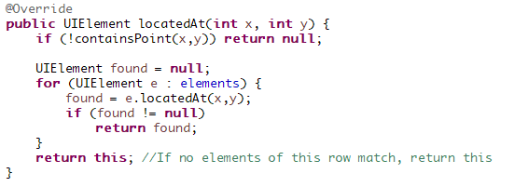


2. Design choices - Polymorphism
UIElement:
UIRow:

Slide 6

2. Design choices - Facades
Communicationmanager uses facades (indirection + high cohesion)

Slide 7
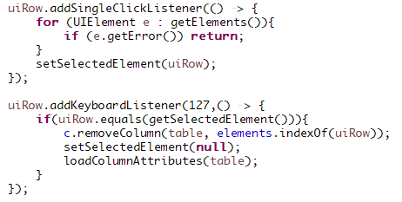
2. Design choices - Listeners
Low coupling

Slide 8
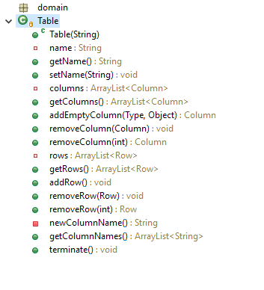
2. Design choices – Independent domain
Low Coupling

Slide 9
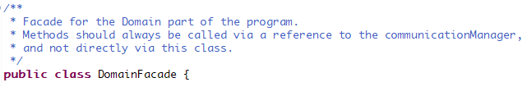
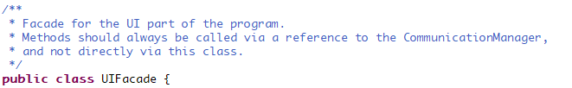
2. Design Choices – Pure fabriction

Slide 10
3. Extensibility
Communication Manager is the only link between UI and domain
→ easy to share domain across multiple UI intances
Validity of values checked on a single place
→ extensions or change in cell values easy to implement

Slide 11
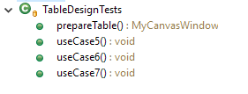
4. Testing Approach – Use cases

Slide 12
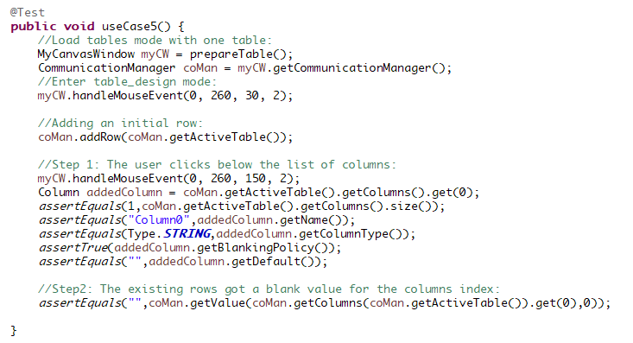
4. Testing approach – Mouse Events

Slide 13
4. Testing Approach – Total Coverage

Slide 14
4. Testing Approach – Adjusted Coverage

Slide 15
Use cases

Slide 16
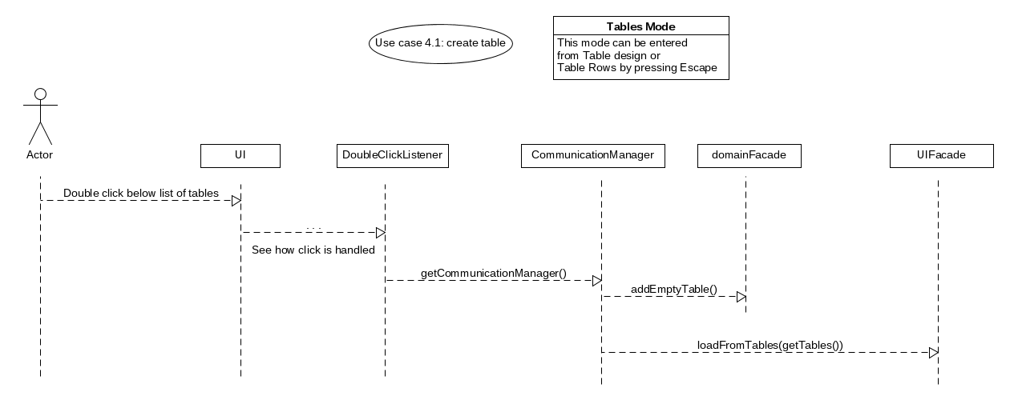
1. Adding a table

Slide 17
2. Edit a table name

Slide 18
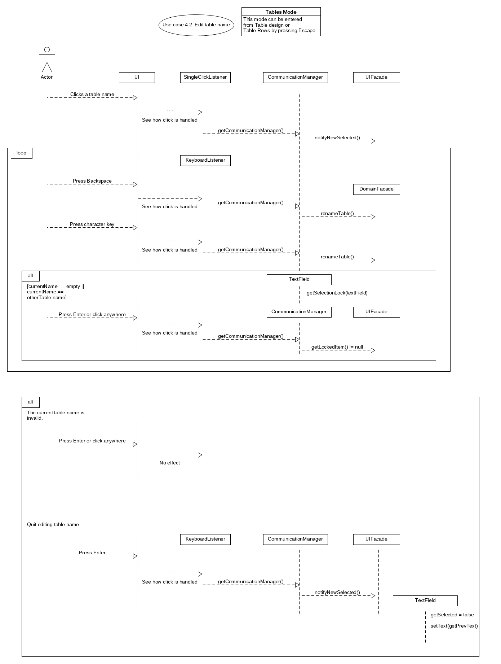

Slide 20
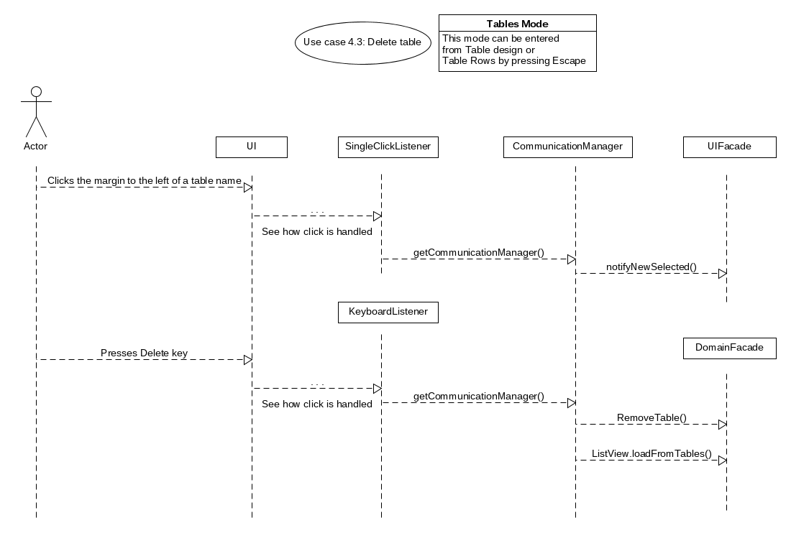
3. Delete table

Slide 21
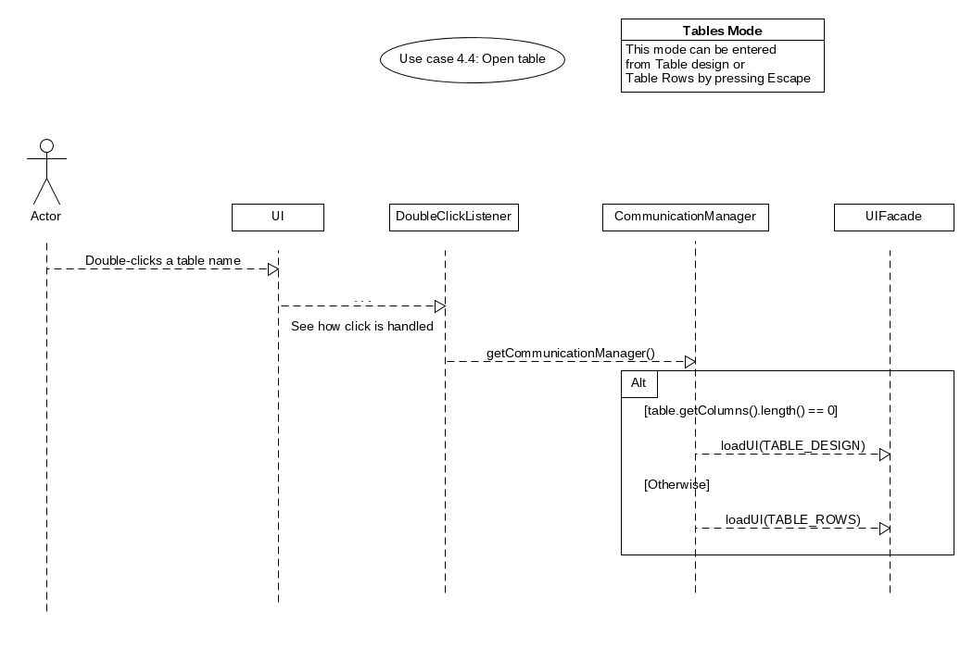
4. Open table

Slide 22
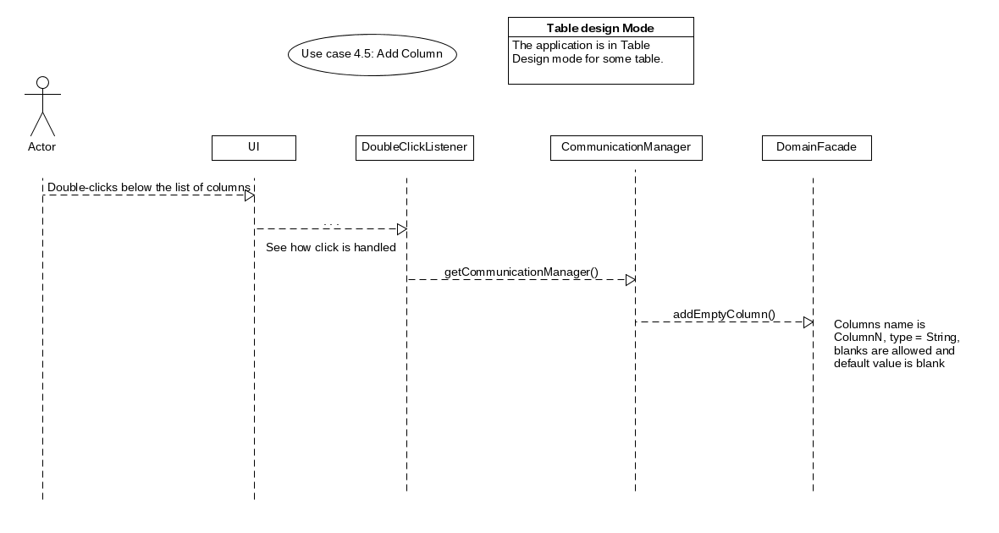
5. Add Column

Slide 23
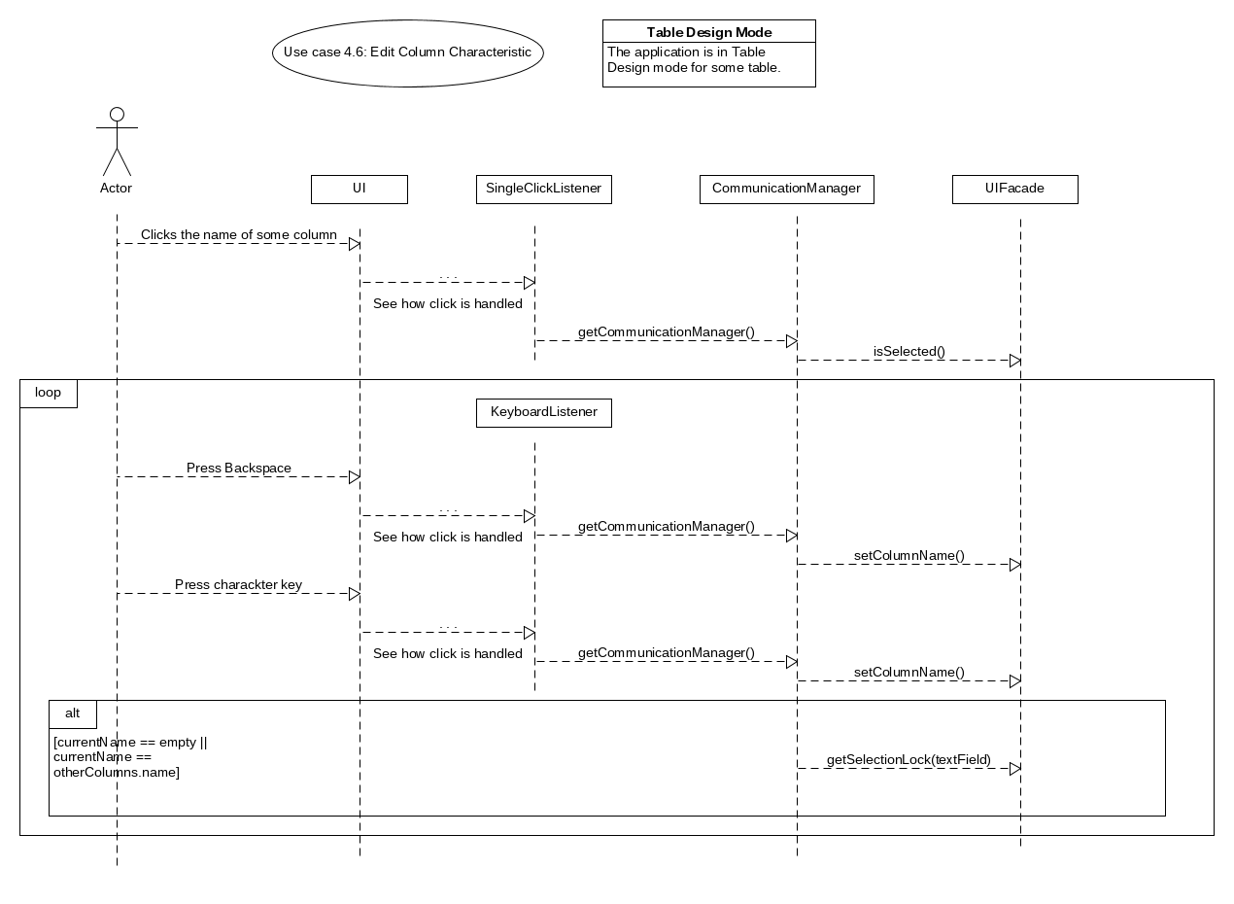
6. Edit Column Characteristic

Slide 24
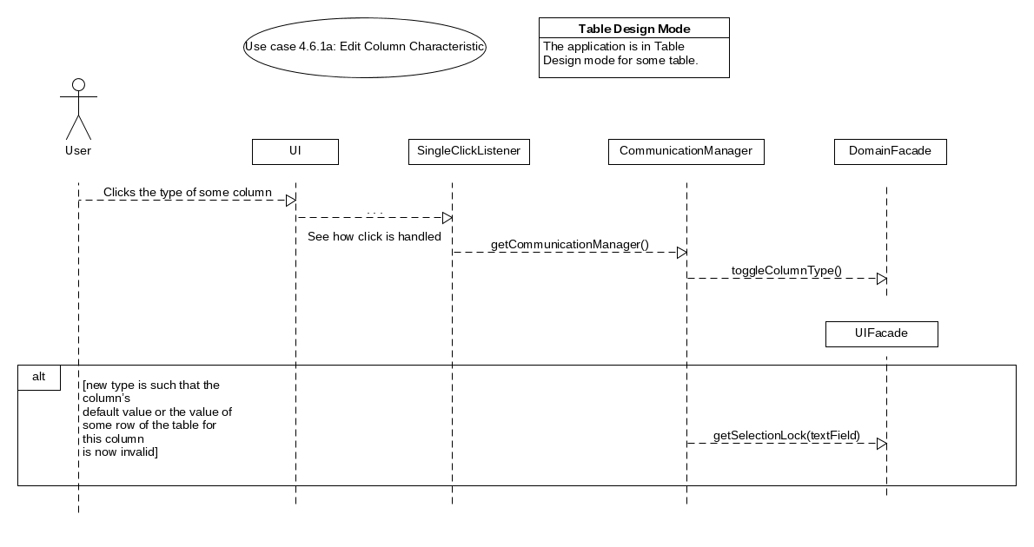
6. Edit Column Characteristic (a)

Slide 25
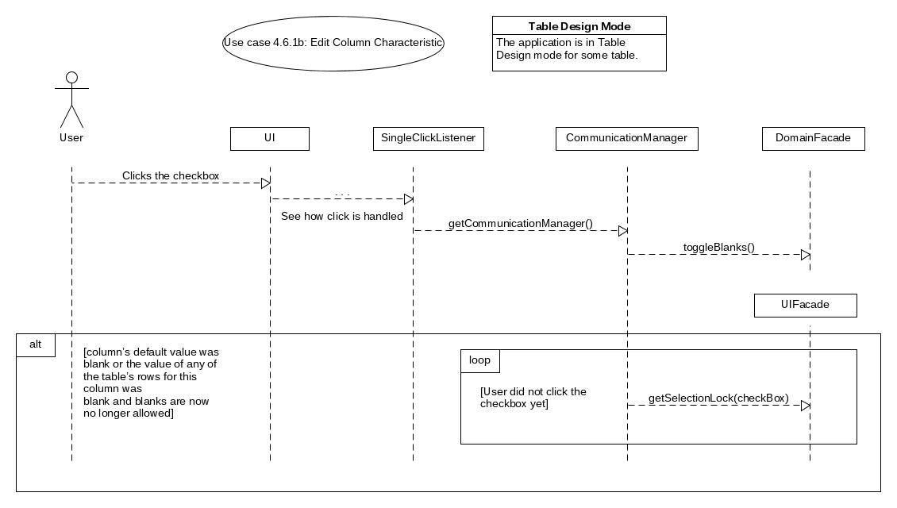
6. Edit Column Characteristic (b)

Slide 26
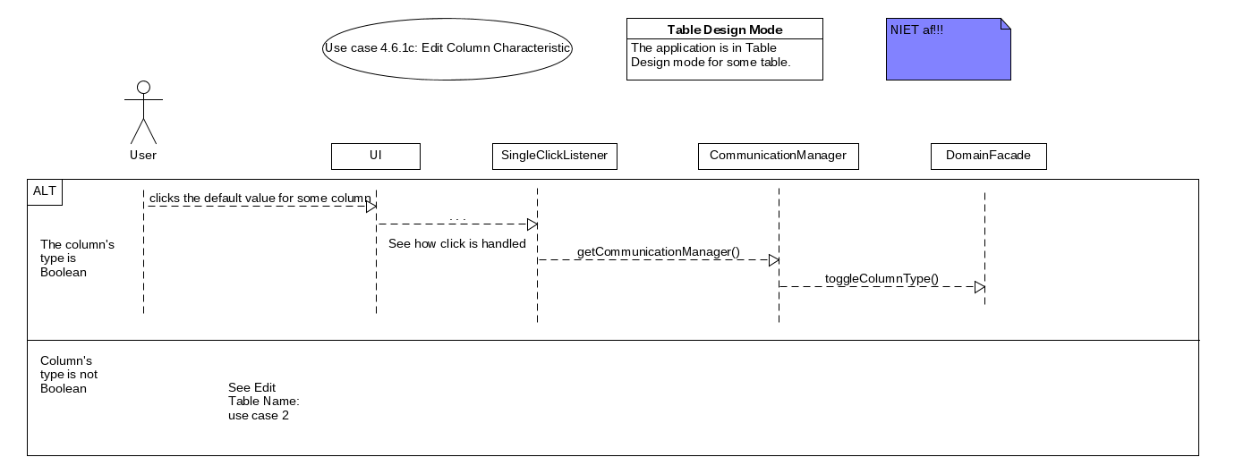
6. Edit Column Characteristic (c)

Slide 27
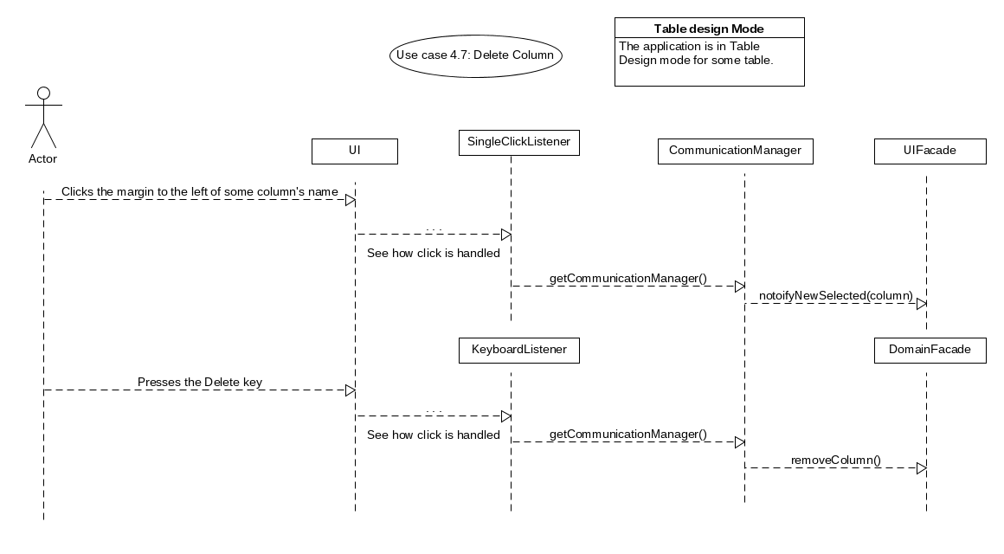
7. Delete Column

Slide 28
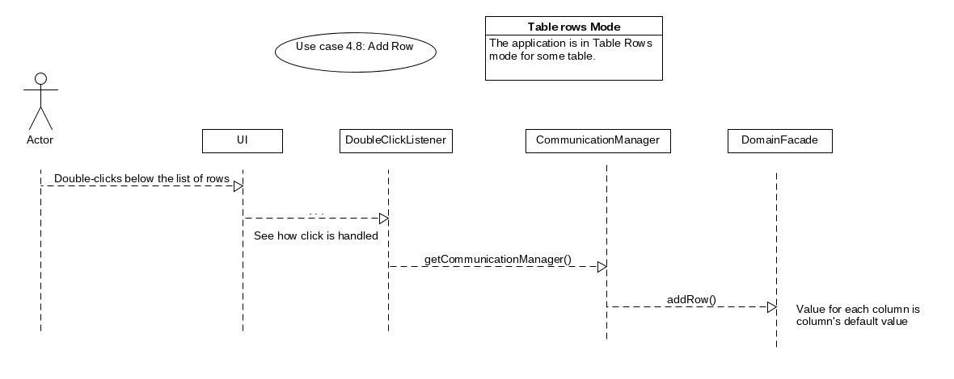
8. Add Row

Slide 29
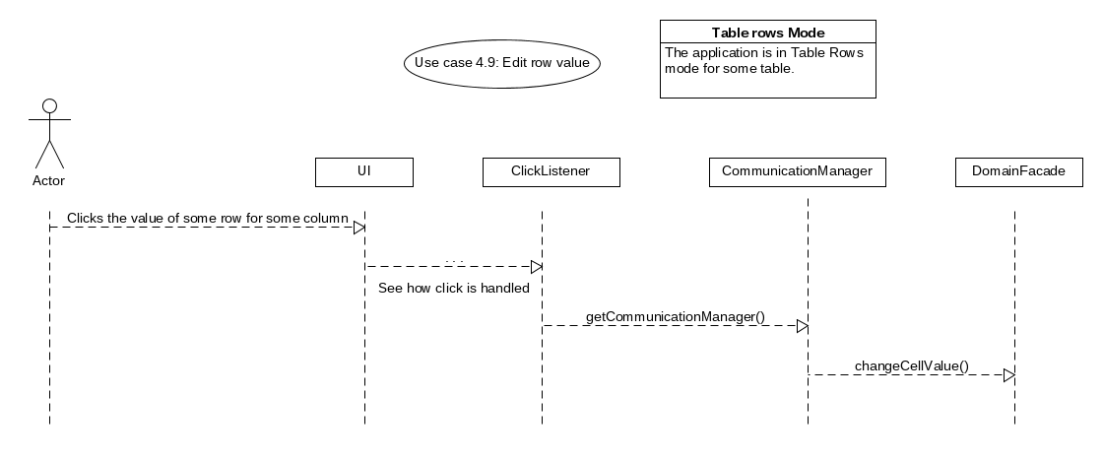
9. Edit Row Value

Slide 30
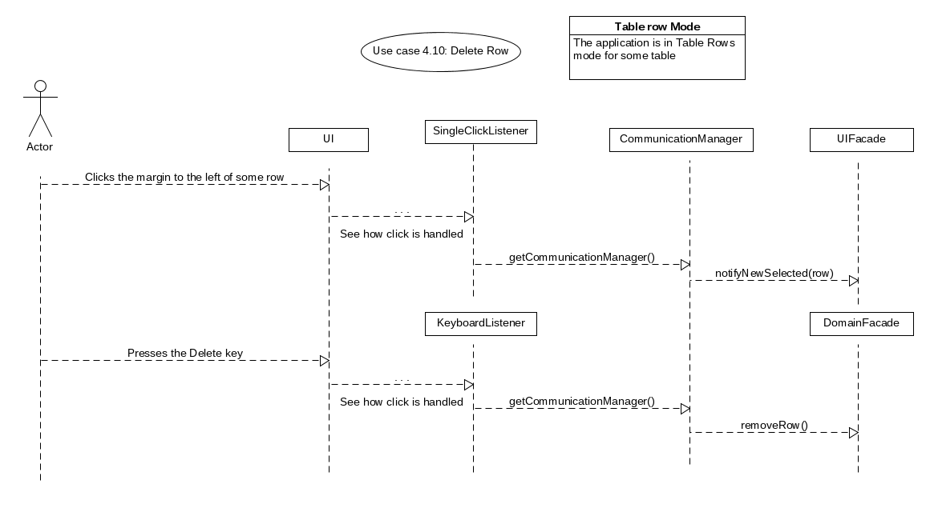
10. Delete Row

