Slide 1

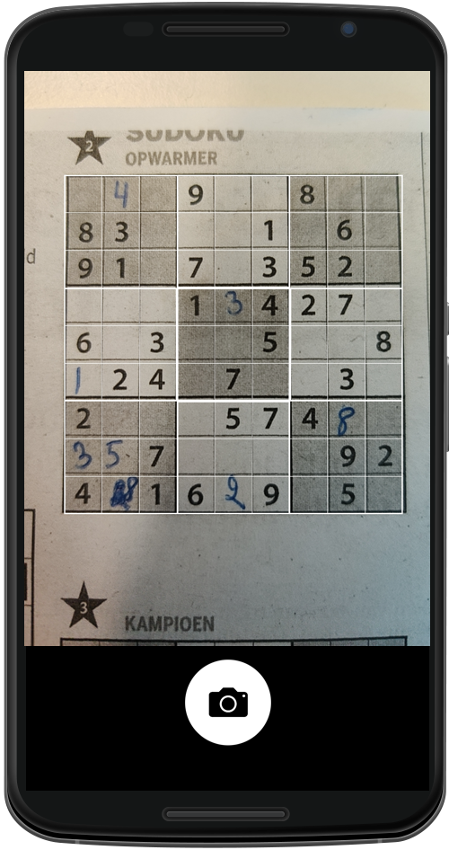
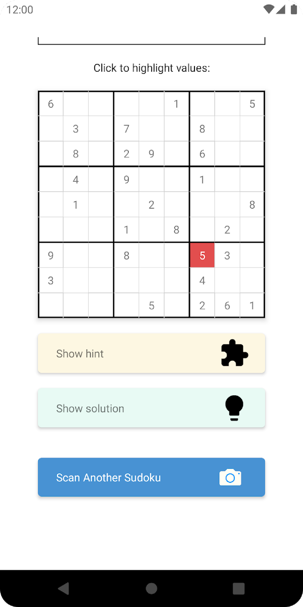
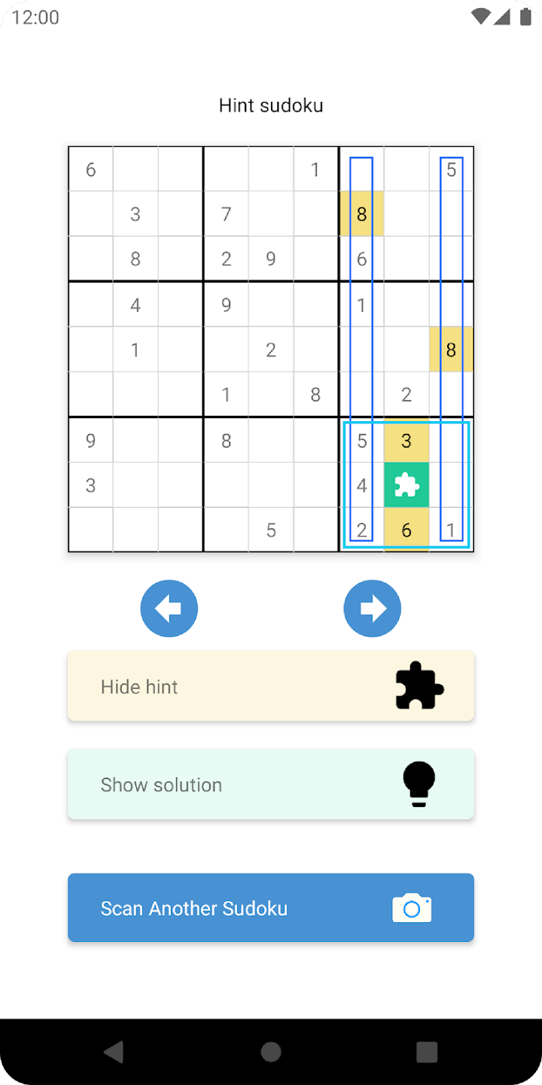
Sudoku Assistant, explanation steps

Slide 2
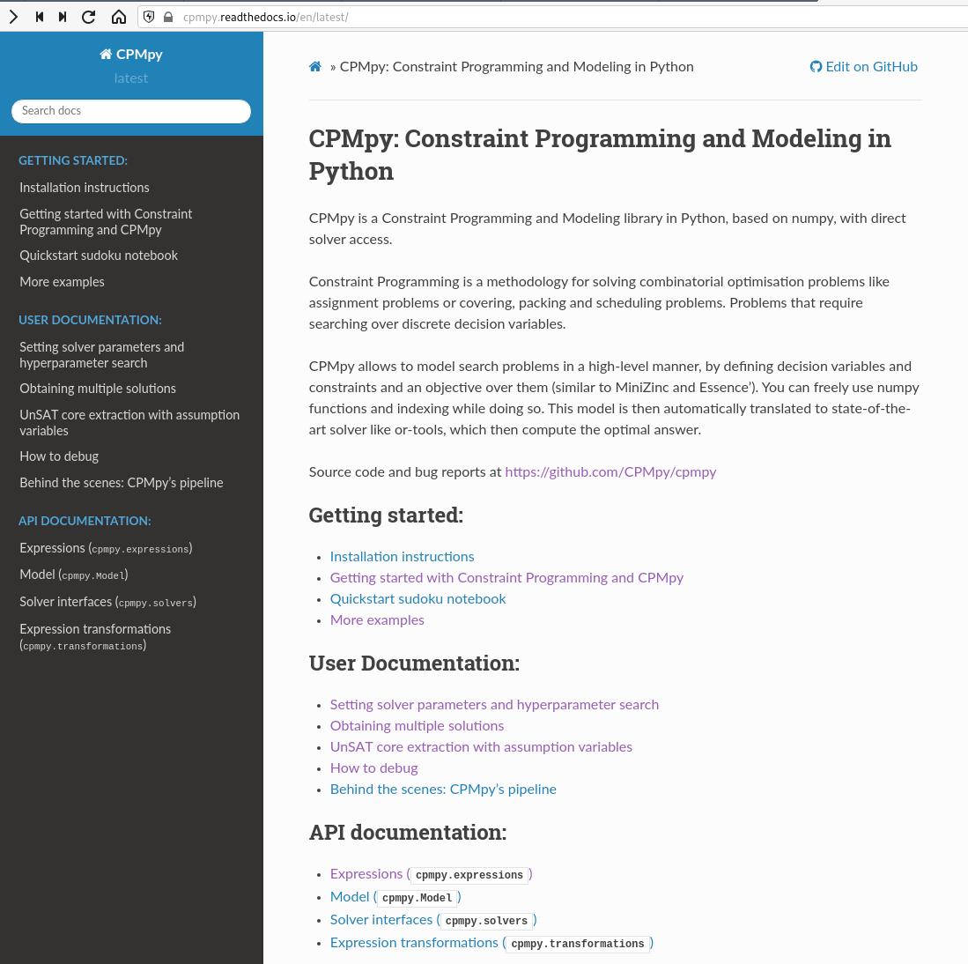
https://github.com/CPMpy/cpmpy
Open source
Python/Numpy based
Direct, incremental solver access
Supported solvers:
ORTools (CP)
Exact (PseudoBoolean+int)
Gurobi (ILP)
Z3 (SMT)
PySAT, PySDD (SAT, know. comp.)
More to come… (Choco, SCIP, CP Opt)

