Slide 1

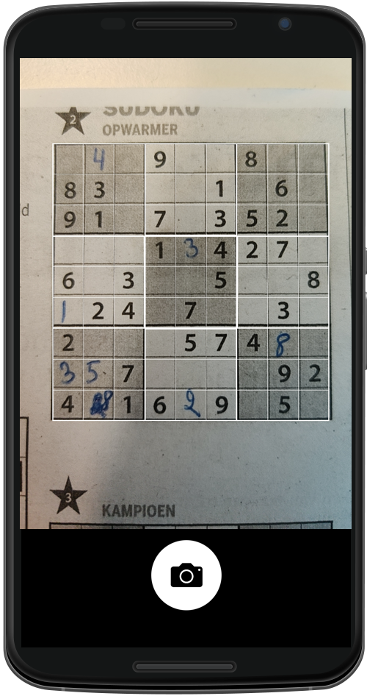
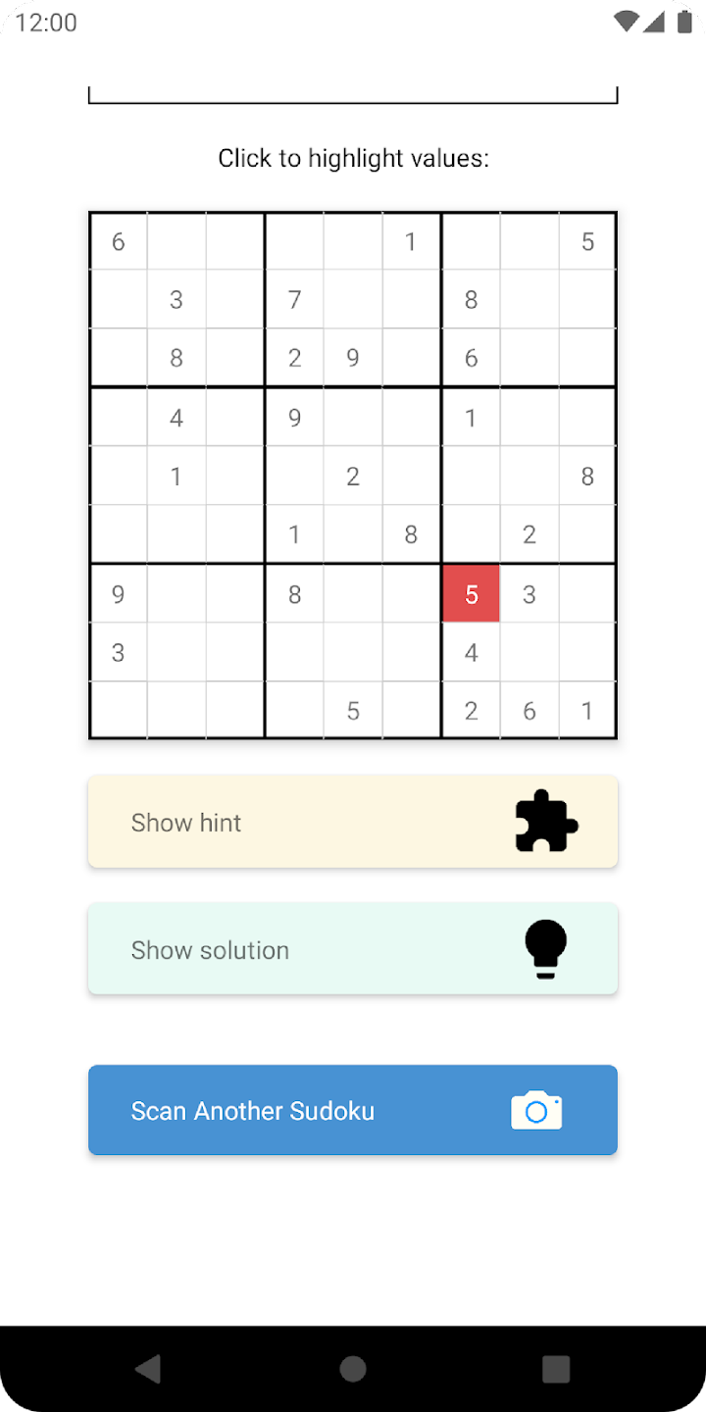
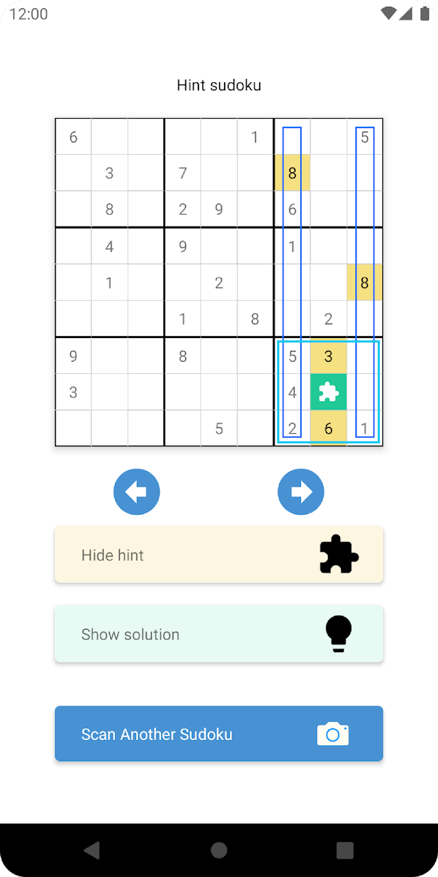
Sudoku Assistant, explanation steps

Slide 2
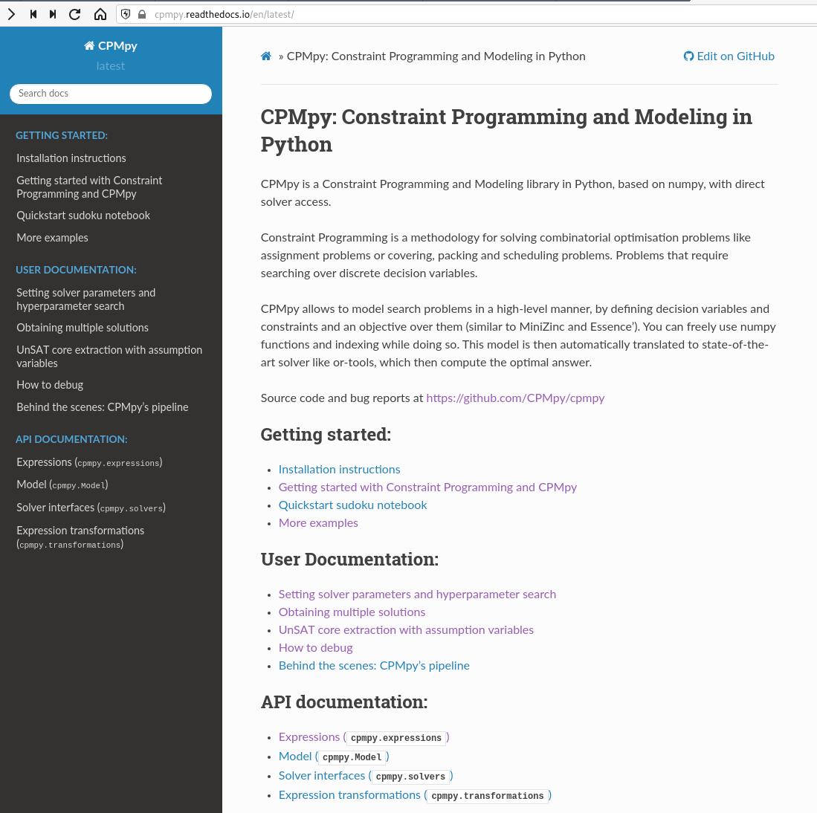
https://github.com/CPMpy/cpmpy
Open source
Python/Numpy based
Direct, incremental solver access
Supported solvers:
ORTools (CP)
Exact (PseudoBoolean+int)
Gurobi (ILP)
Z3 (SMT)
PySAT, PySDD (SAT, know. comp.)
More to come… (Choco, SCIP, CP Opt)

Slide 3
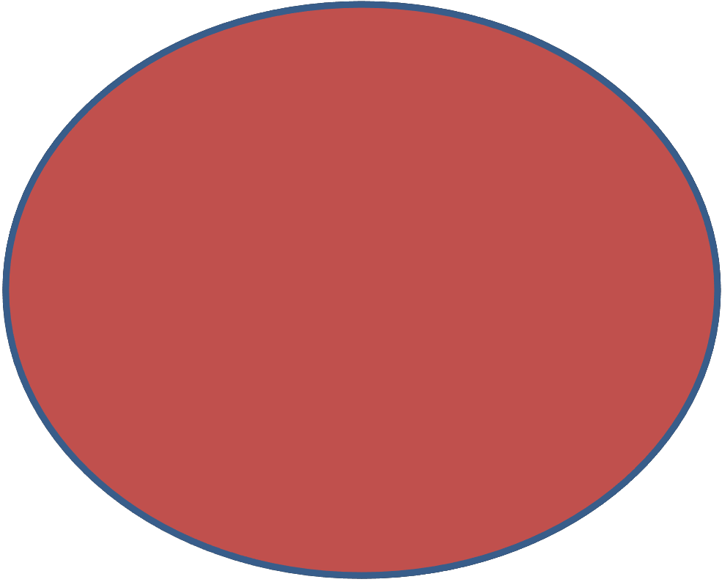
All Constraints

Slide 4
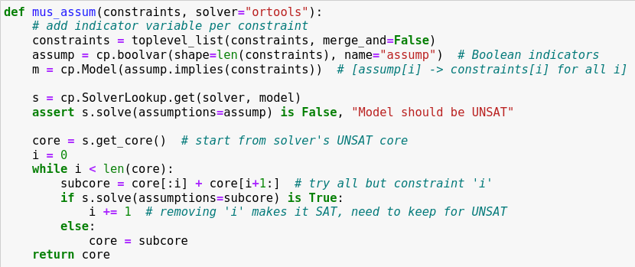
1) Add Boolean indicator variables
2) Assume they are set to ‘true’
3) Extract an unsat subset from solver
4) Incrementally solve diff. subsets

Slide 5
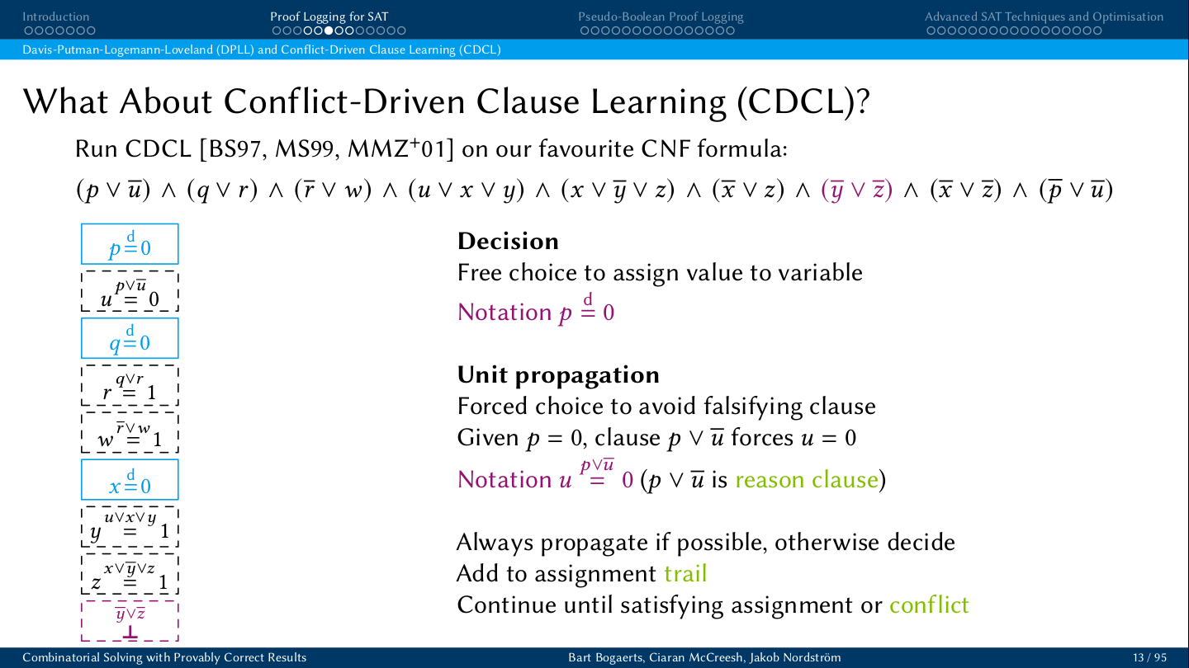
Decision
Unit propagation
Conflict detected

Slide 6
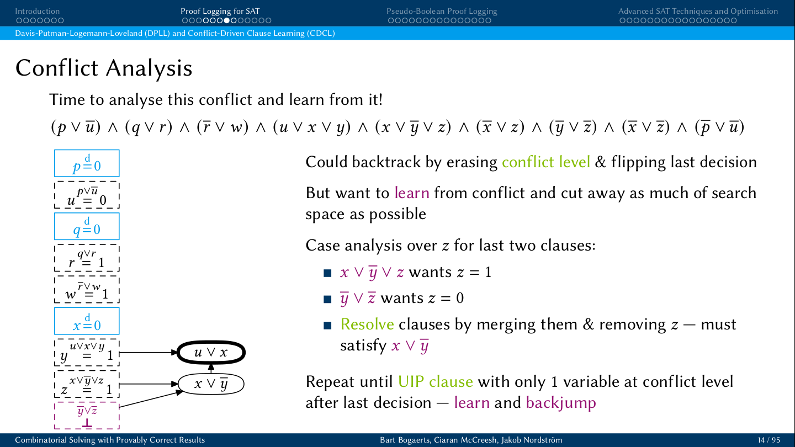
`
Clause learning

Slide 7
`
Clause learning

Slide 8
`
Assumption variables
a1 \/
a2 \/
a3 \/
a4 \/
a5 \/
a6 \/
a7 \/
a8 \/
a9 \/
a1 = 1
Clause learning with assumptions
a2 = 1
a1 \/
a3 = 1
a4 = 1
a5 = 1
a6 = 1
a2 \/
a7 = 1
a8 = 1
a5 \/
a3 \/
a9 = 1
a7 \/
a4 \/
\/ a5 \/ a7
\/ a4 \/ a5 \/ a7
a5 \/
\/ a5 \/ a7
a7 \/

Slide 9
`
Assumption variables
a1 \/
a2 \/
a3 \/
a4 \/
a5 \/
a6 \/
a7 \/
a8 \/
a9 \/
Clause learning with assumptions
Can extract UNSAT core: assumption variables present in ‘final’ conflict
Can solve repeatedly with diff. assumption variables learned clauses remain valid (contain the assumps)
a1 = 1
a2 = 1
a1 \/
a3 = 1
a4 = 1
a5 = 1
a6 = 1
a2 \/
a7 = 1
a8 = 1
a3 \/
a9 = 1
a4 \/
\/ a4 \/ a5 \/ a7
a5 \/
\/ a5 \/ a7
a7 \/

