Slide 1
Cryptolocker
Ignace Frederix
1TING
Notes:
Good afternoon everyone, Today I'm going to tell you a little bit more about Cryptolocker. I really hope none of you have a Cryptolocker on their pc or laptop but probably some of you will have heart of it.

Slide 2
Contents
What is a cryptolocker ?
How it got on your computer ?
How to get rid of it ?
How to avoid it ?
Notes:
So what am I going to tell you about Cryptolocker today ? First I will give a short version what a Cryptolocker is and why it’s so annoying after that I'm going to talk about how it’s got on a pc and naturally what u do after its on your computer. and how to avoid to get it on your computer in the first place.

Slide 3
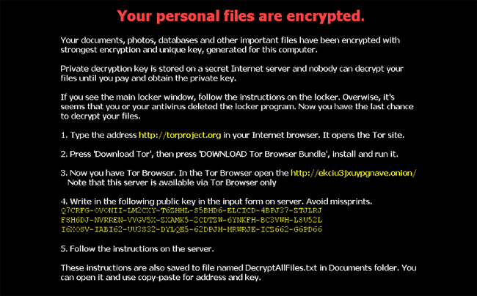
1. What is a cryptocker ?
Ransomemware trojan horse
Windows
Encrypt files
RSA-method
Useless documents
Notes:
So first I'm going to talk about what is a Cryptolocker in short ransomemware trojan horse that only targets persons with a windows pc what is now a days lot of people. But what is it’s in a detail a Cryptolocker? if it is on your pc and your computer runs it will start to encrypt all the documents on your pc but it is also possible that the virus encrypt documents on external drives or even servers if the computer is connected to a sever which can be really annoying if you have it in a company and you can’t use any of your documents. Because that is what it does it encrypt all your documents with the RSA method it use a unique key that only the maker of the virus knows and after your file is encrypted with that key your documents are just useless for the user because you can open it but it’s just nothing of the original document. So that’s why it’s very annoying if it on your pc but it’s just a disaster if it happens with a company file server.

Slide 4
Contents
What is a cryptolocker ?
How it got on your computer ?
How to get rid of it ?
How to avoid it ?
Notes:
So I just gave you a little description of a Cryptolocker so now I am going to talk how you got it on a pc and how to get rid of it.

Slide 5
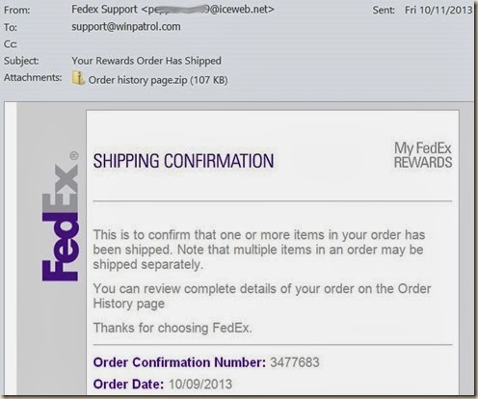
2. How it got on your computer
E-Mail
Attachment
PDF-icon
.EXE
Notes:
So first how did it get on your computer. So most of the time it comes with a mail that your forgotten to pay a bill and there is the bill in the attachment. In the attachment there is an file that have the icon of a PDF and a name of the bill you still have to pay but it is just a .exe file so from the moment you want to open it its start to encrypt all your files and you all you files are useless. From than you got 24 hours to pay 400 euros or they destroy the key to decrypt your files. But the time u get and also the amount you need to pay depends from virus to virus.

Slide 6
Contents
What is a cryptolocker ?
How it got on your computer ?
How to get rid of it ?
How to avoid it ?

Slide 7
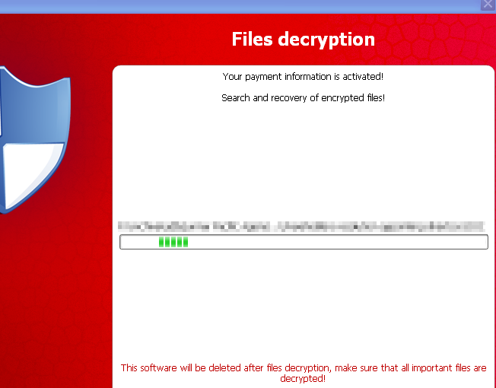
3. How to get rid of it ?
Do nothing ?
Change Backgroud
Remove file
Pay ?
Notes:
So how to get it off your computer u just don’t if your files are encrypted they are and it’s almost impossible to find the key without paying so if you want your files back you have to pay and then hope they will send you the key because you are not sure of it. So is it worth it ? that’s your choice to make if it is an company probably yes in.

Slide 8
Contents
What is a cryptolocker ?
How it got on your computer ?
How to get rid of it ?
How to avoid it ?
Notes:
So I just said how the virus came on your pc now I 'm going to give you a few tips on how not to get it on your computer

Slide 9
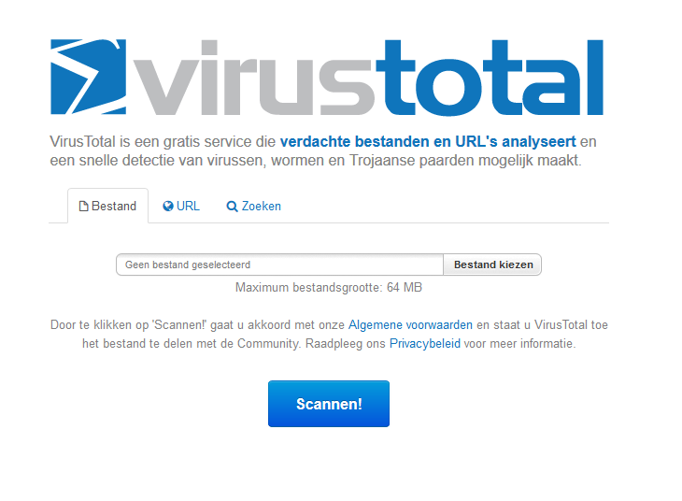
4. How to avoid it ?
Check e-mail adress
Cautious with attachments
virtustotal.com
Backups
Notes:
In fact, some tips on how to try to avoid any virus. In the first place if you get a mail look from who the mail is if you don’t know that person its best to be really cautious. So if someone say u need to look to something in the attachment you can better just delete the mail. Another thing that can be handy. If you want to be sure all the time you can make a backup from your files every day or week depends how much time u want to use. Because if the virus gets on your computer you can just remove the file and put the backup files back on its places. You may be lost some files but not everything normal. But naturally you may not connect your backup drive while u open that file because than your backup is also encrypted and it’s also useless . And use a tool like https://www.virustotal.com/. There you can check a file if its malicious or not.
Thank you everyone for your attention . Are there any question ?

