Slide 1
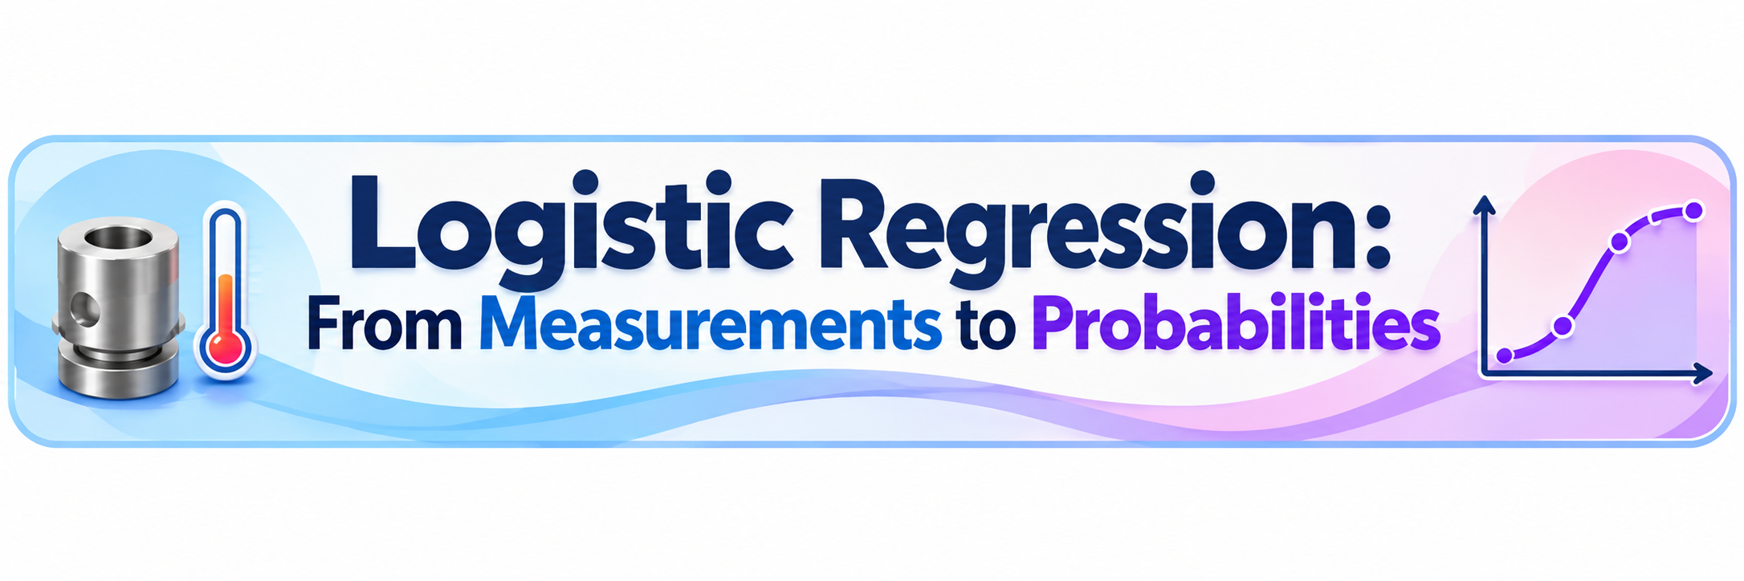

Slide 2
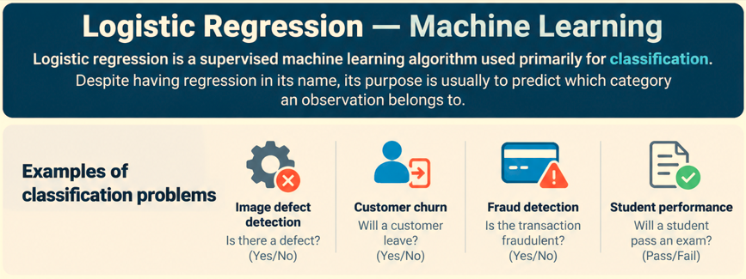

Slide 3
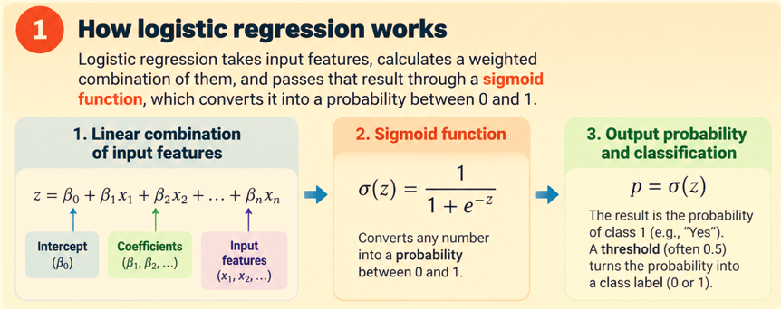

Slide 4
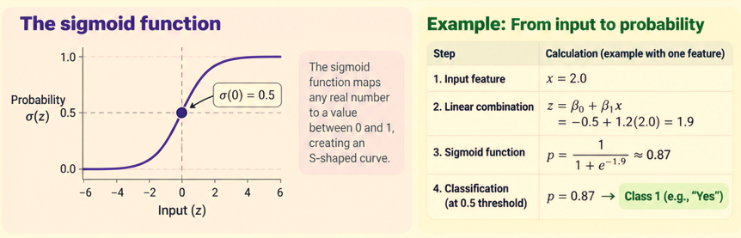

Slide 5
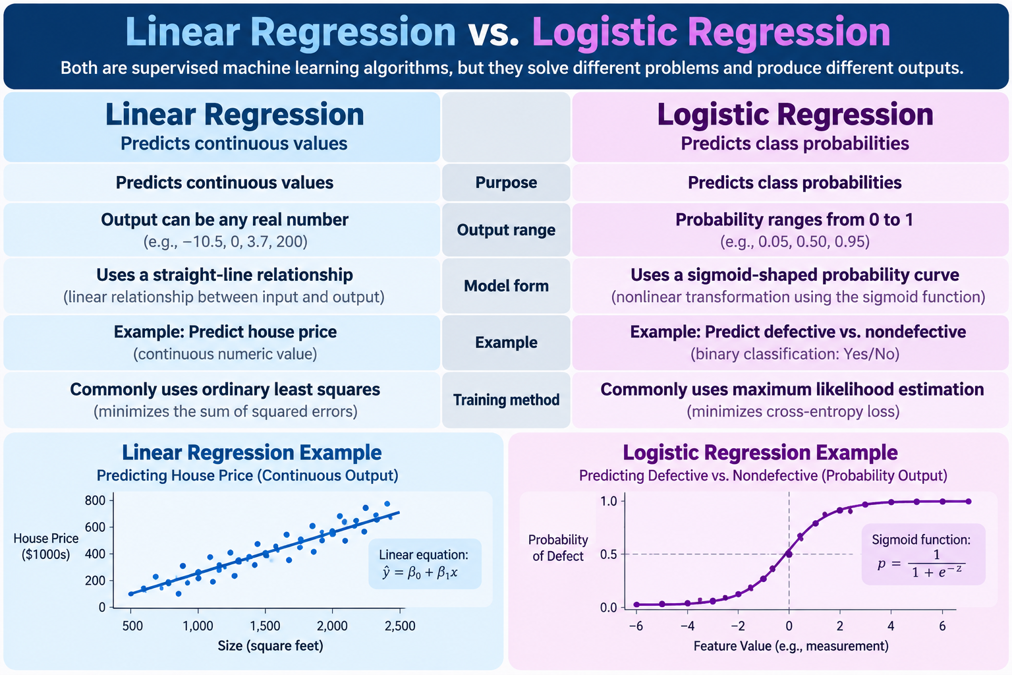

Slide 6
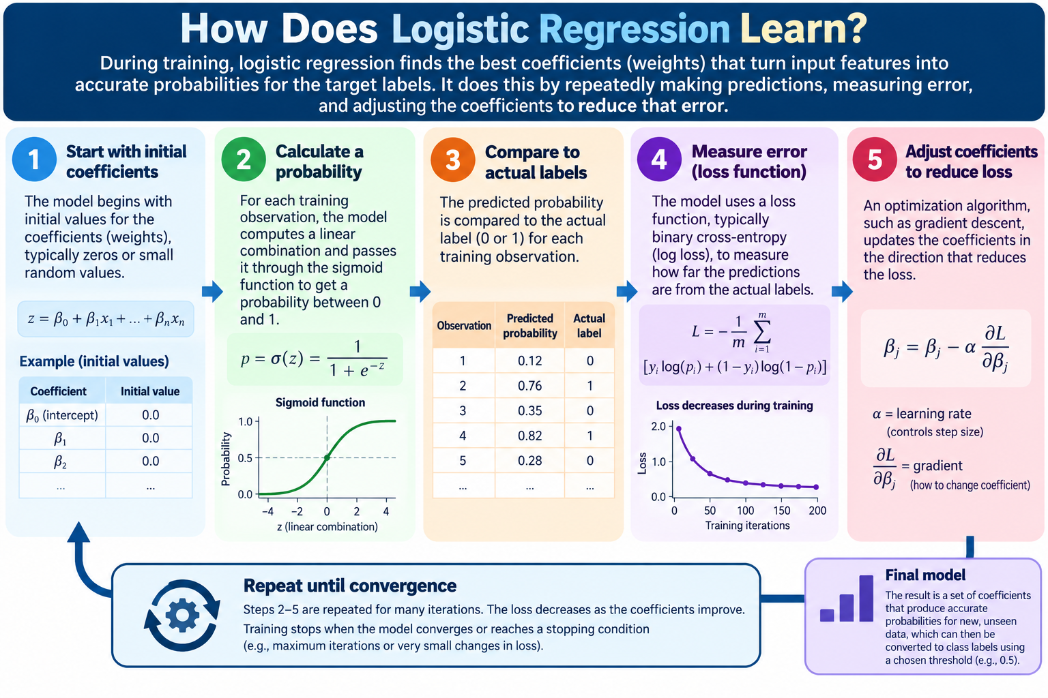

Slide 7
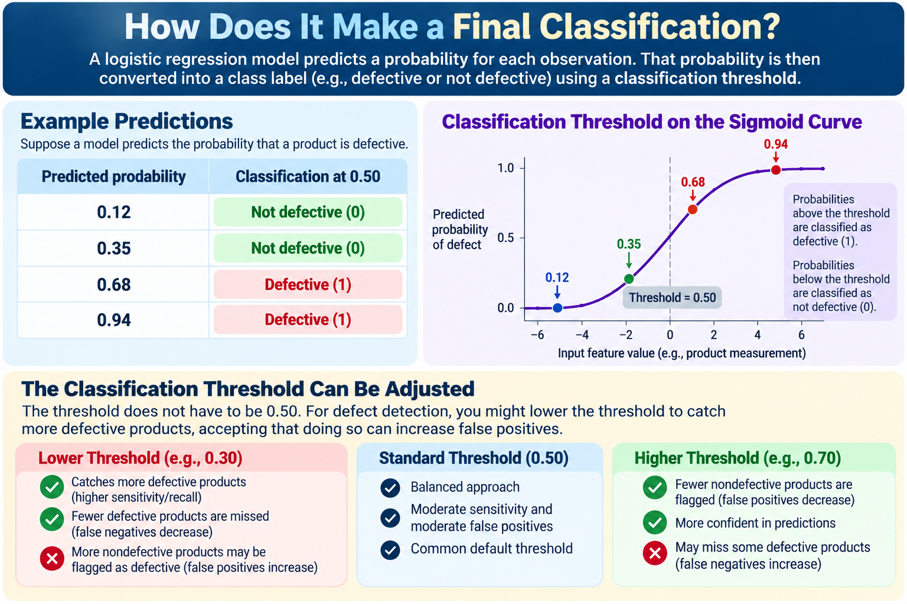

Slide 8
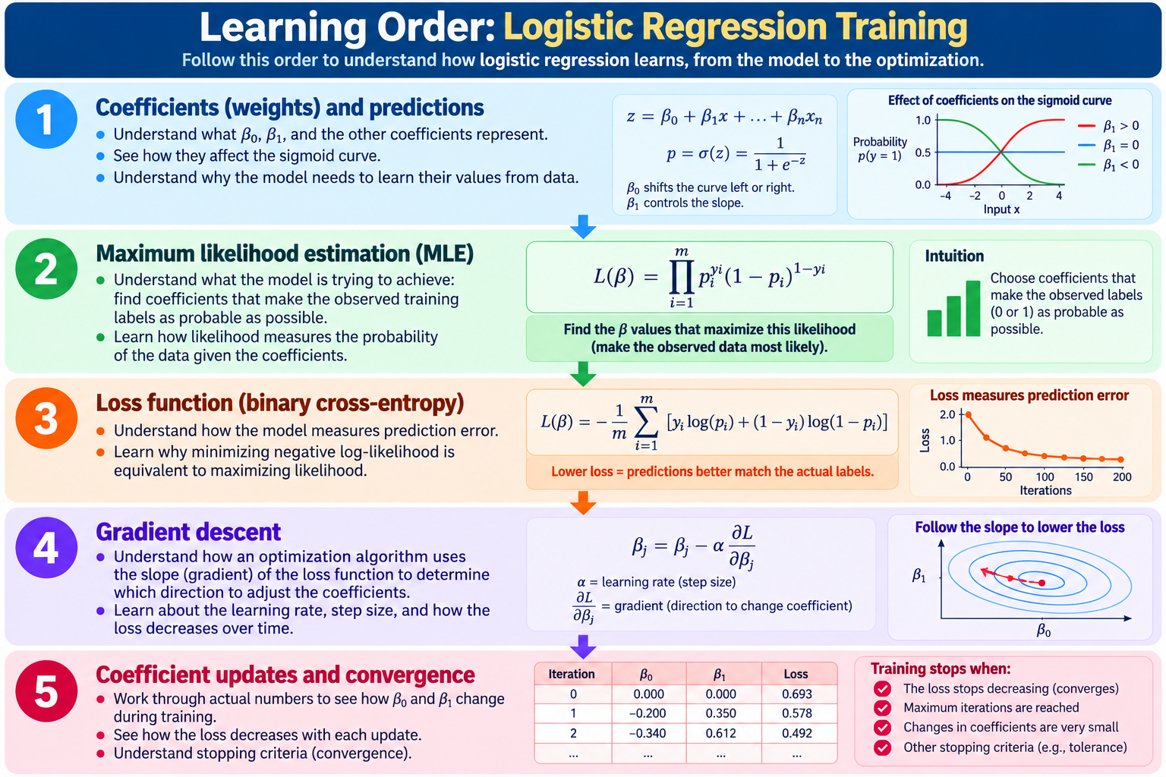

Slide 9
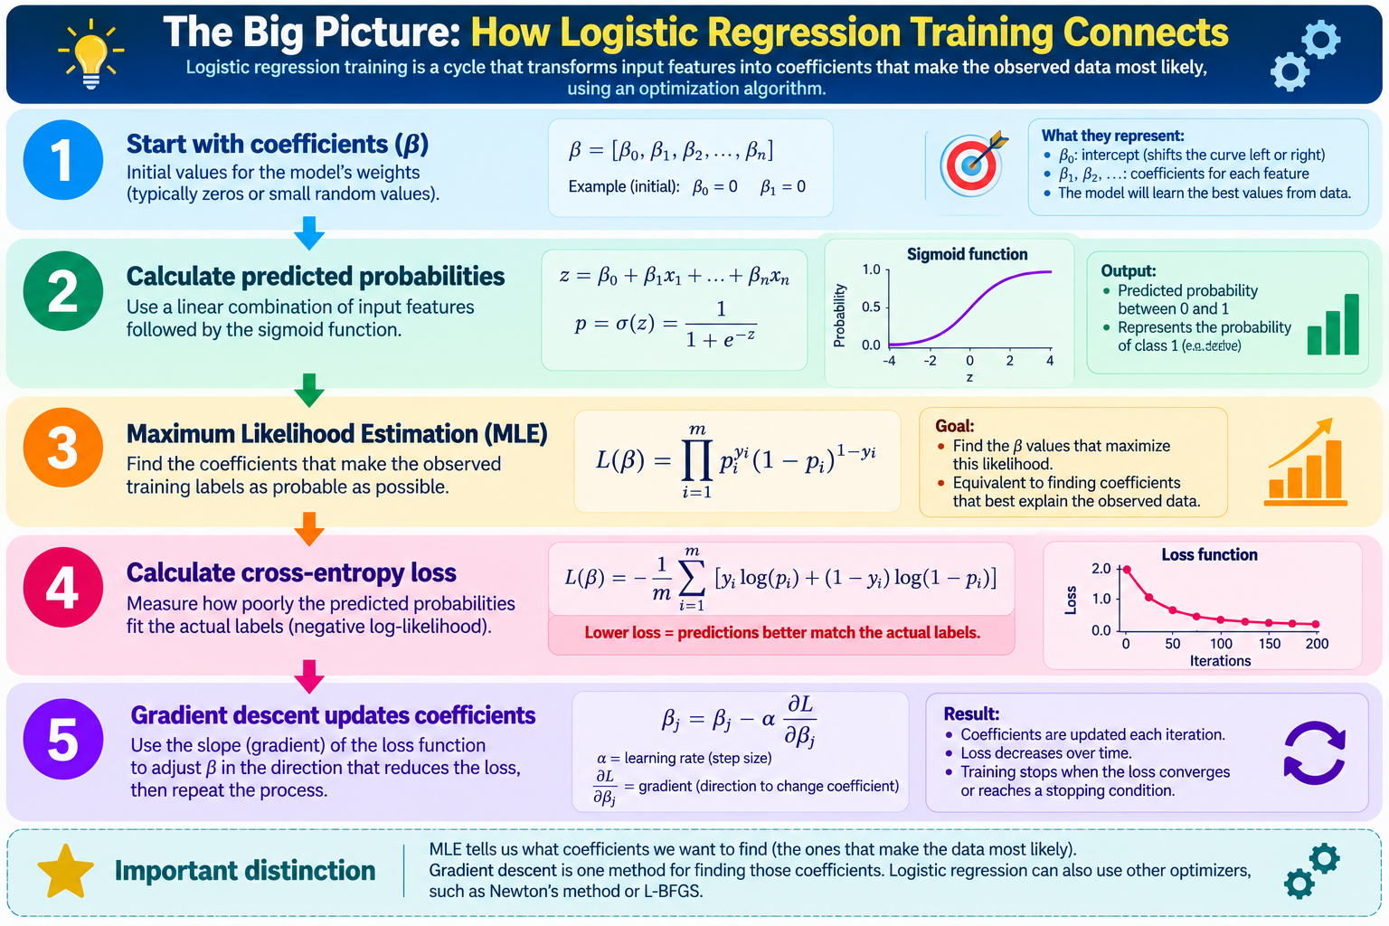

Slide 10
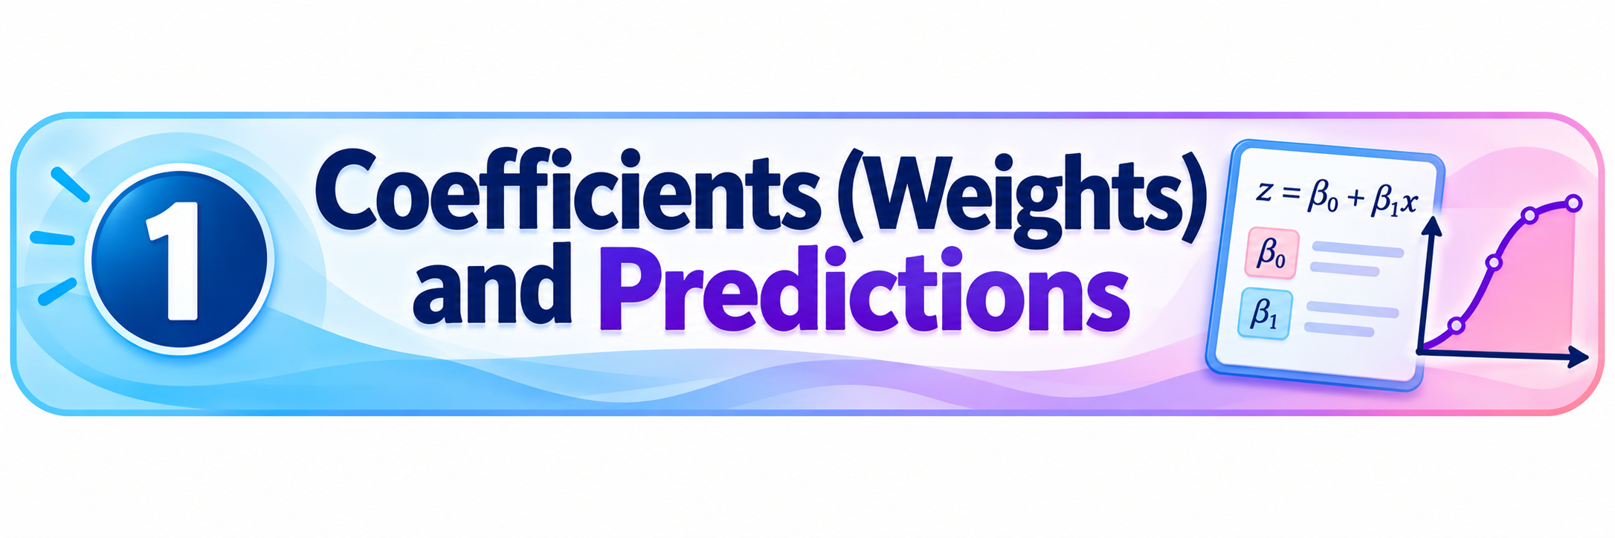

Slide 11
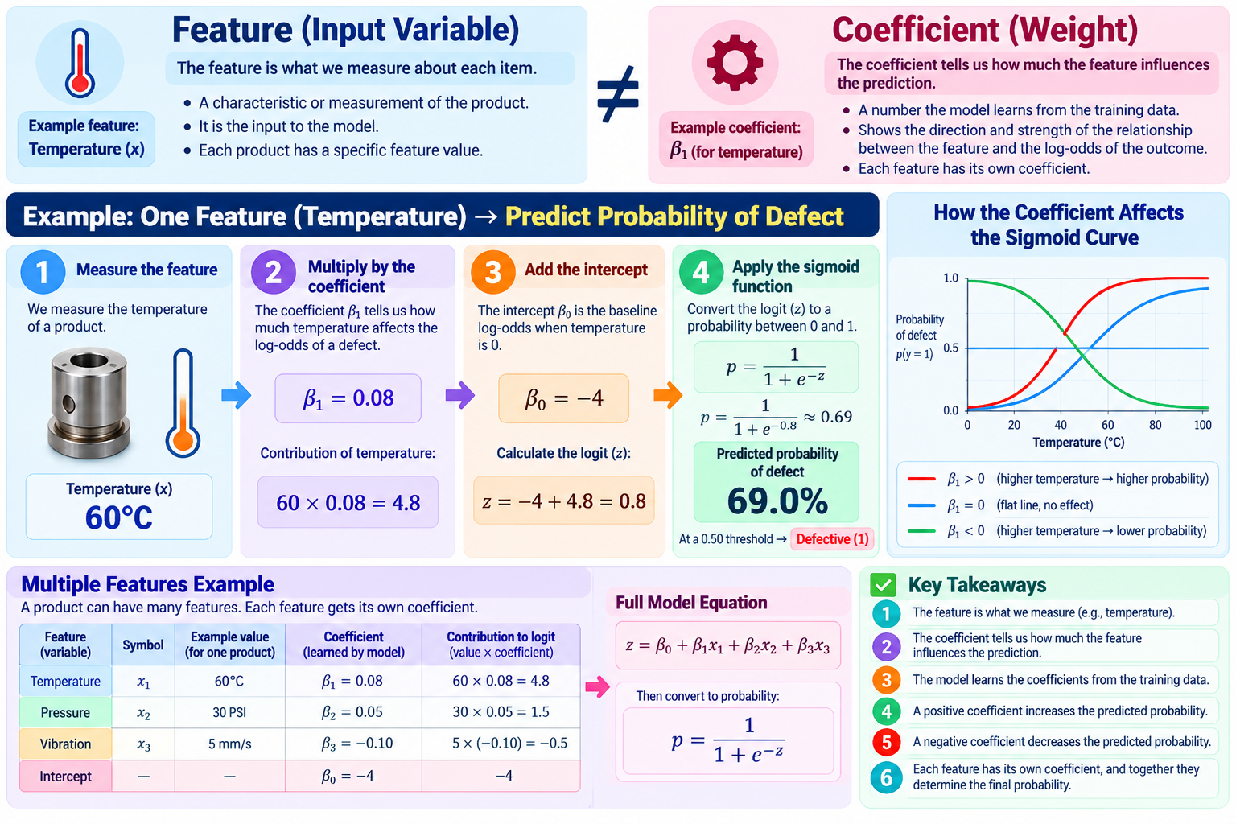

Slide 12
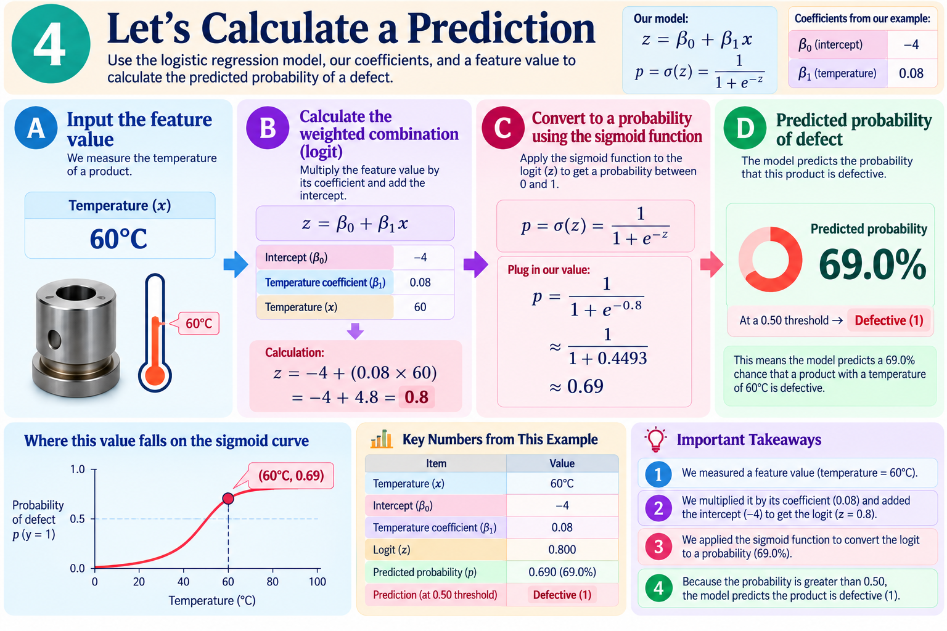

Slide 13
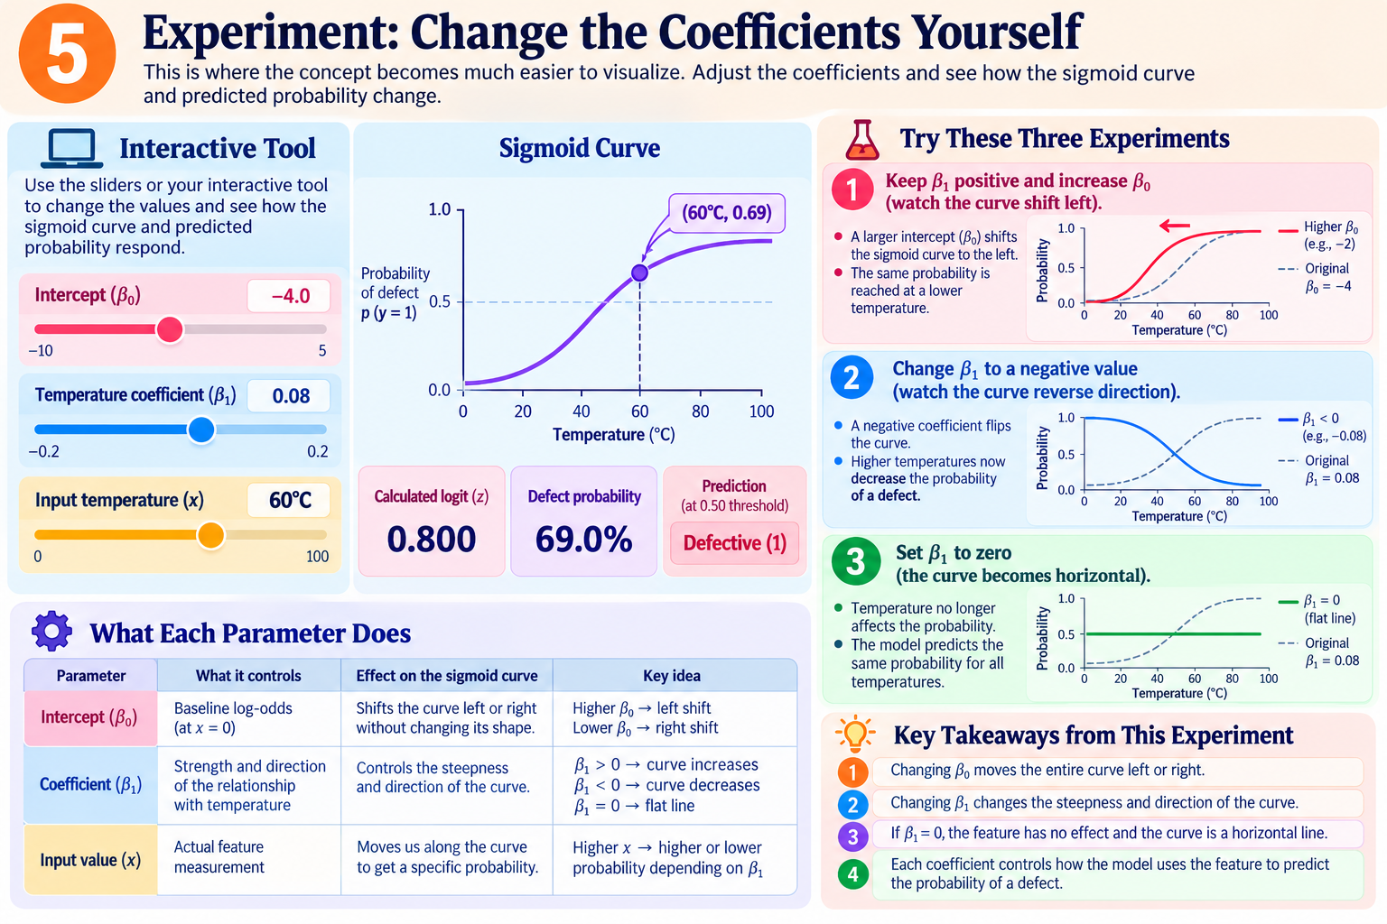
Notes:
Find interactive .py in git

Slide 14
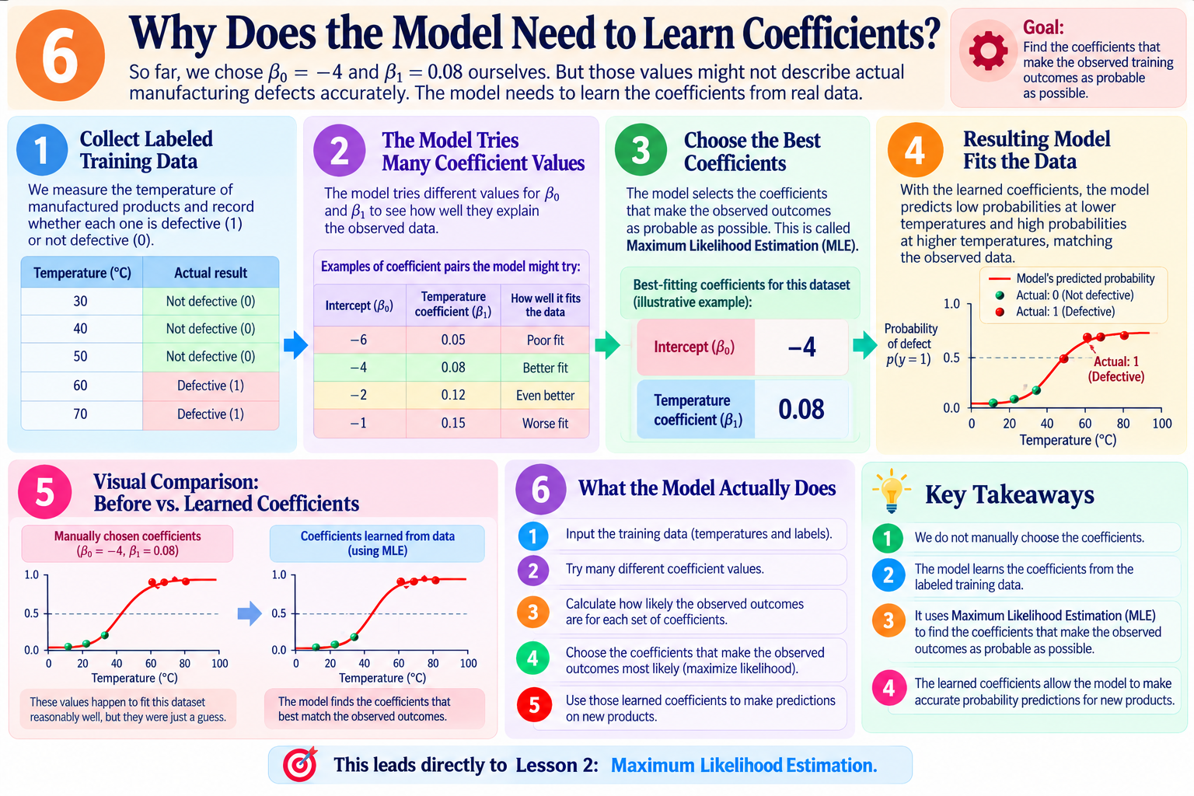

Slide 15
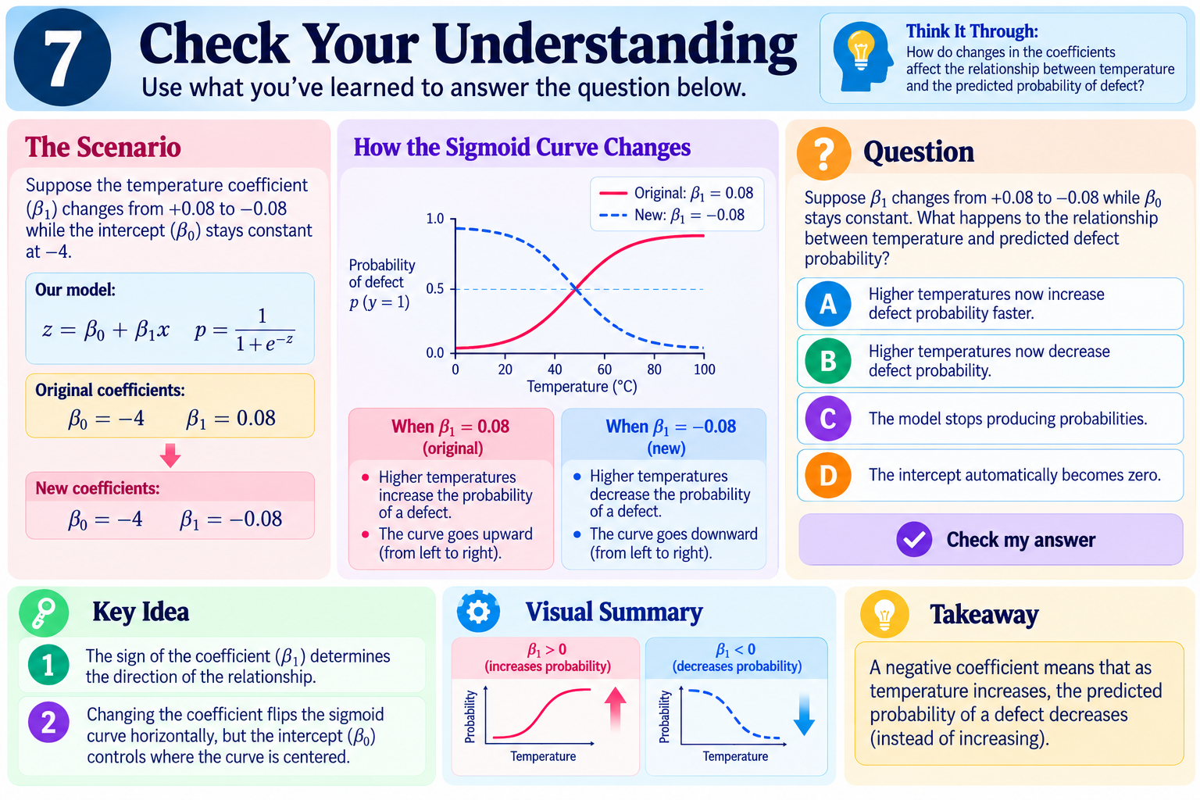

Slide 16


Slide 17
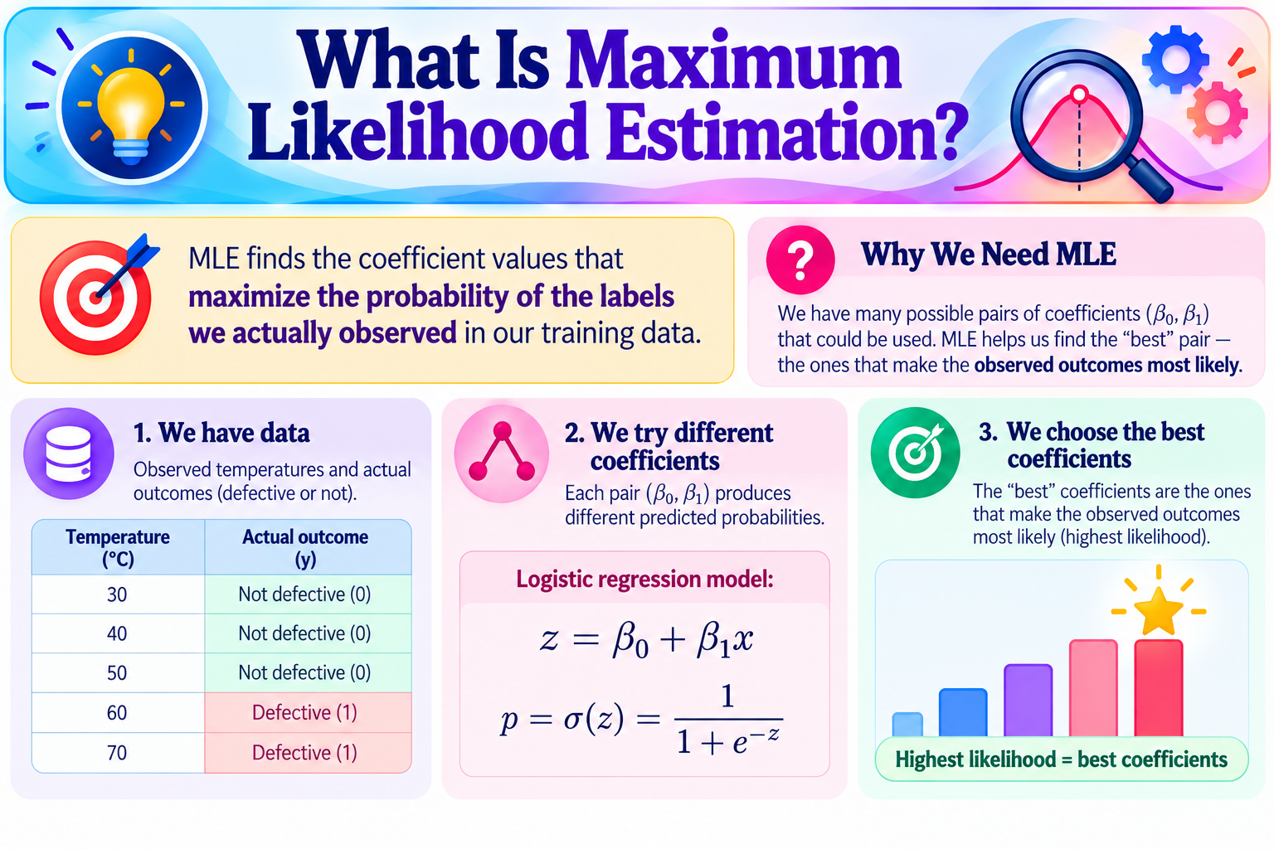

Slide 18
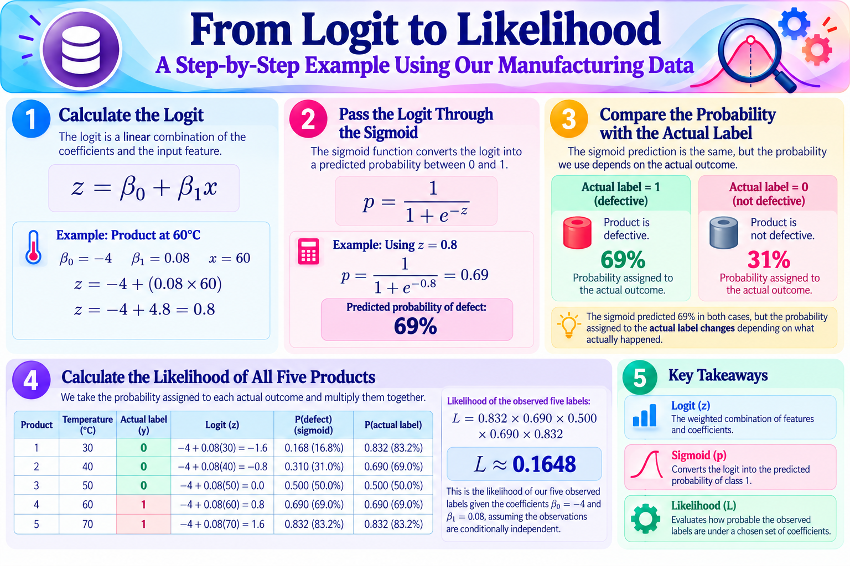

Slide 19
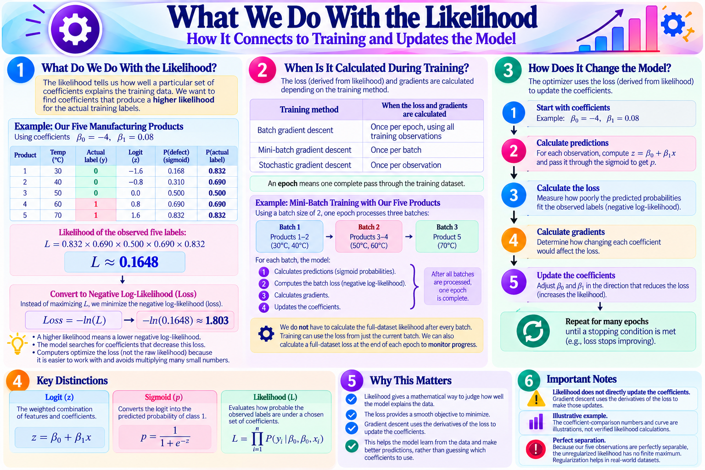

Slide 20
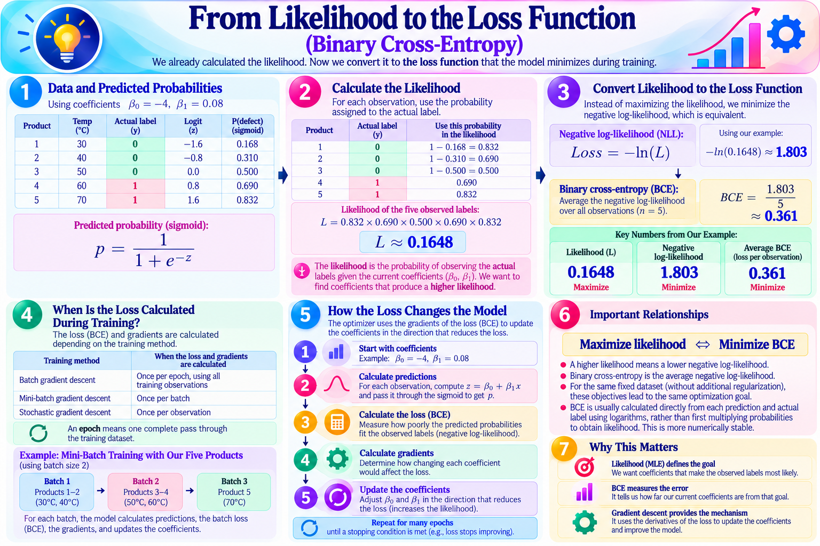

Slide 21
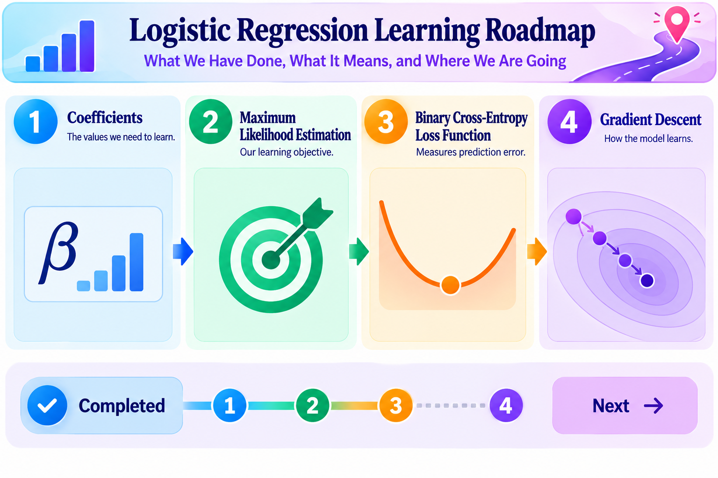

Slide 22
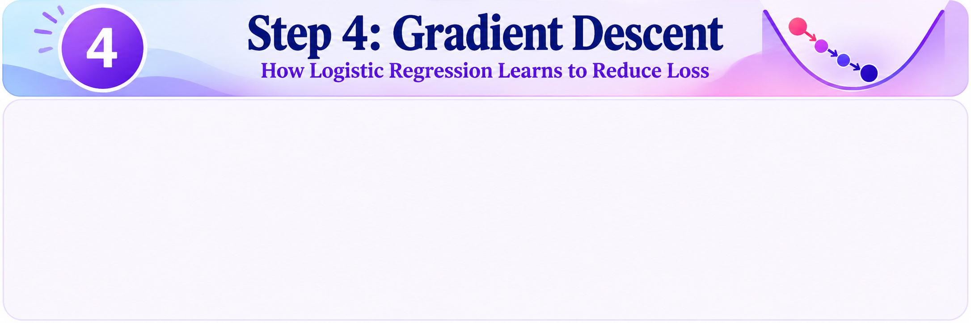

Slide 23
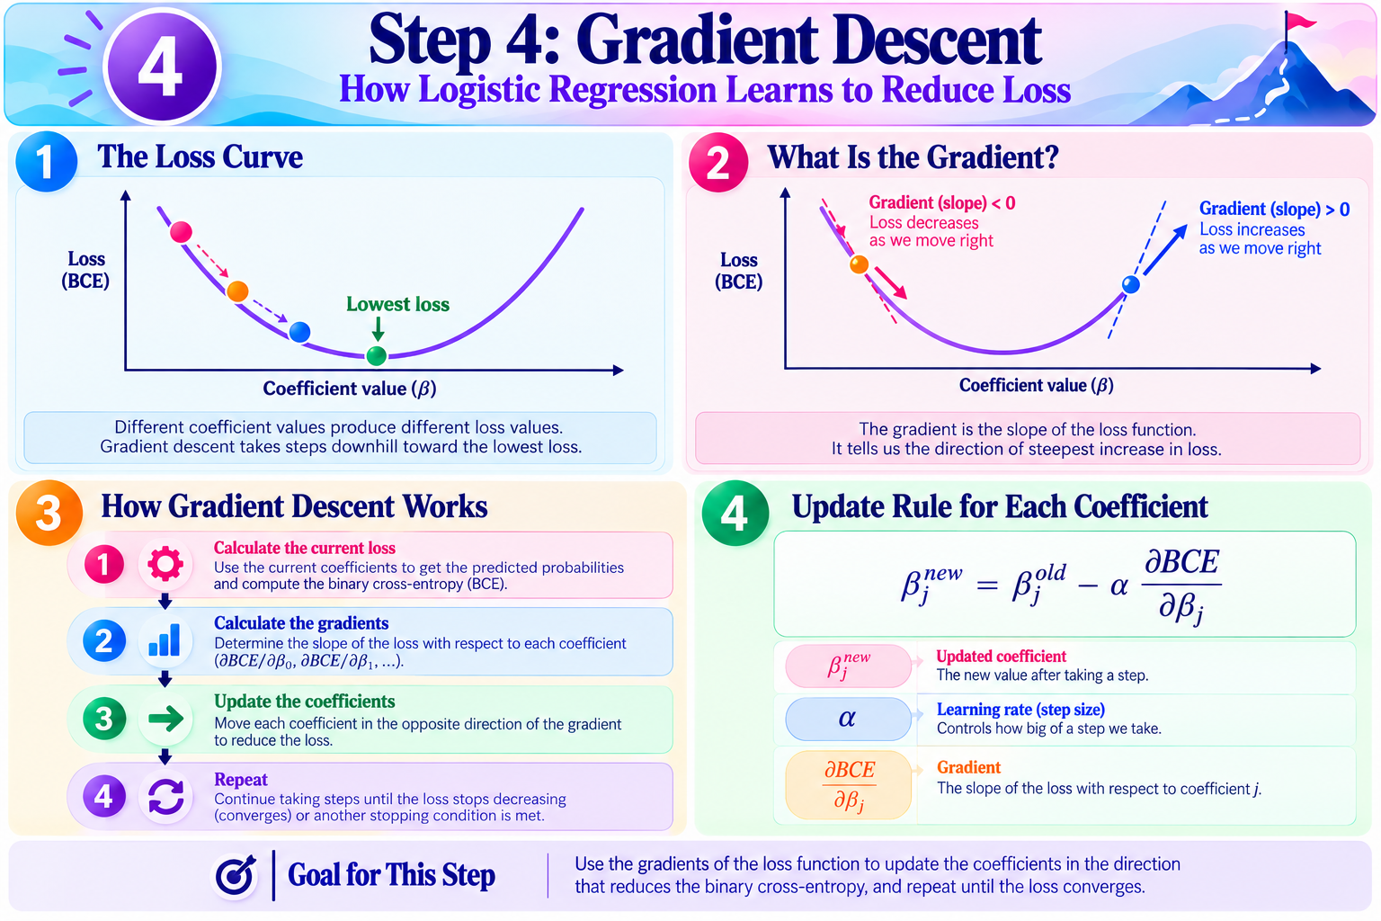

Slide 24
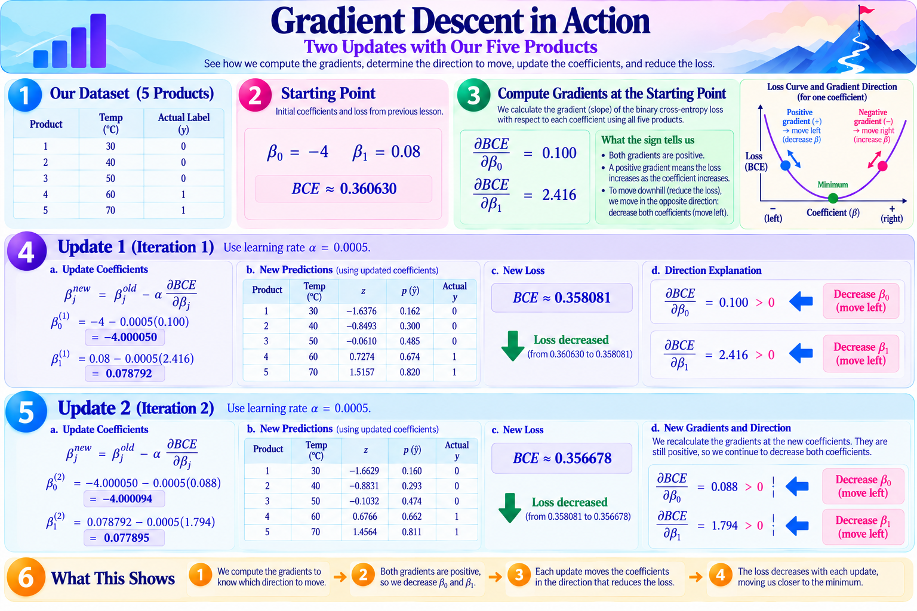

Slide 25
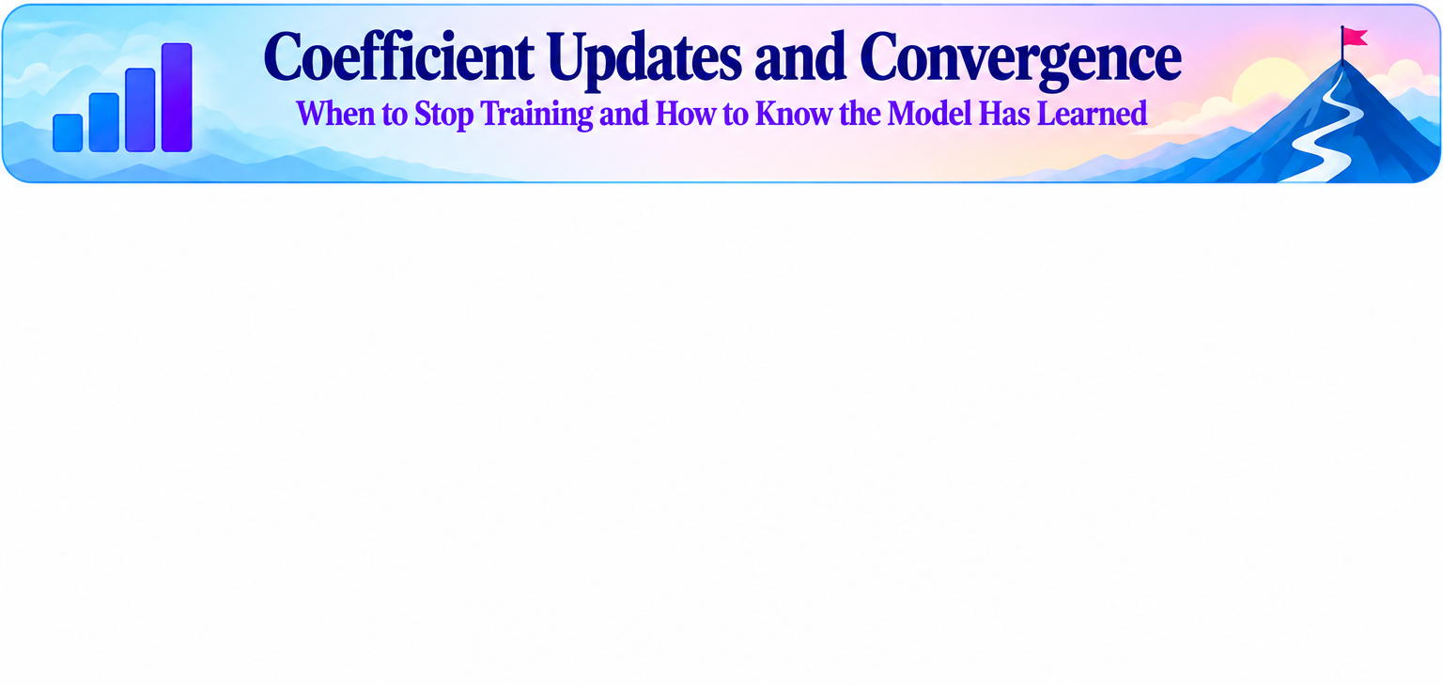

Slide 26
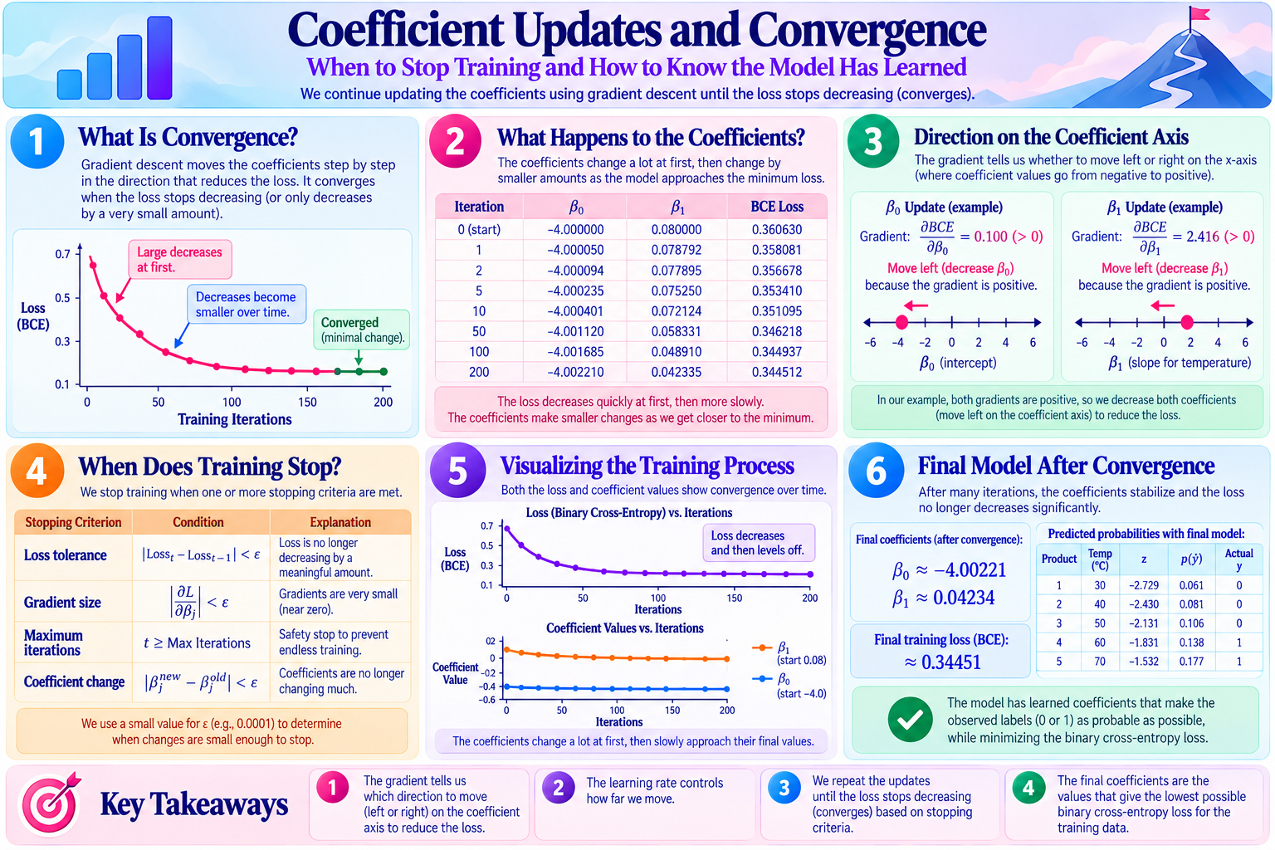

Slide 27
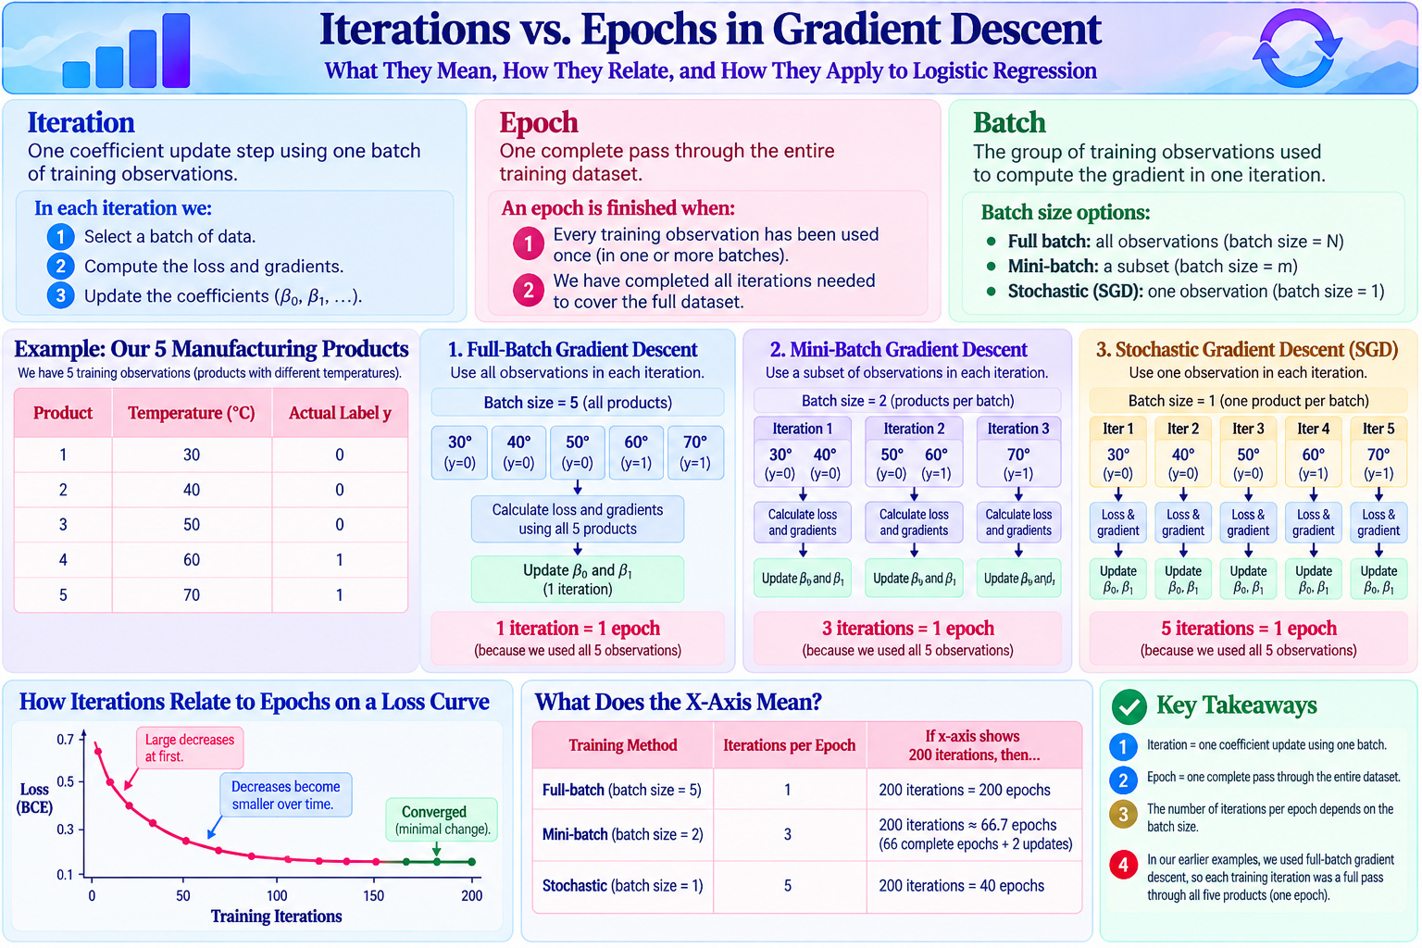

Slide 28
Training Cycle: What Happens at Each Iteration?
The optimizer recalculates predictions, loss, and gradients using the current coefficients.
1 SELECT DATA
2 PREDICT
3 MEASURE ERROR
Choose 32 labeled component-image feature vectors.
Calculate z = β₀ + β₁x and p = sigmoid(z).
Compare p with actual labels using binary cross-entropy.
4 COMPUTE GRADIENTS
5 UPDATE COEFFICIENTS
Find ∂BCE/∂β₀ and ∂BCE/∂β₁ for this batch.
βnew = βold − α × gradient. The next batch uses these NEW values.
100,000 images ÷ 32 per batch = 3,125 updates per epoch.

Slide 29
Epochs, Batches, and Iterations
Example: 100,000 labeled manufacturing images, represented as numerical features.
FULL-BATCH
MINI-BATCH
STOCHASTIC
Batch size: 100,000
Updates per epoch: 1
All feature vectors processed together.
Batch size: 32
Updates per epoch: 3,125
3,125 batches of 32 images each.
Batch size: 1
Updates per epoch: 100,000
One image feature vector per update.
Important: An iteration is ONE update. An epoch is ONE full pass through the dataset.

Slide 30
Why Mini-Batch Loss Can Go Up and Down
A single batch's loss is not the same as the loss across the entire training dataset.
BATCH LOSS (NOISY)
FULL-DATASET LOSS (MONITOR)
Different batches contain different images.
Some include harder defect cases.
A later batch can have higher loss even as overall training improves.
Evaluate all 100,000 training examples with the current coefficients.
Check at each epoch end (or another chosen interval).
Monitor training AND held-out validation loss.
A rising batch loss does NOT automatically mean gradient descent is failing.

Slide 31
When Does Training Stop?
Stopping criteria help decide when further coefficient updates are no longer useful.
LOSS IMPROVEMENT
GRADIENT NORM
Stop when the monitored loss changes less than a chosen tolerance.
Stop when the gradients become sufficiently small.
MAXIMUM ITERATIONS
COEFFICIENT CHANGE
Stop at a preset update limit, even if not converged.
Stop when updates become sufficiently small; check for tiny learning rates.
A stopping condition being met does not always mean the best possible coefficients were found.

Slide 32
Real-World Convergence: What to Watch
Real manufacturing data are noisy; training loss alone does not establish generalization.
100,000 LABELED IMAGES
WHAT CONVERGENCE TELLS US
Each image has extracted numerical features and a defect label (0 or 1).
Some good and defective components look similar.
Use a separate validation set to test generalization.
With mini-batches, individual batch losses can fluctuate.
Monitor overall training loss and validation loss.
Use regularization and stopping criteria to limit overfitting.
Training loss flattening is not proof of good defect detection: check validation recall and precision.

