Slide 1
TIC TAC TIger
Matt^3, Devin, and Lee

Slide 2

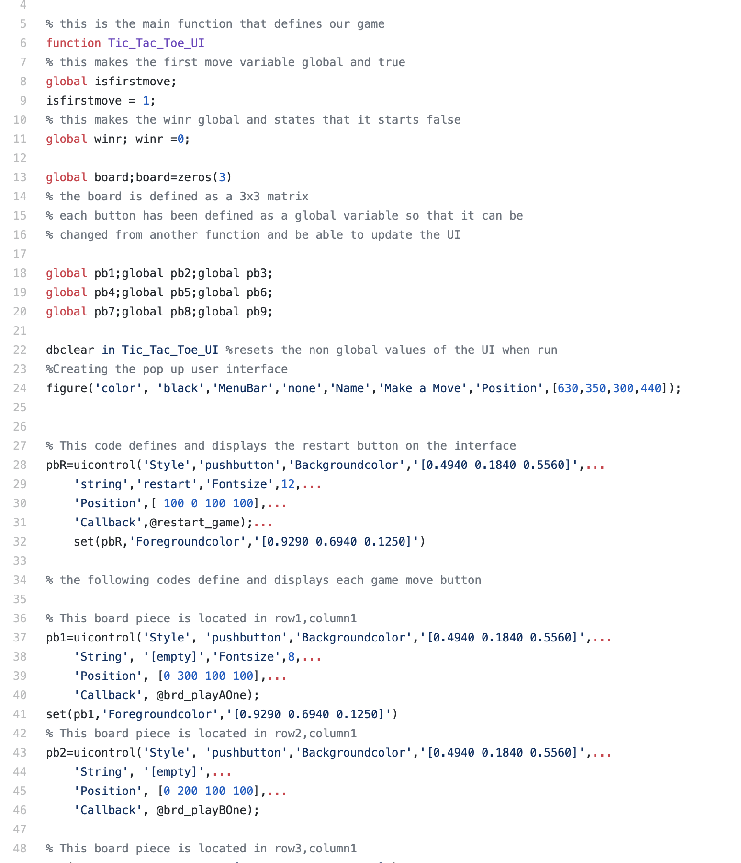
User Interface
Creating an interface that was instantly recognizable as Tic-Tac-Toe was key in making the game easy to use for anyone, rather than keeping the display in matrix form.

Slide 3
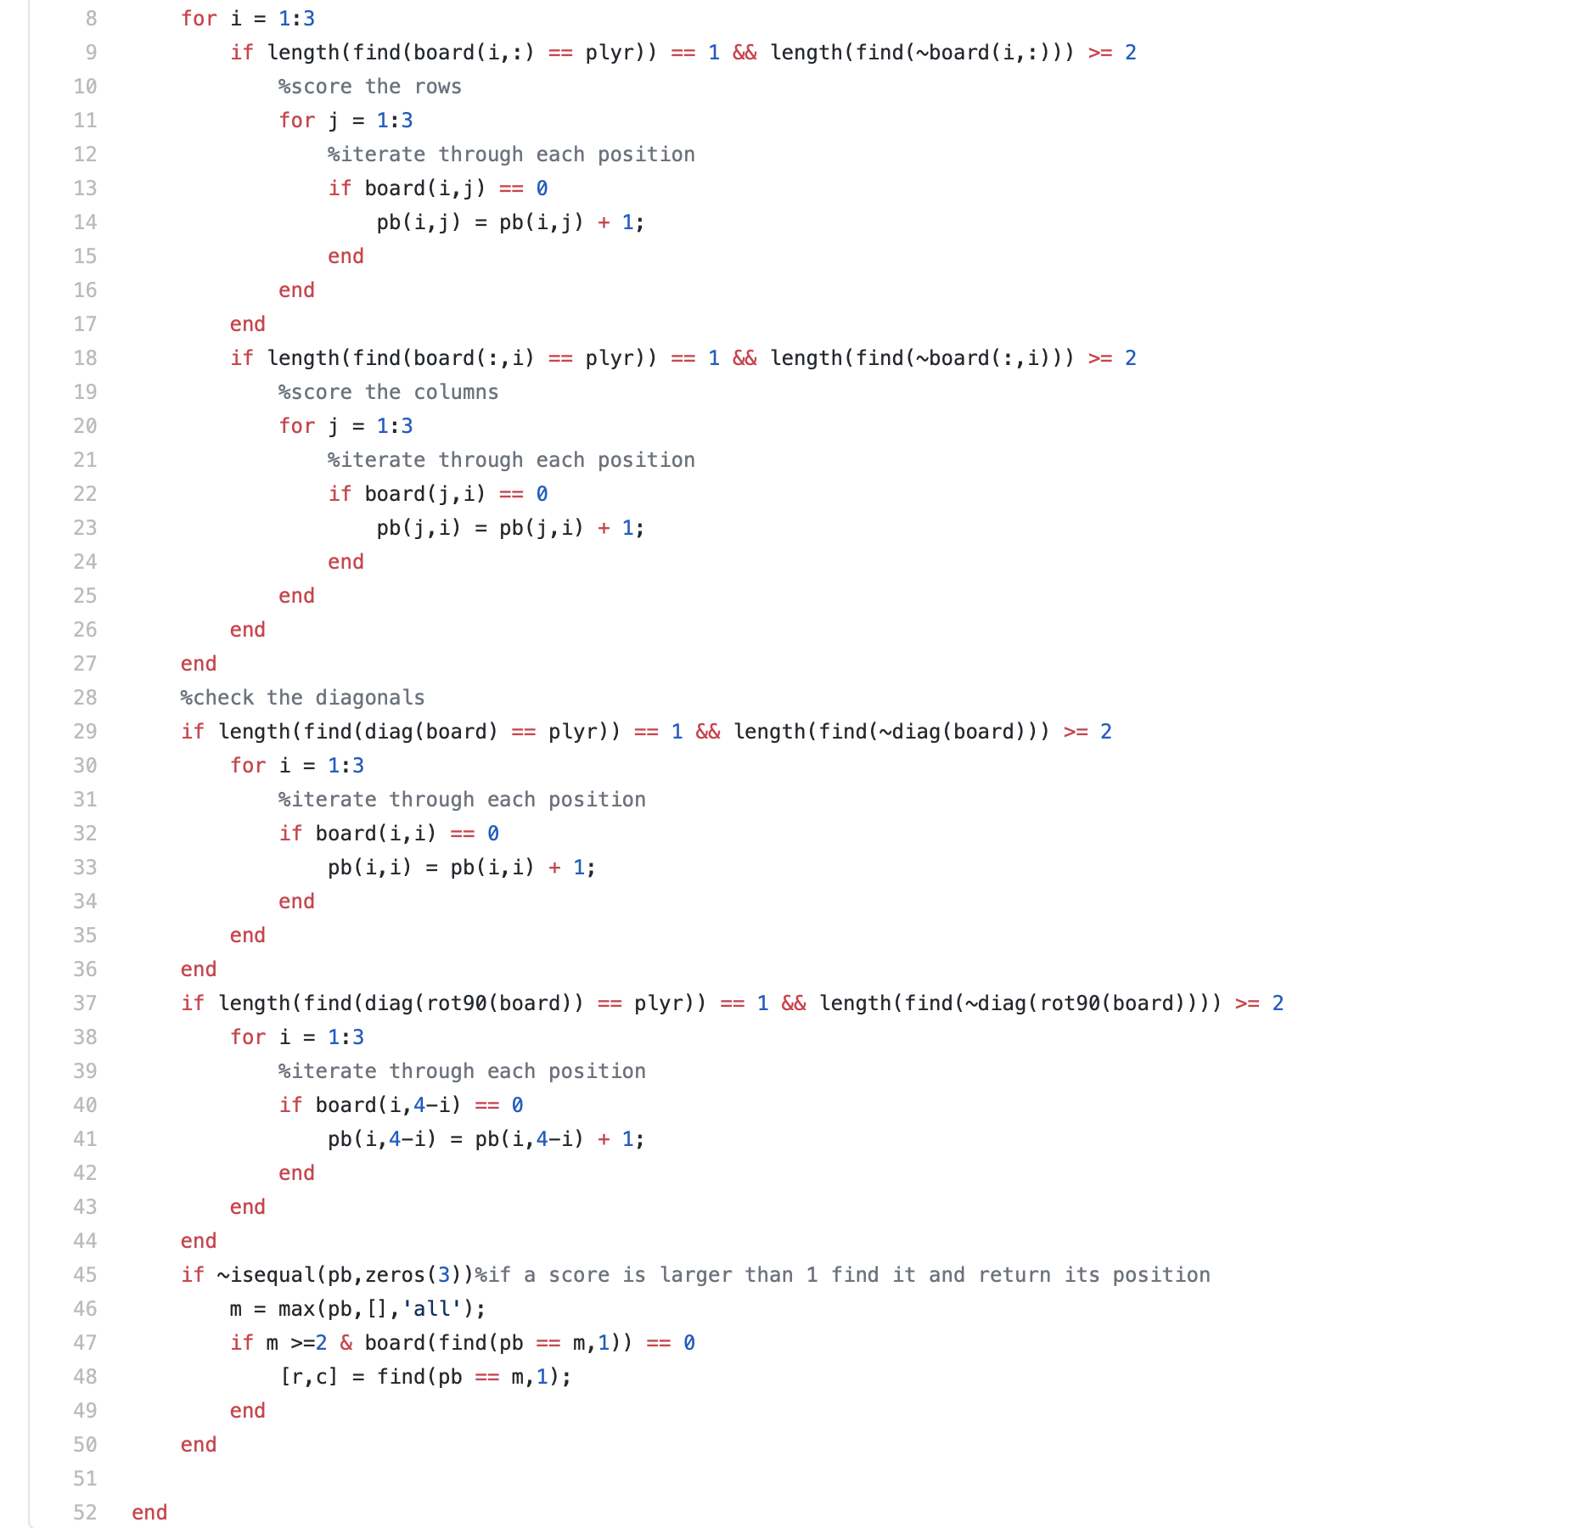
cOMPUTeR DECISION MAKING
This part of the code takes into account the whole board and all possible scenarios and efficiently responds in the best possible way for the computer to win or result in a draw using “fork scanner” and other strategic code.

Slide 4
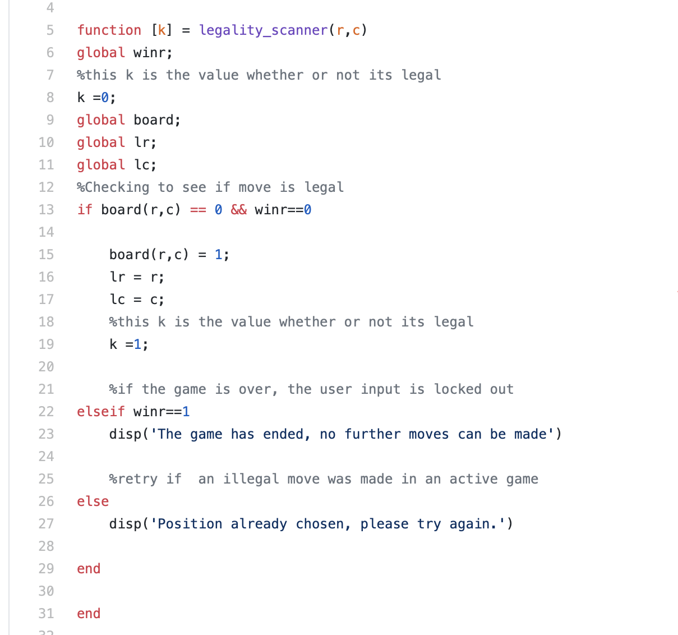
Player Decision Making
Implemented a “legality scanner” that prevents the player from making an illegal move, establishing a built-in rule book of sorts. For example, it prevents the player from selecting a square previously chosen by the computer.

Slide 5
Questions?
If not, come try it out!

