Slide 1





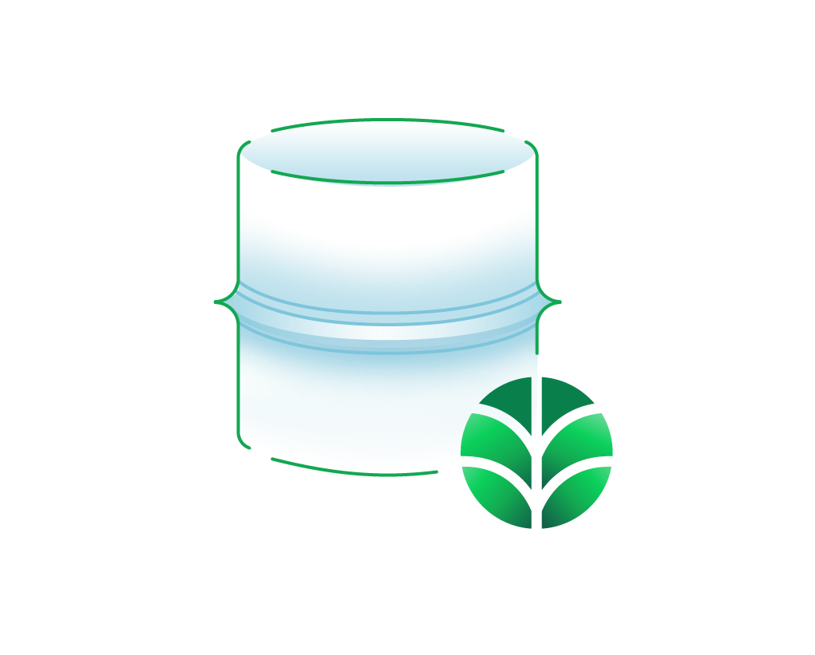

AWS Cloud
Availability Zone 1
Availability Zone 2
VPC
VPC
Public subnet
Public subnet
Availability Zone 1
Availability Zone 2
Availability Zone 3
VPC
peering connection
NAT gateway
NAT gateway
Private subnet
Private subnet
MongoDB Atlas cluster

