Slide 1
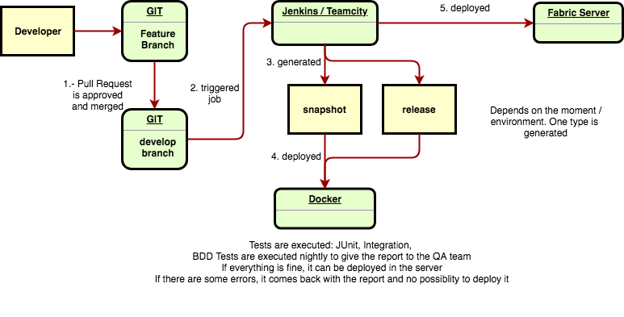
Continuous Integration and Delivery proposal

