Slide 1
DigData – Excel Cheatsheet
Step Up

Slide 2
The below data is included in the example spreadsheet to follow along if you’d like
Class | ID | Name | Gender | Attendance | Revised | Science | Maths1 | Maths2
Class A | 1 | Tom | X | Good | TRUE | 98 | 80 | 81
Class A | 2 | Ben | M | Satisfactory | TRUE | 72 | 81 | 76
Class A | 3 | Lily | F | Good | TRUE | -84 | 92 | 88
Class A | 4 | Ivy | F | Good | TRUE | 910 | 78 | 74
Class A | 5 | Alex | M | Good | TRUE | 77 | 76 | 83
Class A | 6 | Oliver | M | Satisfactory | TRUE | #N/A | 85 | 82
Class B | 7 | Hazel | F | Good | FALSE | 81 | 83 | 87
Class B | 8 | Emily | F | Poor | TRUE | 85 | 83 | 91
Class B | 9 | John | M | Great | TRUE | 95 | 91 | 87
Class B | 10 | James | M | Poor | FALSE | 73 | 88 | 80
Class B | 11 | Anna | F | Great | TRUE | 96 | 89 | 85
Class B | 12 | Rose | F | Good | TRUE | 90 | 77 | 79
Class B | 12 | Rose | F | Good | TRUE | 90 | 77 | 79

Slide 3
DigData – Data Cleaning
Step Up

Slide 4
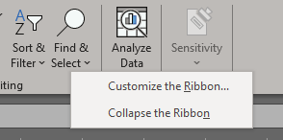
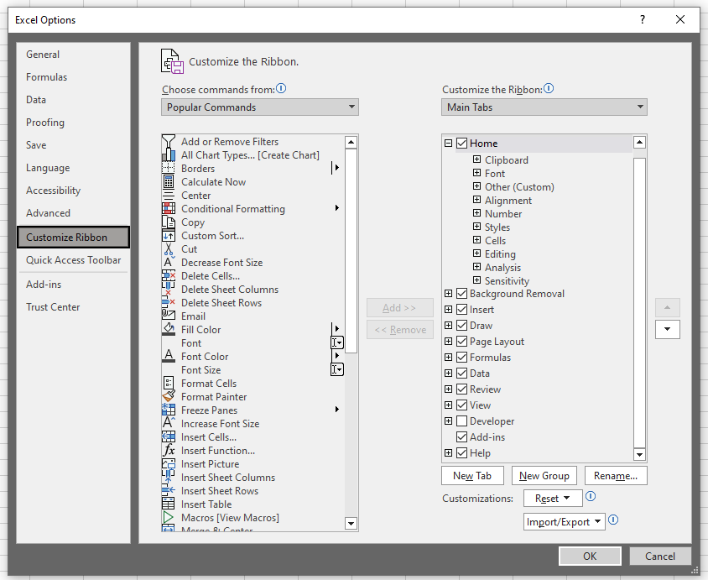
Enable ‘Data’ tab
Right-click in empty space in ribbon
Click ‘Customise the Ribbon’
Ensure the ‘Data’ tab is ticked (circled)
Click ‘OK’
1
2

Slide 5
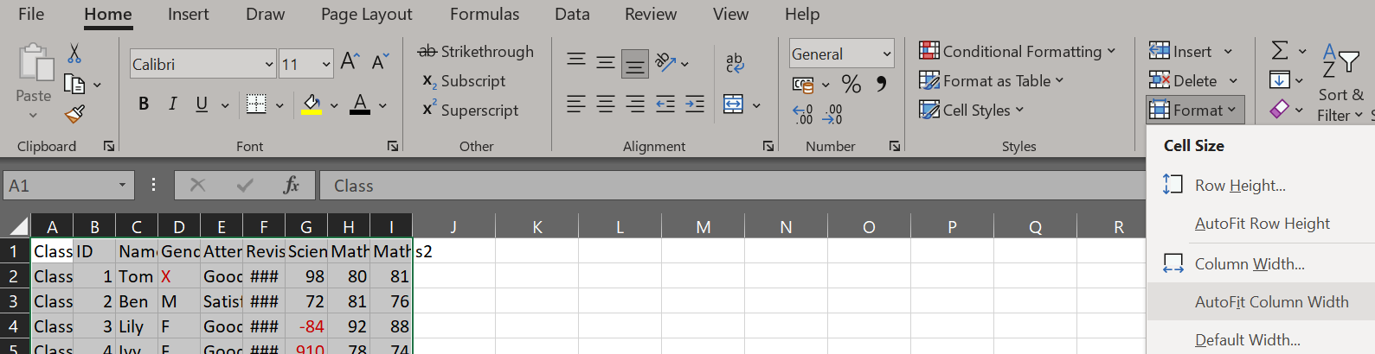
Autofit column width
Highlight all the columns
Format > AutoFit Column Width
1

Slide 6
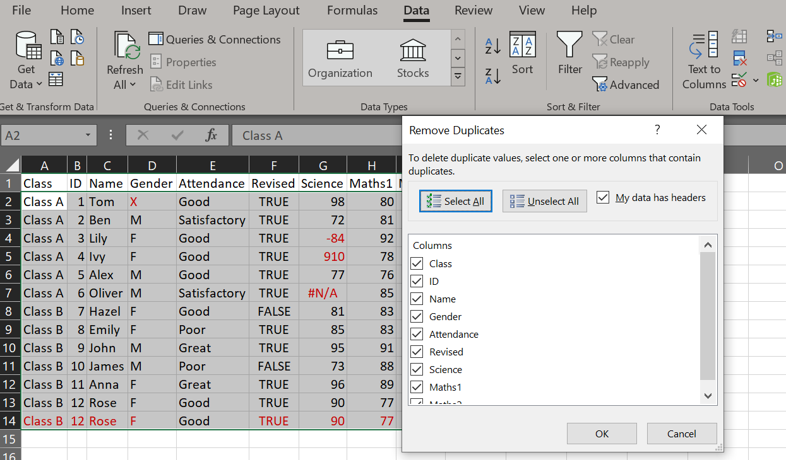
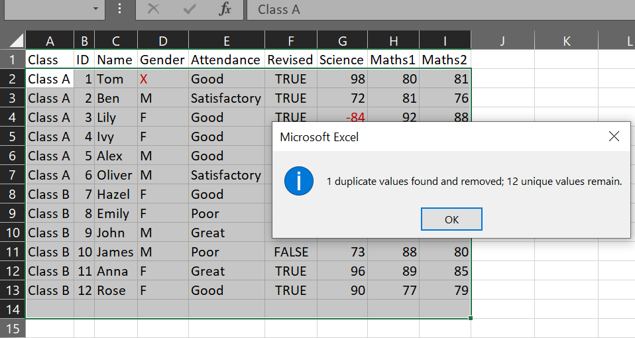
Remove duplicate rows
Go to the Data tab > Remove Duplicates (circled)
Ensure all columns are ticked, then click ‘OK’
1
2

Slide 7
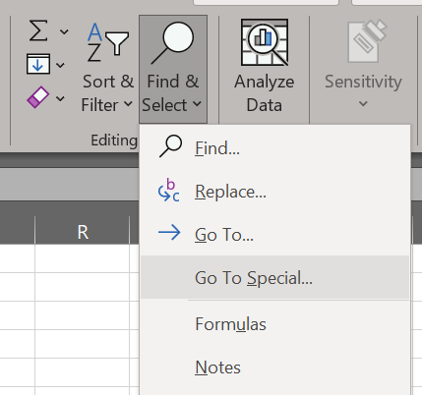
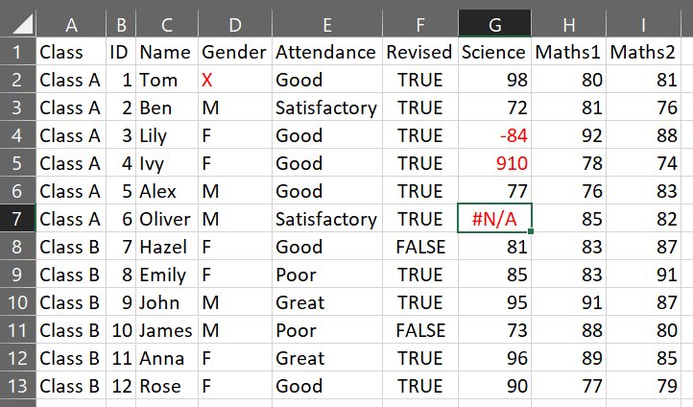
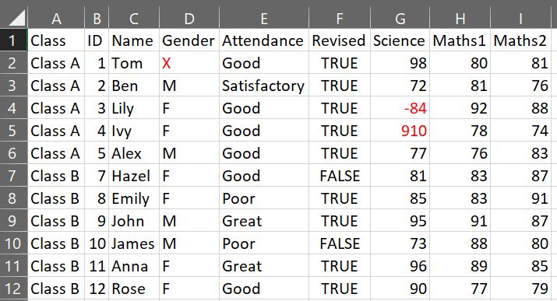
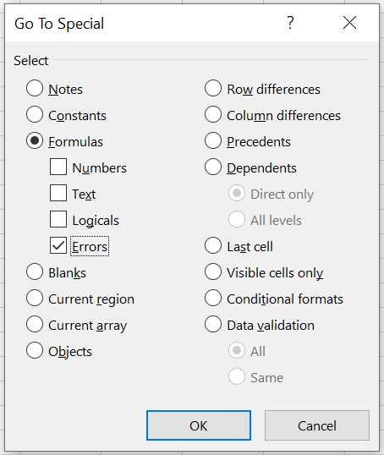
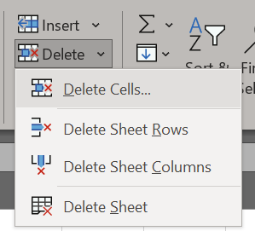
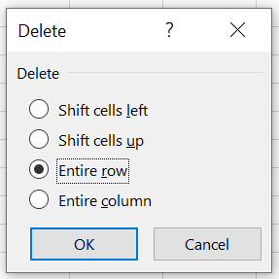
Remove rows with missing values
Home tab > Find & Select > Got To Special > Tick ‘Errors’ only (now the row/s with NA are highlighted)
Home tab > Delete > Delete Cells > Select ‘Entire row’ > OK (now the row/s containing NA is removed)
1
3
6
4
5
2

Slide 8
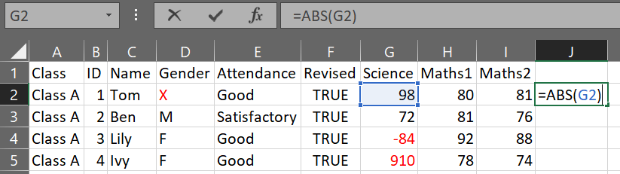
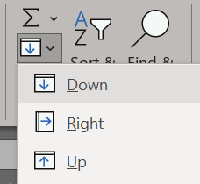
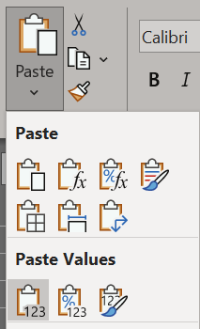
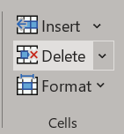
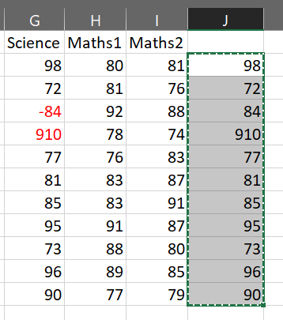
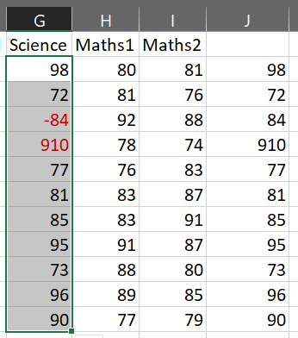
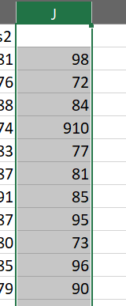
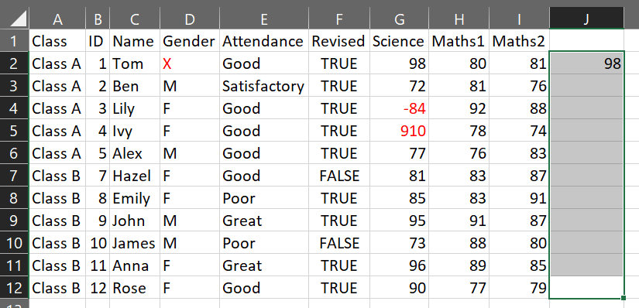
Make all negative values positive
In a new column, select the first value below the heading row
Enter =ABS() and within the backets click/enter the cell value of the first value in the column we’re going to fix
Select the rows in the column you’d like to fill, Home tab > Fill > Down (Tip: you can type ctrl+D as a shortcut)
Copy the new values, select the column values we’re fixing, Home > Paste > Paste Values, delete new column
1
5
3
7
4
8
2
6

Slide 9
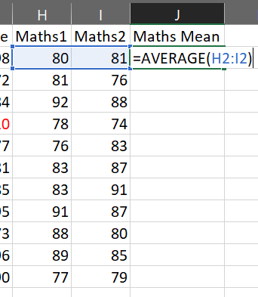
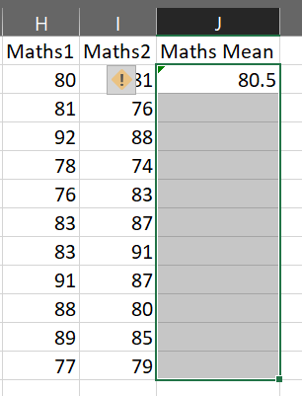
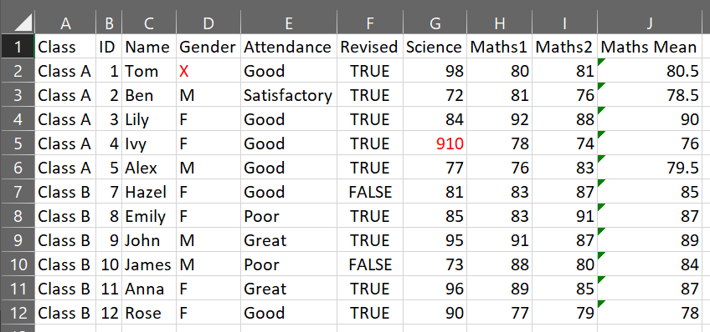
Add row means column
Type the new column heading, select the first cell below
Enter =AVERAGE() and within the backets highlight the cells we’re finding the mean for, then fill down (as previous slide)
1
2
3

Slide 10
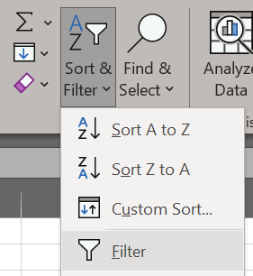
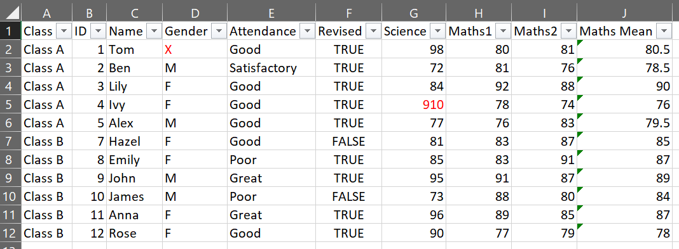
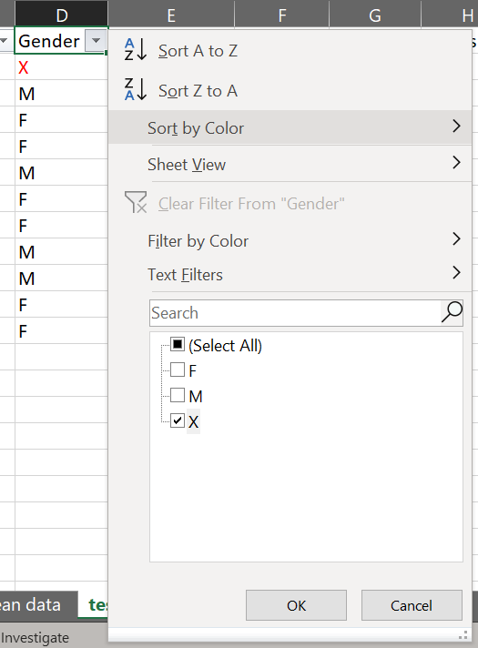
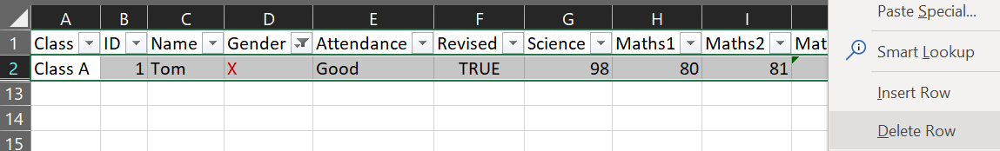
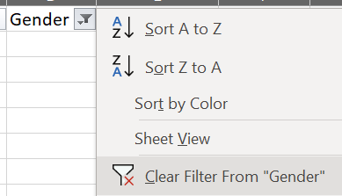
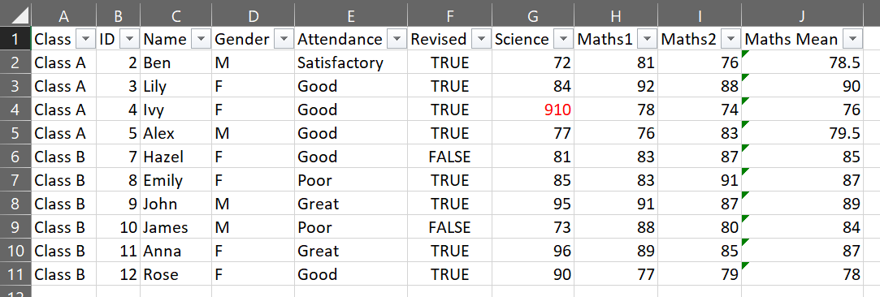
Filter data and remove rows
Select all data, Home > Sort & Filter > Filter (dropdown buttons appear besides heading, autofit column width if desired)
Click dropdown for column to be filtered, tick the values you want to remove > OK
Highlight all rows > right-click > Delete Row > click dropdown button > Clear Filter From “Column”
1
2
3
4
5
6

Slide 11
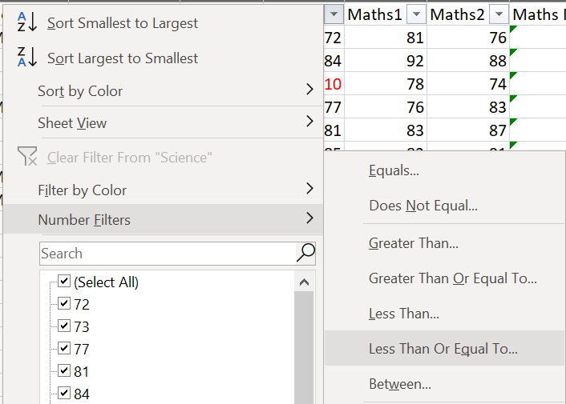
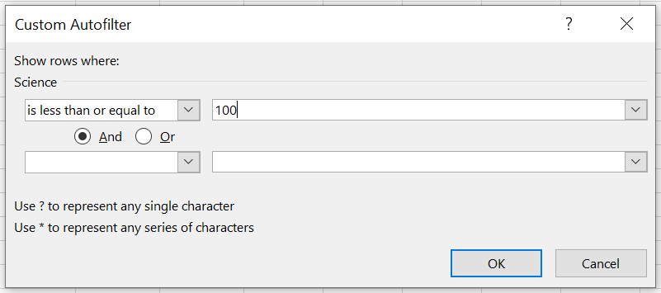
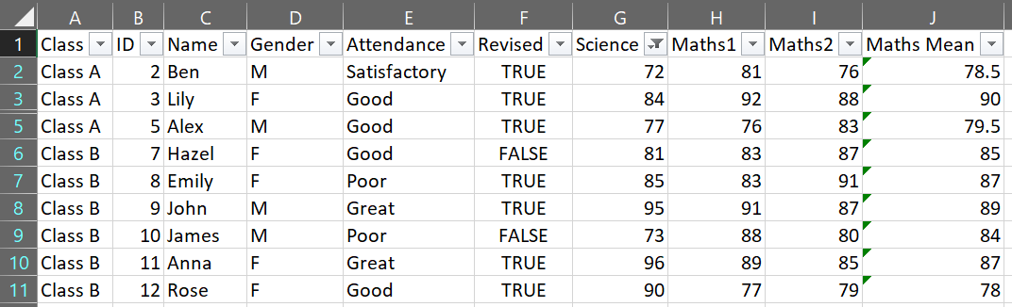
Filter data only
Click dropdown for column to be filtered > Number Filters > Less Than Or Equal To (or whichever filter required)
Enter parameter for filter > OK
In this example, score is out of 100 so we’re filtering the “Science” column to show values <= 100
1
2
4
3

Slide 12
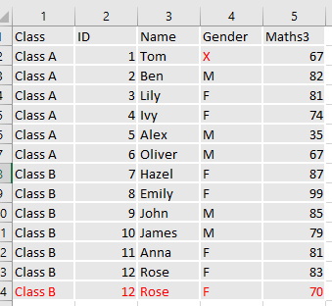
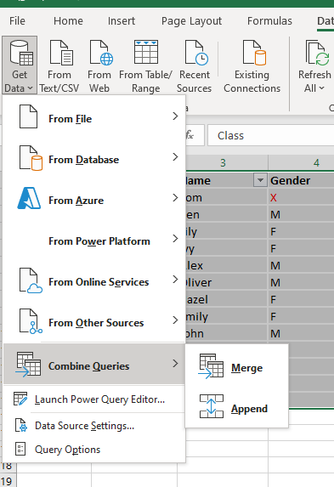
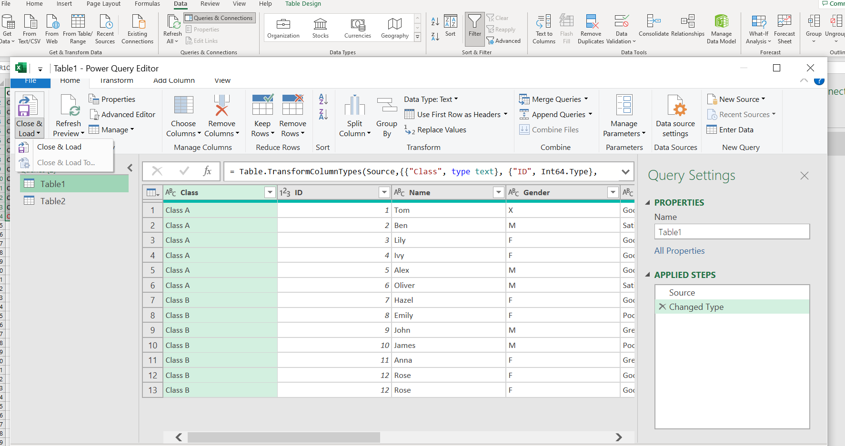
Merge data
You may need to merge two datasets together.
There are quite a few steps involved for this so please review the guide online here
You will need to use the From Table/Range option and then combine your queries

Slide 13
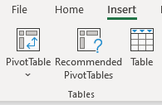

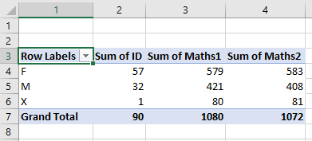

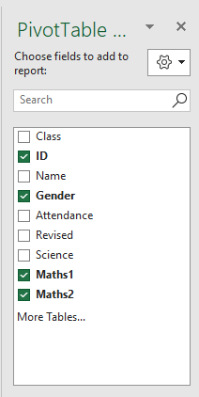

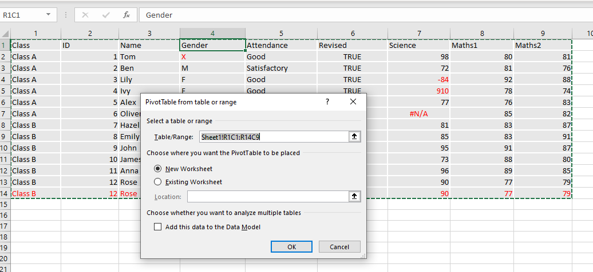
Pivot tables
Pivot Tables are a great way to summarize and analyse trends in data. You can turn you dataset into a Pivot table
Click insert > Pivot Table and select your range of data
You can now select the data to include in your pivot table and experiment with different combinations
1

Slide 14
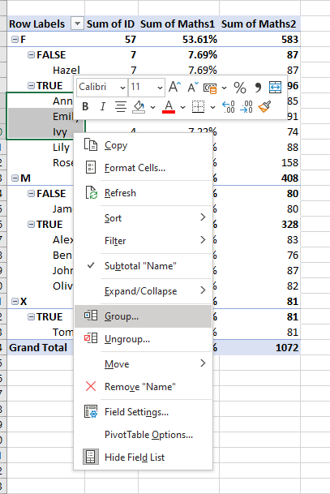
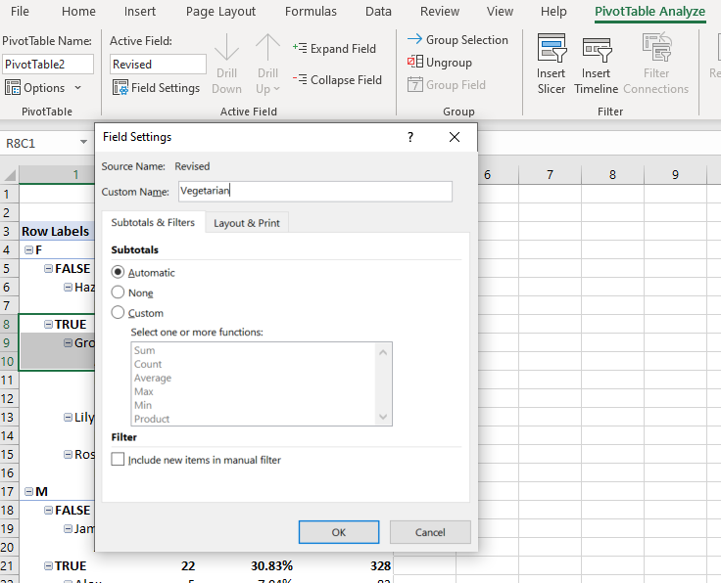
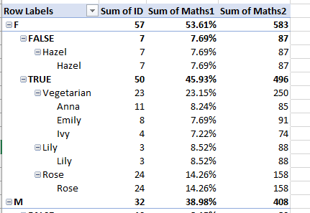
Group Data in Pivot Tables
Grouping data in a PivotTable can help you show a subset of data to analyse
After creating your pivot table select a range of cells and right click to explore grouping options
You can group data in different sub populations
1
2
3

Slide 15
DigData – Summary Statistics/ Visulisation
Step Up

Slide 16
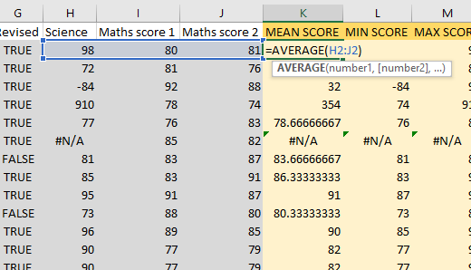
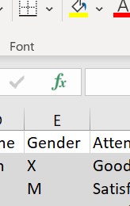
STATS
STAT | Function
COUNT | COUNT(value1, [value2], …)
COUNTIF | COUNTIFS(criteria_range1, criteria1, [criteria_range2, criteria2]…)
MEAN | AVERAGE(number1, [number2], …)
MIN,MAX | MIN(number1, [number2], …),MAX(number1, [number2], …)
MEDIAN | MEDIAN(number1, [number2], …)
TOTAL | TOTAL(number1, [number2], …)
Double click the cells in the example spreadsheet to see the formulae
Functions can be adapted to ignore #NA values by using their ‘IF’ versions e.g. AVERAGEIF(number1, number2,"<>#N/A")
Don’t be limited by our example statistics. Clicking the cell you require and then the fx button presents you with a range of different functions to use.

Slide 17
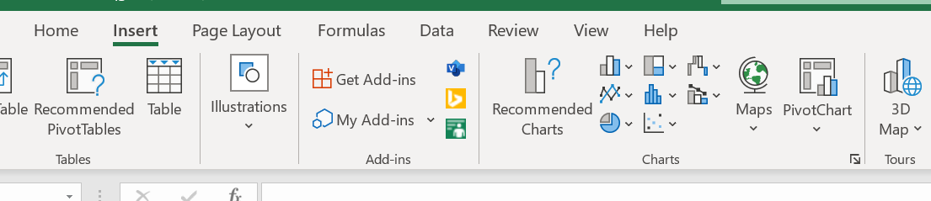
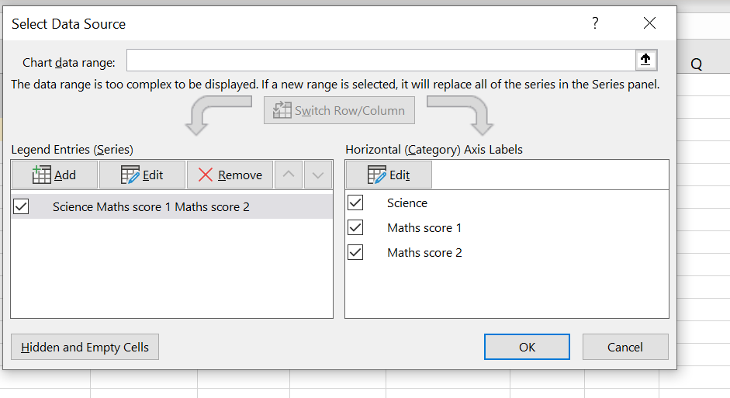
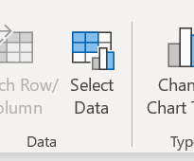
PLOTS
On the insert tab there are a range of different plots to choose from
Click on the graph you want, and specify your data as shown
You can view the example data range by clicking on the example plot provided

