Slide 1
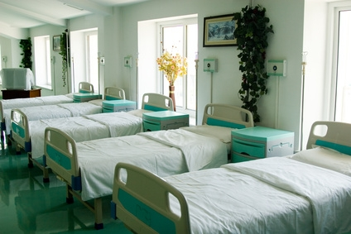

Nottingham University Hospitals NHS Trust Overnight Bed Occupancy Rate Forecast
Marcos Fabietti
28/11/2022

Slide 2
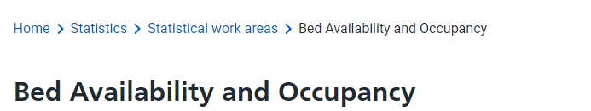
Overview
Problem
Can we predict the overnight bed occupancy rate for Nottingham University Hospitals?
Goal
Accurately forecast the overnight bed occupancy rate for Quarter December 2022 via Machine Learning.
Data
https://www.england.nhs.uk/statistics/statistical-work-areas/bed-availability-and-occupancy/

Slide 3
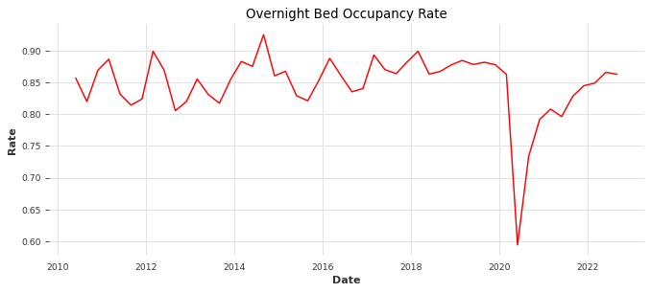
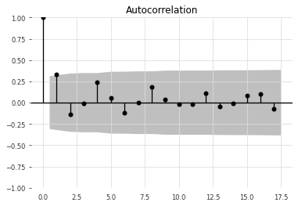
Exploratory Data Analysis
Stationary Test: p<0.05
Stationary ✅
Covid-19 Drop
No seasonality

Slide 4
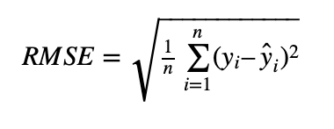


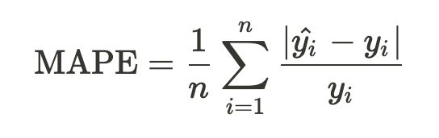

Models & Metrics
MODELS
METRICS
ARIMA:
Autogressive (p)
Integration (d)
Moving Average (q)

Slide 5

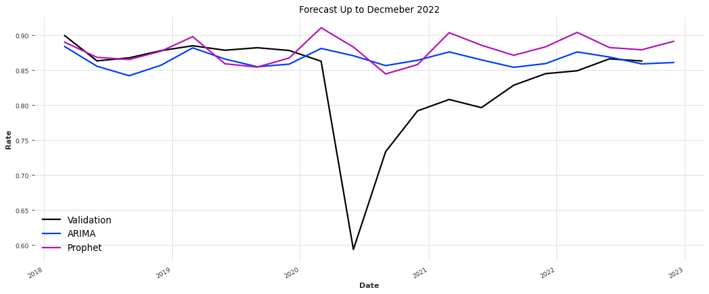

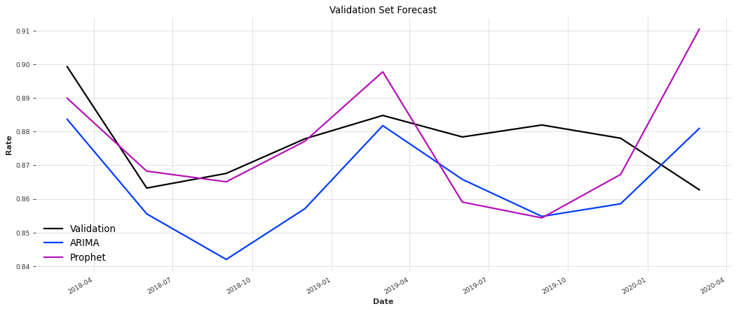
Results and Forecast

Slide 6
Conclusion and Future work
We were able to forecast the overnight bed occupancy with machine learning.
The best model, Prophet, achieved a MAPE value of 1.72885.
The model can be improved complementary sources, so that more complex models for multivariate-time series can be used.
If the reports of the daily, weekly or monthly occupancy were available, there would be more data points to train models and thus obtain better results.
With a more robust model, it could be used by other NHS-listed Hospitals to forecast their own overnight bed occupancy.
In the future, it could incorporate routines that deal with possible NaNs, Outliers, zeros and other possible distortions in the dataset.

