Slide 1
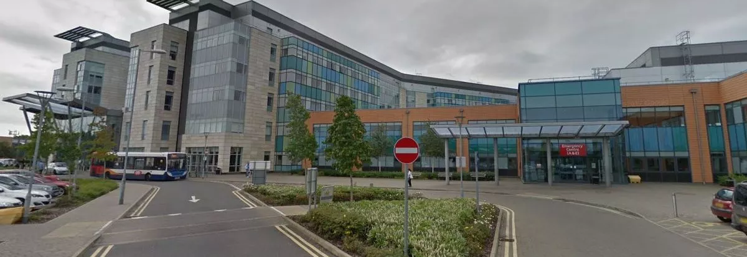
Predicting A&E Demand in Peterborough and Huntingdon to 2040
Marcos Fabietti
Data Scientist |Ph.D.
30/01/2025

Slide 2
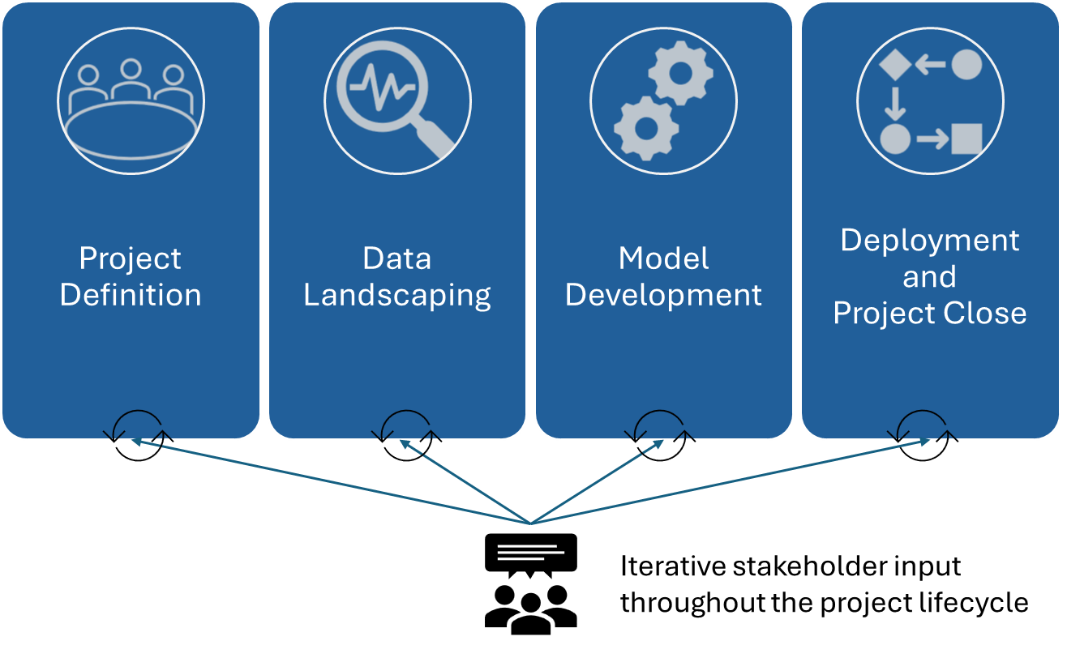
What makes a Forecasting model “successful”?
“Success”: positive impact (of the project):
“Model” can’t succeed on its own
Stakeholders don’t ask for “models”, they want actionable insights:
Enable better decision making, increase agency
Thus, my first step would be working with stakeholders to define what is the business intelligence request behind the question asked:
Planning workforce and infrastructure, understanding population growth and demographics, financial and resource allocation.
Components of a forecasting (project) success:
(AGILE)

Slide 3
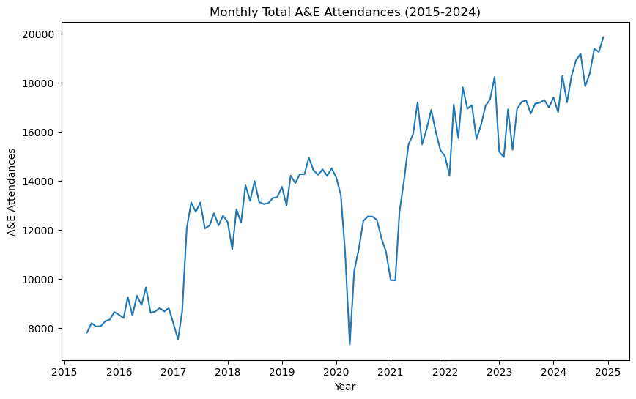
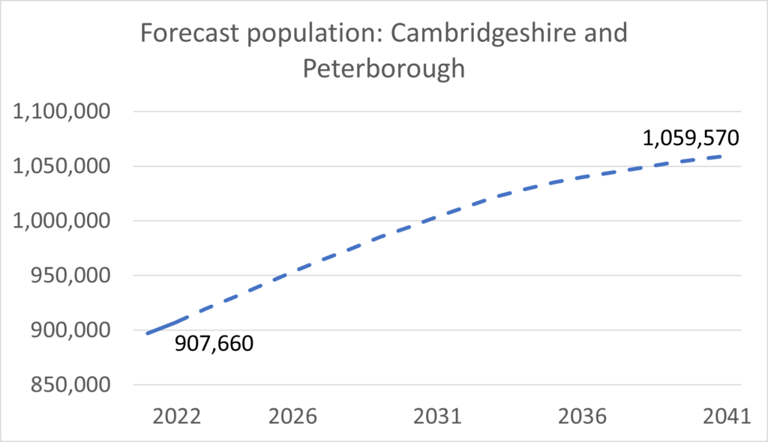
Modelling Factors
Historical Data Trends:
Analysing past patterns in A&E attendances, such as annual growth rates, seasonal fluctuations, and long-term trends. The analysed time series is the sum of: Type 1, Type 2 and Other A&E Department non-booked A&E attendances.
Covid -19:
The pandemic created an anomaly in historical data, which needs to be accounted for to avoid skewing future projections.
Population Growth:
Using Local Councils and Office for National Statistics (ONS) projections for population growth to estimate future healthcare demand. Cambridgeshire and Peterborough’s population is forecast to grow by 17% between 2022 and 2041.
Action Mitigators:
Interventions or policies designed to reduce A&E demand or manage patient flow more effectively.
Planned service changes:
Anticipated changes in healthcare delivery that may affect A&E attendances, either by increasing or reducing demand.
Uncertainty:
The further the time horizon (e.g., 2040), the greater the uncertainty due to unforeseen changes in policy, technology, or societal behaviour.
Historical A&E Total Attendances at Northwest Anglia NHS Foundation Trust, scrapped from NHS England statistical work
Extracted from Cambridgeshire County Council’s locally produced population estimates and forecasts

Slide 4
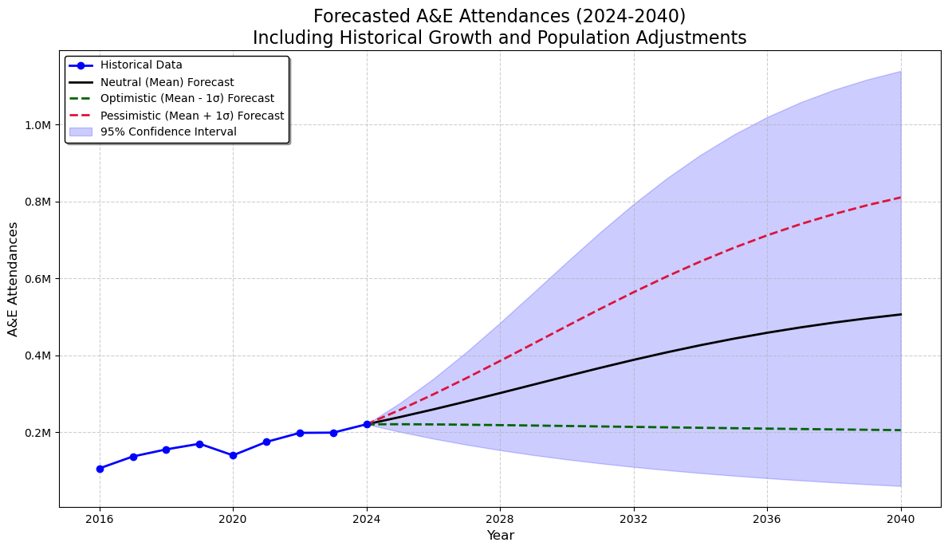
Forecasting
Monte Carlo simulation was chosen for its ability to model uncertainty by generating a range of possible outcomes, making it well-suited for long-term forecasting where variability and complex factors like population growth and demand fluctuations must be accounted for.
The model randomly samples historical growth rates, and factors in the provided population growth, to simulate 10,000 different potential future scenarios.
Given the inherent uncertainty in the model's output over a long-time horizon, we can improve stakeholder communication by translating the forecast into actionable insights through scenario modelling (e.g., optimistic, neutral, and pessimistic scenarios).
By delivering scenario-driven insights, we enable senior management to develop actionable strategies, such as:
Aligning workforce planning with anticipated demand.
Scaling capacity and infrastructure to meet projected needs.
Enhancing patient flow across services for greater efficiency.
Monte Carlo Simulation Forecast
Scenarios | 2025 | 2030 | 2035 | 2040
Optimistic (Mean - 1σ) | 0% | -2% | -4% | -7%
Neutral (Mean) | 8% | 56% | 100% | 128%
Pessimistic (Mean + 1σ) | 17% | 114% | 205% | 264%
Projected percentage increase in yearly A&E attendances from the 2024 baseline (220,000) under optimistic, neutral, and pessimistic scenarios.

Slide 5
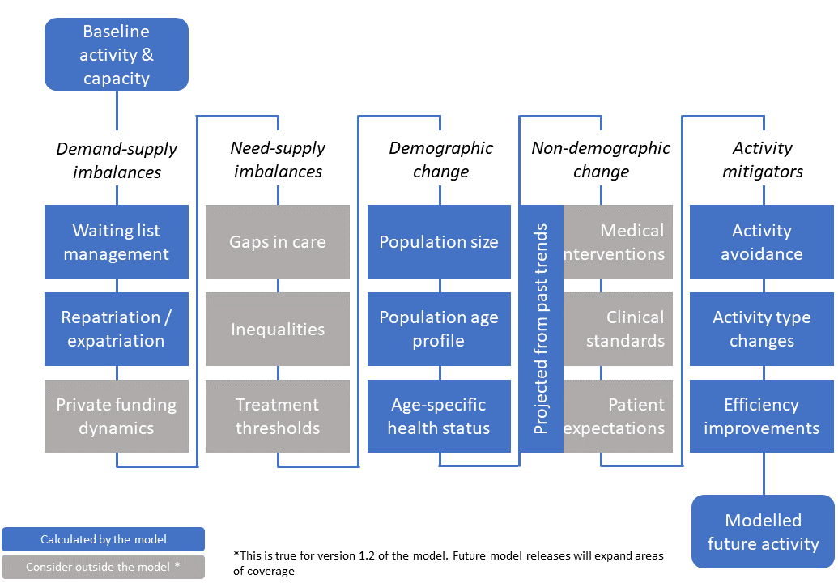
Conclusion and Future Work
Initial Monte-Carlo simulation predicts A&E demand in Peterborough and Huntingdon until 2024 factoring in historical data, population growth and Covid-19.
Validating the accuracy and reliability of predictions, and benchmarking against other methods, would build further confidence in the results would be key for its use and adoption.
Model Improvements includes implementing other modelling factors such as activity mitigators and planned service changes. Additionally, forecasting at a more granular level, for example the different types of attendances: Type 1, Type 2 and Other A&E Department.
Forecasting allows the Trusts to proactively manage rising A&E attendances. The next step would be collaborating with stakeholders to implement strategies effectively, ensuring the organisation is future-ready.
Alternatively, we can utilise the New Hospitals Programme developed by the Strategy Unit. The model uses historical activity levels for each hospitals trust’s catchment population and project this forward based on a number of key drivers and factors to produce estimates of future activity levels and capacity requirements with projections from baseline year to a user selected final year (total time horizon likely to be in the region of 10 to 30 years).
Diagram of New Hospitals Programme Model Process

Slide 6


Thank You!
The Python script is
available on my GitHub repository.
Marcos Fabietti
mifabietti@outlook.com

