Slide 1

Puerto Rico Travel Assistant
By Ignacio Cabrera Lugo

Slide 2

Introduction to the Travel Assistant
This AI-powered tool helps users plan trips by:
- Recommending locations based on preferences
- Providing weather forecasts
- Calculating travel distances
It combines retrieval and AI-based generation to create an interactive travel planner.

Slide 3
How It Works: Retrieval + Generation (RAG)
1. The system retrieves relevant locations using a search engine (FAISS).
2. It generates responses based on retrieved data using AI (GPT-4).
3. The user interacts with the chatbot to refine the itinerary.
4. The system calculates travel distances and provides weather updates.

Slide 4
Step 1: Retrieving Locations
- Uses FAISS (a fast similarity search tool) to find the best matches for user input.
- Embeds all landmarks as numerical vectors for quick retrieval.
- When a user searches for 'beaches,' FAISS finds the most relevant locations.

Slide 5
Step 2: Understanding Locations with Embeddings
- A Sentence Transformer converts location descriptions into numbers (embeddings).
- This allows the system to compare how similar two locations are.
- The assistant can then suggest places that match the user’s interest.

Slide 6
Step 3: Generating Answers with AI
- OpenAI GPT-4 is used to interpret responses and answer questions.
- It classifies user input ('yes', 'no', 'done') to guide interaction.
- It also provides descriptions of places based on retrieved data.

Slide 7
Step 4: Distance Calculation & Route Planning
- Uses the Haversine formula to compute the shortest distance between locations.
- Organizes locations in the best order to minimize travel time.
- Displays the total travel distance for better trip planning.

Slide 8
Full Process Overview
1. The user enters trip preferences (e.g., 'beaches').
2. FAISS retrieves the most relevant locations.
3. The user selects places to visit.
4. The assistant provides weather updates and distances.
5. A complete itinerary is generated.

Slide 9
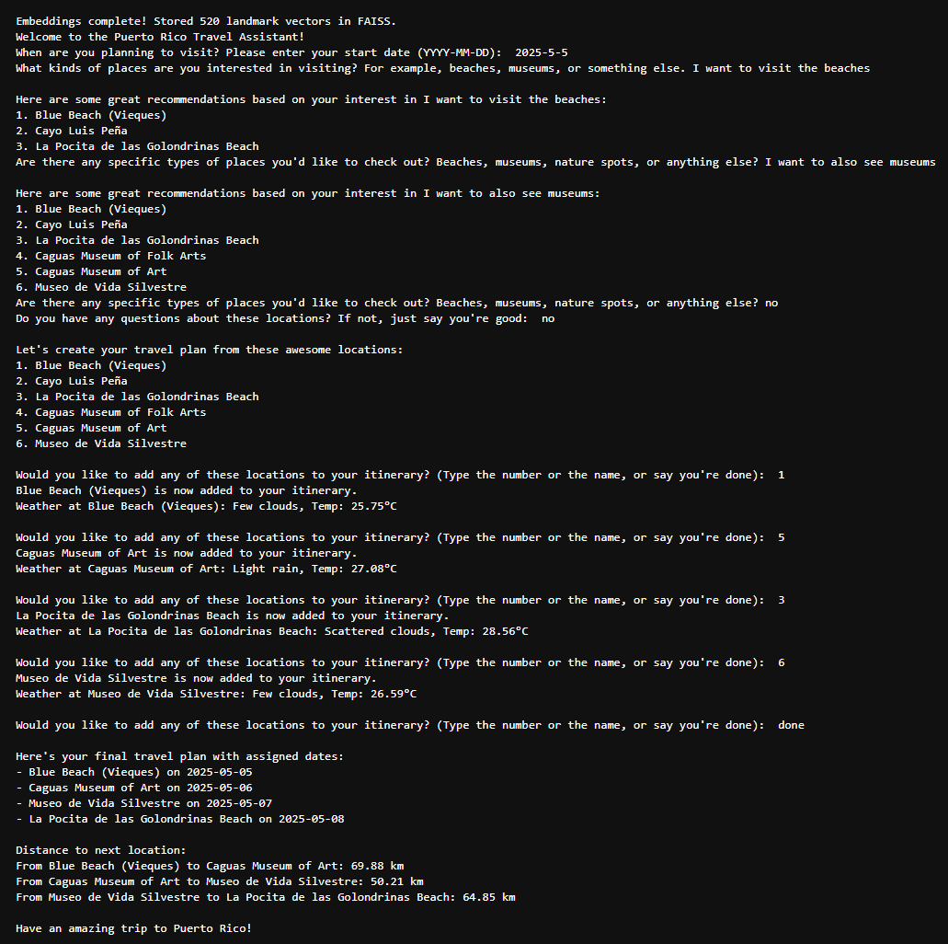

Slide 10
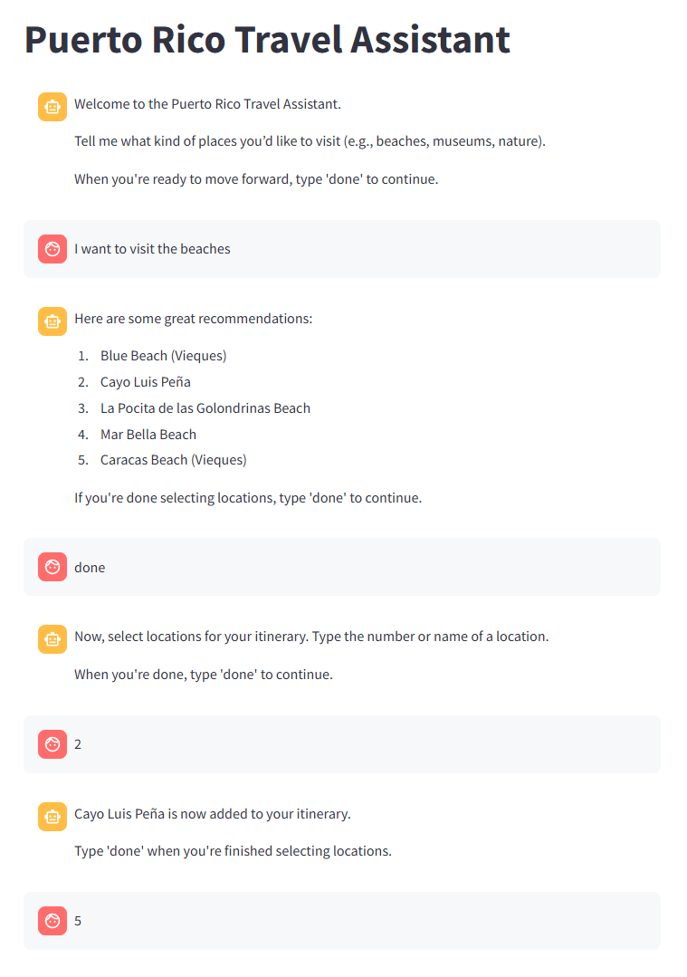

Slide 11
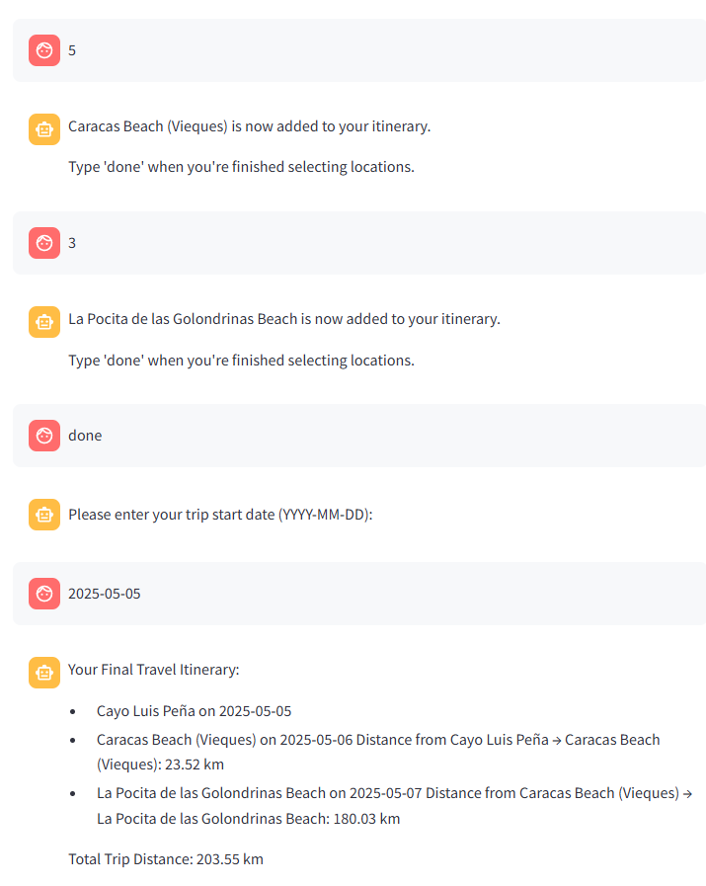

Slide 12
Future Enhancements
Optimize travel routes for shortest distance
1
Add hotel and restaurant recommendations
2
Increase the data size
3
Enable itinerary export option
4

Slide 13

Summary of the Travel Assistant
- Combines retrieval (FAISS) and AI (GPT-4) for trip planning.
- Finds relevant locations based on user interests.
- Provides weather updates and distance calculations.
- Helps travelers build an optimized itinerary quickly.

Slide 14

Thank you

