Slide 1
Time Series Forecasting

Slide 2
Antecedentes
¿Por qué no utilizar un modelo seq2seq? Ya que se trabaja tanto con LSTM parece interesante seguir con otro modelo secuencial. Particularmente, en [1], se utiliza uno con atención para que las predicciones se adecuen mejor a los picos de demanda. En [3] se muestra como se utiliza un modelo seq2seq para profundizar sobre el LSTM y en [5] se compara directamente un modelo LSTM con uno LSTM con arquitectura Seq2Seq.
En [6] se sugiere que los modelos LSTM son aptos para predicciones del día después y no tanto para predicciones de una hora después.
https://doi.org/10.1016/j.epsr.2022.108152
Zonghan Wu, Shirui Pan, Guodong Long, Jing Jiang, Xiaojun Chang, and Chengqi Zhang. 2020. Connecting the Dots: Multivariate Time Series Forecasting with Graph Neural Networks. In 26th ACM SIGKDD Conference on Knowledge Discovery and Data Mining (KDD ’20), August 23–27, 2020, Virtual Event, USA. ACM, New York, NY, USA, 11 pages. An electricity load forecasting model based on multilayer dilated LSTM network and attention mechanism,” Frontiers in Energy Researchhttps://doi.org/10.1145/XXXXXX. XXXXXX
Y. Wang, W. Jiang, C. Wang, Q. Song, T. Zhang, Q. Dong, and X. Li, “, vol. 11, p. 1116465, June 2023.
K. Liu, H. Li and S. Yang, "Short-Term Electricity Demand Forecasting for DanceSport Activities," in IEEE Access, vol. 12, pp. 99508-99516, 2024, doi: 10.1109/ACCESS.2024.3424688. keywords: {Predictive models;Load modeling;Feature extraction;Transformers;Graph neural networks;Humanities;Demand forecasting;Electricity supply industry;Short-term demand forecasting;graph neural networks;DanceSport;hybrid fusion},
D. L. Marino, K. Amarasinghe and M. Manic, "Building energy load forecasting using Deep Neural Networks," IECON 2016 - 42nd Annual Conference of the IEEE Industrial Electronics Society, Florence, Italy, 2016, pp. 7046-7051, doi: 10.1109/IECON.2016.7793413. keywords: {Load forecasting;Buildings;Computer architecture;Load modeling;Standards;Predictive models;Logic gates;Deep Learning;Deep Neural Networks;Long-Short-Term memory;LSTM;Energy;Building Energy;Energy Load forecasting},
arXiv:2501.19234
Aleksey V. Kychkin, Georgios C. Chasparis, Feature and model selection for day-ahead electricity-load forecasting in residential buildings, Energy and Buildings, Volume 249, 2021, 111200, ISSN 0378-7788, https://doi.org/10.1016/j.enbuild.2021.111200. (https://www.sciencedirect.com/science/article/pii/S0378778821004849)

Slide 3
An electricity load forecasting model based on multilayer dilated LSTM network and attention mechanism
“Generally speaking, for series with orders of magnitude less than 100, LSTM networks can perform the task of serial forecasting relatively well. Beyond this limit, the forecasting accuracy of the LSTM network will be decreasing. Secondly, in serial forecasting the input and output dimensions are often unequal, which requires the use of Seq2Seq models to map them. One of the two: in serial forecasting the input and output dimensions are often unequal, which requires the use of Seq2Seq model to map them. However, Seq2Seq has the generation of context vectors, which will lose the series information extracted by the Encoder layer to some extent, making the forecasting accuracy lower.”
Proposed Solutions:
(1) We used a multilayer extended LSTM network instead of traditional LSTM to extend the length of the historical series in load forecasting.
(2) In order to improve the accuracy of load forecasting, a new model has been established. This model uses a multilayer dilated LSTM structure as Encoder layer to extract long series information under the Seq2Seq framework, introduces attention mechanism to focus on key information, and finally LSTM are employed to decode the context vectors.
(3) Experiments have been conducted on two real load datasets in different regions, and the results show that the proposed model has a higher forecasting accuracy compared to the benchmark methods.

Slide 4
Building Energy Load Forecasting using Deep Neural Networks
“The main advantage of this architecture is that it allows inputs of arbitrary length. I.e. an arbitrary number of available load measurements of previous time steps can be used as inputs, to predict the load for an arbitrary number of future time steps.”
Problem
“For the first 60 hours, the actual load measurements on previous time steps were used as inputs to perform the prediction. Starting at hour 60, the predictions were introduced as inputs to generate a forecast for the next 60 hours. The figure shows how the model is incapable of providing accurate forecast for the last 60 hours, even with the forecast for one-time step ahead being very accurate. It can be assumed that the reasons behind this behaviour is that predicting the next step can be achieved with low error by simply bypassing the input from the current step straight to the output, this is because consequent measurements are very similar (when using one-minute resolution data). Therefore, if the network predicts that the load for the next time step is the same that the load on the current time. Thus, the neural network is learning a naïve mapping, where it generates an output equal to the input”
Proposed solution:
“Two approaches were investigated to solve the aforementioned problem. First was to introduce measurements from further in the past as inputs, for example 5 steps back, as opposed to inputting the load from the previous time step. This was done so that the input and output would different enough for the network to be able to learn a useful representation of the data. It can be seen that the architecture provides an estimation that follows the general trend of the future load. This method produced accurate results when used with hourly data, but failed to perform well with one-minute resolution data. Given that a delay of the input was not sufficient to provide a useful model for one-minute time steps, the second approach that was tested was to experiment with a S2S, LSTM-based architecture.”

Slide 5
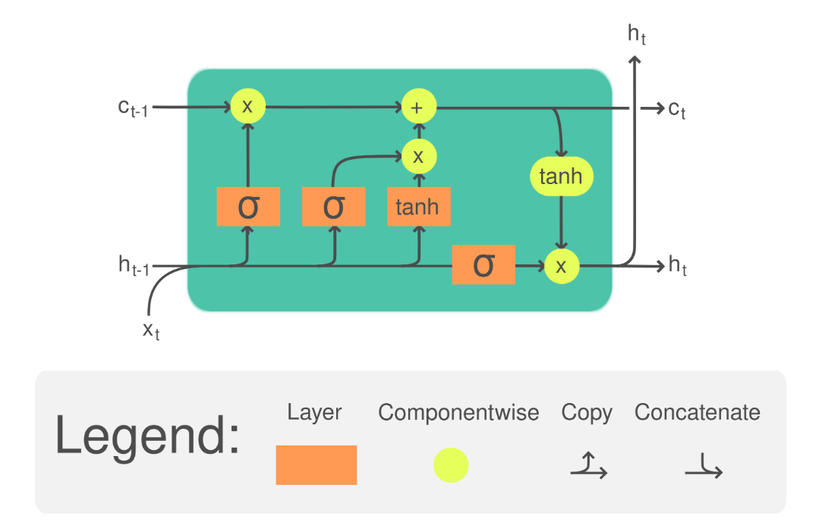
LSTM

Slide 6
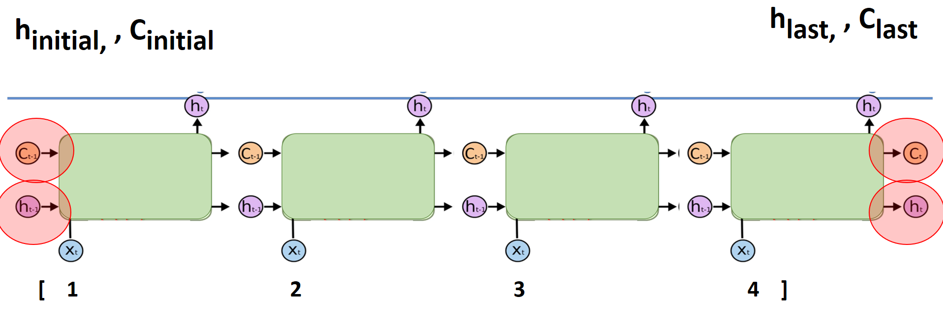
LSTM Unrolled

Slide 7
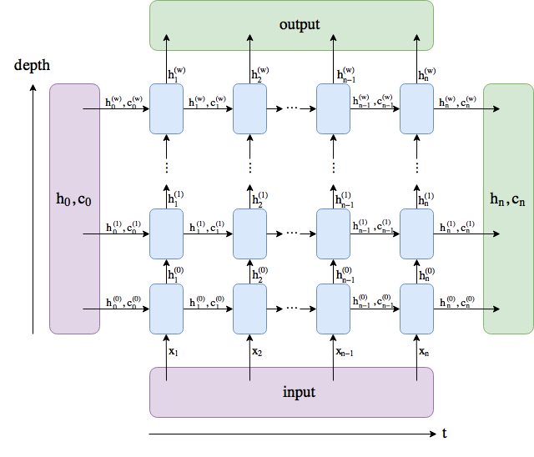
LSTM en pytorch
Parameters
input_size – the number of expected features in the input x
hidden_size – The number of features in the hidden state h
num_layers – Number of recurrent layers. E.g., setting num_layers=2 would mean stacking two LSTMs together to form a stacked LSTM, with the second LSTM taking in outputs of the first LSTM and computing the final results.
bias – If False, then the layer does not use bias weights b_ih and b_hh.
batch_first – If True, then the input and output tensors are provided as (batch, seq, feature) instead of (seq, batch, feature). Note that this does not apply to hidden or cell states.
dropout – If non-zero, introduces a Dropout layer on the outputs of each LSTM layer except the last layer, with dropout probability equal to dropout.
bidirectional – If True, becomes a bidirectional LSTM.
proj_size – If > 0, will use LSTM with projections of corresponding size.

Slide 8
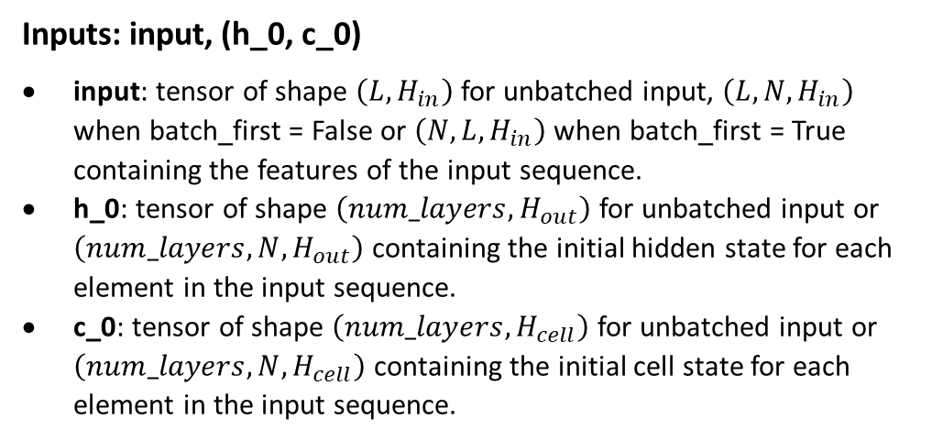
LSTM en pytorch
Inputs: input, (h_0, c_0)
input: tensor of shape $\left(L,H_{in}\right)$ for unbatched input, $\left(L,N,H_{in}\right)$ when batch_first = False or $\left(N,L,H_{in}\right)$ when batch_first = True containing the features of the input sequence.
h_0: tensor of shape $\left(num_layers,H_{out}\right)$ for unbatched input or $\left(num_layers,N,H_{out}\right)$ containing the initial hidden state for each element in the input sequence.
c_0: tensor of shape $\left(num_layers,H_{cell}\right)$ for unbatched input or $\left(num_layers,N,H_{cell}\right)$ containing the initial cell state for each element in the input sequence.

Slide 9
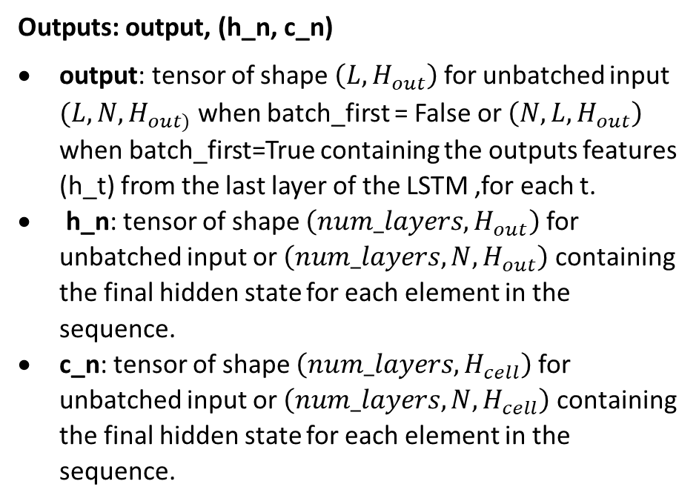
LSTM en pytorch
Outputs: output, (h_n, c_n)
output: tensor of shape $\left(L, H_{out}\right)$ for unbatched input $(L,N, H_{out)}$ when batch_first = False or $\left(N,L,H_{out}\right)$ when batch_first=True containing the outputs features (h_t) from the last layer of the LSTM ,for each t.
h_n: tensor of shape $\left(num_layers,H_{out}\right)$ for unbatched input or $\left(num_layers,N,H_{out}\right)$ containing the final hidden state for each element in the sequence.
c_n: tensor of shape $\left(num_layers,H_{cell}\right)$ for unbatched input or $\left(num_layers,N,H_{cell}\right)$ containing the final hidden state for each element in the sequence.

Slide 10
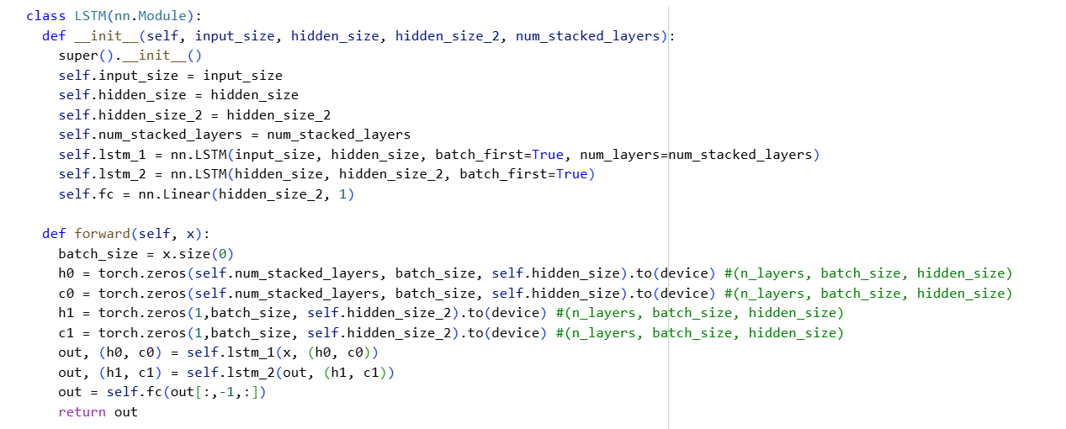
LSTM en pytorch

Slide 11
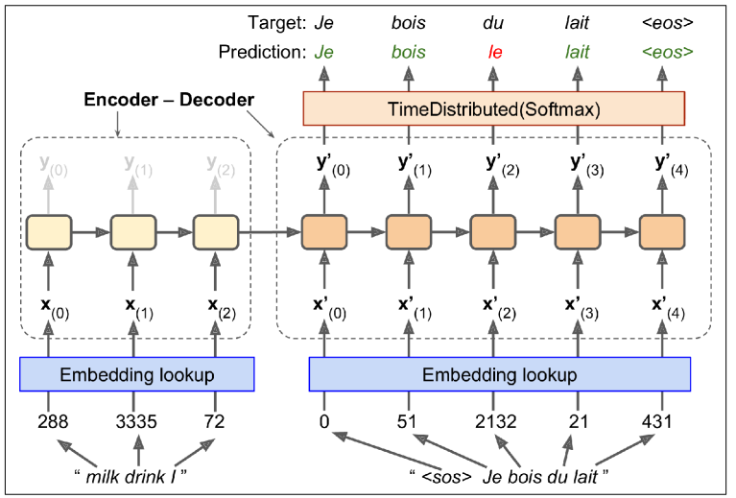
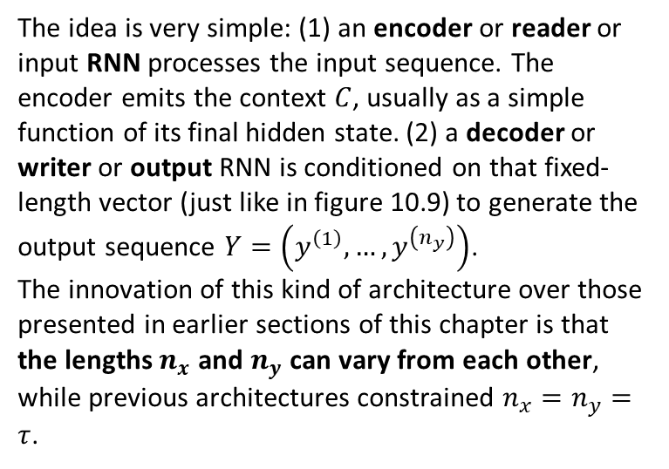
Encoder-Decoder Network
The idea is very simple: (1) an encoder or reader or input RNN processes the input sequence. The encoder emits the context $C$, usually as a simple function of its final hidden state. (2) a decoder or writer or output RNN is conditioned on that fixed-length vector (just like in figure 10.9) to generate the output sequence $Y=\left(y^{\left(1\right)},…,y^{\left(n_{y}\right)}\right)$.
The innovation of this kind of architecture over those presented in earlier sections of this chapter is that the lengths $n_{x}$ and $n_{y}$ can vary from each other, while previous architectures constrained $n_{x}=n_{y}=τ$.

Slide 12
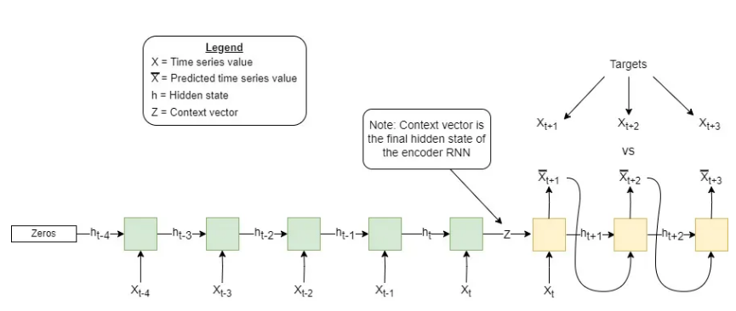
Aplicación en python

Slide 13
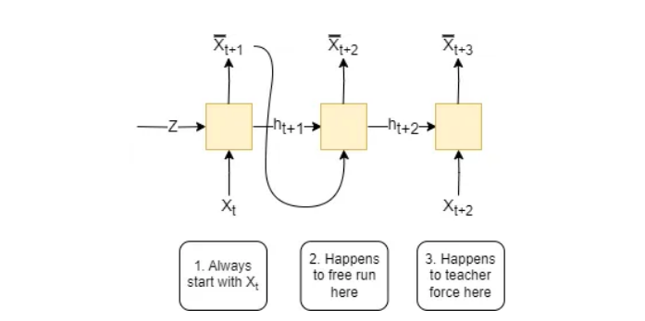
Scheduled Sampling

Slide 14
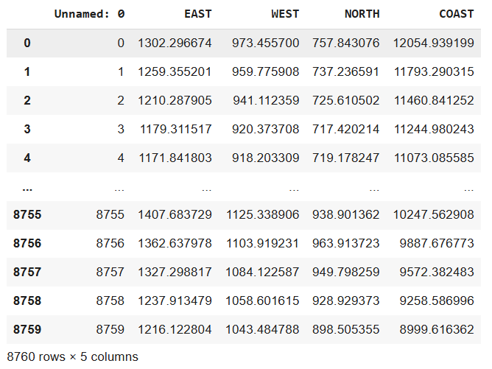
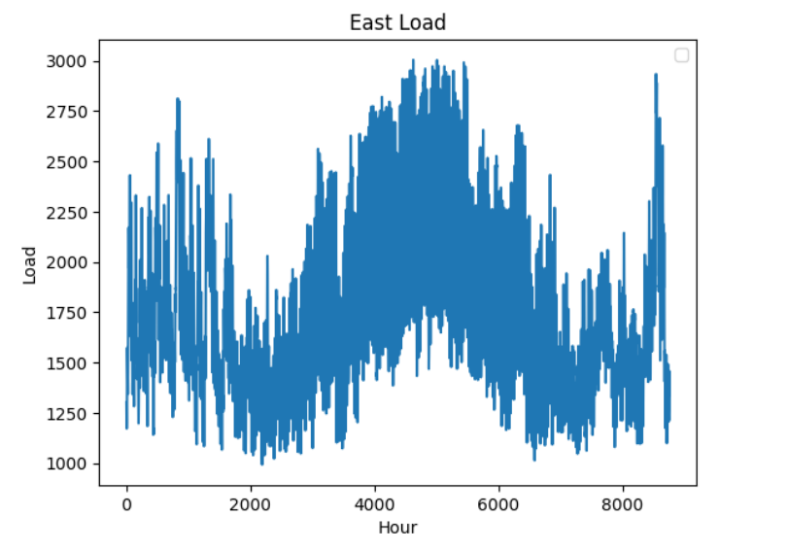
Ercot Data
Ercot is the organization that manages Texas’s power supply. Their hourly load data can be found here, dating back to 1995 and across multiple regions of Texas.
We will use the hourly 2022 data for 4 regions: East, West, North and Coast.

Slide 15
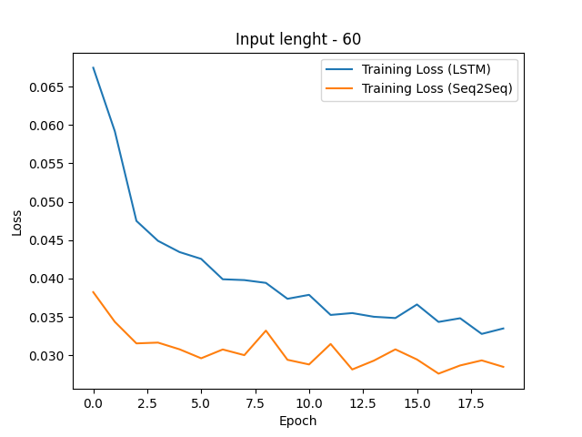
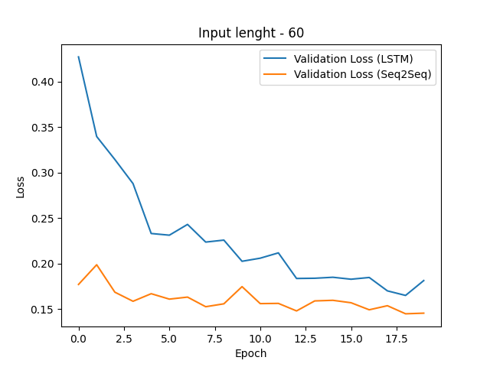
LSTM vs Seq2Seq Results

Slide 16
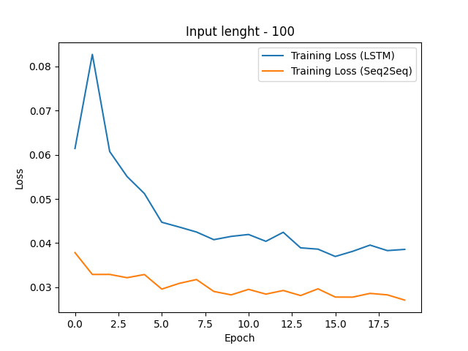
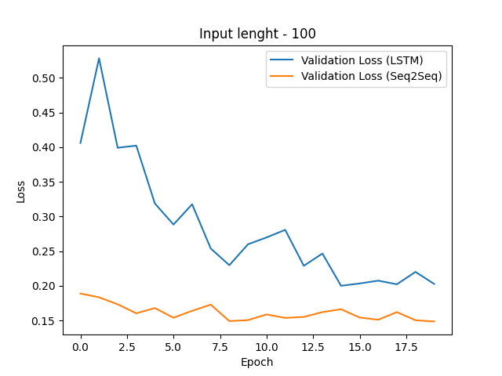
LSTM vs Seq2Seq Results

Slide 17
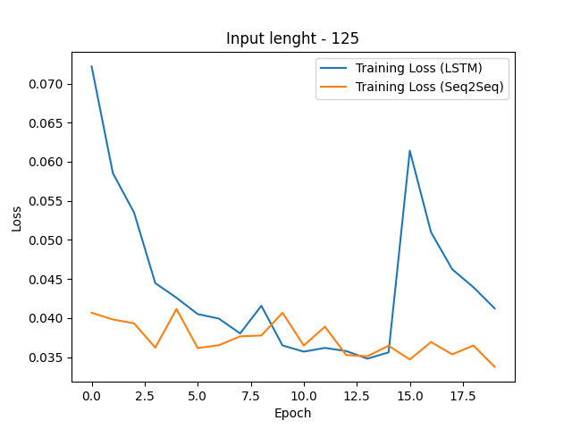
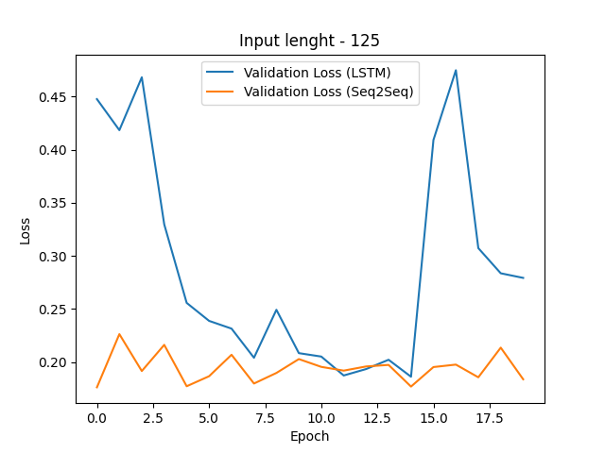
LSTM vs Seq2Seq Results

Slide 18
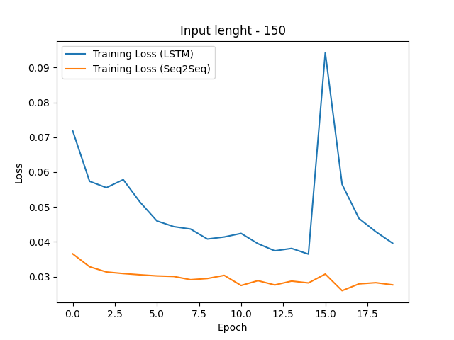
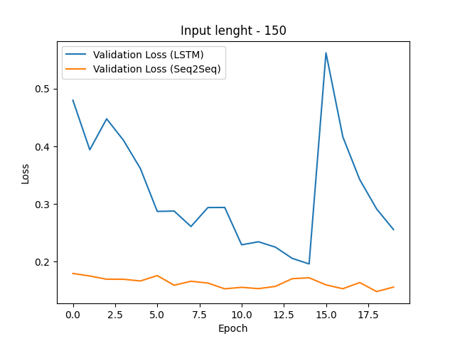
LSTM vs Seq2Seq Results

Slide 19
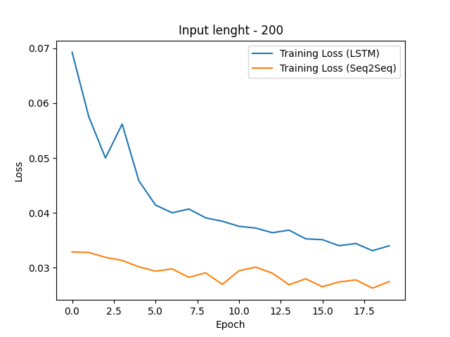
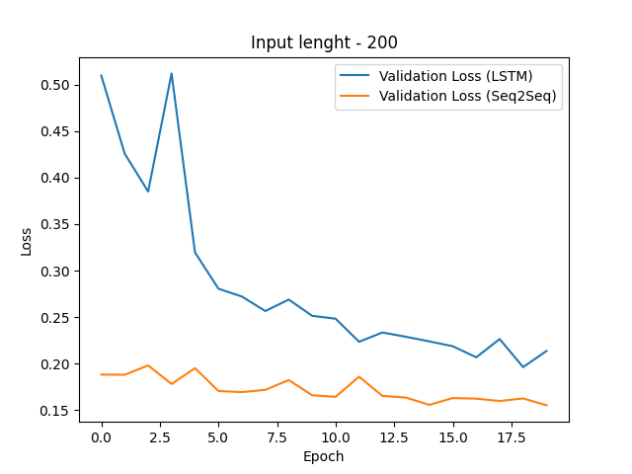
LSTM Learning Rate

Slide 20
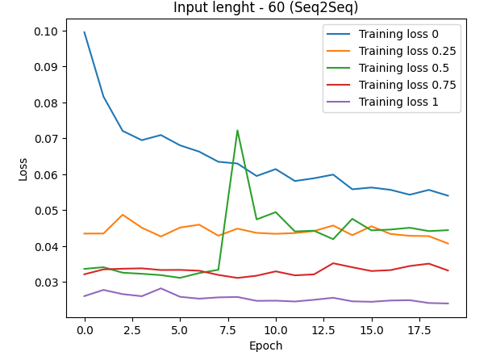
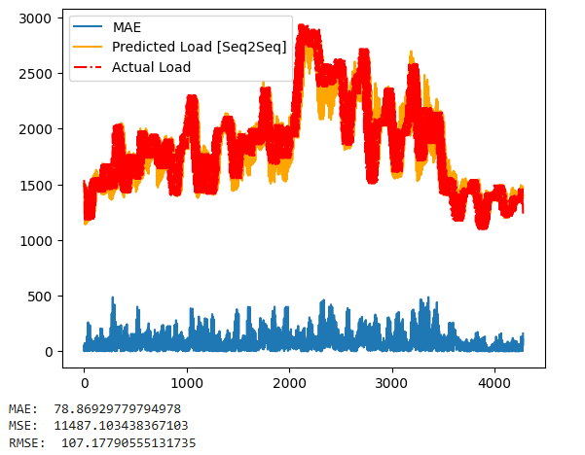
Seq2Seq

