Slide 1
Galera Cluster
MySQL Database Replication
Instructor: Hadi Alnabriss

Slide 2
Agenda
Database Replication Concepts
Asynchronous and Synchronous Replication
Row and Statement Based Replication
Certification Based Replication
Building Galera Cluster
Experiencing Node’s Failure and Adding Additional Nodes
Monitoring and Checking Cluster Status
Understanding Weighted Quorum
Load Balancing

Slide 3
Database Replication

Slide 4
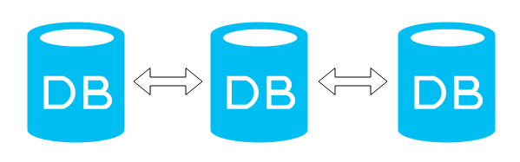
Database Replication
Database Replication refers to copying data from one node to another
This will replicate the same database to many nodes.

Slide 5
Database Replication
Can be used for load balancing.
Useful for backup and reporting.
Client

Slide 6
Database Replication
Database replication looks simple, but under the hood it is very complex.
The daunting part is to keep data among the nodes consistent.

Slide 7
ACID Model of Database
Replication Must Guarantee the ACID Model Requirements:
Atomicity: Database transactions should be atomic units of changes that can be committed upon successful completion or can be rolled back upon abortion of transaction.
Consistency: the database state should be consistent at all times, during the progression of a transaction and after commits and rollbacks.
Isolation: Transactions should be isolated from one another, so that one transaction could not interfere with the work set of another transaction and also to avoid conflicts.
Durability.

Slide 8
Master/Slave & Multi Master Replication

Slide 9
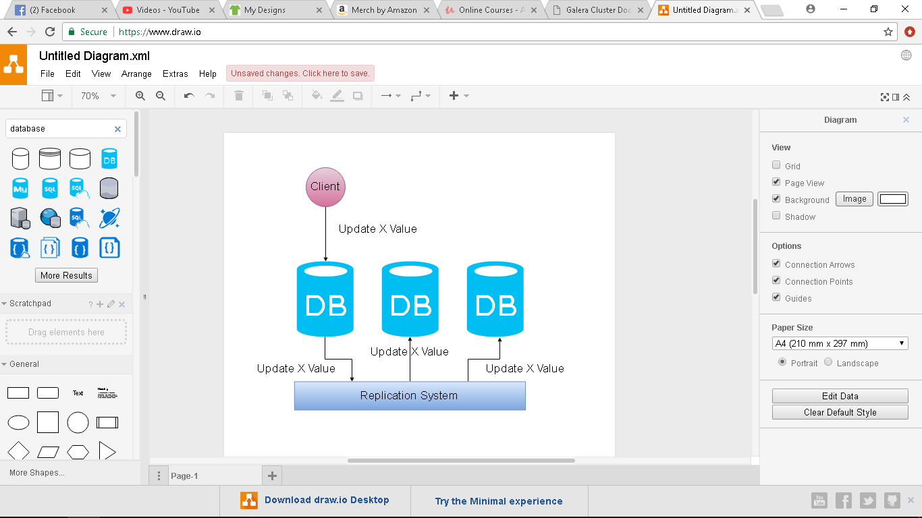
Master/Slave Replication
Master server receives the updates and propagates them to slaves.
Master copies all updates to a binary log file, then slaves copy this file and replay it locally.

Slide 10
Master/Slave Replication
Inserts, Updates and deletes queries (DML) will be forwarded to the master server.
Read queries can be scaled
Most applications are read-heavy
Web developers need to modify
their applications

Slide 11
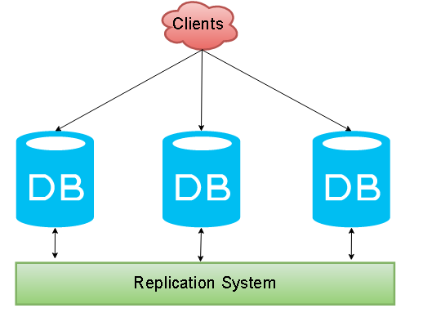
Multi Master Replication
Updates can be sent to any node, then the replication system will propagate the updates to the other DBMS (Database Management Systems) using the Replication System.

Slide 12
Replication Types

Slide 13
Asynchronous & Synchronous Replication

Slide 14
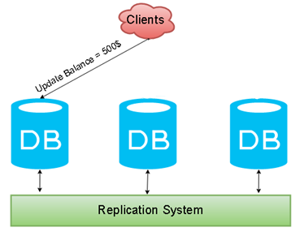
Asynchronous Replication
Writes the new update on the local DB, commit to the client, then propagate to the other nodes using binary log file.
Update the local DBMS, commit to the client, then tell the other nodes
Ok, Balance = 500

Slide 15
Asynchronous Replication
Writes the new update on the local DB, commit to the client, then propagate to the other nodes using binary log file.
Update the local DBMS, commit to the client, then tell the other nodes
I am busy now, I will do that in 3 minutes

Slide 16
Asynchronous Replication
Writes the new update on the local DB, commit to the client, then propagate to the other nodes using binary log file.
I am too busy now, I will do that in 30 minutes
Update the local DBMS, then tell the other nodes

Slide 17
Asynchronous Replication
(Cons) Data is not always consistent.
(Pros) Can work with low bandwidths and long distances.

Slide 18
Synchronous Replication
Local DB must guarantee that new data will be added to all the nodes at the same time.
Send the update to the Replication Manager
When the Acknowledgment received, all the nodes will update the record at the same time

Slide 19
Synchronous Replication
If one of the DBMS didn’t commit the modification, it will be rejected
Send the update to the Replication Manager
When the Acknowledgment received, all the nodes will update the record at the same time
After all the nodes make the modifications, commit to client

Slide 20
Synchronous Replication
(pros) No data Loss when nodes crash
(pros) Data Replicas always consistent
(cons) Any increase in the number of nodes leads to an exponential growth in the transaction response times and in the probability of conflicts and deadlock rates.

Slide 21
Semi-synchronous replication
Semi-synchronous replication guarantees that a transaction is correctly copied to at least one of the other servers.
2. Ok, I copied that
1. Copy the update to the other servers
3. Node 3, confirmed, Commit

Slide 22
Semi-synchronous replication
(Pros) Semi-sync allows for additional data integrity.
(Cons) Slower than Asynchronous

Slide 23
We need Synchronous Replication
We need Synchronous Replication because it makes data consistency, but its performance will degrade too much if you increase the number of nodes.
How to solve this problem?

Slide 24
Proposed Solutions
Proposed Solutions
Group Communication
Write Sets
Database State Machine
Transaction Reordering
Galera Cluster uses Certification-based Replication that uses these approaches.

Slide 25
Statement vs Row Based Data Replication

Slide 26
Data Replication
Statement Based Replication
SQL statements will be replicated
not safe
Row Based Replication
Actual Data Changes will be replicated
Safe
If a statement changes many rows, replication writes more data to the binary log

Slide 27
Certification-Based Replication

Slide 28
Group Communication
The Group Communication decides which node can be added to the cluster (or the group) or evicted from it.
Performs failure detection.
Orders servers’ messages.
Group Communication

Slide 29
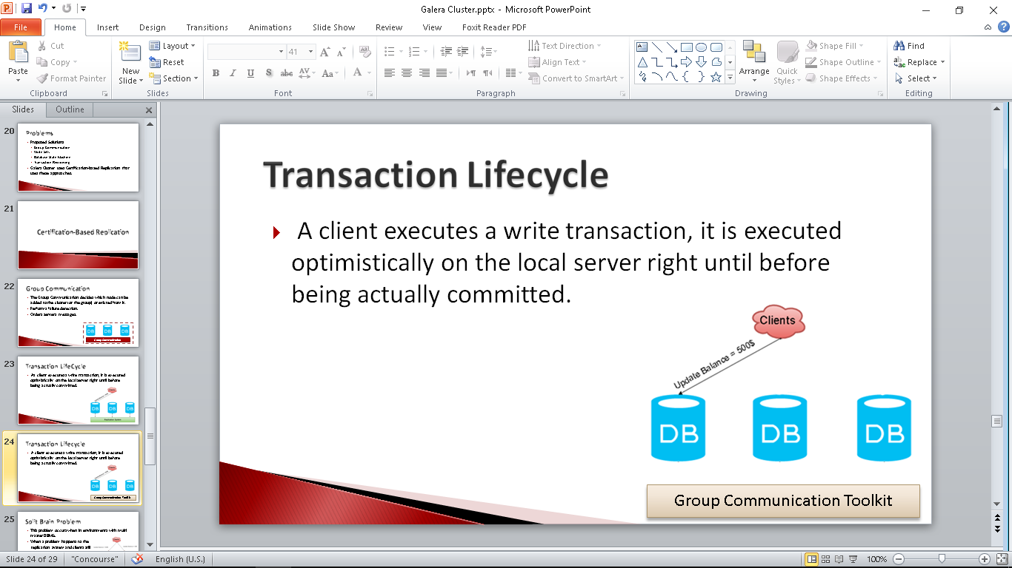
Transaction Lifecycle
A client executes a write transaction, it is executed optimistically on the local server right until before being actually committed.

Slide 30
Transaction Lifecycle
Transaction is bundled into a write-set and sent to the Group Communication toolkit

Slide 31
Transaction Lifecycle
Message is ordered by the Group Communication Toolkit, and sent to all nodes in the same order.

Slide 32
Transaction Lifecycle
Every server keeps for each row update an associated version, and each transaction has a version number to guarantee consistency.

Slide 33
Transaction Lifecycle
If the transaction has no conflicts it will be executed
Certification is used to detect conflicts between version numbers

Slide 34
Certification

Slide 35
Certification Example (1)
We have a 3 nodes database group
Each Database has a Database Version Number
Database version number is increased after any transaction is committed
DBV=1
DBV=1
DBV=1

Slide 36
Certification Example (1)
A client will execute a write transaction on DB1
DBV=1
DBV=1
DBV=1

Slide 37
Certification Example (1)
The transaction executes until the before commit stage, then it broadcasts write set and data to the group.
DBV=1
DBV=1
DBV=1

Slide 38
Certification Example (1)
The transaction write set is composed by the primary keys of each updated table row and the database version at which transaction was executed
DBV=1
DBV=1
DBV=1

Slide 39
Certification Example (1)
The database version number is compared now.
Current version equals database version, so no conflicts and transaction will be allowed to commit, and row version on certification module will be updated to 2 (cv: 2).
Transaction TX1
Current Version =1
DBV=1
DBV=1
DBV=1

Slide 40
Certification Example (1)
After updating the row version On the local server DB1 it proceeds to commit and return success to client.
On the remote servers (s2 and s3) the transaction will be queued to be applied by applier module.
Transaction TX1
Current Version =1
DBV=1
DBV=1
DBV=1

Slide 41
Certification Example (1)
If the version number in the write set less than the database version number, then rollback
i.e (CV =3, DBV=5)
Transaction TX1
Current Version =1
DBV=1
DBV=1
DBV=1

Slide 42
Certification Example(2)
In this example we have two clients updating the same record at the same time
Each server (DB1 and DB2) will complete the request until before the commit to the client.
Client 1
Client 2
Set X=500
Set X=0
DBV=1
DBV=1
DBV=1

Slide 43
Certification Example(2)
Now the write set is bundled and sent to the group communication.
From DB1:
Transaction T1
Update x=500
Current Version = 1
Client 1
Client 2
Set X=500
Set X=0
From DB2:
Transaction T2
Update x=0
Current Version = 1
DBV=1
DBV=1
DBV=1

Slide 44
Certification Example(2)
The group communication will choose the right order for the two transactions ( assume T1 will be first)
From DB1:
Transaction T1
Update x=500
Current Version = 1
Client 1
Client 2
Set X=500
Set X=0
From DB2:
Transaction T2
Update x=0
Current Version = 1
DBV=1
DBV=1
DBV=1

Slide 45
Certification Example(2)
T1 will be checked for certification.
Since the CV >= DBV , then there is no conflicts and it will be certified.
Client 1
Client 2
Set X=500
Set X=0
DBV=1
DBV=1
DBV=1

Slide 46
Certification Example(2)
The version number will be increased to 2 now, and the applier module will guarantee that this transaction will be applied on the two other servers
And commit will be sent to client.
Client 1
Client 2
Set X=500
Set X=0
DBV=2
DBV=2
DBV=2

Slide 47
Certification Example(2)
Now the Group communication will send the 2nd transaction T2.
The Current Version = 1, while the DBV = 2, certification will fail
Client 1
Client 2
Set X=500
Set X=0
From DB2:
Transaction T2
Update x=0
Current Version = 1
DBV=2
DBV=2
DBV=2

Slide 48
Certification Example(2)
Server 2 will rollback the transaction and return an error to the client.
Client 1
Client 2
Set X=500
Set X=0
DBV=2
DBV=2
DBV=2

Slide 49
Isolation Levels in Galera Cluster

Slide 50
What is Isolation?
A transactional DBMS uses the concept of isolation to isolate concurrent transactions.
Concurrent transactions isolated for:
Performance
Reliability
Consistency
The “isolation level” determines the degree of isolation needed when multiple transactions try to make changes and issue queries to the database.

Slide 51
No Isolation Example
In the following example we have two concurrent transactions, assume that T1 will be applied before T2, what is the final value of X?
Transaction 2 didn’t read the updated value of X (update by T1)
So if we don’t have isolation the final value will be X=0 (Wrong Value)
Old Data | Transaction 1 | Transaction 2
X=500 | Select X, Update X = (X + 500) | Select X, Update X = (X - 500)

Slide 52
What is Isolation?
Transactions should be isolated from one another
A transaction must not interfere with the work set of another transaction to avoid conflicts
This is achieved through table and row locking.

Slide 53
Isolation and Performance
The more restricted is the isolation level with longer locking causes delays and performance issues for the sake of transaction integrity.

Slide 54
Isolation Levels
Galera Cluster supports 4 isolation levels:
(1) READ-UNCOMMITED: In this level, transactions can see data changes made by other transactions even before they are committed.
Also known as dirty read
This level does not provide real isolation at all.
X=1000
(before committing)
Old Data | Transaction 1 | Transaction 2
X=500 | Select X, Update X = (X + 500) | Select X, Update X = (X - 500)

Slide 55
Isolation Levels
Galera cluster supports 4 isolation levels:
(2) READ-COMMITED: transactions can see committed changes made by other transactions.
SELECT queries read the committed data prior to the query.
So when a single transaction runs multiple SELECT queries, each one sees their own snapshot of committed data that are different due to the changes in data caused by other transactions.
Each select reads different data
Old Data | Transaction 1 | Transaction 2
X=500 | Select X, Update X = (X + 500) Update X = 100 | Select X, Update X = (X - 500) Select X, Update X = (X - 500)

Slide 56
Isolation Levels
Galera cluster supports 4 isolation levels:
(3) REPEATABLE–READ: The default isolation level for MySQL InnoDB.
Here snapshots of data are taken before the first SELECT query and all subsequent queries see the same snapshot
Queries will not see changes committed by other transactions making reads repeatable.
All the queries see the same value
Old Data | Transaction 1 | Transaction 2
X=500 | Select X, Update X = (X + 500) | Select X, Update X = (X - 500) Select X, Update X = (X - 500)

Slide 57
Isolation Levels
Galera cluster supports 4 isolation levels:
(4) SERIALIZABLE: In this level, all rows accessed by the transaction are locked
Since the data snapshot available to SELECT queries are the same ones, this is similar to REPEATABLE-READ but read-only.
All the queries see the same value
Old Data | Transaction 1 | Transaction 2
X=500 | Select X, Update X = (X + 500) | Select X, Update X = (X - 500) Select X, Update X = (X - 500)

Slide 58
Isolation Levels
In the master-slave mode of Galera Cluster, all four levels of isolation can be used,
In multi-master mode the REPEATABLE-READ level is only supported.

Slide 59
“lost update” problem
If we have configured MySQL with the default REPEATABLE-READ level, transactions at same nodes will be isolated at that level.
This will show the “lost update” problem

Slide 60
“lost update” problem
Here we have two concurrent Transactions on the same node , T1 and T2,
 | T1 | T2
1 | Get the same data snapshot using “select”
2 | Lock data and update | Try to update locked data
3 | Pending for commit
4 | Commit and release lock
5 |  | Update and commit
T2 missed the updates applied by T1

Slide 61
SNAPSHOT ISOLATION
With Galera Cluster’s SNAPSHOT ISOLATION, the first committer wins logic is used for ensuring data integrity
When concurrent transactions operate on separate nodes in the cluster (same database). It is implemented.

Slide 62
SNAPSHOT ISOLATION
With Galera Cluster’s SNAPSHOT ISOLATION, the first committer wins logic is used for ensuring data integrity
When T1 and T2 work on two different nodes, the lost update problem will not occur, because the second transaction will be totally rejected

Slide 63
Lost Update Problem Solution
To overcome this issue, Galera Cluster utilizes MySQL/InnoDB’s “SELECT FOR UPDATE” statement for reading for updates.
This statement locks the table from the READ operation prior to UPDATE operation itself making the table read only so that conflicting WRITEs are prevented.
In our example, when T2 tries to read the data for update, it will be rejected.

Slide 64
State Transfers

Slide 65
State Transfers
State transfer is the process of replicating data from the cluster to individual node.
Synchronizing node’s data with the cluster is called provisioning

Slide 66
Provisioning Methods
Two methods available in Galera Cluster to provision nodes:
State Snapshot Transfers (SST)
Where a snapshot of the entire node state transfers.
Incremental State Transfers (IST)
Where only the missing transactions transfer

Slide 67
State Snapshot Transfer (SST)
The cluster provisions nodes by transferring a full data copy from one node to another.
Two different approaches in Galera Cluster to transfer a state from one database to another:
Logical : This method uses mysqldump.
Physical This method copies the data files directly from server to server (i.e rsync)

Slide 68
Incremental State Transfer (IST)
The cluster provisions a node by identifying the missing transactions on the joiner and sends them only, instead of the entire state.

Slide 69
Galera Cluster Limitations

Slide 70
Galera Cluster Limitations
Currently replication works only with the InnoDB storage engine.
Any writes to tables of other types, including system (mysql.*) tables are not replicated
This limitation excludes DDL (Data Definition Language) statements such as CREATE USER, which implicitly modify the mysql.* tables
There is however experimental support for MyISAM (wsrep_replicate_myisam system variable)

Slide 71
Galera Cluster Limitations
All tables should have a primary key (multi-column primary keys are supported).
DELETE operations are unsupported on tables without a primary key.
Rows in tables without a primary key may appear in different order on different nodes.

Slide 72
Galera Cluster Limitations
Transaction size:
Galera does not explicitly limit the transaction size, a writeset is processed as a single memory-resident buffer and as a result, extremely large transactions (e.g. LOAD DATA) may adversely affect node performance.
To avoid that, the wsrep_max_ws_rows and wsrep_max_ws_size system variables limit transaction rows to 128K and the transaction size to 1Gb by default.
If necessary, users may want to increase those limits.
Future versions will add support for transaction fragmentation.

Slide 73
Building the Environment
Practical Section

Slide 74
Requirements
Three Nodes Minimum, with Hardware Specifications at least:
1 GHz single core
512 MB RAM
100 Mbps Network Connectivity (use NAT to guarantee network connectivity and Internet Access)
Note 1 : One Slow node might slow your whole cluster
Note 2 : Configure enough swap space on your system.

Slide 75
Preparing the Nodes
Install CentOS 7 (latest version) on each node
To avoid security issues disable firewalld and selinux.
Configure network connections (Internet access required)
Configure hostnames on the three nodes (gdb01, gdb02 and gdb03)
During Galera DB configurations we will use hostnames instead of IP address
Configure the hosts file on each node (IP and name for each node)
10.12.0.134 gdb01
10.12.0.135 gdb02
10.12.0.136 gdb03

Slide 76
Install MariaDB
CentOS Repositories include the old version 5.5.
We will install MariaDB version 10.1
Add the repository (Ref: https://mariadb.com/kb/en/library/yum/):
Create the file : /etc/yum.repos.d/MariaDB.repo
Install MariaDB server, client and common tools using the command:
yum install MariaDB-server MariaDB-client MariaDB-common
[mariadb]
name = MariaDB
baseurl = http://yum.mariadb.org/10.1/centos7-amd64 gpgkey=https://yum.mariadb.org/RPM-GPG-KEY-MariaDB
gpgcheck=1

Slide 77
Configure MariaDB
On The 1st node (any node), start MariaDB and run the command :
mysql_secure_installation

Slide 78
Configure Galera
Configure Galera Section in the file : /etc/my.cnf.d/server.cnf
[galera]
wsrep_on=ON
wsrep_provider=/usr/lib64/galera/libgalera_smm.so
wsrep_cluster_address="gcomm://10.12.0.134,10.12.0.135,10.12.0.136"
binlog_format=row
default_storage_engine=InnoDB
innodb_autoinc_lock_mode=2
bind-address=0.0.0.0
wsrep_cluster_name="cluster1"
wsrep_sst_method=rsync
wsrep_node_address= " 10.12.0.134"
wsrep_node_name="gdb01"

Slide 79
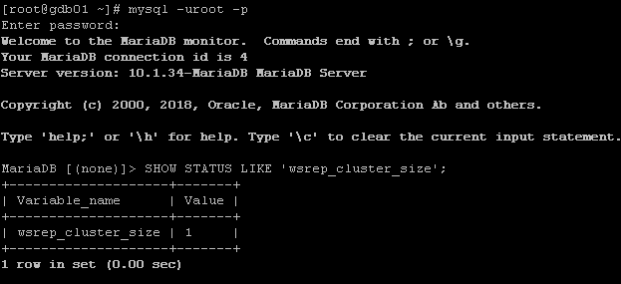
Start the Cluster
On the 1st node, run the command:
galera_new_cluster
Now the Cluster size = 1 (check that)

Slide 80
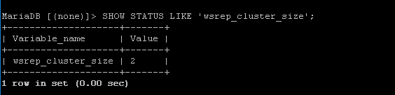
Start the Cluster
On the 2nd node run
systemctl start mariadb
Check the cluster size again

Slide 81
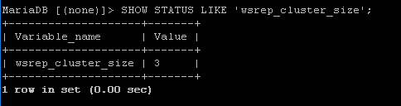
Start the Cluster
On the 3rd node run
systemctl start mariadb
Check the cluster size again

Slide 82
Check the cluster
To check the cluster, create new database and new table (InnoDB) , insert data, and check that everything is replicated to the other servers.
On the other nodes check the new data
create database test100;
use test100;
CREATE TABLE t1 (a INT) ENGINE=InnoDB;
insert into t1(a) values(50);
insert into t1(a) values(60);
insert into t1(a) values(70);

Slide 83
Practical Examples (Hands-on-lab)
Check what happens when we shutdown some of the nodes gracefully?
Check what happens when we power off some of the machines?
How to restart the cluster ( stop and start all the nodes)?

Slide 84
Join a new node to the cluster
Prepare the node as you did with the previous three nodes.
Install the required repository and packages for MariaDB.
Modify the galera section in the /ety/my.conf.d/server.conf in the three nodes.
Copy the galera section configurations from any one of the three nodes, and paste it to the new node (modify the IP and the name of the node).
Restart mariadb service on the nodes of the cluster (the 3 nodes)
Start the mariadb service on the new node.

Slide 85
Weighted Quorum

Slide 86
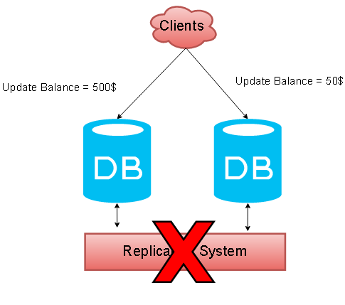
Split Brain Problem
This problem occurs in environments with multi master DBMS.
When a problem happens to the
replication system and clients still
make updates to the database.
Which Value is right?

Slide 87
Split Brain Problem
Cluster failures that result in database nodes operating autonomous of each other are called split-brain conditions.
When this occurs, data can become irreparably corrupted,
i.e when two database nodes independently update the same row on the same table.

Slide 88
Weighted Quorum
The current number of nodes in the cluster defines the current cluster size.
Every time a node joins the cluster, the total cluster size increases.
When a node leaves the cluster, gracefully, the cluster size decreases.
Cluster size determines the number of votes required to achieve quorum.

Slide 89
Weighted Quorum
Cluster needs quorum before making any decisions
What happens if we have two members?
What is the final decision? Yes or No
Yes
No
Do you accept increasing the DB size:

Slide 90
Weighted Quorum
What happens if we have three members?
What is the final decision? Yes
Yes
No
Yes
Do you accept increasing the DB Size:

Slide 91
Weighted Quorum
Galera Cluster takes a quorum vote whenever a node does not respond and is suspected of no longer being a part of the cluster.
The component that has quorum alone continues to operate as the Primary Component, while those without quorum enter the non-primary state and begin attempt to connect with the Primary Component.
Expected Votes: 3
Total votes: 1
No Quorum
Expected Votes: 3
Total votes: 2
Valid Quorum

Slide 92
Even Numbers
Clusters that have an even number of nodes risk split-brain conditions.
If you lose network connectivity between the partitions in a way that causes the number of nodes to split exactly in half, neither partition can retain quorum and both enter a non-primary state
Expected Votes: 4
Total votes: 2
No Quorum
Expected Votes: 4
Total votes: 2
No Quorum

Slide 93
5 Nodes Example
One partition will be primary component, and the second will be non-primary
Expected Votes: 5
Total votes: 3
Valid Quorum
Expected Votes: 5
Total votes: 2
No Quorum

Slide 94
Weighted Quorum
When you design your infrastructure try to avoid split brain conditions (by using multiple datacenters, switches, servers, Power sources, etc )
You can also make advanced configurations to modify the weights for member nodes

Slide 95
Galera Cluster Security

Slide 96
Used Ports
You can protect your Galera cluster using your firewall, or using iptables or firewalld in linux, but you need to keep the following ports open:
3306 For MySQL client connections and State Snapshot Transfer that use the mysqldump method.
4567 For Galera Cluster replication traffic, multicast replication uses both UDP transport and TCP on this port.
4568 For Incremental State Transfer.
4444 For all other State Snapshot Transfer.

Slide 97
SSL Connections
For securing database server and client connections, you can use the internal MySQL SSL support.
In the event that you use logical transfer methods for state snapshot transfer, such as mysqldump, this is the only step you need to take in securing your state snapshot transfers.
##### /etc/my.cnf File
# MySQL Server
[mysqld]
ssl-ca = /path/to/ca-cert.pem
ssl-key = /path/to/server-key.pem
ssl-cert = /path/to/server-cert.pem
# MySQL Client Configuration
[mysql]
ssl-ca = /path/to/ca-cert.pem
ssl-key = /path/to/client-key.pem
ssl-cert = /path/to/client-cert.pem

Slide 98
Securing Replication Traffic
In order to enable SSL on the internal node processes, you need to define the paths to the key, certificate and certificate authority files that you want the node to use in encrypting replication traffic.
## Add the following line to the my.cnf file
wsrep_provider_options="socket.ssl_key=/path/to/server-key.pem/;socket.ssl_cert=/path/to/server-cert.pem;socket.ssl_ca=/path/to/cacert.pem“
# OR use:
SET GLOBAL wsrep_provider_options="socket.ssl_key=/path/to/server-key.pem/;socket.ssl_cert=/path/to/server-cert.pem;socket.ssl_ca=/path/to/cacert.pem“

Slide 99
Load Balancing

Slide 100
Load Balancing
How to balance client requests to your cluster?
Client

Slide 101
HAProxy
Clients connect to HAProxy
HAProxy is used for load balancing
HAProxy used for fault tolerance
Client
Client
Client
HAProxy

Slide 102
Avoiding SPOF
In this Environment we still have Single Point Of Failure.
To avoid Single Point Of Failure , you need to use more than one HAProxy
Client
Client
Client
HAProxy

Slide 103
Avoiding SPOF
To which IP clients will connect?
Client
Client
Client
HAProxy
HAProxy

Slide 104
Pacemaker
Pacemaker creates cluster for HAProxy nodes
It monitors the nodes using heartbeat
It can be used to create Virtual IP
Virtual IP will run on one HAProxy
If the HAProxy with VIP fails, the
VIP will be migrated to the second
HAProxy
Like Active/Passive solution
Client
Client
Client
VIP
HAProxy
HAProxy

Slide 105

Congratulations
Congratulations for completing this course
Please Rate How Much This Course Was Helpful For You
I Will be glad to share my knowledge with you, and to hear from you about your experience and advices regarding Galera Cluster and MySQL High Availability.
I will consider adding any additional topics that you think it’s important for this course.

Slide 106
References
http://galeracluster.com/documentation-webpages/
https://mysqlhighavailability.com
https://clusterengine.me

