Slide 1
Why do female flies live longer than male flies?
J. Ignacio Lucas Lledó

Slide 2
Outline
Introduction
The Unguarded X hypothesis
Testing sexually antagonistic pleiotropy
Computer simulations
Work in progress
Acknowledgements

Slide 3
Introduction

Slide 4
Introduction
Repeatability
  same authors, same methods.
Reproducibility
  other authors, same methods.
Replicability
  other authors, other methods.
Reliability

Slide 5

Introduction
https://github.com/IgnasiLucas

Slide 6
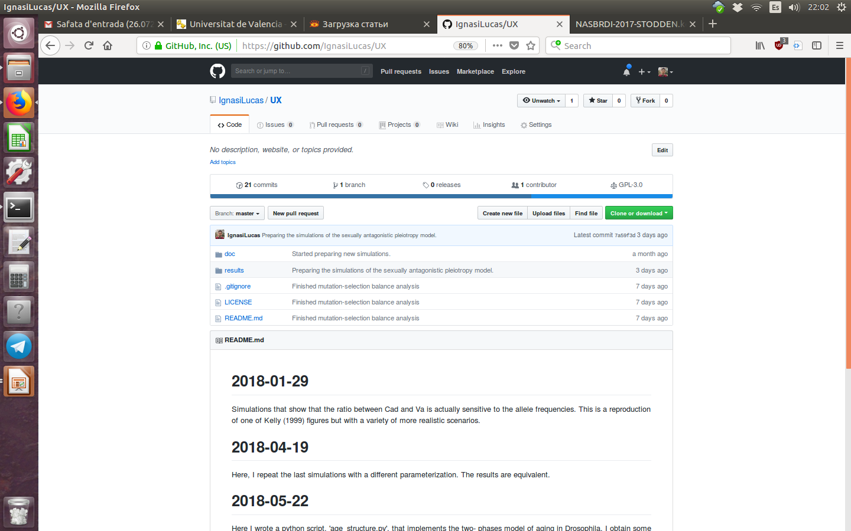
Introduction

Slide 7

Introduction

Slide 8
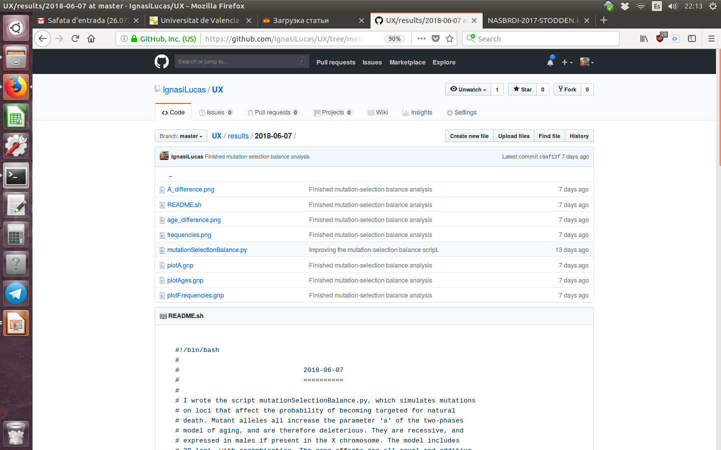
Introduction

Slide 9
How I became interested in the topic

Slide 10


Motivation
Dr. Pau Carazo
Zahida Sultanova (PhD candidate)

Slide 11
The Unguarded X hypothesis

Slide 12
The Unguarded X hypothesis
Why do sexes age differently?
  Adaptive processes:
    Different optimum lifespans.
    E.g., sexually antagonistic pleiotropy.
  Maladaptive processes:
    Mother’s curse hypothesis.
    Unguarded X hypothesis.

Slide 13
The Unguarded X hypothesis
males
females
X Y
X X
Expressed mutation
Unexpressed mutation
«sex-specific ageing can be caused by the increased expression of deleterious recessive mutations in the heterogametic sex» (Sultanova et al. 2018, Evolution, 72:540-552).

Slide 14
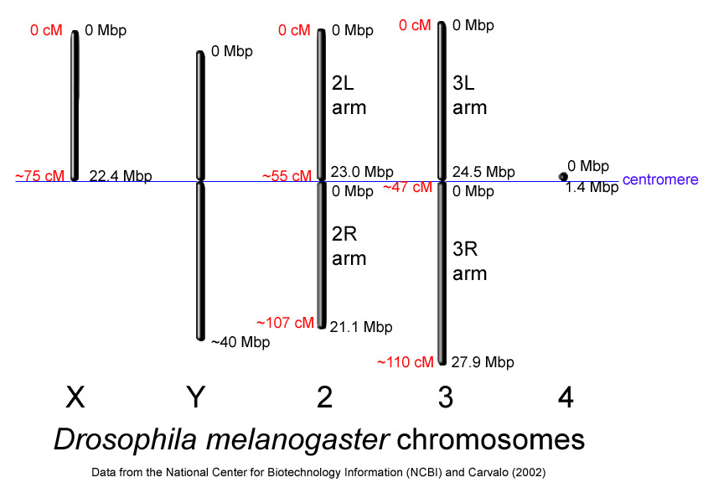
The Unguarded X hypothesis
In D. melanogaster, the X chromosome contains about 20% of the total number of genes.
The dosage compensation system doubles the expression of X-linked genes in males.

Slide 15
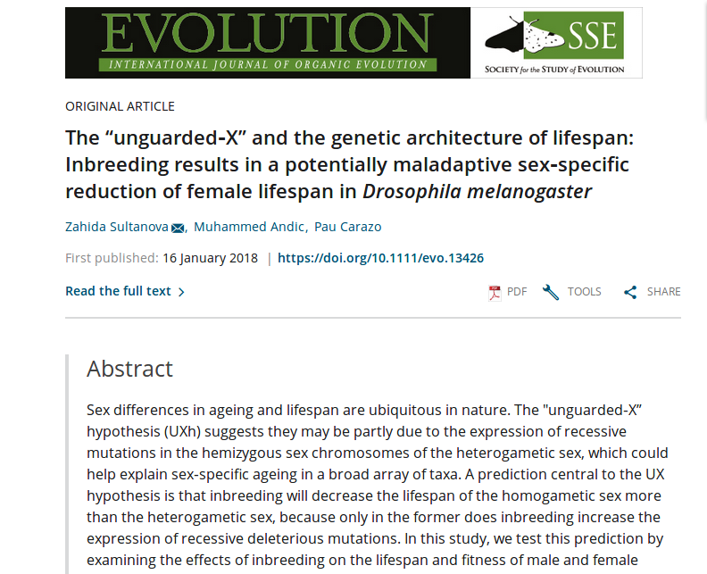
The Unguarded X hypothesis

Slide 16
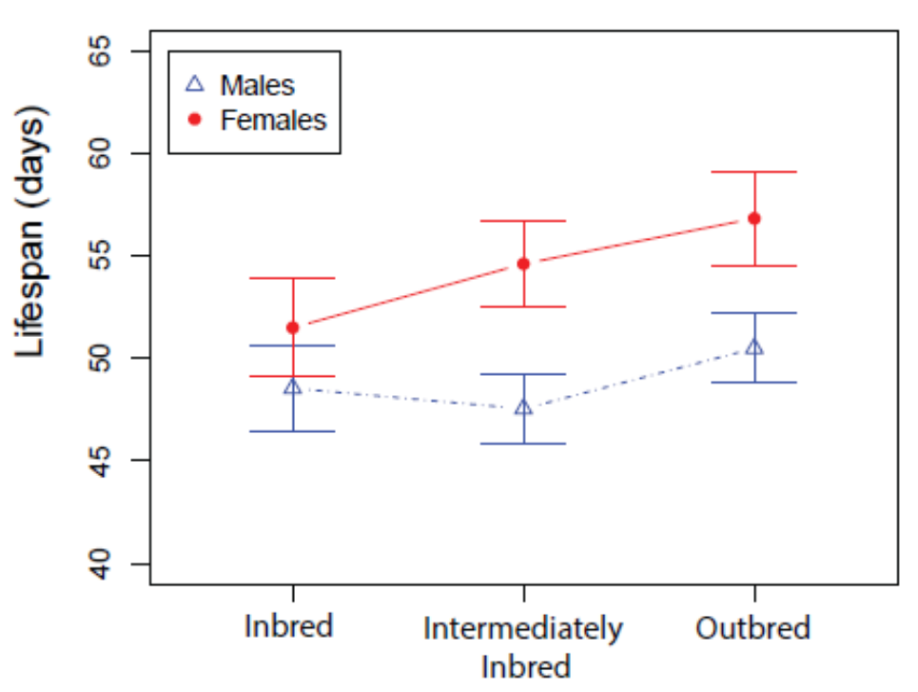
The Unguarded X hypothesis
Female-specific reduction of lifespan with inbreeding supports the unguarded X hypothesis.
However, sexually antagonistic pleiotropy would produce the same result.
Sultanova, Z., Andiç, M. & Carazo, P. 2018. Evolution 72:540-552.

Slide 17
Sexually antagonistic pleiotropy
In an X-linked locus, recessive allele A1 reduces female lifespan (and therefore, fitness), but increases male fitness.
When rare, it will be exposed to selection mostly in males (hemizygous), and its frequency will increase.
If abundant, the negative effects on homozygous females could overcome the benefits to males and drive a decrease of frequency.
Under these conditions, an equilibrium frequency can exist.

Slide 18
Sexually antagonistic pleiotropy
 | Unguarded X | Sexually antagonistic pleiotropy
Female-specific effect of inbreeding on lifespan? | Yes | Yes
Sustained genetic variation? | Yes | Yes
Type of equilibrium | Mutation-selection balance | Selection balance
Expected frequencies of alleles affecting lifespan | Low | Intermediate

Slide 19
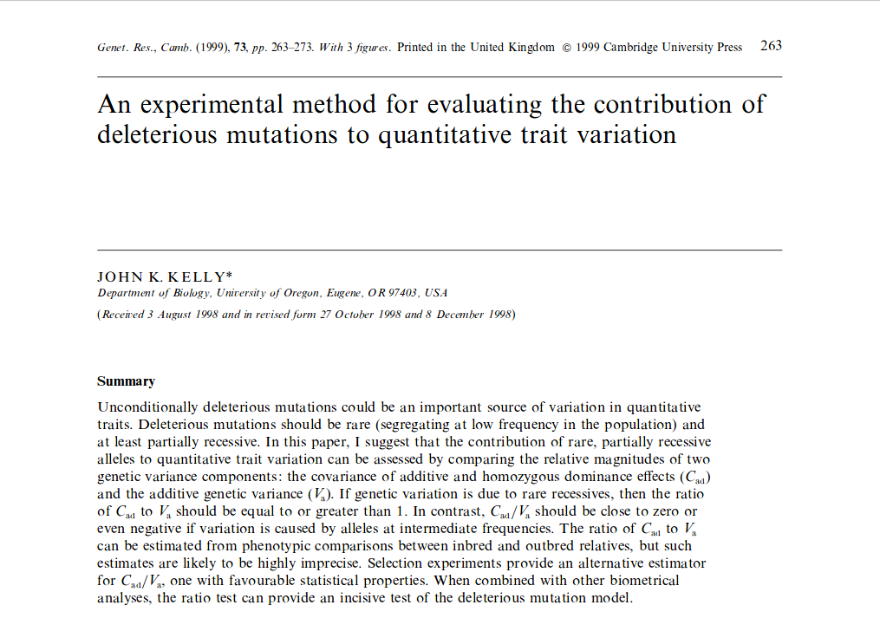
John K. Kelly’s method

Slide 20
John K. Kelly’s method
Phenotype (lifespan) measurements may be re-scaled for convenience.
Genotypic values (black dots) are represented as an additive component (empty circles) and a dominance deviation.
The linear regression depends on genotype frequencies.
a
d
0
Average lifespan
A₂A₂ A₁A₂ A₁A₁

Slide 21
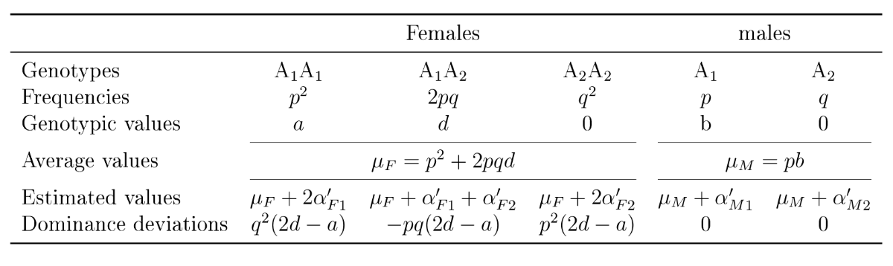
John K. Kelly’s method
= ‘average’, ‘additive’ or ‘genic’ effect of allele A₁ on females.
Additive effect of an allele is the average deviation from the population’s mean caused by that allele.
homozygous dominance effects = difference between genotypic and breeding (expected) values of homozygous genotypes, due to dominance.
C_{ad} = covariance between average effects and homozygous dominance effects.

