Slide 1
Sympatric speciation or secondary contact of Baltic ciscoes?
J. Ignacio Lucas Lledó
Michael T. Monaghan
Thomas Mehner

Slide 2
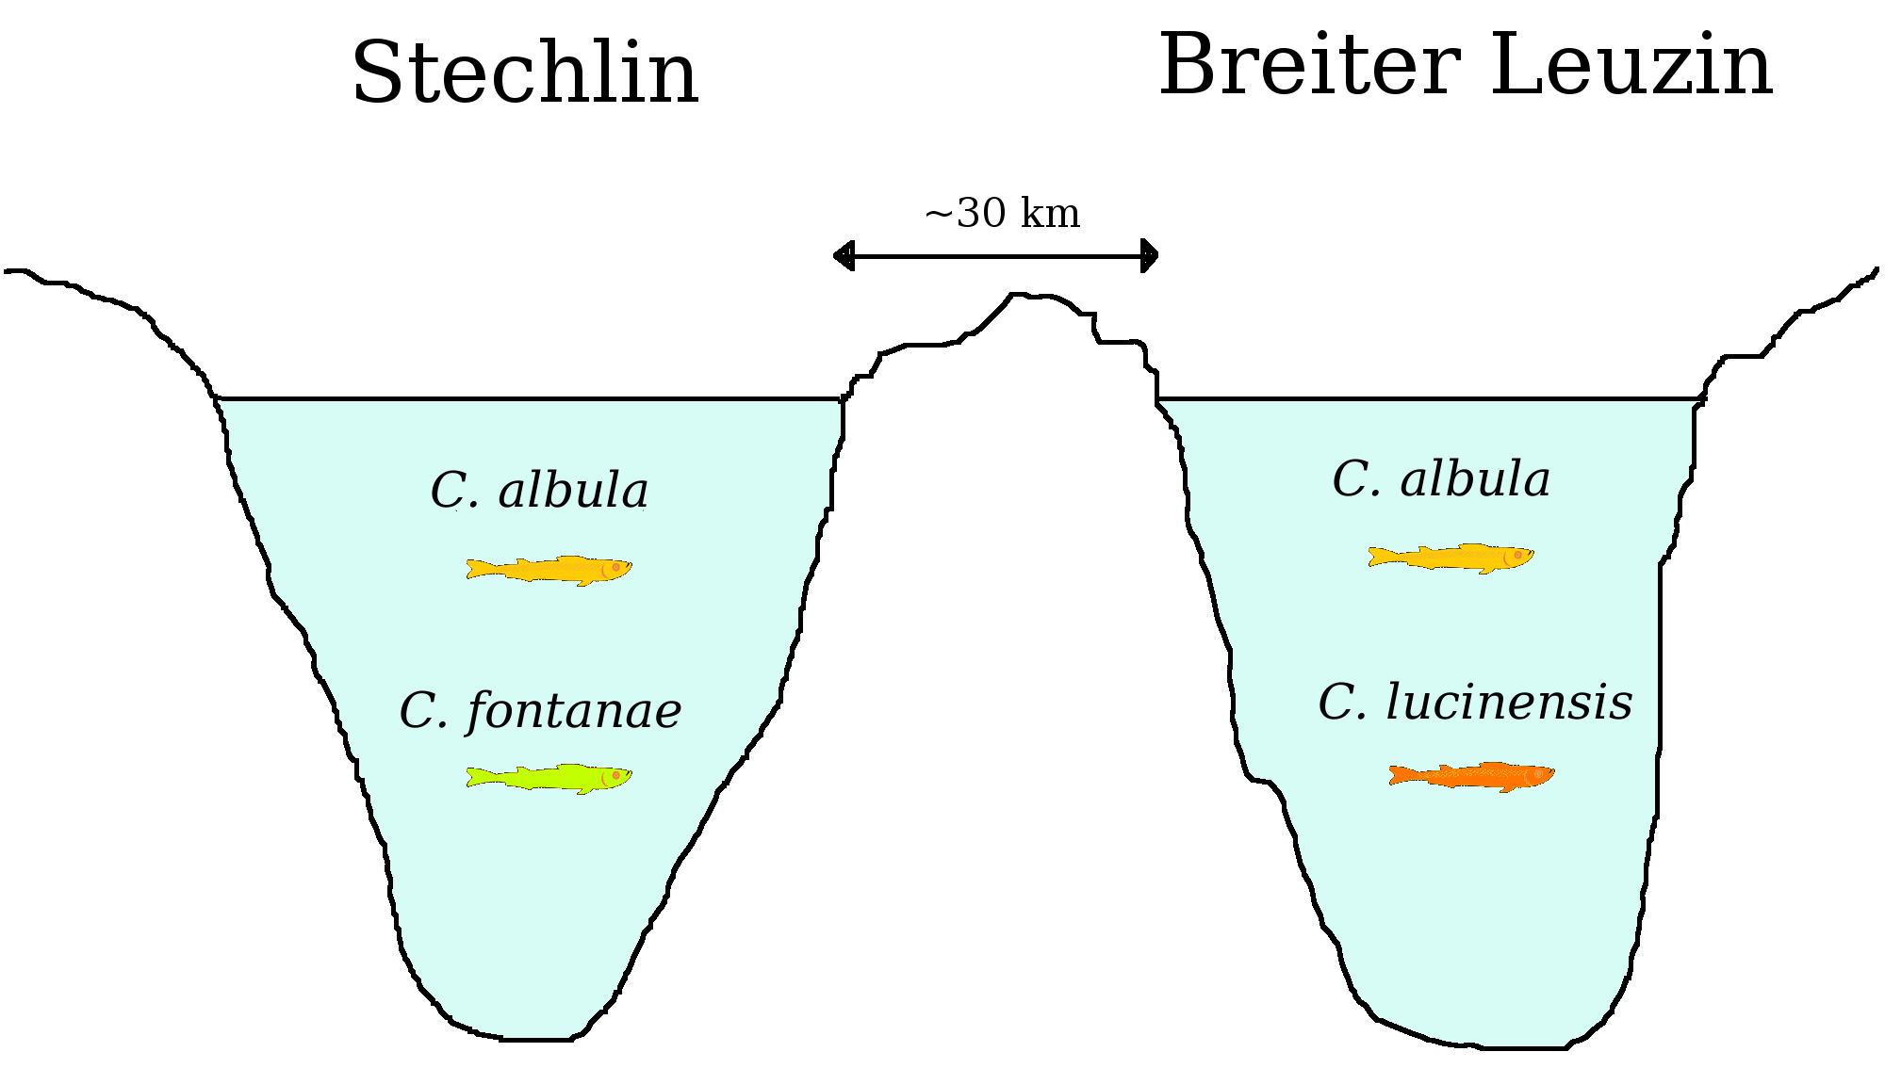
Coregonus albula complex (Salmonidae)
Autumn spawner
Spring spawner
Autumn spawner
Spring spawner

Slide 3



Parallel speciation or secondary contact?
C. albula
C. albula
Breiter Leuzin
C. lucinensis
C. albula
C. fontanae
C. lucinensis
C. fontanae
C. albula
Stechlin Breiter Leuzin
Stechlin

Slide 4
Microsatellite data
Parallel speciation
6 markers.
>30 fish/population.
Greater differentiation between allopatric taxa.
C. albula
C. albula
C. fontanae
C. lucinensis
Stechlin Breiter Leuzin
Schulz, M. et al. 2006. Journal of Fish Biology 68 (Suppl. A): 119-135

Slide 5
mtDNA data
Secondary contact
12 variable sites in ND-3 region.
12 haplotypes.
~20 fish/population.
Greater differentiation between sympatric taxa.
Breiter Leuzin
C. lucinensis
C. albula
C. fontanae
C. albula
Schulz, M. et al. 2006. Journal of Fish Biology 68 (Suppl. A): 119-135
Stechlin

Slide 6
AFLP data
Secondary contact
>1200 loci.
>20 fish/population.
Greater differentiation between sympatric taxa.
Breiter Leuzin
C. lucinensis
C. albula
C. fontanae
C. albula
Mehner, T. et al. 2010. BMC Evolutionary Biology 10(85):1-14.
Stechlin

Slide 7
ddRAD-seq data
Most studies:
  SNPs.
  100 bp reads.
  Illumina HiSeq.
  >20 ind./population.
  FST, Structure...
This study:
  Haplotypes.
  2*300 bp reads.
  Illumina MiSeq.
  6 ind./population.
  Coalescence.

Slide 8
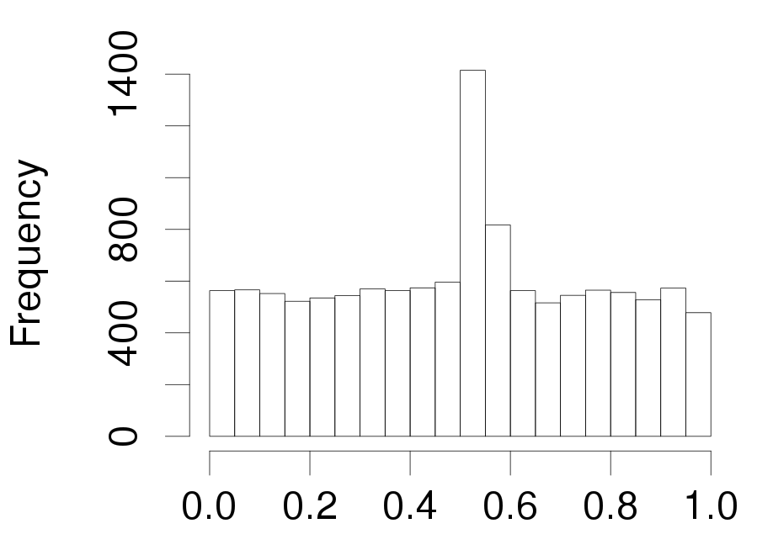
ddRAD-seq data
Read 1
Read 2
Distribution of variable sites along assembled reads (500-588 bp). The excess of variable sites in the middle must be due to sequencing errors. Those sites are removed from the analysis.
Relative position

Slide 9
“Multispecies” coalescence

Slide 10
“Multispecies” coalescence
*BEAST.
106 genes with 2 or 3 informative sites.
jModelTest to determine best gene-specific molecular model.
200,000,000 generations.

Slide 11
Results
Parallel speciation
Overall prob.: 0.912
Secondary contact
Unexpected topology
StCa StCf BlCl BlCa
Probability: 0.884
StCf BlCl StCa BlCa
Probability: 0.058
StCa BlCl StCf BlCa
Probability: 0.030
StCa: Lake Stechlin, Coregonus albula (autumn spawner).
StCf: Lake Stechlin, Coregonus fontanae (spring spawner).
BlCa: Lake Breiter Leuzin, C. albula (autumn spawner).
BlCl: Lake Breiter Leuzin, C. lucinensis (spring spawner).
StCa StCf BlCl BlCa
Probability: 0.022
StCa StCf BlCa BlCl
Probability: 0.006

Slide 12
Results
Parallel speciation Secondary contact
0.912 0.058
C. albula
C. albula
Breiter Leuzin
C. lucinensis
C. albula
C. fontanae
C. lucinensis
C. fontanae
C. albula
Stechlin Breiter Leuzin
Stechlin

Slide 13
Next steps
Include more genes.
Fit a model with migration.
Revise the MCMC (priors, convergence...).
Explain incongruence among data types.
https://github.com/IgnasiLucas

Slide 14



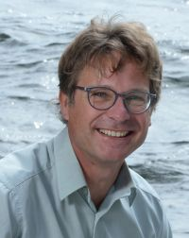

Acknowledgements
Michael T. Monaghan (IGB, Berlin)
Thomas Mehner (IGB, Berlin)

