Slide 1
Secondary contact of hedgehogs in central Europe
Kristýna Eliášová, J. Ignacio Lucas Lledó*, Pavel Hulva, Barbora Černá Bolfíková
* e3 (Population genomics)

Slide 2
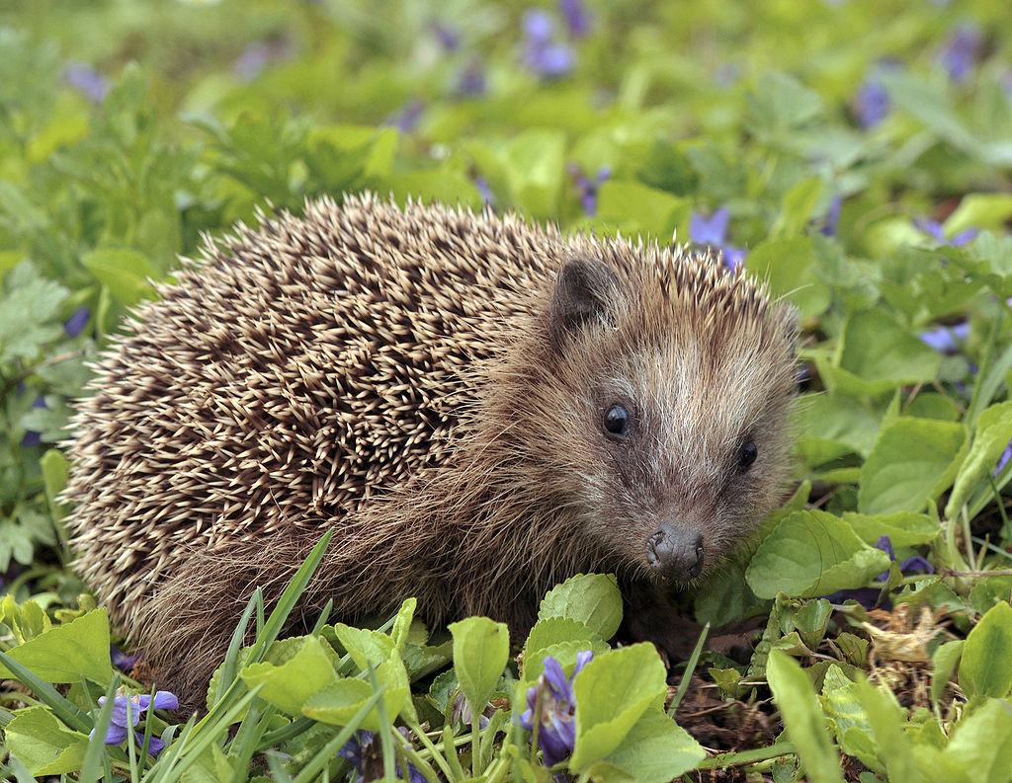
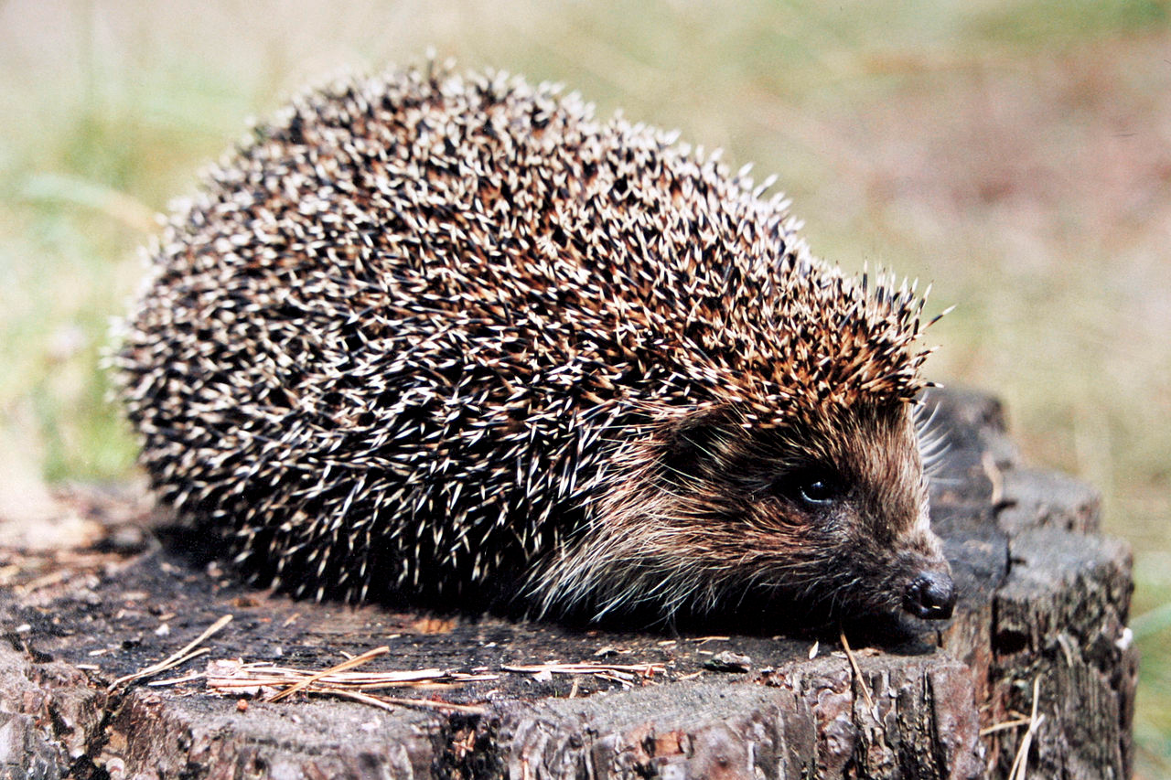
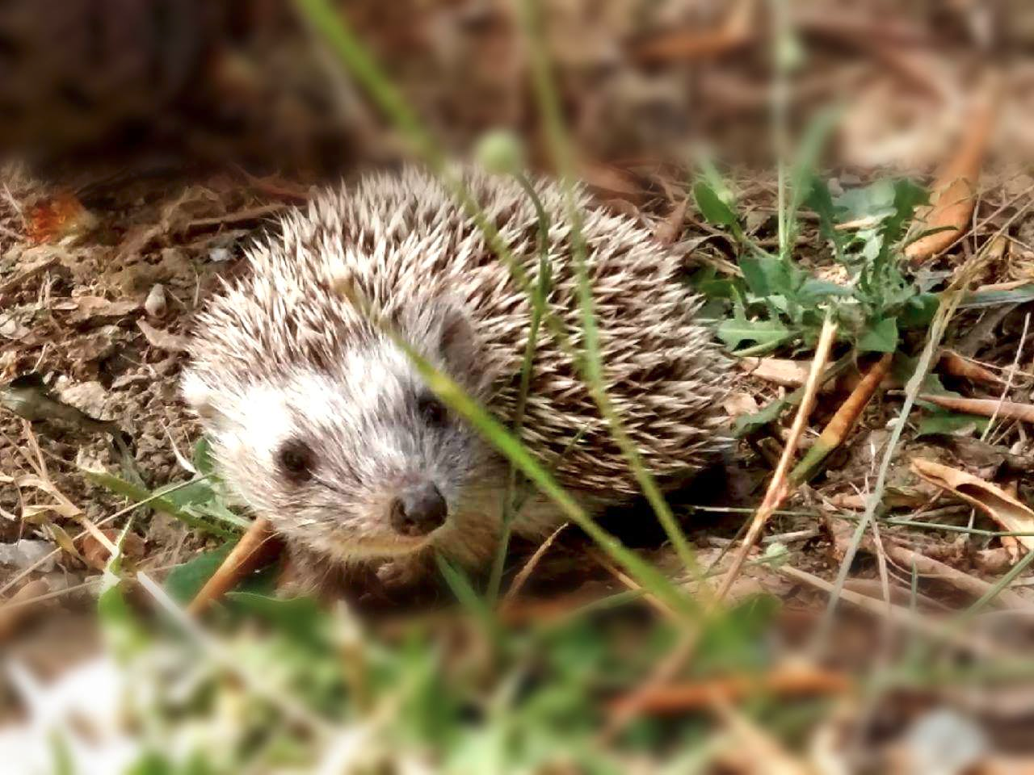
5.8 Ma.
3.0 Ma.
Erinaceus europaeus
European hedgehog
Erinaceus roumanicus
Northern white-breasted hedgehog
Erinaceus concolor
Southern white-breasted hedgehog

Slide 3
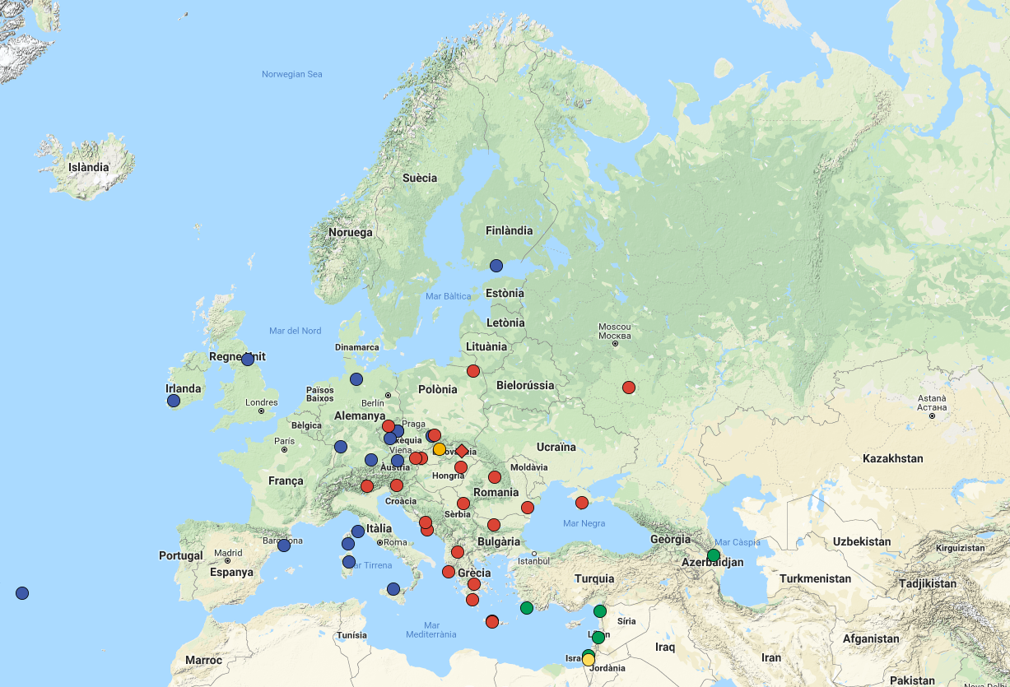
E. europaeus
E. roumanicus
hybrid
E.concolor
Hemiechinus

Slide 4
Goals
Check classic model of post-glacial colonization.
Quantify hybridization.
Does natural selection determine the fate of introgressed variation?

Slide 5
Methods
Restriction-Associated DNA (RAD) sequencing
  ~100,000 SNPs in 16 eur., 25 rou., 5 con., 1 Hem.
Model-based ancestry estimation (Admixture).
Geographically informed ancestry estimation (TESS3).
Inference of local blocks of admixture (LAMP).
Test of historical introgression (ABBA/BABA test).

Slide 6
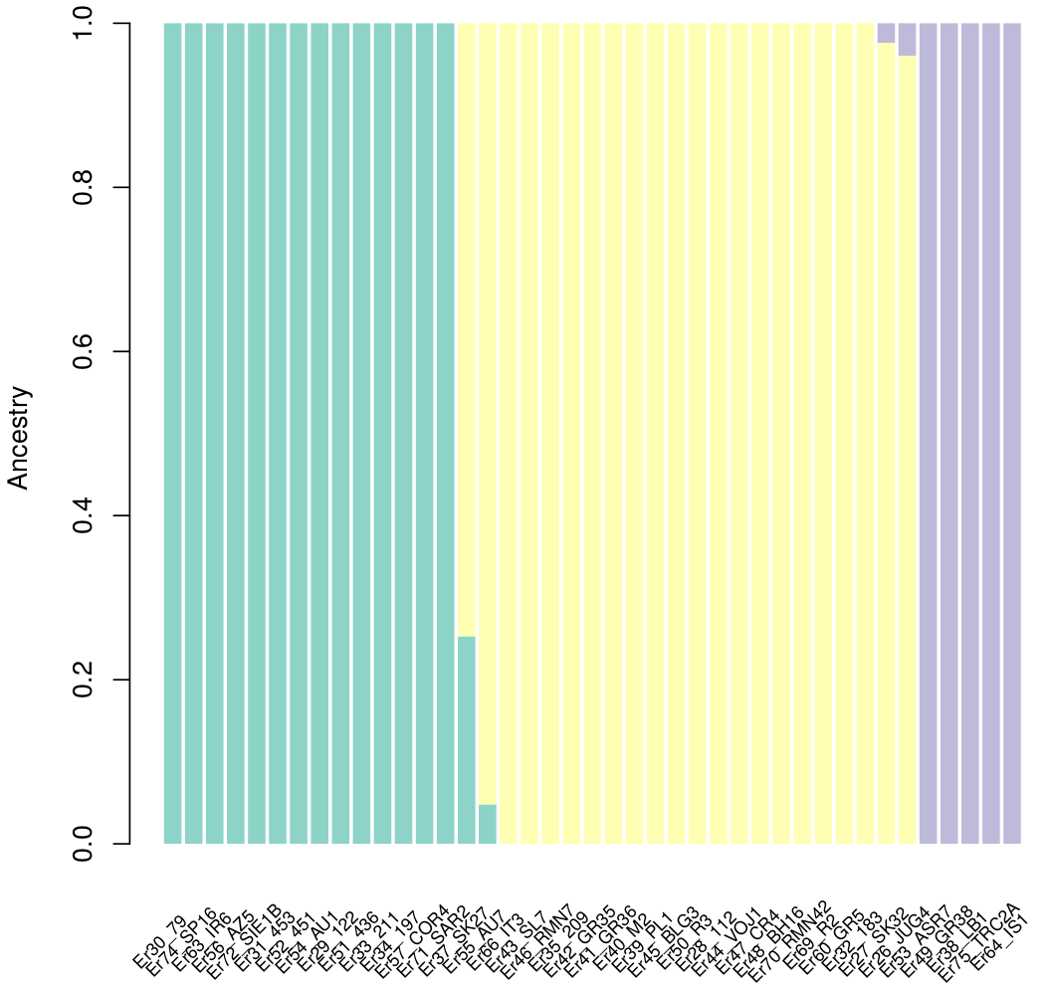
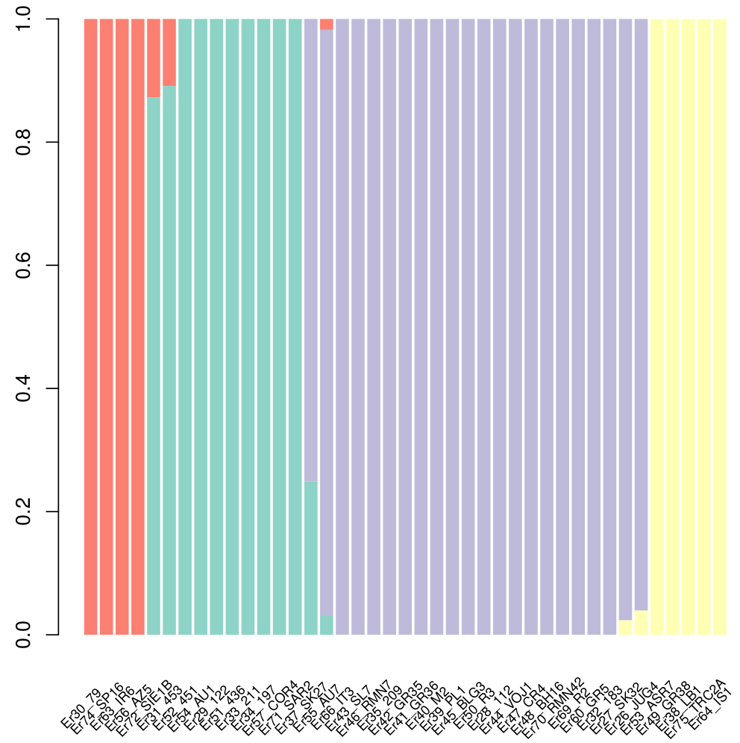
Results. Admixture.
K=3
K=4
europaeus
western eastern roumanicus concolor
europaeus roumanicus concolor

Slide 7
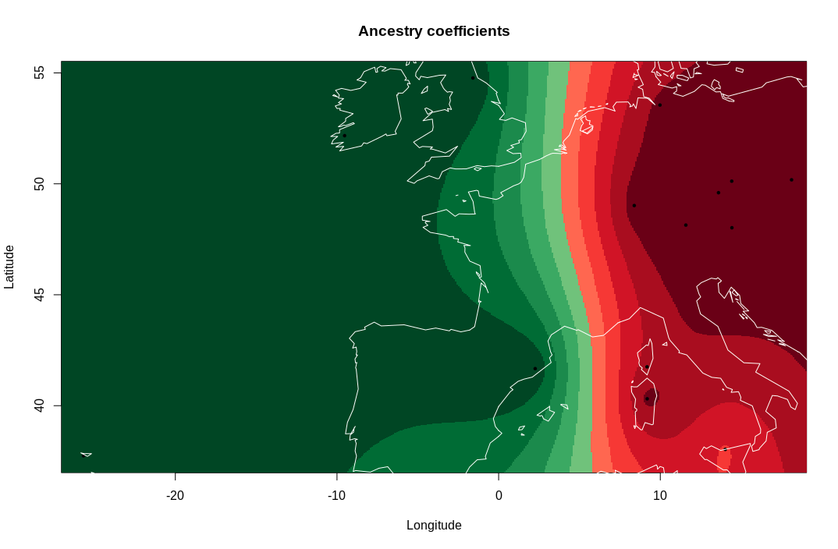
Results. TESS3. E. europaeus, K=2.

Slide 8
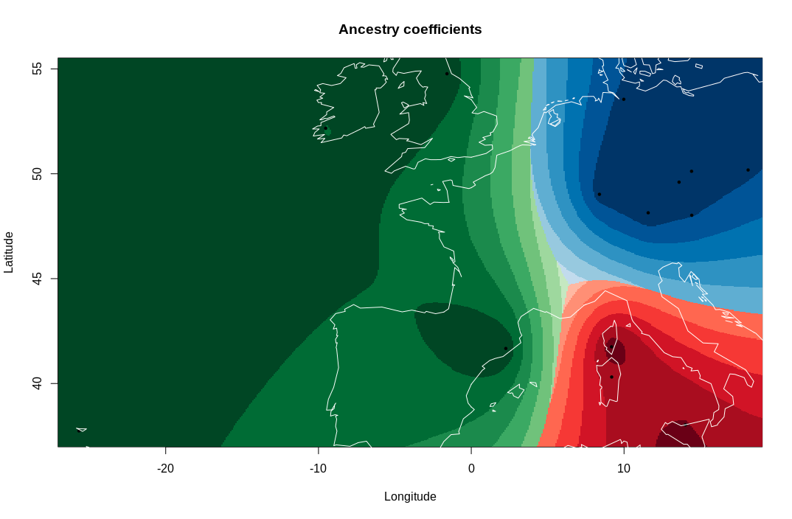
Results. TESS3. E. europaeus, K=3.

Slide 9
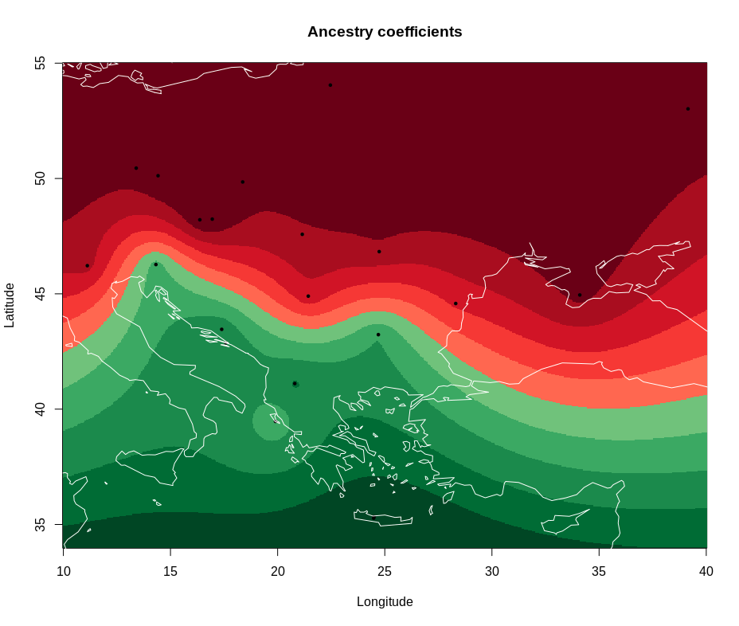
Results. TESS3. E. roumanicus, K=2.

Slide 10
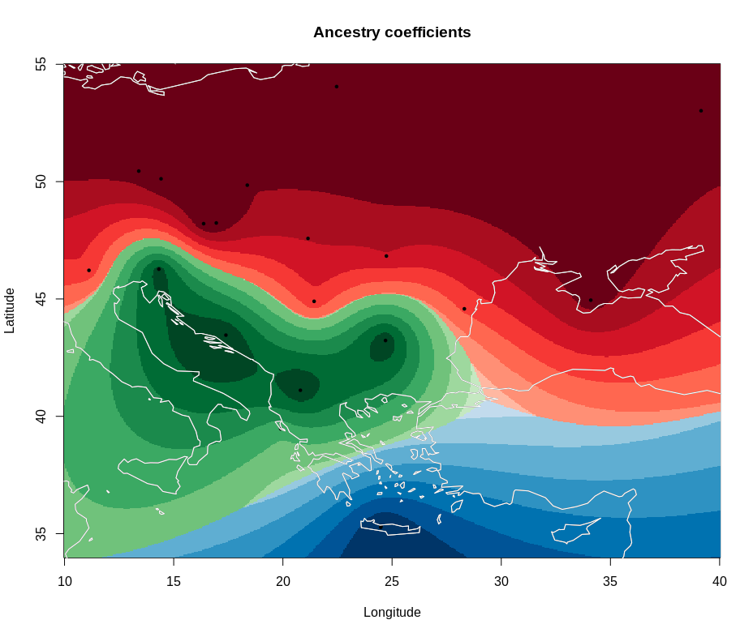
Results. TESS3. E. roumanicus, K=3.

Slide 11
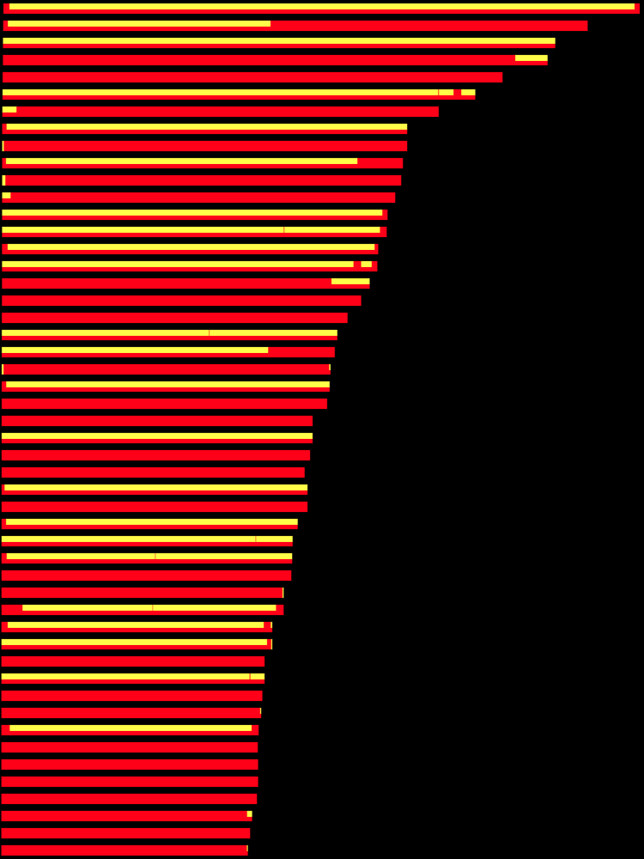
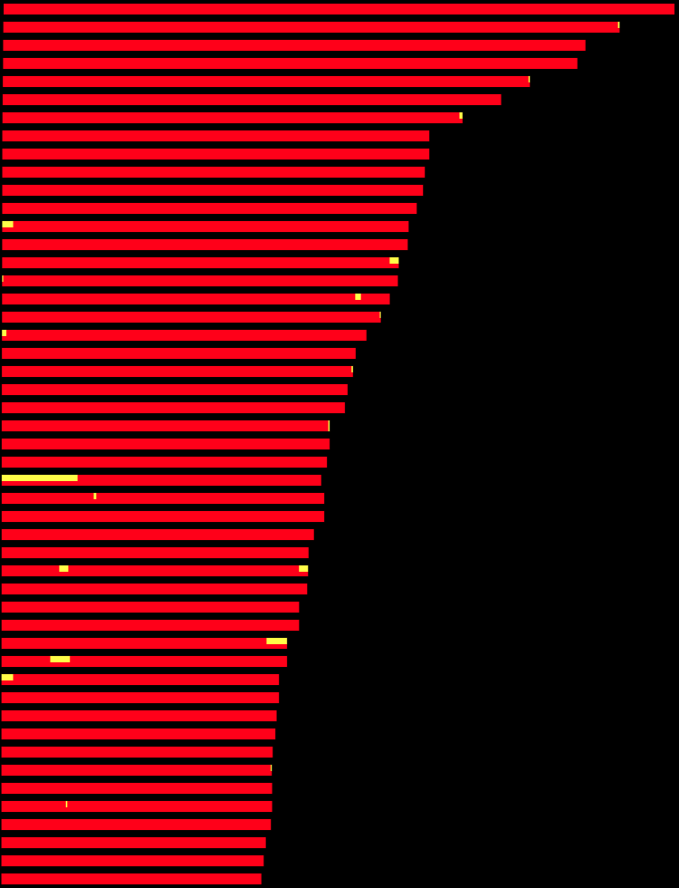
Results. Genomic blocks of ancestry (LAMP).
The «hybrid» individual
Unexpected admixed individual
roumanicus
europaeus
50 largest contigs
(6.7 – 17.4 Mb)

Slide 12
Results. ABBA/BABA or D-test of introgression.
A B
In the absence of introgression between E. europaeus and E. roumanicus, incomplete lineage sorting would produce a similar number of sites with the ABBA and the BABA patterns.
D-test compares the frequency of both patterns.
f statistics quantify the portion of the genome affected by introgression.
E. concolor E. roumanicus E. europaeus Hemiechinus sp.
A B B A
B A B A
derived
ancestral

Slide 13
Results. ABBA/BABA or D-test of introgression.
D (±S.E.) 0.154 (±0.018)
p-value 3.1E-18
Num. sites 99365
f 0.0432
fHOM 0.0395
fd 0.0234
A B
D > 0
E. concolor E. roumanicus E. europaeus Hemiechinus sp.
ABBA > BABA
A B B A
B A B A
Gene flow between E. europaeus and E. roumanicus
derived
ancestral

Slide 14
Results. Association bw. D-test and blocks of admixture
Introgressed variants may be neutral, deleterious or beneficial.
If they are neutral, they must be lost randomly.
If natural selection governs the fate of introgressed variation, independent signals of introgression should be associated in the genome.

Slide 15
Results. Association bw. D-test and blocks of admixture
admixed blocks
D = 0.372 (±0.138)
p-value = 0.0072
f = 0.104
fHOM = 0.106
fd = 0.059
E. roumanicus background
D = 0.133 (±0.020)
p-value = 1.25E-11
f = 0.037
fHOM = 0.034
fd = 0.020
Are differences significant?

Slide 16
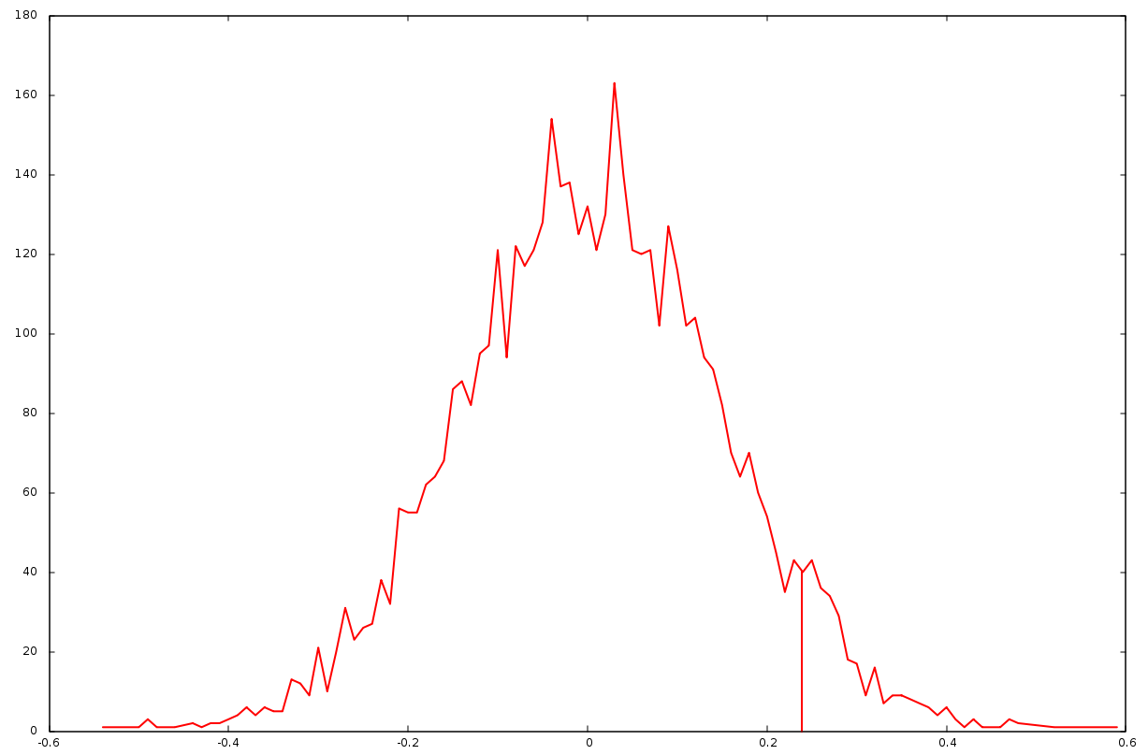
Results. Association bw. D-test and blocks of admixture
Null distribution of the difference in D statistic between admixed genomic blocks and rest of the genome, obtained by shuffling the admixed regions of individual Er55.
p-value: 0.0608

Slide 17
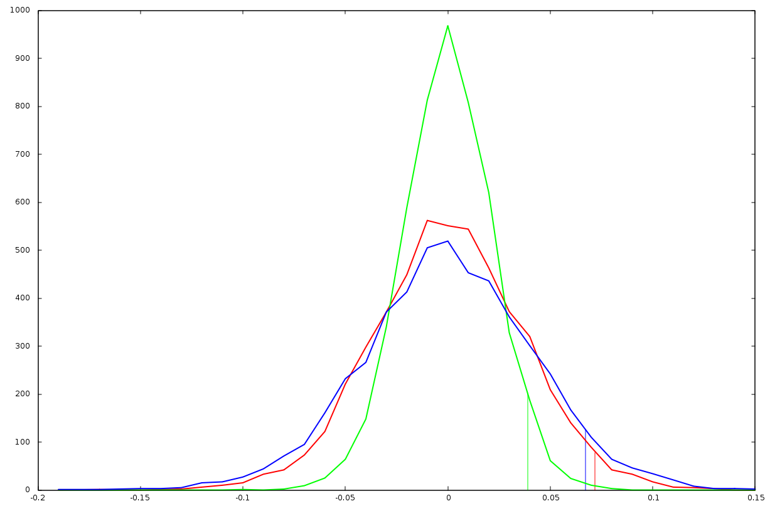
Results. Association bw. D-test and blocks of admixture
fHOM
fd
f
p-values
fHOM 0.0252
fd 0.037
f 0.0536

Slide 18
Conclusions
Support for the classic model of post-glacial colonization.
Detection of low levels of hybridizacion, both historical and recent, in the central European contact zone.
Evidence that natural selection determines the fate of the introgressed variation.

Slide 19
Acknowledgements
Barbora Černá Bolfíková, Life Science University of Prague
Kristýna Eliášová, Charles University of Prague
Pavel Hulva, Charles University of Prague.

