Slide 1

Internet of Things (IoT)
Ignat Ignatov
https://github.com/ignat99/mosquitto
ignat99@gmail.com

Slide 2
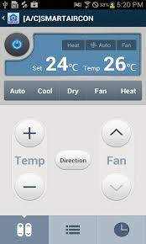
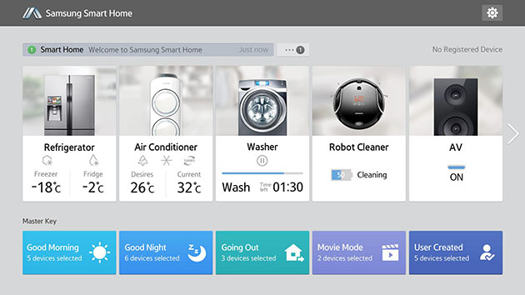
Smart Things - Samsung
https://shop.smartthings.com/#!/kits?scrollTo=home-security-kits#home-security-kits
~ US 389.00 $

Slide 3

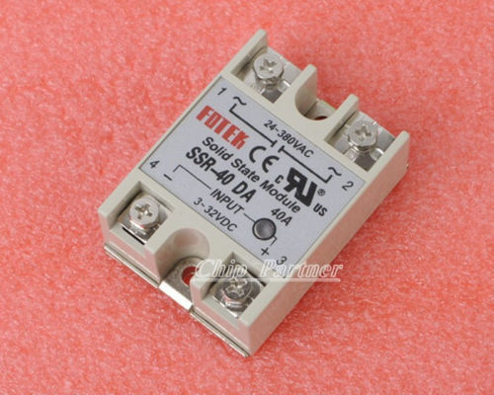
Relay Module
1pcs Solid State Relay SSR-40DA 40A /250V 3-32VDC
US $4.36
http://www.ebay.com/itm/251154726090
Arduino PIC AVR MCU DSP
US $ 8.41
http://ru.aliexpress.com/item/New-5V-8-Channel-Relay-Module-Board-for-Arduino-PIC-AVR-MCU-DSP-ARM-Electronic-11121/663483123.html?promotionVersion=1
Arduino NooLite sheld

Slide 4
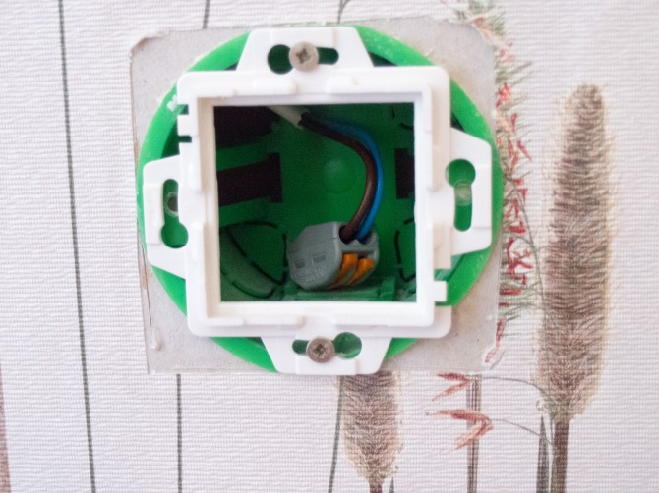
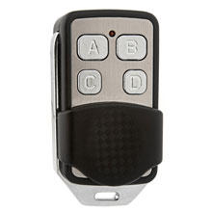
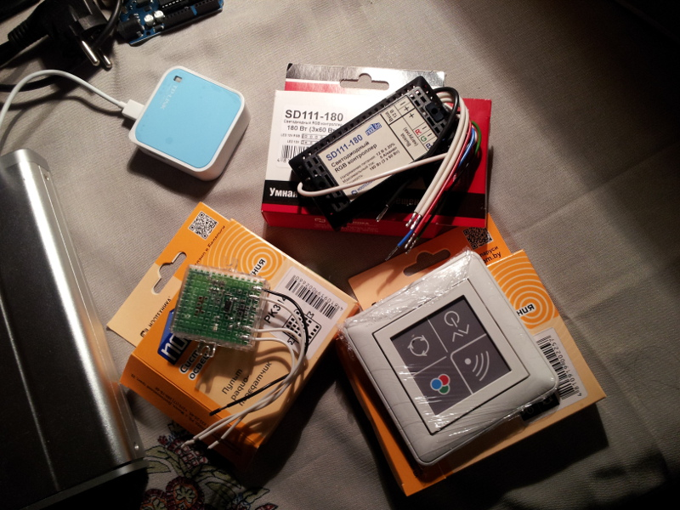
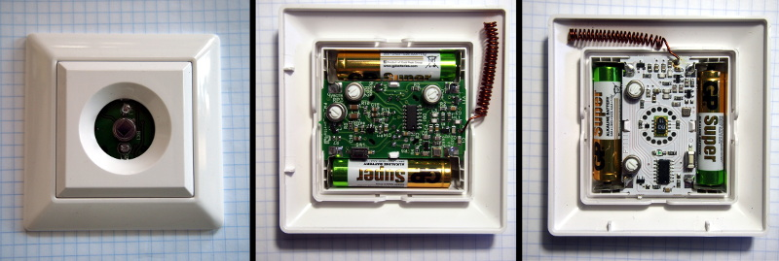
Protocol NooLite
http://habrahabr.ru/company/contactless/blog/229469/
http://habrahabr.ru/company/contactless/blog/216023/
http://habrahabr.ru/post/222663/
WAGO 222–412 or 222–413
Socket Strip from:
Wessen or Schneider Electric model W59

Slide 5
Cryptographic algorithm for NooLite
For NooLite possible use next code:
https://en.wikipedia.org/wiki/KeeLoq
Encryption:
# define KeeLoq_NLF 0x3A5C742E
# define bit(x,n) (((x)>>(n))&1)
# define g5(x,a,b,c,d,e) (bit(x,a)+bit(x,b)*2+bit(x,c)*4+bit(x,d)*8+bit(x,e)*16)
u32 KeeLoq_Encrypt (const u32 data, const u64 key){
u32 x = data, r;
for (r = 0; r < 528; r++)
x = (x>>1)^((bit(x,0)^bit(x,16)^(u32)bit(key,r&63)^bit(KeeLoq_NLF,g5(x,1,9,20,26,31)))<<31);
return x;
}
Decoding:
u32 KeeLoq_Decrypt (const u32 data, const u64 key){
u32 x = data, r;
for (r = 0; r < 528; r++)
x = (x<<1)^bit(x,31)^bit(x,15)^(u32)bit(key,(15-r)&63)^bit(KeeLoq_NLF,g5(x,0,8,19,25,30));
return x;
}

Slide 6
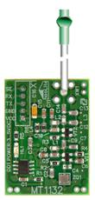
Arduino NooLite МТ1132
US 17,8 $ - http://www.noo.com.by/modul_mt1132.html

Slide 7
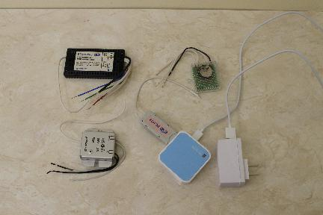
For demonstration need Sensors
Transmitters
Three light switch mounted in the junction box - 20,8 $
RGB light switch - 20,8 $
USB transmitter fot TP-Link - 66$
http://www.noo.com.by/adapter-dlya-pk-pc1132.html
Receiver
USB reciever for TP-link – 45$
http://www.noo.com.by/adapter-dlya-kompyutera-rx1164.html
Dimmers
500 Wt – 23,9$
RGB controller. - 37,3$

Slide 8
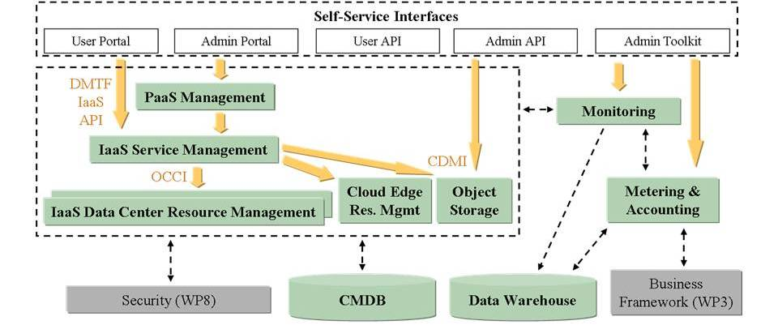
FI-WARE
Free Virtual Server with free IP
https://cloud.lab.fi-ware.org/
Free Domain Name in 2 hours
http://dot.tk

Slide 9

Mosquitto is MQTT-broker
MQTT(s) subscribe/publish
http://mosquitto.org/
apt-get install mosquitto mosquitto-clients python-mosquitto libmosquitto0
/etc/init.d/mosquitto restart
Arduino
http://knolleary.net/arduino-client-for-mqtt/
Android
https://play.google.com/store/apps/details?id=at.tripwire.mqtt.client
Java MQTT Resthttp://forkbomb-blog.de/2014/bringing-mqtt-authentication-and-rest-together
Python - NooLile
https://github.com/ignat99/mosquitto

Slide 10

Node.JS
adduser <name_for_mqtt_agent>
su – <name_for_mqtt_agent>
mkdir -p ~/.nodes && cd ~/.nodes
curl -O \ http://nodejs.org/dist/v0.10.12/node-v0.10.12-linux-x64.tar.gz
tar -xzf node-v0.10.12-linux-x64.tar.gz
mv node-v0.10.12-linux-x64 0.10.12
ln -s 0.10.12 current
export PATH="~/.nodes/current/bin:$PATH"
rm ~/.nodes/node-v0.10.12-linux-x64.tar.gz
node –version
npm install express

Slide 11

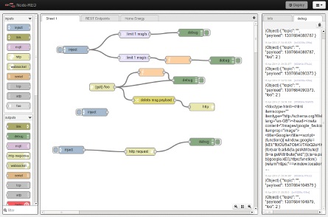
Node Red by Node.js
Node-red
http://nodered.org/
git clone https://github.com/node-red/node-red.git
cd node-red/
npm install
node red.js
curl http://127.0.0.1:1880/
Problem with http://heroku.com
nano settings.js
nano /etc/init.d/node-red

Slide 12
Extra nodes(STOMP,XMMP,..)
https://github.com/node-red/node-red-nodes
That is solution with NooLite in 3 time cheaper than
Samsung Smart Things or Z-wave or KNX, etc.

Slide 13
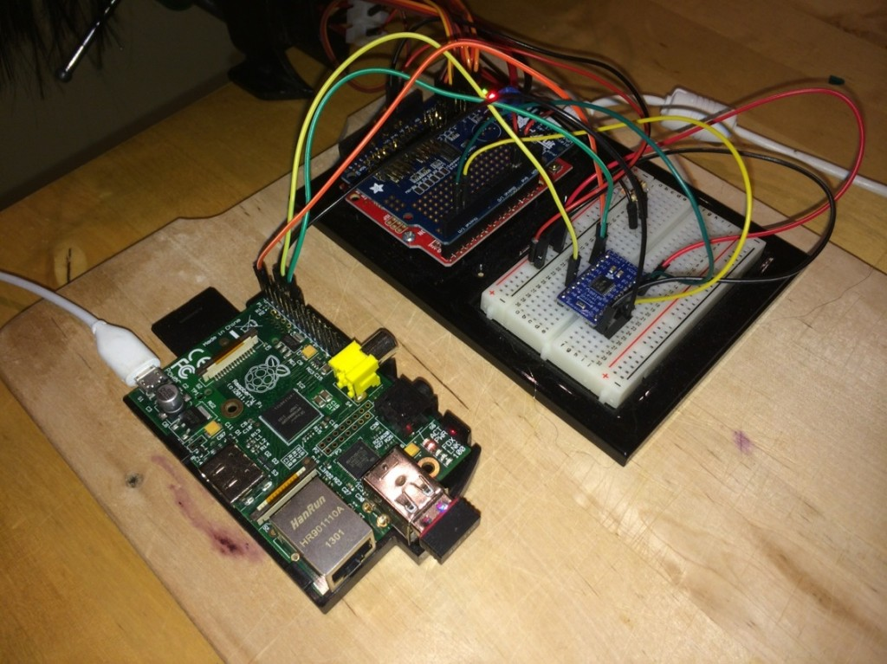
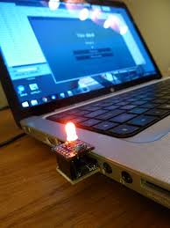
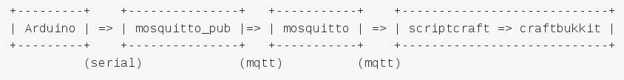
Arduino and Minecraft
http://walterhiggins.net/blog/Arduino-Minecraft
https://github.com/walterhiggins/ScriptCraft
https://github.com/walterhiggins/scriptcraft-extras-mqtt/tree/master/sketches/example-1
http://blogg.bouvet.no/2014/03/10/an-internet-of-things-demo-using-raspberry-pi-arduino-minecraft-and-mqtt/

