Slide 1

Santa's Stolen Sleigh
Ivan Anokhin, Alexey Ignatov, Dmitrii Tochilkin
2017

Slide 2
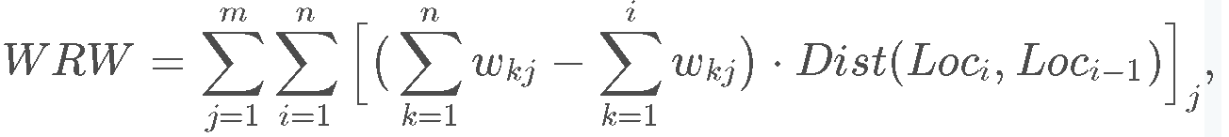
The problem
Santa's magic sleigh has been stolen
Santa is determined to deliver toys to all the good girls and boys using his day-to-day, magic-less sleigh.
Weighted Reindeer Weariness = (distance traveled) * (weights carried for that segment)
All sleighs start from north pole (Lat=90, Long=0), then head to each gift in the order that a user gives, and then head back to north pole
Sleighs have a base weight = 10
Each sleigh has a weight limit = 1000 (excluding the sleigh base weight)
where m is the number of trips, n is the number of gifts for each trip jj, wijwij is the weight of the ithith gift at trip jj, Dist()Dist() is calculated with Haversine Distance between two locations, and LociLoci is the location of gift ii. Loc0Loc0 and LocnLocn are North Pole, and wnjwnj, a.k.a. the last leg of each trip, is always the base weight of the sleigh.

Slide 3
Example
For A, B gifts to deliver in the trip, the WRW is calculated as:
dist( North pole to A ) * ( weight A + weight B + base_weight ) +
dist( A to B ) * ( weight B + base_weight ) +
dist( B to North pole ) * ( base_weight )
Solution has the format
GiftId,TripId
1,1
5,1
3,2
4,2
2,1

Slide 4
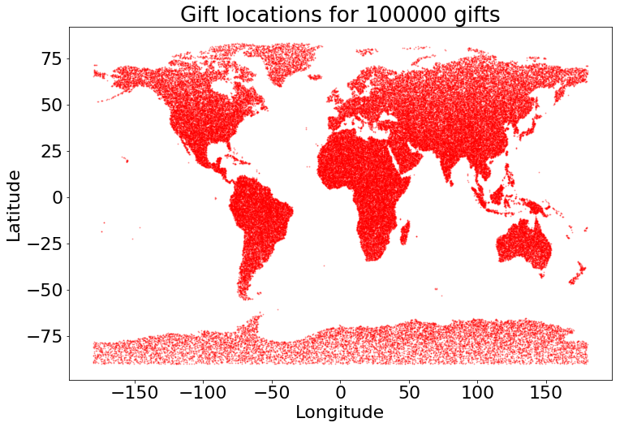
How big is the problem

Slide 5
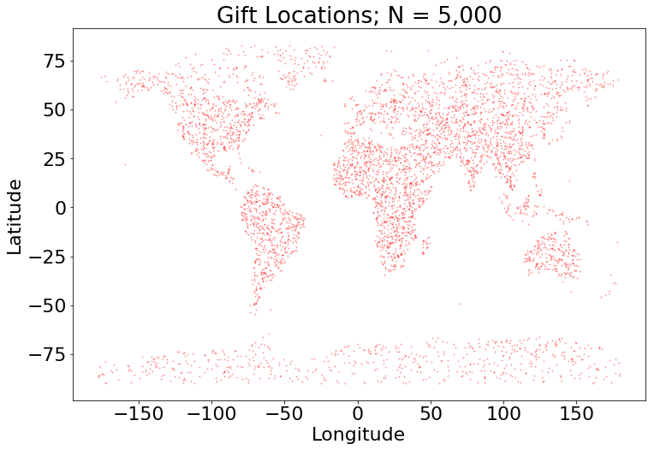
But we consider the less one (up to 5000)

Slide 6
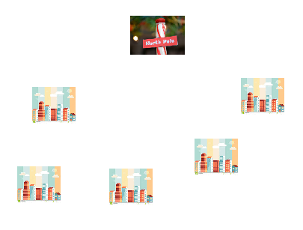
Random

Slide 7
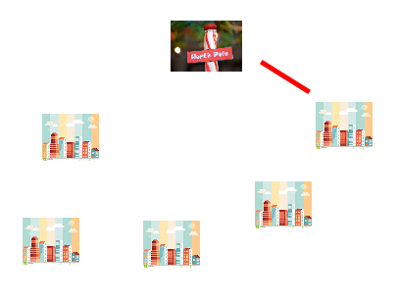
Random

Slide 8
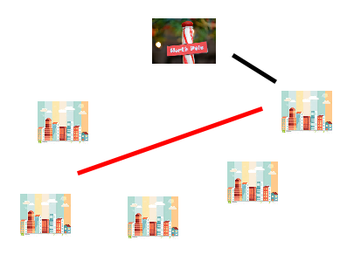
Random

Slide 9
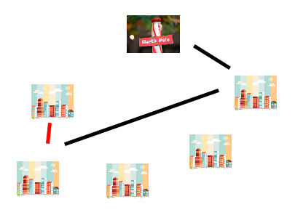
Random

Slide 10
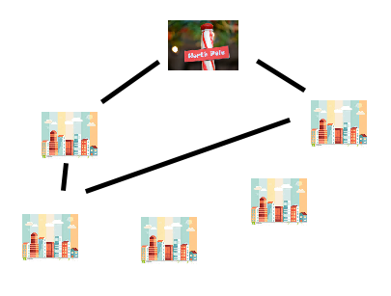
Random

Slide 11
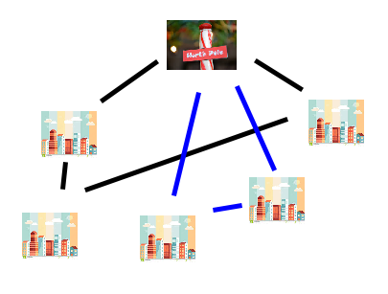
Random

Slide 12
Random
Dist = Harvesine(Gifts.Latitude, Gifts.Longitude)
Choices = GenerateChoices(Gifts)
current _weight = 0
While len(choices) not equal 0
X = make _random_choice(Choices)
current _weight.add(Gifts_weight[X])
If sleight_limit - sleight_weight > current _weight
Choices.exclude(X)
Update solution
else
Initialize new trip
current _weight = 0.

Slide 13
Greed (mindistance trip)

Slide 14
Greed (mindistance trip)
Dist = Harvesine(Gifts.Latitude, Gifts.Longitude)
current_destination = North pole
current _weight = 0
While dist.min() < inf
X = nearest_destination(dist[:, current_destination ])
current_weight.add(Gifts.weight[X])
If sleight_limit - sleight_weight > current_weight
dist[X,:] = inf
Update the trip
else
Initialize new trip
current _weight = 0.
current_destination = North pole

Slide 15
Greed2 (min ratiodistance)
Greed Minratiodist
random
Greed Mindist

Slide 16
Greed2 (min ratiodistance)
Dist = Harvesine(Gifts.Latitude, Gifts.Longitude)
current_destination = North pole
current _weight = 0
While dist.min() < inf
X = nearest_destination(dist[:, current_destination ]/Gifts.weight)
current _weight.add(Gifts_weight[X])
If sleight_limit - sleight_weight > current _weight
dist[X,:] = inf
Update the trip
else
Initialize new trip
current _weight = 0.
current_destination = North pole

Slide 17
Greed3 (simple minwork)
Dist = Harvesine(GiftsId.Latitude, GiftsId.Longitude)
current_destination = North pole
current _weight = 0
current_trip_distance = 0.
While dist.min() < inf
available_dist_to_cities = dist[:, current_destination ] + current_trip_distance
X = nearest_destination(available_dist_to_cities*Gifts.weight)
current _weight.add(Gifts_weight[X]);
current_trip_distance.add(dist[X,current_destination ])
If sleight_limit - sleight_weight > current _weight
dist[X,:] = inf
Update the trip
else
Initialize new trip
current _weight = 0. ; current_trip_distance = 0.;
current_destination = North pole

Slide 18
Greed4 (onetrip minpower) the idea
Trips_list = initilize(N) #zero at 1st step
Consider_new_nodes_list = initilize(N) #set of cities
While Consider_new_nodes_list.any() >0:
X = find_min_branch(dist_to_cities*Gifts.weight+dist_to_cities*sleight.weight)
Update Trips_list
Update Consider_new_nodes_list

Slide 19
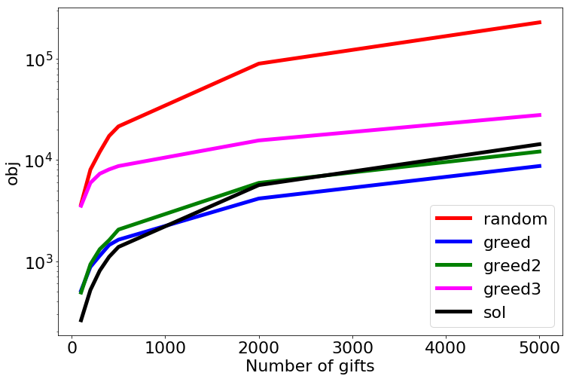
Results
sol = sample_submission

Slide 20
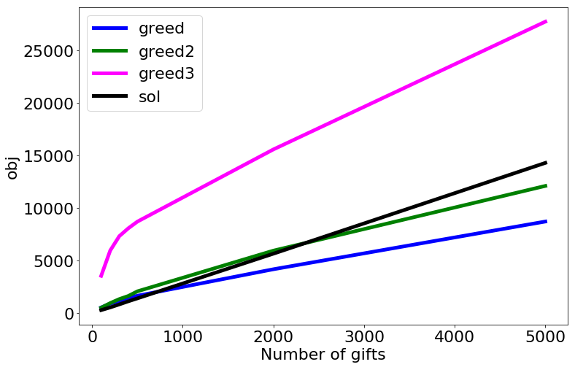
Results
sol = sample_submission

Slide 21
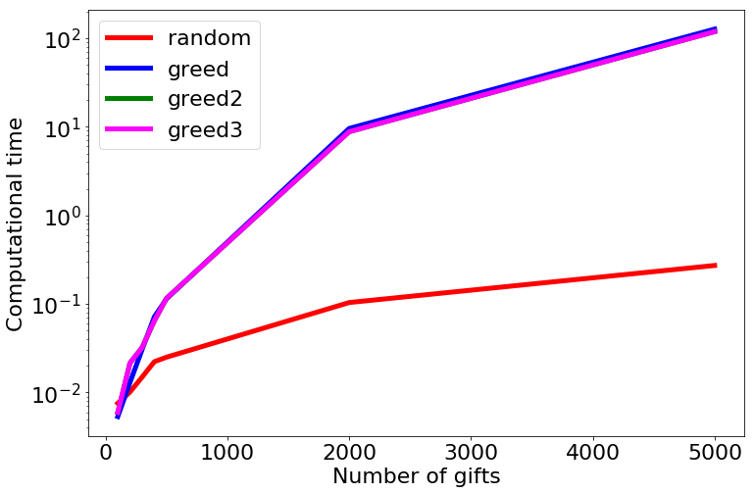
Results

Slide 22
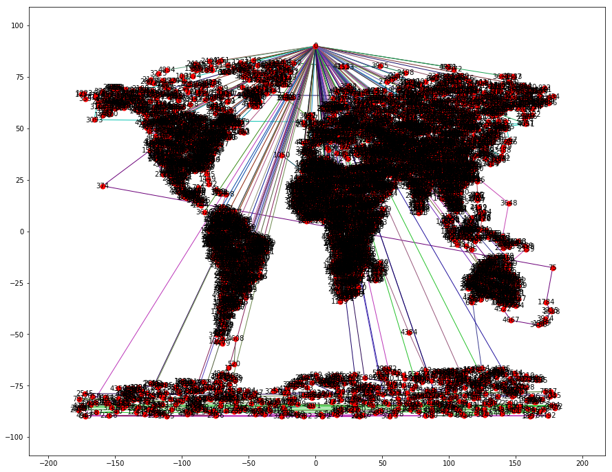
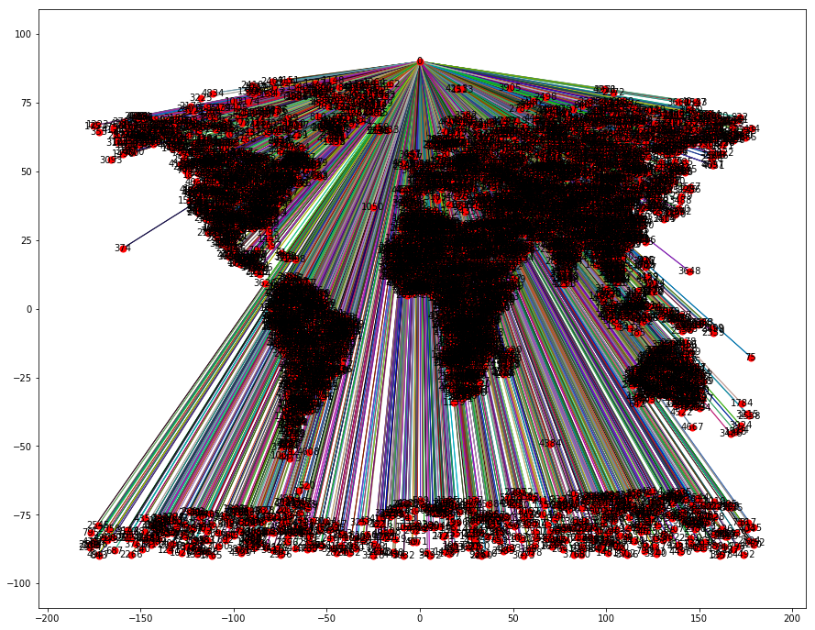
Results N =5000 gifts
Distance greed
Sample submission

Slide 23
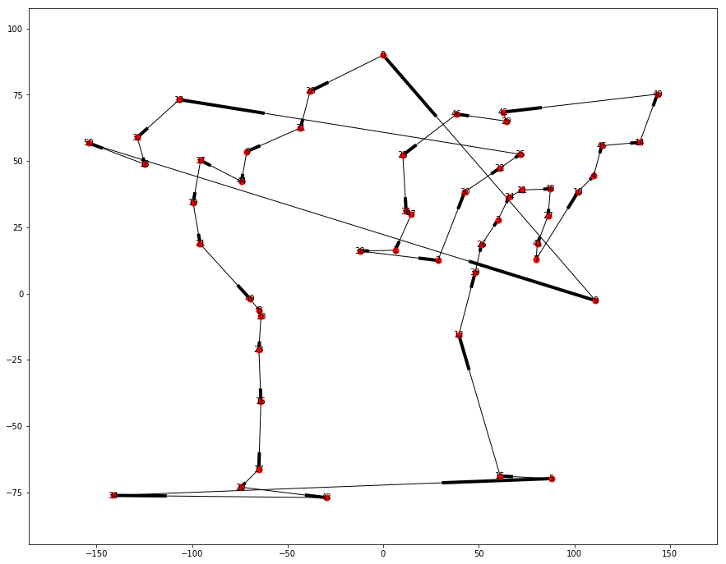
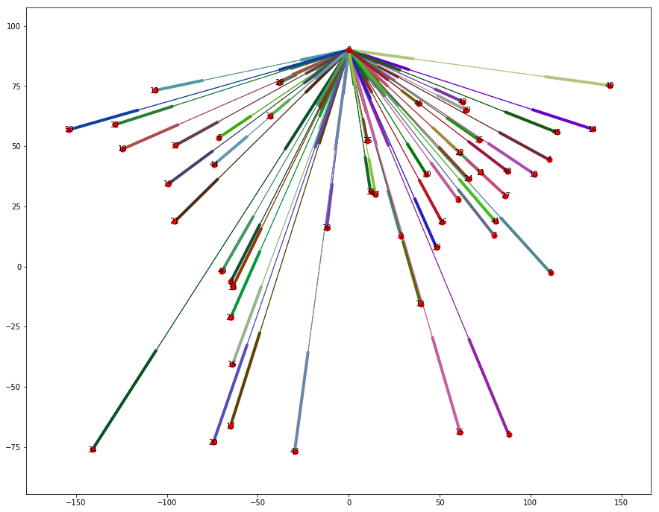
Results N = 50 gifts
Distance greed
Sample submission

Slide 24

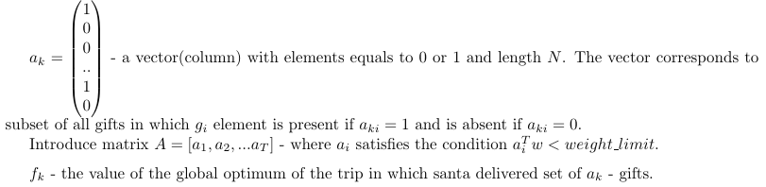
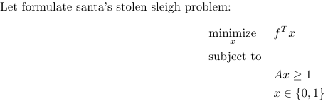
Column generation

Slide 25
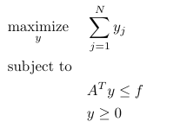
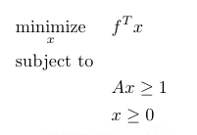
Relaxation to LP
Dual problem

Slide 26
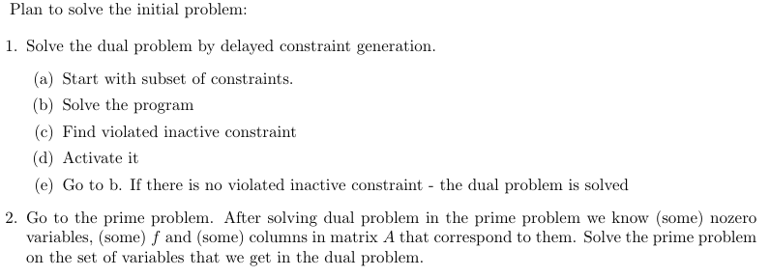
Solution

Slide 27
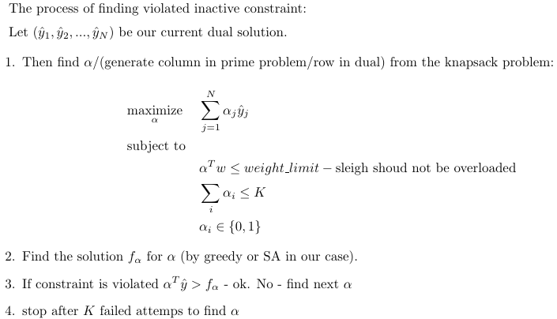
Key part - finding violated constraints

Slide 28
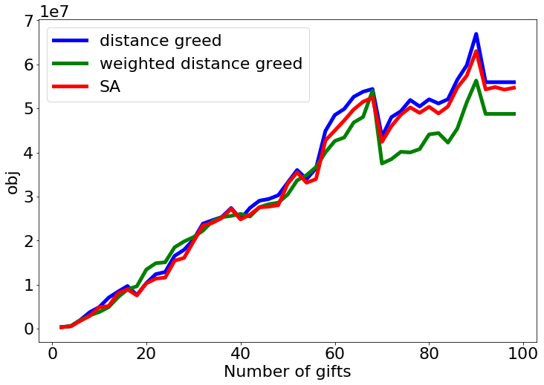
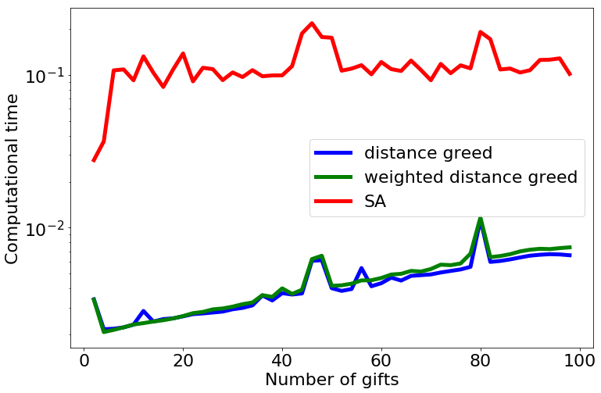
Key part - good heuristics to find f coefficients

Slide 29
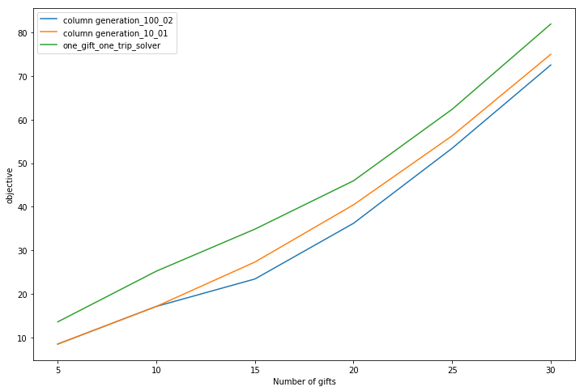
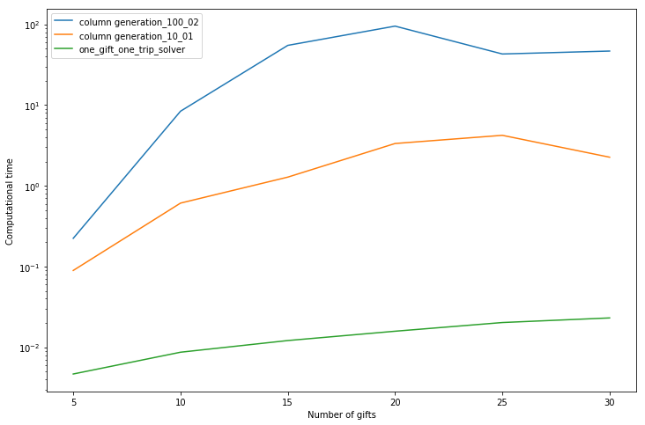
Column generation (greedy) with different hyperparameters
Conclusion: Need more experiments on tuning the finding of violated constraints

Slide 30
Simulated annealing [1]
Let s = s₀
For k = 0 through k_{max}:
Pick a random neighbour, s_{new} ← neighbour(s)
If P(E(s), E(s_{new}), T) ≥ random(0, 1):
s ← s_{new}
T ← T*mu
Output: the final state s

Slide 31
SA initial solution
Clustering based on longitudes
Sort by latitudes (from north to south)
Each cluster weight is limited to MAX_weight - 20
Better search space

Slide 32
Neighbourhood moves
Inside single random trip | Between two random trips
SWAP(t[i=rand], t[i+1]) | SHIFT(t1[i=rand], t2, pos_t2=best)
SHIFT(t[i=rand], j=rand) | SHIFT_BLOCK(t1[i=rand:i+N], t2, pos_t2=best)
PERMUTE(t[i=rand]:t[i+N]) | SWAP_BEST(t1[i=best], t2[j=best])
CUT(t, pos=best) | MERGE(t1, t2)

Slide 33
SA vs exact solution [2]
Number of gifts | Our SA (T=10000, mu=1.00002) | Exact solution
50 | 7.663.711,47 (10 trips) | 7.489.511,24 (9 trips)
100 | 14.455.248,31 (12 trips) | 13,632,670.39 (12 trips)
1000 | 139.054.716,77 (51 trip) | 127,092,812.37 (53 trips)

Slide 34
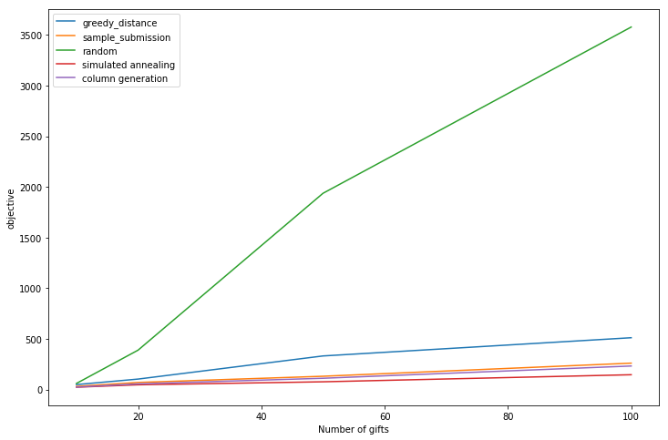
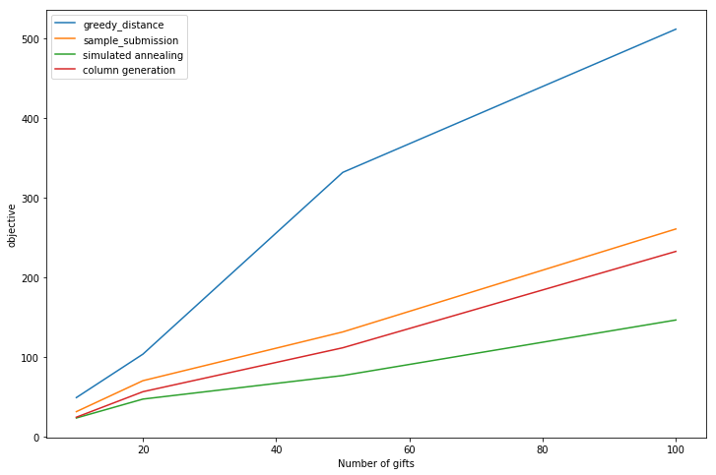
Random/Greedy/CG/SA/Sample_submission

Slide 35
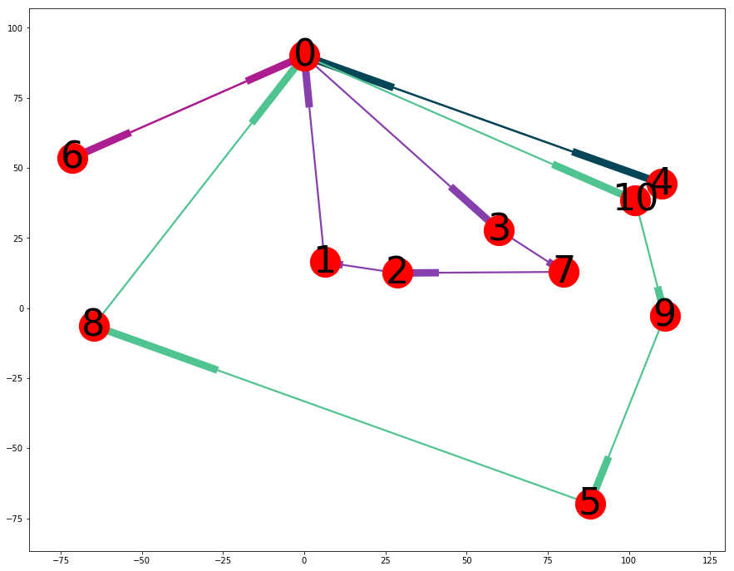
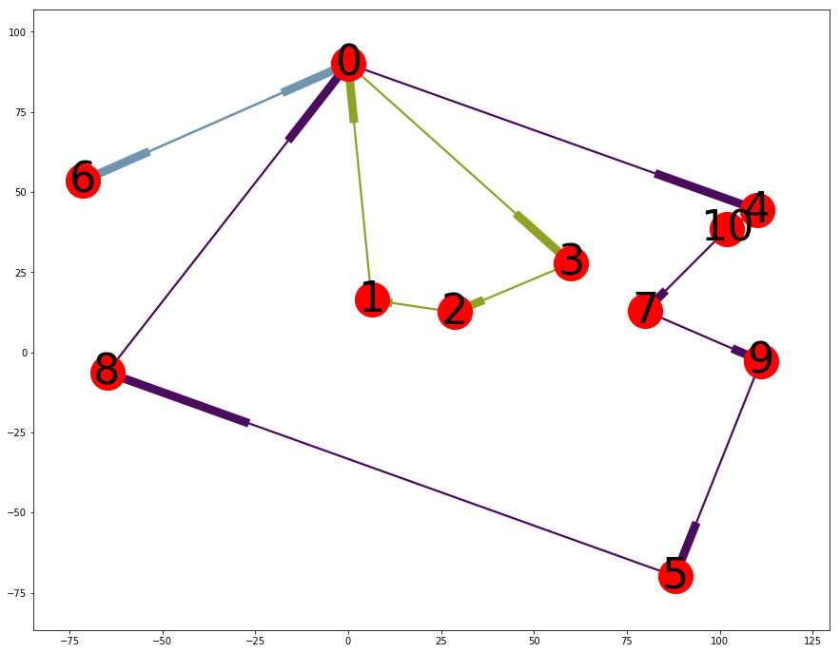
CG vs SA N = 10 gifts
Column generation
Simulated annealing

Slide 36
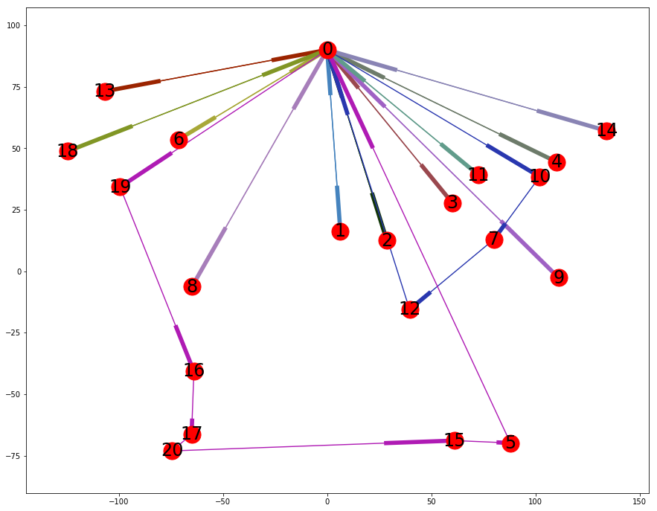
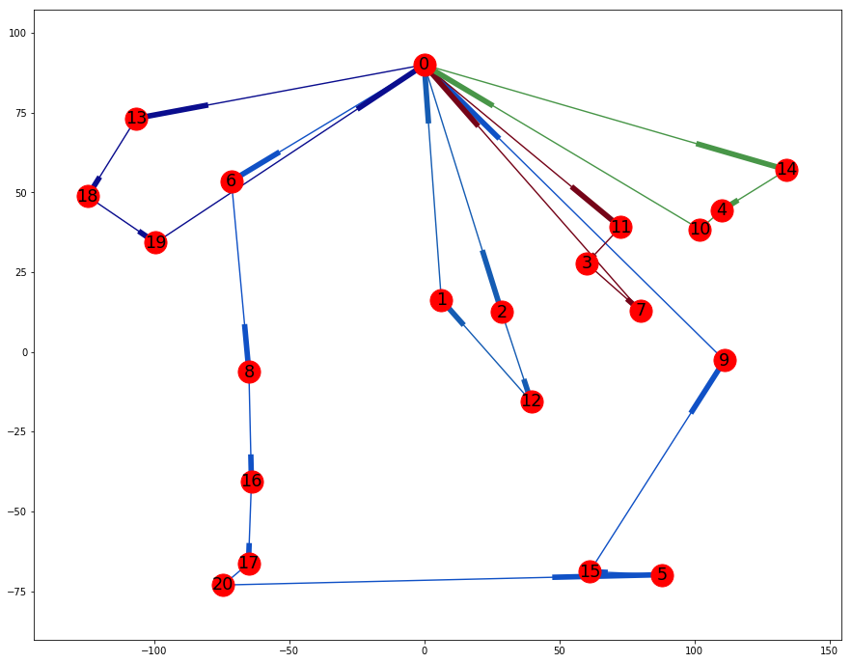
CG vs SA N = 20 gifts
Column generation
Simulated annealing

Slide 37
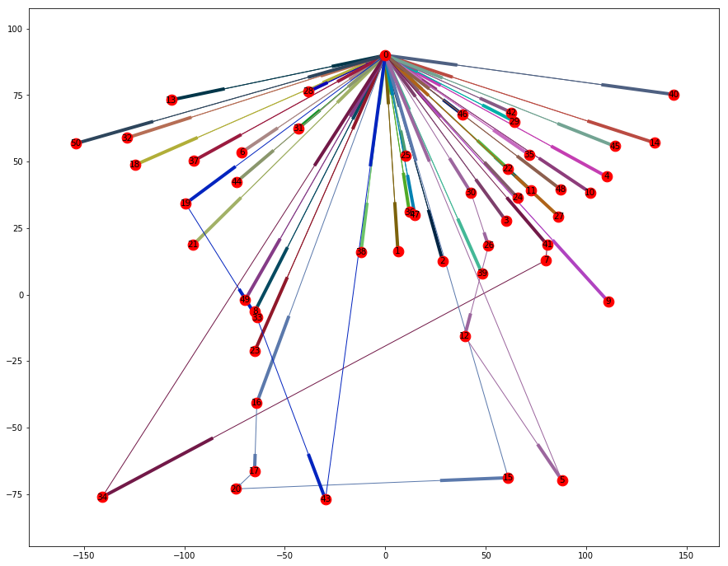
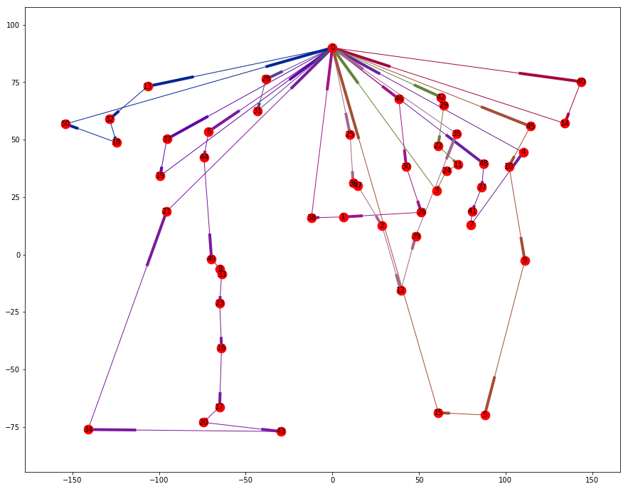
CG vs SA N = 50 gifts
Column generation
Simulated annealing

Slide 38
Santa Group
Thank you for your attention
Ivan.Anokhin@skoltech.ru
Dmitry.Tochilkin@skolkovotech.ru
Alexey.Ignatov@skolkovotech.ru

