Slide 1

ALPHA
your need is just a click away!
Done by-
PRAGATHI , SOMYA , BHAVIKA , ARPITHA , RAMYA , POORNIMA
Mentored by-
DIVYA , SHUBHAM ,JAYA

Slide 2
REQUIREMENTS
A complete E-commerce website with the following services:
Authentication and authorization service
Profile service
Product service
Checkout service

Slide 3
AUTHENTICATION AND AUTHORIZATION SERVICE

Slide 4
USE CASES:
If the user is new to the website they can have a look at the products (homepage).
The user can create a new account by filling the sign-up form.
If the user has an account already they can sign-in through email-id and password to have access to all services.
The user can also use Google sign-in to sign-in.

Slide 5
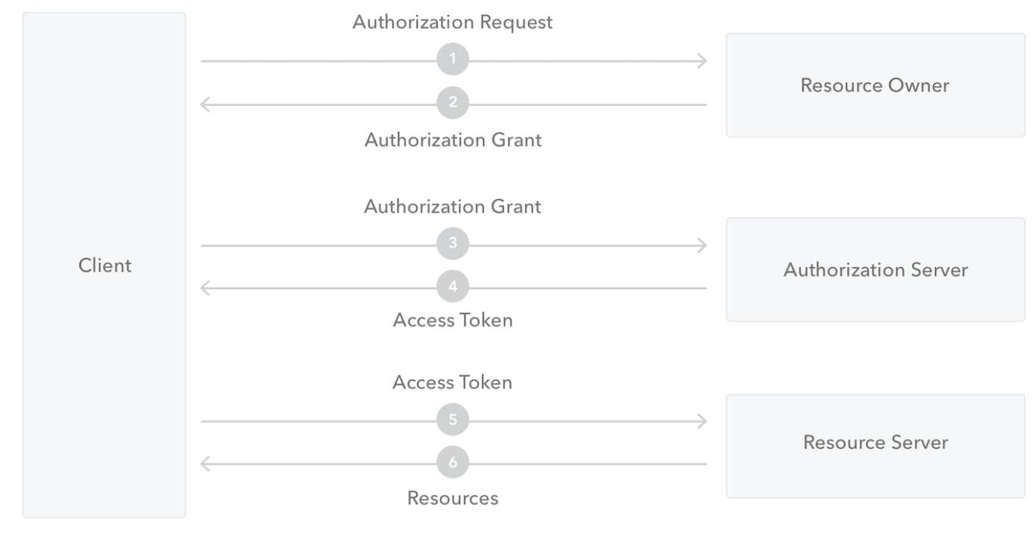

Slide 6
Faced challenges with dependency and gradle while integrating Google OAuth sign-in with the application.
Overcame challenges by adding dependencies in build.gradle file.
Upgraded dependencies to work with java 11.
Learnt to use Google Cloud Console in order to generate OAuth2.0 client credentials.
Challenges and learning:

Slide 7
PROFILE SERVICE

Slide 8
USE CASES:
The user can access their personal, address and wallet information that was provided.
User can have multiple addresses and cards stored out of which one is going to be default.
These information can be added , edited or deleted according to choice.

Slide 9
Integrating profile, address and wallet table was challenging.
Understood various concepts in cassandra such as primary key and writing the custom queries.
Learnt the usage of various new annotations in spring mainly @CrossOrigin(origins=”*”)
Challenges and learning:

Slide 10
PRODUCT SERVICE

Slide 11
USE CASES:
The user should be able to browse different categories, subcategories to view all products with ease. Subheader provides an easy way. Navigation through pictures has been added to attract the user attention.
Being able to display product specific details for wide variety of products and fetching size and id to check stock availability.
A search to find a subcategory and view items belonging to it.Local storage is used for more efficiency.

Slide 12
Challenges and learning:
Making services to fetch item list based on multiple parameters and consuming those in frontend.
Designing data model keeping in mind various requirements by understanding primary key concept.
Coming up with custom queries.
Routing and changing url
Use of local storage

Slide 13
CHECKOUT SERVICE

Slide 14
USE CASES:
If the user has signed in they can view their items in cart. Otherwise they will be redirected to the login page.
If the userId exists in the local storage then they can view the cart items,total price,total quantity of items on the cart page fetched by their cartId.
An user can add an item to cart on click of add to cart button if user has signed in .
On the cart page the user can update quantity or delete an item based on the choice.

Slide 15
To add an item with different size as a separate cart item was one of the challenges.We overcame by considering item_size as a clustering key.
To calculate the total price and quantity in the cart was another challenge.We overcame by creating a response model with that attributes.
Learnt to create end points and services according to our requirements.
Learnt the use of local storage
Challenges and learning:

Slide 16
UPCOMING FEATURES
Integrating Google sign-in with the project.
Accessing the user information(profile, address, wallet) only after sign-in
Inventory management for tracking of stock availability.
Adding the items into the cart .
Updating quantity or deleting an item based on the choice in the cart page.
Looking into the various third party payment service.

Slide 17
KEY LEARNINGS
Team work and group discussion.
Code handover with KT session.

Slide 18


Slide 19
THANK YOU

