Slide 1

USER EXPERIENCE
“Design is not just what it looks like and feels like. Design is how it works.” — Steve Jobs.
BY:
ANKITHA
BHAVIKA
PRATILIPI
YASHASWINI

Slide 2
WHAT IS UX AND WHY IS IT NECESSARY?
User experience (abbreviated as UX) is how a person feels when interacting with a system. It’s about how the digital content feels, what the experience of it is. UX is important because it tries to fulfill the user's needs. It aims to provide positive experiences that keep users loyal to the product or brand.

Slide 3


UI
Focuses on how it looks .
Tangible elements.
Focused on the product.
.
UX
Focuses on how it feels.
Conceptual aspects.
Focused on the user and their journey.

Slide 4

UX Design Process
Empathy
Problem Solving
And Psychology!
USER RESEARCH
CREATING PERSONAS
SKETCHING
TESTING A PROTOTYPE
Product/Product Features from Start -------> Finish.
Includes Design & Implementation to Testing & Feedback!

Slide 5
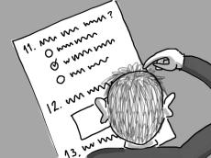
USER RESEARCH
Ranging from conducting analysis of our Competitors to Surveying and Interviewing our prospective Users.
Get to know how Users think,behave, their needs & Pain points
Engage with users directly
Find patterns and commonalities of target users
Tells you who your users are
What context they will be using your products/service.
When is the best time to conduct User Research?

Slide 6

Creating Personas
A unique aspect of UX design!
It’s like creating a fictional person who will want to use your product.
Why is this step important?

Slide 7

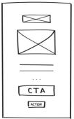

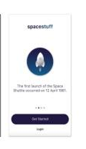
Sketching - Wire Frames
WireFrames are like ScreenShots of what the App will look like and what steps the user will take to accomplish a task.
LOW FIDELITY
MID FIDELITY
HIGH FIDELITY

Slide 8
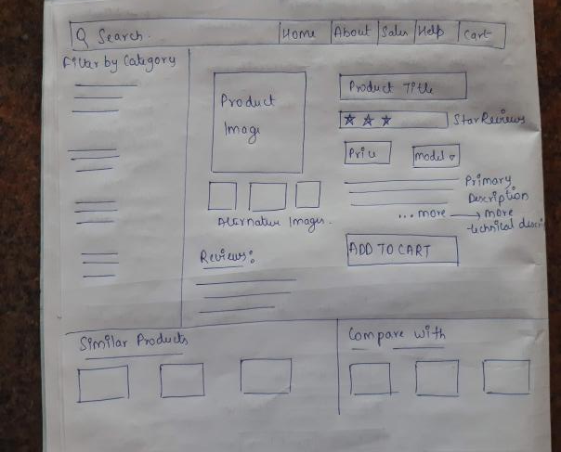





Slide 9

Testing a Prototype
User testing is a fundamental aspect of UX design.
Without testing a feature/product with real users, there’s no way of knowing if the product is meeting user needs.
Is user testing only done in the last?

Slide 10
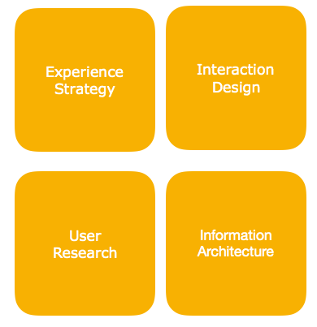
QUADRANT MODEL or SPECIALIZATIONS
Experience Strategy (ExS)
User Research (UR)
Interaction Design (IxD)
Information Architecture (IA)

Slide 11
UX Strategy (ExS)
User Research (UR)
BUSINESS VISION
USER NEEDS
QUANTITATIVE
QUALITATIVE
TECHNICAL CAPABILITIES
ATTITUDINAL
BEHAVIORAL

Slide 12
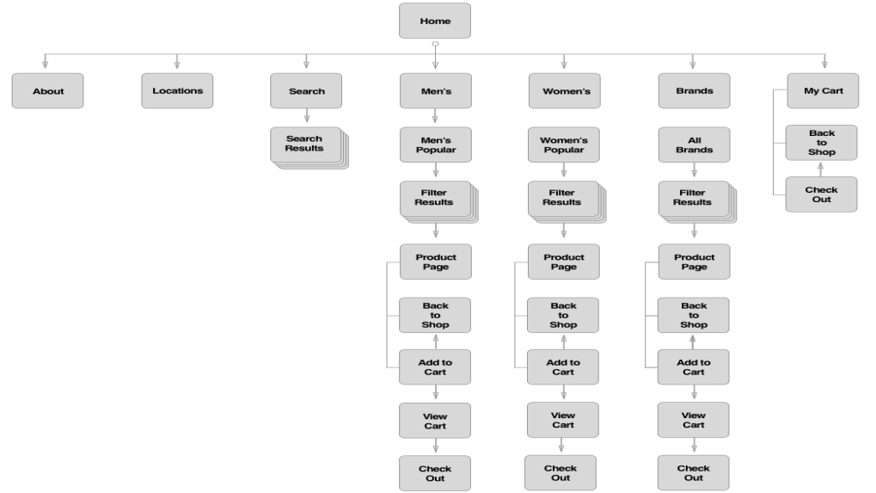
SITE MAP (HIERARCHY)

Slide 13
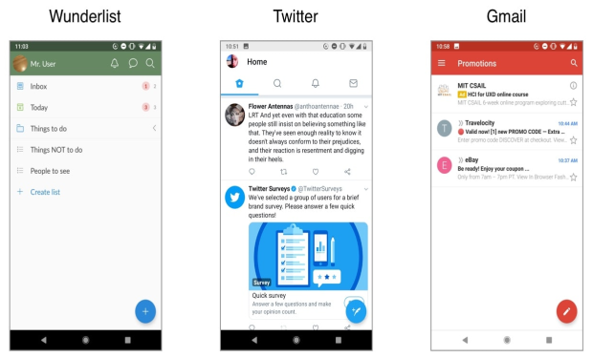
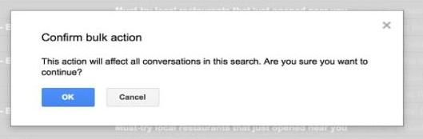
CONSISTENCY
CONFIRMATION

Slide 14


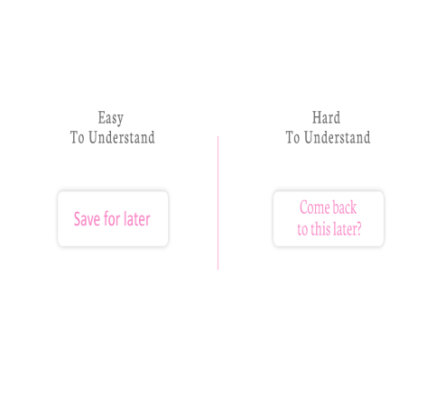
REDUCE COGNITIVE LOAD
AND
PROVIDE
CLARITY

Slide 15
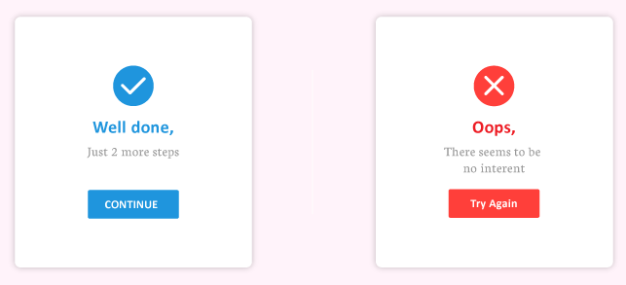
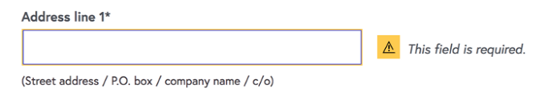
EFFECTIVE ERROR MESSAGES
AND
RELEVANT FEEDBACK

Slide 16
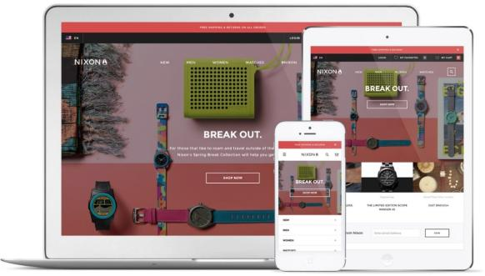
Features of ecommerce website with good ux
1. Mobile Experience with Responsive Web Design
A responsive web design allows customers to have a consistent ecommerce website experience across any device they choose to use while shopping–whether desktop, tablet or mobile.

Slide 17
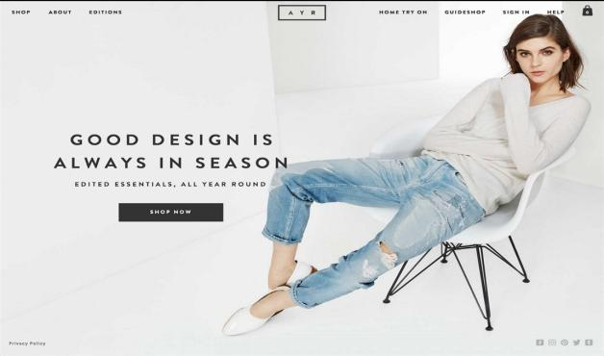
2. Flat Design = Clean & Focused Design
Clean design gives a page the breathing room it needs to offer a compelling call to action for engagement.
Focused design can help showcase products—such as large and detailed imagery that a customer needs to make their decision to buy now.

Slide 18
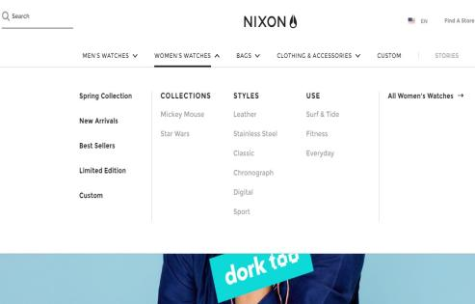

3. Organized & Easy-to-use Navigation
Always make the navigation prominent and super organized.
Ecommerce website best practices to consider for search:
Offer auto-complete suggestions
Allow for search by product name, and model number

Slide 19

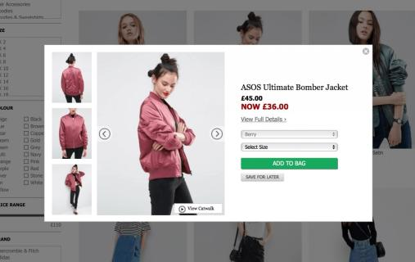
4. VISUALS
The best way to describe what’s for sale is by using
High resolution photos
Close detail shots
Product video
360° view

Slide 20

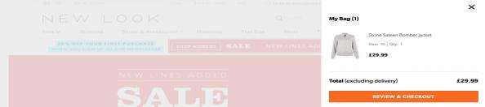

5. Product Detail Page Must-Haves
Use trust badges
It will help strengthen the buying confidence of a customer.
A Visible Add to Cart button
Allow customers to read and add reviews
It might seem daunting to give the public access to fully disclose about a product, but 7 out of 10 shoppers consult reviews before making a purchase
In addition to trust badges, get your site working with an SSL certificate so that browsing and buying from the site is even more secure.

Slide 21
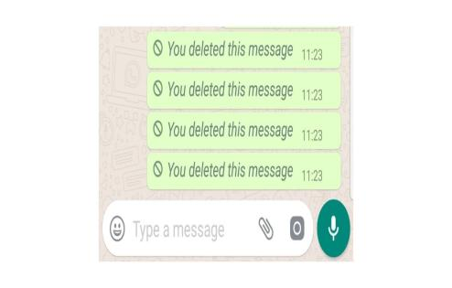
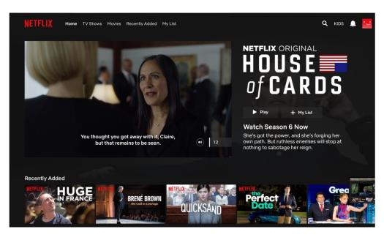
UX DESIGN FAILS
WhatsApp’s delete message feature
Netflix hover auto-play

Slide 22
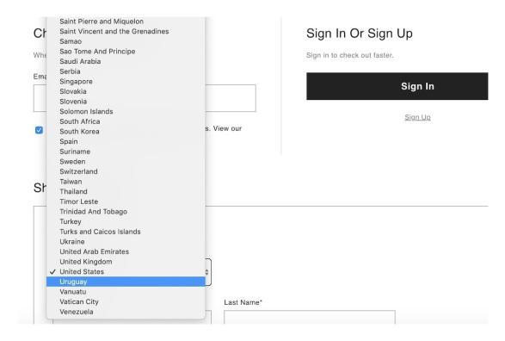
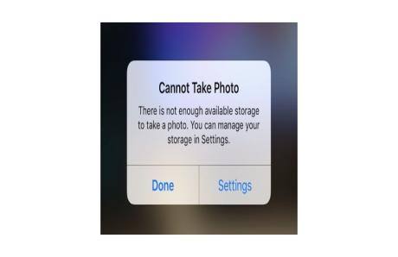
Super long dropdowns
Apple’s storage management system

Slide 23
THANK YOU

