Slide 1
MOVIE RATINGS
Data from Rotten Tomatoes

Slide 2
Table of contents
01
02
03
04
05
06
Introduction
Tomatometer Ratings Scale
Genre and Ratings Distribution
Monthly Releases
Critics vs Audience Ratings
Critics Language

Slide 3
01
Introduction

Slide 4
Problem & Background
Problem
Ratings and reviews for 15,000+ movies reviewed by Rotten Tomatoes. Each record includes film details (title, description, rating, genre, directors, cast, release date, studio, runtime, etc.), as well as featured reviews, "Tomatometer" status, and audience ratings

Slide 5
Goals & KPIs
Q 1
Q 2
Q 3
What does the distribution of films look like by rating? My primary genre? (hint: use the first genre listed)
What % of films received a Certified Fresh Tomatometer rating? What about Rotten?
Explore new film releases over time. How has the volume of releases by month trended over time? What year/month were the newest films released?
Q 4
Q 5
Q 6
Compare average Tomatometer ratings by Studio. Which studios produce the highest-rated films, on average? The lowest?
Compare the Tomatometer ratings against audience ratings. Which films showed the largest discrepancies between audiences and critics?
Explore the critic's consensus rating: what language is used most often?

Slide 6
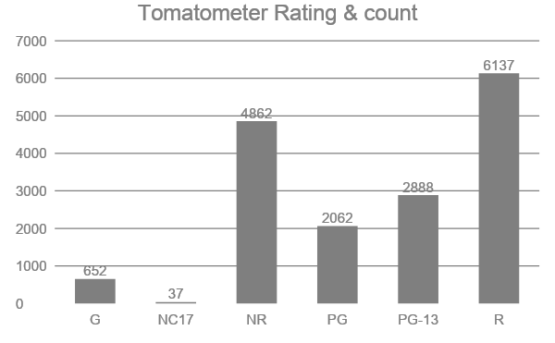
2. Tomatometer Ratings Scale
Tomatometer ratings counts from 1 to 100.
Highest count is 6137 under the "R" rating category.

Slide 7
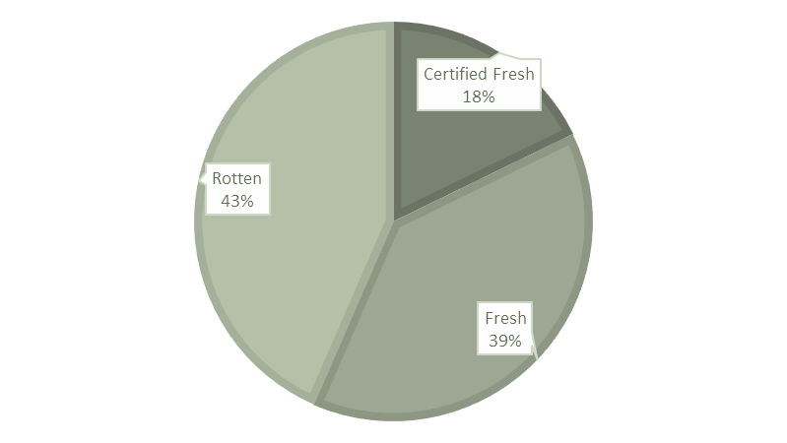
Tomatometer Status
Movies with above 75% positive ratings are given status as Certified Fresh, 60% as Fresh and below are Rotten.

Slide 8
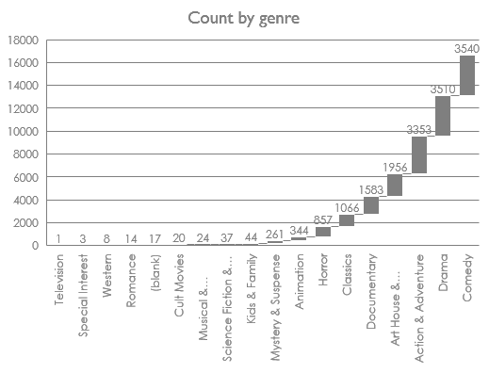
3.Genre and Ratings Distribution
Comedy genre count is highest at 3540.

Slide 9
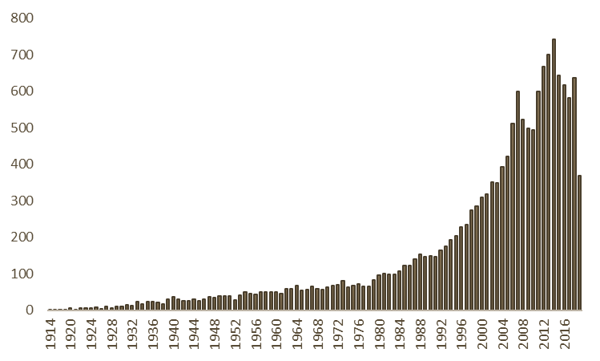
4. Yearly Release
Highest movies released in 2014 with a count of 743.
October month has the highest count for new release movies at 85.
New Release over years

Slide 10
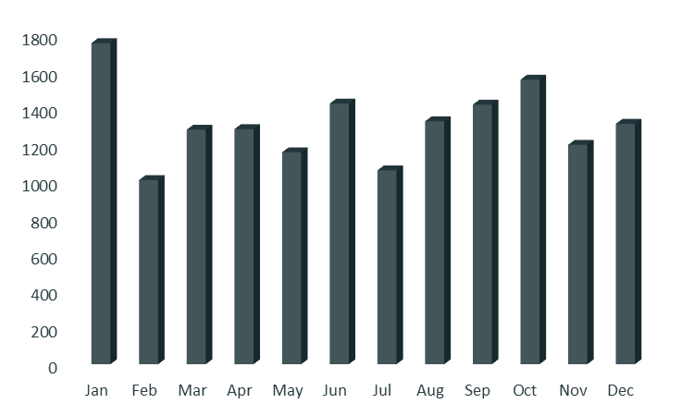
Monthly Release
January month has the highest count for new release over all the years.
Monthly release in all the years

Slide 11
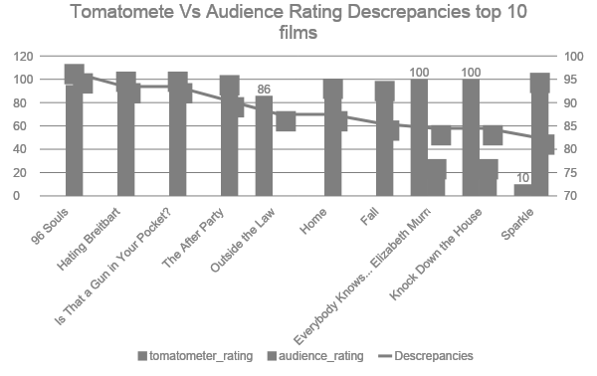
5. Critic vs Audience Ratings
Some movies have discrepancies between tomatometer rating and audience ratings. Below are the Top 10 Discrepancies Films .

Slide 12
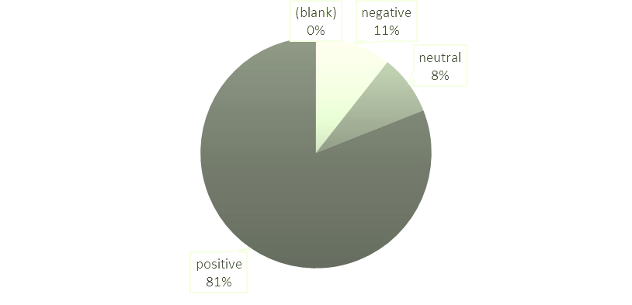
6. Critics Language
Critics given are classified into three types: Positive, Negative and Neutral.
Critics Languages Used

Slide 13
Thanks!
Do you have any questions?
igniterofficial909505@gmail.com

