Slide 1
S.C.A.R Arcade:
Presented by Saxon, Charlie, and Ryan.

Slide 2
Introduction:
What is it? In essence a Game Management Application.
Why?
Today’s presentation: 3 Games
Tower of Hanoi
Memory test (Deck of cards)
Ball Maze (Gyroscope)

Slide 3
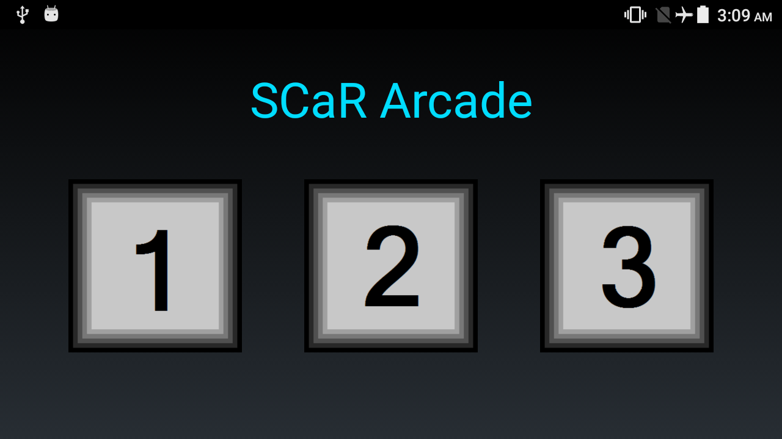
INTERFACE:
Grid layout with clickable buttons to run a specific game.

Slide 4
Tower Of Hanoi:

Slide 5
Memory Test (Deck of Cards)

Slide 6
Ball Maze (Gyroscope)

