Slide 1
S.C.a.R. arcade
Presented by Ryan and MARTIN.

Slide 2
What is S.C.a.R. arcade?
S.C.a.R. is a Library Game Application Manager (LGAM).
It is designed for the Android OS, featuring 2 different games:
Towers of Hanoi
Dice Roll (Original)

Slide 3
Why our application?
From development to a working prototype (written in C#), we have utilized and incorporated into the application:
Event driven methods.
Sensors.
Extensible android storage (Could be either File based, or Relational base storage).
Robustness in terms of error handling.
Pleasing (and simple) user interfaces.
Intuitive navigation.

Slide 4
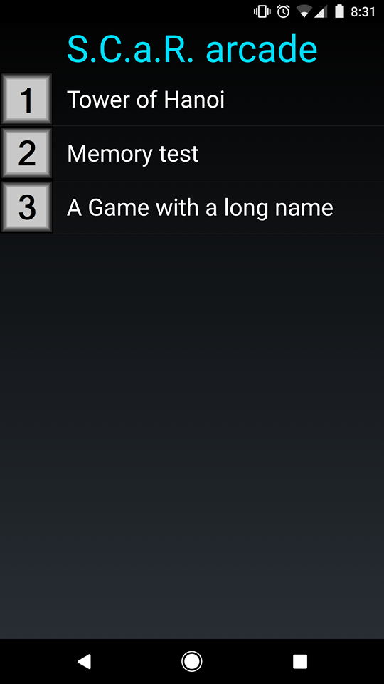
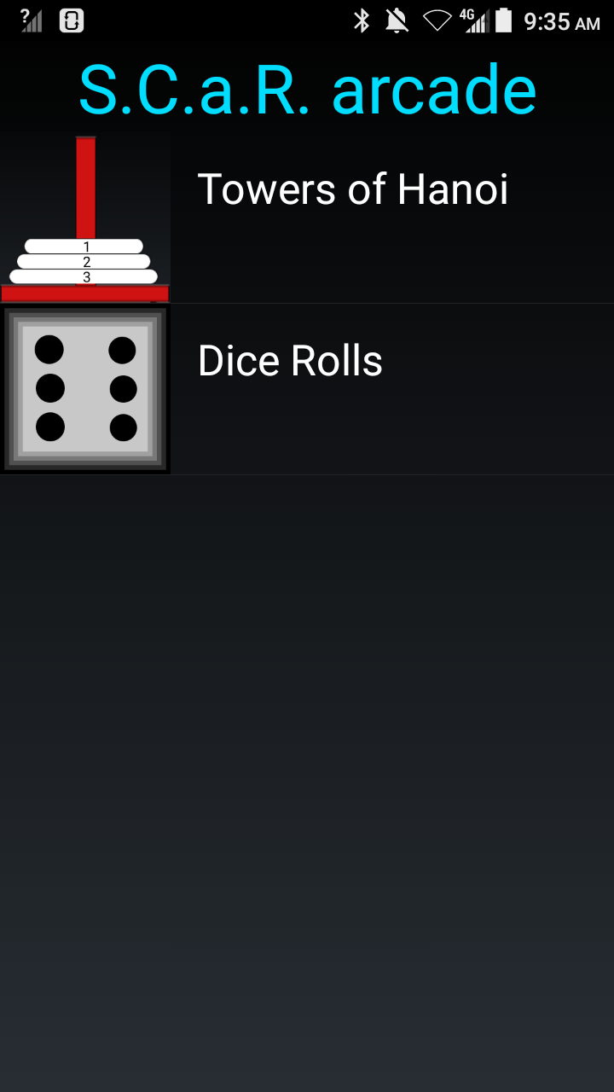
Game selection interface
Notes:
This is the screen that users are presented with upon starting the application.
Linear layout(vertical) with selectable buttons to run a specific game.
Each game ill display a screen shot of the game.
Simple, informative, conveys all necessary information while efficiently using screen ‘real-estate’.
Version 1.0
Version 2.0
Figure 1: Game selection interface v.1 (Ryan)

Slide 5
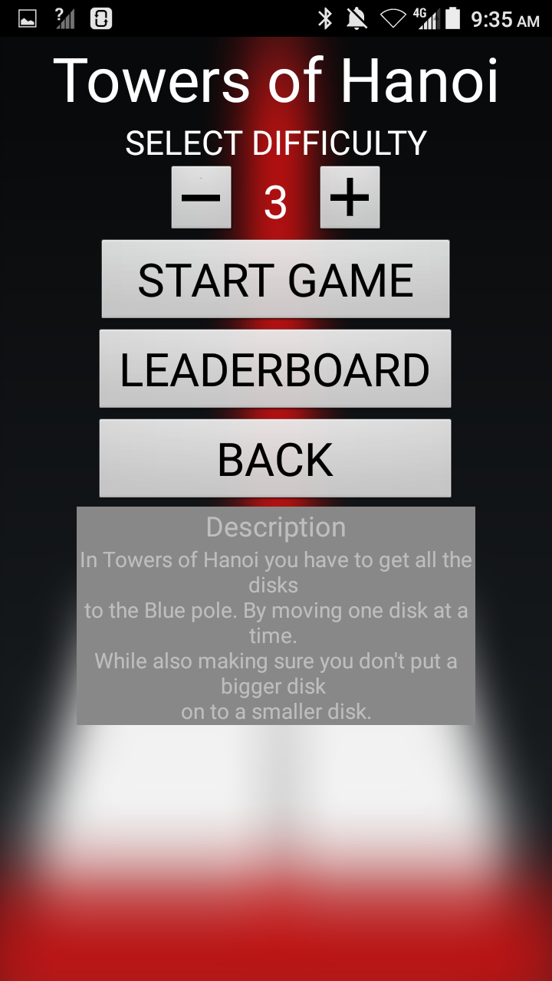
Game menu interface
NOTES:
Each game uses the same menu interface, providing a consistent look and feel across the application.
Games will range in difficulty (information for difficulty will be provided in the description).
Figure 2: Menu Interface (Martin)

Slide 6
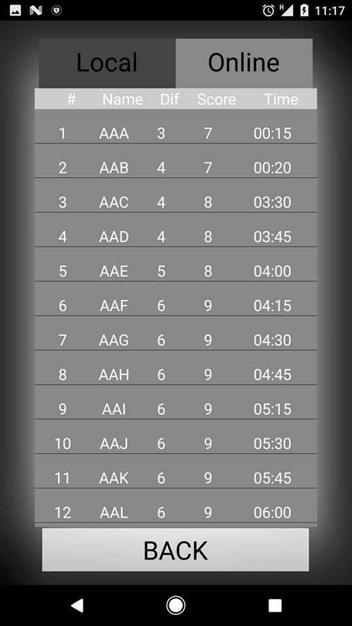
Leaderboard Interface
Notes:
leaderboard interface shared across games.
Leaderboard is a scrollable list is updated from local database in the application.
Shows top 20 or 100 players.
Local leaderboard
Figure 3: Leaderboard Interface

Slide 7
Towers of Hanoi:
Presented by Ryan:

Slide 8
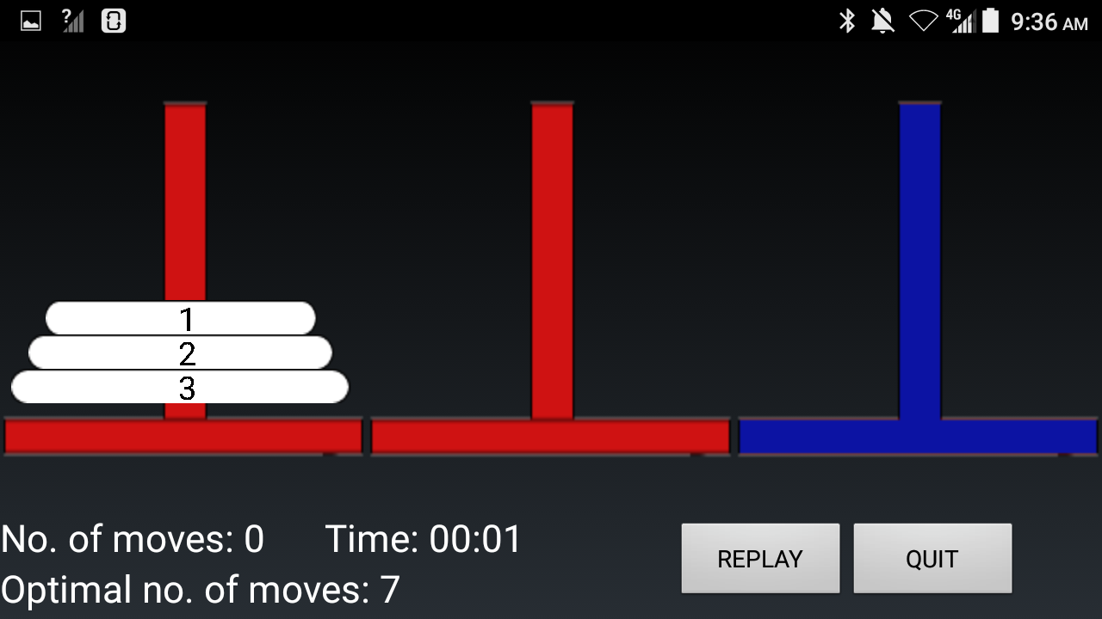
Towers of Hanoi interface:
Notes:
The timer will be recorded and be viewable from the leaderboard.
Once the game has ended the score will be submitted for evaluation to the leaderboard.
Disks display numbers to make it easier to differentiate.
Optimal number of moves will also be displayed as to challenge the player.
Player can increase number of disks, but cannot increase the number of poles.
Figure 4: Towers of Hanoi interface (Ryan)

Slide 9
Dice Roll:
PRESENTED BY RYAN (LIVE DEMONSTRATION BY MARTIN):

Slide 10
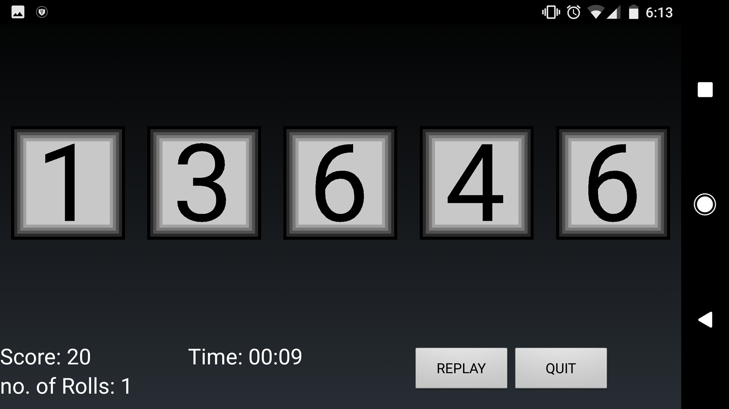
Dice Roll interface:
Notes
What is Dice Roll? Dice Roll is a game of luck, the objective is to obtain the highest score, by rolling two or more identical values. The game will end once all the dice have different values.
Dice Roll utilizes the sensor Accelerometer, to simulate the ability of rolling dice.
Maximum of 5 dice, minimum of 2.
Will show the values. If the dice have identical values, allows for more rolls.
Figure 5: Dice Roll interface (Martin)

Slide 11
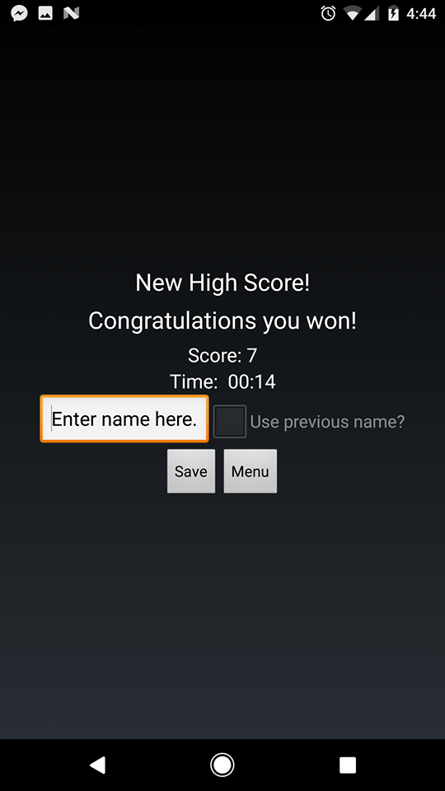
Hooray you’ve won!!
Upon winning the game.
Allows the player to use their previous name, throughout multiple games.
Displays score, and time of last game session.
Save button will only be enabled if the players score can be added to the leader board(top 20, or top 100).
Figure 6: User input (Martin)

Slide 12
Working prototype:
Presented by Martin.

