Slide 1
S.C.a.R. arcade
Presented by Saxon, Ryan and MARTIN.

Slide 2
What is S.C.a.R. arcade?
A game arcade, initially featuring 2 different games:
Tower of Hanoi
Memory test (Deck of cards).
Possible stretch goals:
Features cloud-integrated leaderboards.
Adjustable games library.
Discussed towards end of presentation.
Possible third game implemented (Gyroscope ball maze).

Slide 3
Why a game arcade?
Developing games provides us the opportunity to utilize the skills taught in this course related to mobile application development, including:
Programming with C#
Event driven programming
Use of sensors
Utilizing cloud services
Additionally, game development is a sensible, realistic goal because the foundational knowledge has been provided; it just needs to be expanded upon.

Slide 4
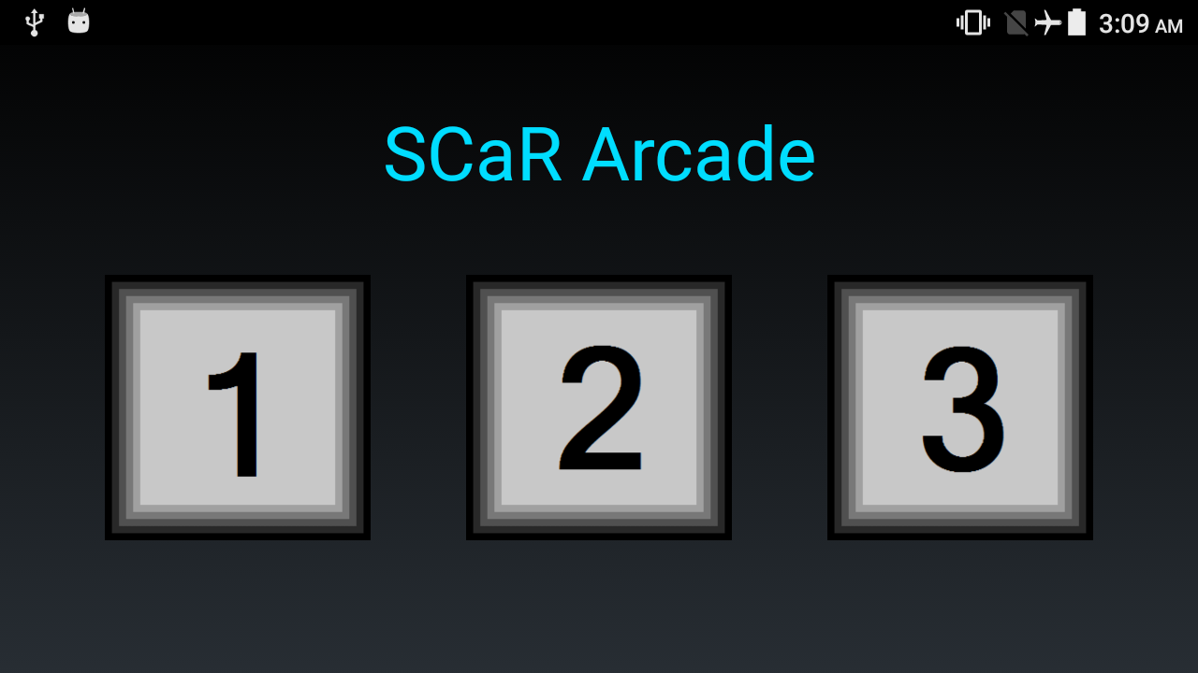
Game selection interface
Notes:
This is the screen that users are presented with upon starting the application.
Grid layout with selectable buttons to run a specific game.
Simple, informative, conveys all necessary information while efficiently using screen ‘real-estate’.
Figure 1: Game selection interface v.1 (Ryan)

Slide 5
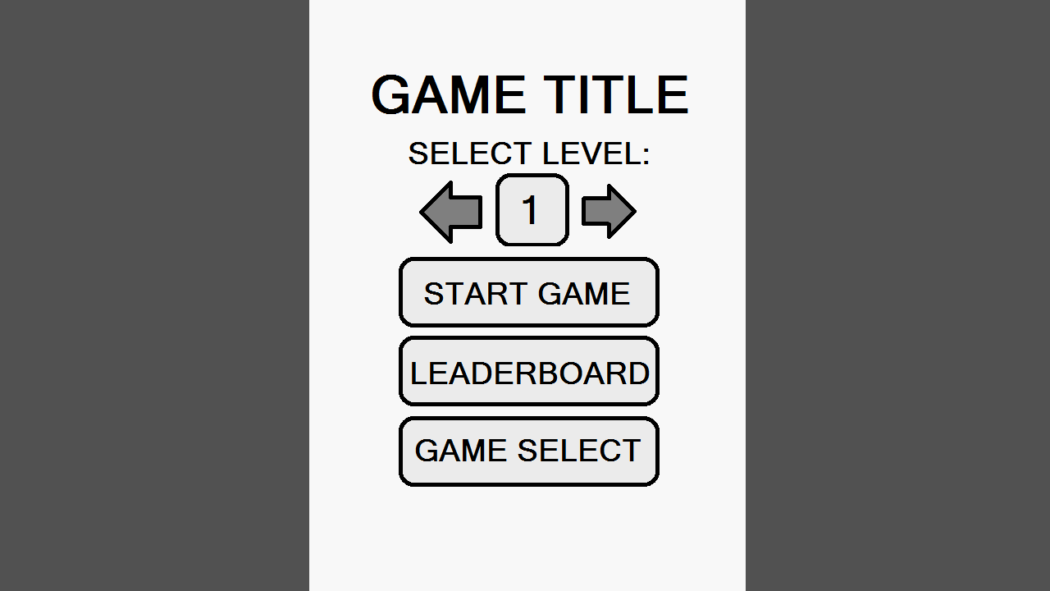
Generic game menu interface
NOTES:
Each game uses the same menu interface, providing a consistent look and feel across the application.
Aesthetic variations can be applied to uniquely identify games (colour scheme, background, game title).
Each game will have 5 levels.
Level 5 will have an exponentially high difficulty.
Memory test: hint will disabled, number of cards will increase, and cards will re-shuffle upon fail.
Tower of Hanoi: Number of disk will increase to 8.
Figure 2: Menu Interface
(Charles)

Slide 6
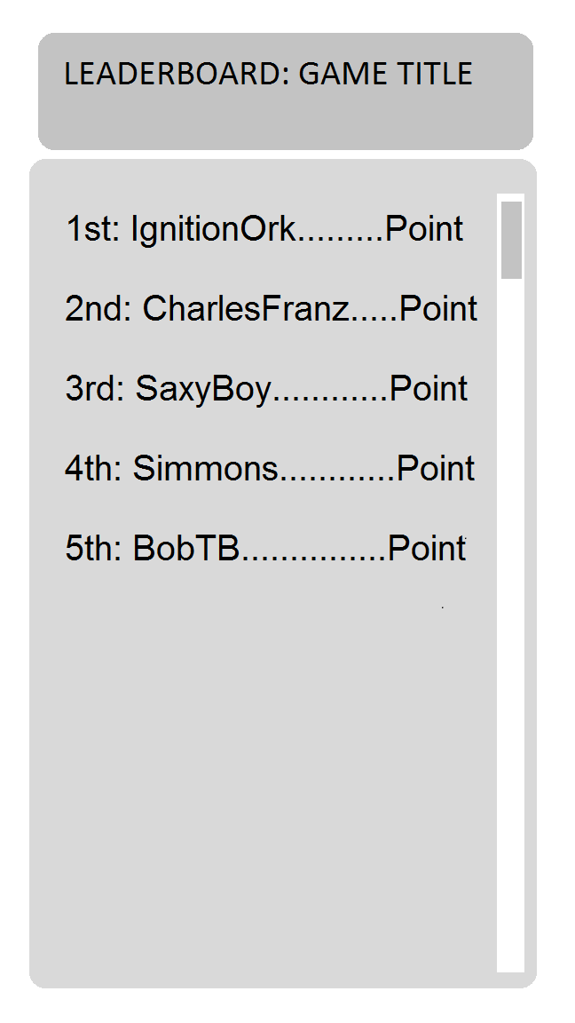
Leaderboard Interface
Notes:
Generic leaderboard interface shared across games.
Game title colour scheme vary across games.
Leaderboard is a scrollable list view updated from local database in the application.
Shows top 100 players.
Score from previous game is highlighted in leaderboard.
Scores with matching name are highlighted in bold.
Figure 3: Leaderboard Interface

Slide 7
Development Plan:

Slide 8
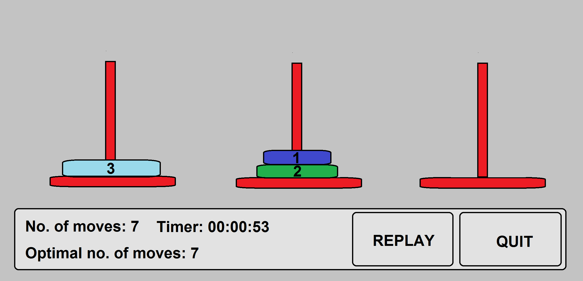
Tower of Hanoi interface:
Notes:
The timer will be recorded and be viewable from the leaderboard (if the user is placed in the top 100).
Once the game has finished the score will be submitted to the cloud services.
Options of reply, and quitting the game.
Disks will display numbers to make it easier to differentiate.
Note the optimal number of moves will also be displayed as to challenge the player to match it.
Figure 3: Tower of Hanoi interface (Ryan)

Slide 9
Tower of Hanoi:
Presented by Ryan:

Slide 10
Memory Test (Deck of Cards)
PRESENTED BY Saxon:

Slide 11
Optional Features
Adjustable games library
Add/Remove games
Additional games available through cloud
Cloud-based Leaderboard
Track country data (Google maps API?)
Single database stored on cloud (top 100)

Slide 12
Thank you.

