Slide 1
S.C.a.R. arcade
Presented by Saxon, Ryan and MARTIN.
Notes:
Greetings gentlemen, I am Martin and today I’ll be introducing our application Scar arcade, while also running through some of the components as well as some of the issues anticipated and solutions to those issues. Ryan will then talk about a game in the application and its issues and solutions. Then Saxon will do the same and wrap up the talk.

Slide 2
What is S.C.a.R. arcade?
A S.C.a.R. is a Game Manager application.
It is designed for the Android OS, featuring 2 different games:
Tower of Hanoi
Picture Memory test.
Possible stretch goals:
Features cloud-integrated leaderboards.
Adjustable games library.
Possible third game implemented.
Notes:
Scar arcade is a Game manager designed for Android with the ability to manage and run games and keep track of personal high scores.

Slide 3
Why a game arcade?
Developing games provides us the opportunity to utilize the skills taught in this course related to mobile application development, including:
Programming with C#
Event driven programming
Use of sensors
Utilizing cloud services
Additionally, game development is a sensible, realistic goal because the foundational knowledge has been provided; it just needs to be expanded upon.
Notes:
Why did we choose this application, well games are a great way to utilize the skills taught in INFT2050, but it would be silly to try and implement all of the skills into just one game. When you can focus skills, like coding sensors for example with a game dedicated to using a sensor for an action. Grouping these games together in a manager seemed like the most logical step, this also gives us the ability to implement more skills like cloud services in leader boards.

Slide 4
Development Plan:
Phase: | Description:
1 | Design: Interface Navigational mapping of application Games to be implemented. Leaderboard.
2 | Prototype: Build interfaces (game, menu) from design plan Connect games, and menus together. Build prototype of games. Leaderboard (storage).
3 | Test: Navigational mapping. Different phone specifications (screen size, and android version). User inputs. Leaderboard.
4 | Finalize, and Deploy
Notes:
We have a four phase development plan, That includes a Design phase, prototyping phase, testing phase and lastly a finalizing and deployment phase.

Slide 5
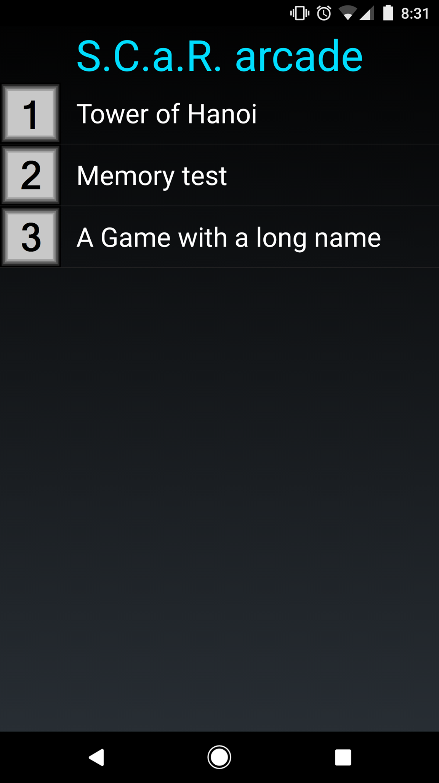
Game selection interface
Notes:
This is the screen that users are presented with upon starting the application.
Linear layout(vertical) with selectable buttons to run a specific game.
Each item will display the name, and a button to show description/rules of the game.
Simple, informative, conveys all necessary information while efficiently using screen ‘real-estate’.
Figure 1: Game selection interface v.1 (Ryan)
Notes:
The game selection interface is the start point of the application, that gives the user the option to pick a program they want to run, it shows the title and logo of the game.

Slide 6
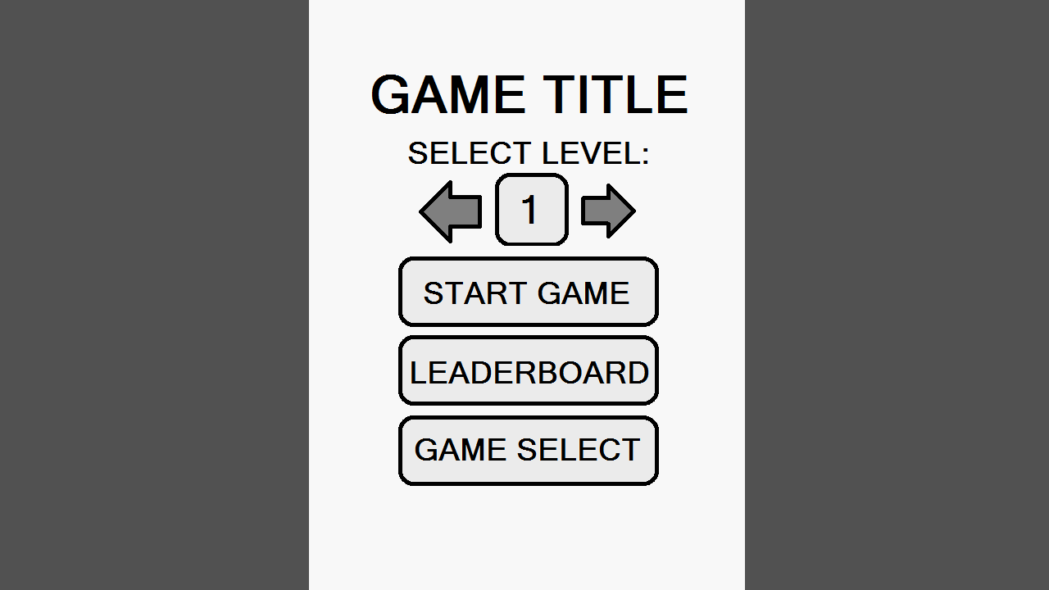
Generic game menu interface
NOTES:
Each game uses the same menu interface, providing a consistent look and feel across the application.
Aesthetic variations can be applied to uniquely identify games (colour scheme, diffused background, game title).
Each game will range in difficulty (information for difficulty will be provided in the description).
Figure 2: Menu Interface
(Martin)
Notes:
The game menu interface is the hub for games that has a difficulty modifier a start program button and a open leader board button and a way of getting back to the game selection interface.

Slide 7
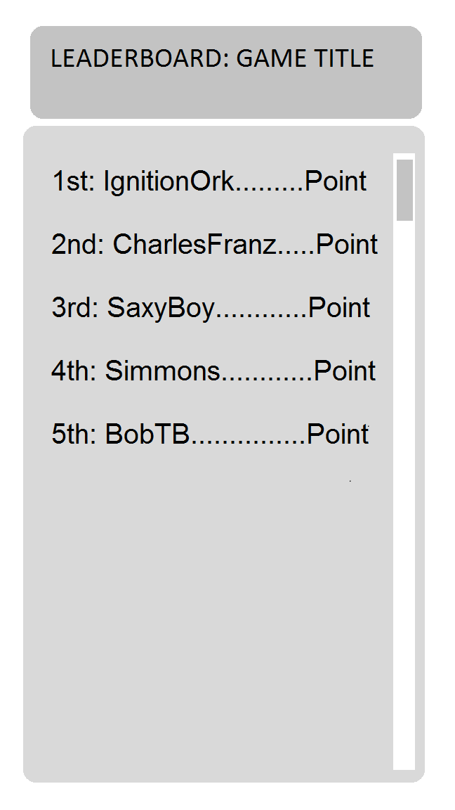
Leaderboard Interface
Notes:
Generic leaderboard interface shared across games.
The background will be based upon game menu interface.
Leaderboard is a scrollable list updated from local database in the application.
Shows top 100 players.
Score from previous game is highlighted in leaderboard.
Figure 3: Leaderboard Interface
Notes:
The leader board interface is a display for personal high scores that have been recorded after a game has ended.

Slide 8
Issues anticipated, and solutions:
Problems:
Solutions:
Deployment to various Android OS’s.
Unable to connect to cloud-services.
Unable to save necessary game data (scores, or game state).
Abnormalities in positioning application components.
Android OS:
Specify minimum Android OS.
Specify target Android OS.
cloud-services:
Upcoming class material.
Saving game data:
Implement procedures for saving, and updating high-scores.
Abnormalities:
Research components for layout.
Test different parameters, and layout managers.
Notes:
Some of the issues with these interfaces can be abnormalities when positioning application components, this can be over come by researching and testing different layouts and views.
Another is the issue of updating files from cloud services if a online leader board was to be implemented these solution may come up in the upcoming class materials, so reading ahead would be necessary. Here is Ryan to explain His game and the issues he might face and some solutions.

Slide 9
Tower of Hanoi:
Presented by Ryan:

Slide 10
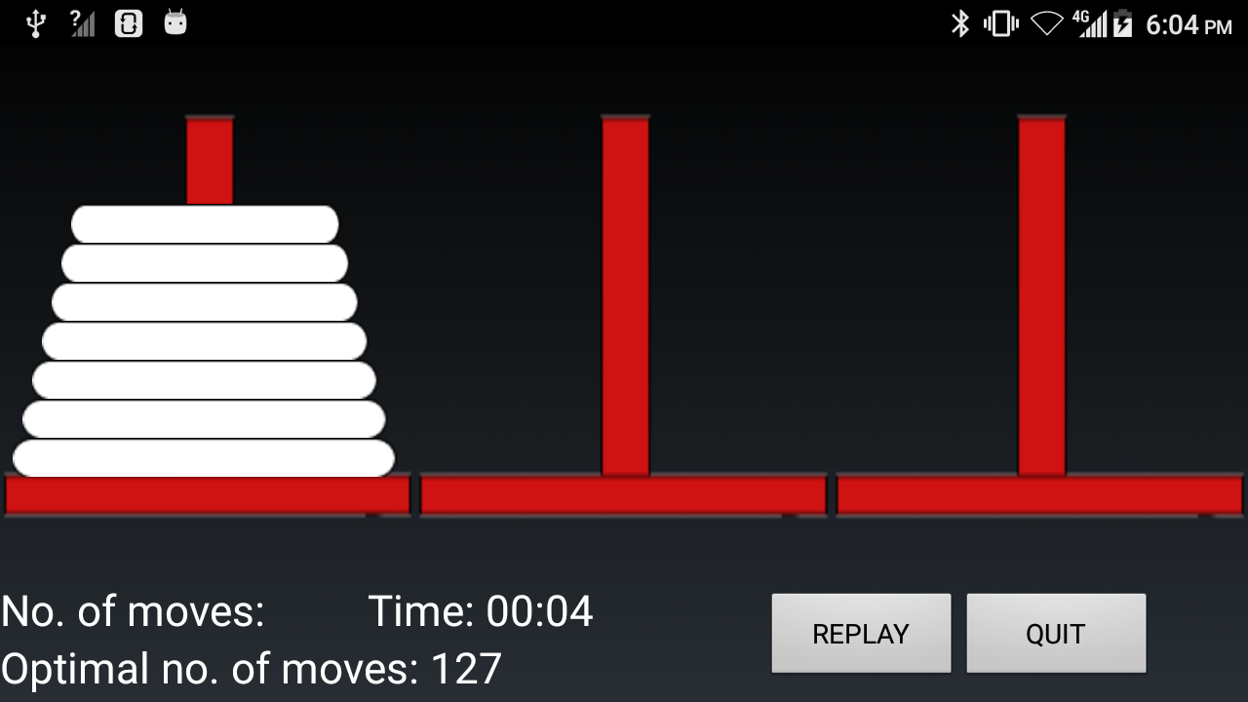
Tower of Hanoi interface:
Notes:
The timer will be recorded and be viewable from the leaderboard.
Once the game has ended the score will be submitted for evaluation to the leaderboard.
Disks will display numbers to make it easier to differentiate.
Optimal number of moves will also be displayed as to challenge the player.
Player can increase number of disks, but cannot increase the number of poles.
Figure 3: Tower of Hanoi interface (Ryan)

Slide 11
Tower of Hanoi Problems/Solutions:
Problems
Solutions:
Drag, and drop functionality.
Event handlers will not be triggered correctly or at all.
Image sizes.
Images decrease in size as number of disks are created, with distance between disks increase.
Freedom of customization.
Implementing game logic.
Incorrect functions not being implemented correctly.
Unforeseen exceptions thrown
Drag and drop:
Additional research into user input data collection, for triggering key event handlers.
Image size:
Downscaling image resolution to fit a desired screen.
Setting an image size to a set value.
Freedom of customization:
Limit number of disks.
Fixed number of poles.
Game logic:
Research into the rules of the game and its components.

Slide 12
Memory Test (Deck of Cards)
PRESENTED BY Saxon:

Slide 13
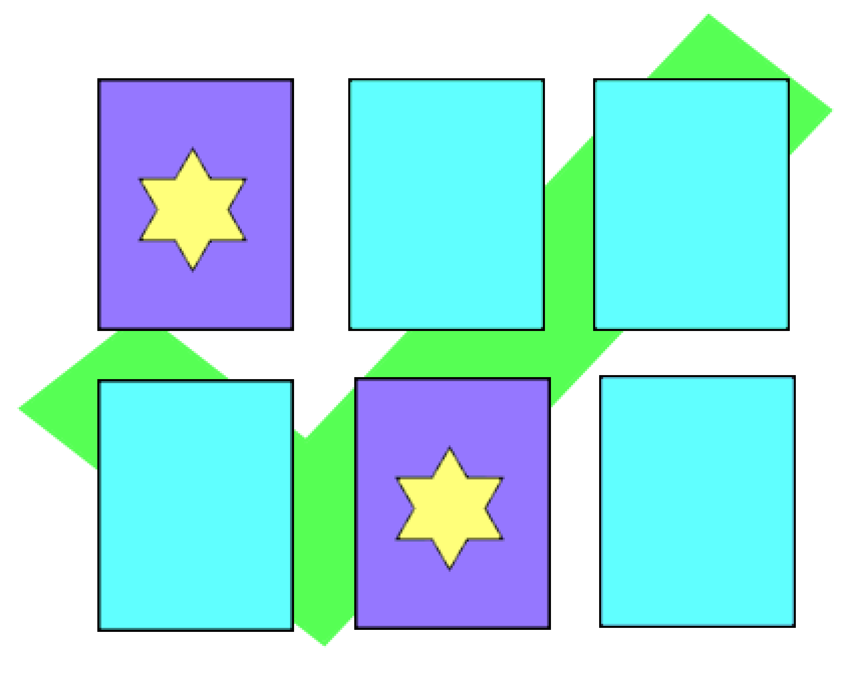
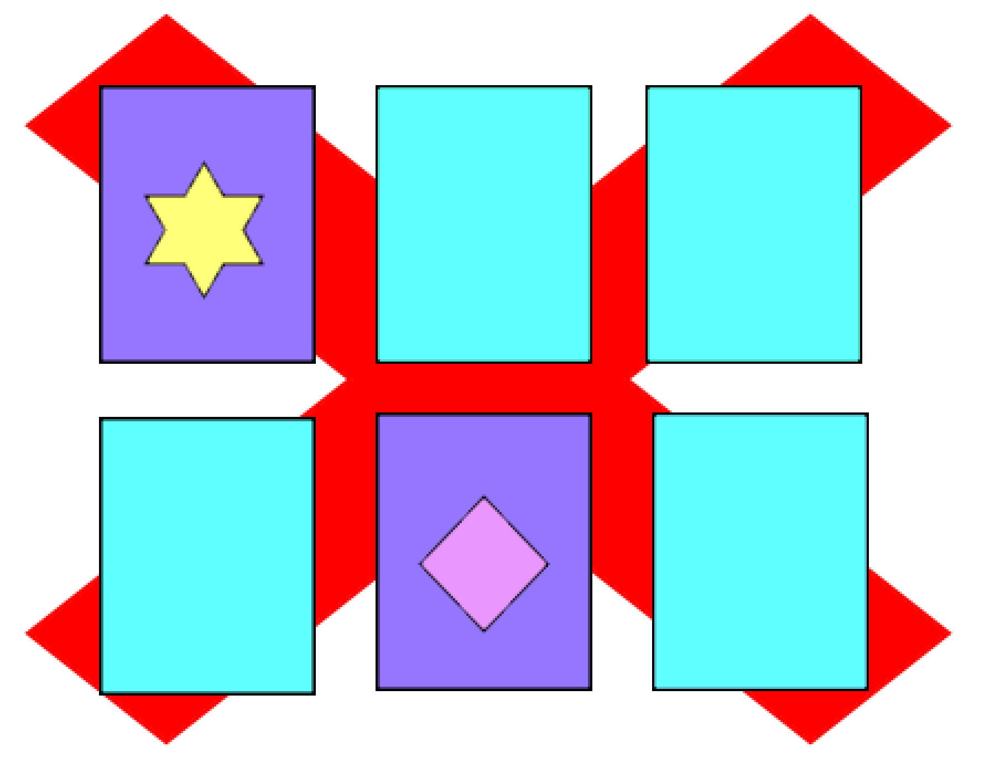
Memory Test (Deck of Cards)
Notes
Memory test difficulties: hint can be disabled, number of cards can increase, and cards can re-shuffle upon fail.
Once the game has ended the score will be submitted for evaluation to the leaderboard.
Player can increase number of cards, but cannot increase the time or the number of failures.

Slide 14
Memory Test Problems/Solutions:
Problems
Solutions:
Image sizes.
Images decrease in size as number of pairs are created, with distance between cards decreased.
Freedom of customization.
Implementing game logic.
Incorrect functions not being implemented correctly.
Cards
Shuffling.
Animations
Image size:
Downscaling image resolution to fit a desired screen.
Setting an image size to a set value.
Freedom of customization:
Limit number of pairs.
Fixed time/failures.
Having a deck on the side to pull new pairs
Game logic:
Research into the rules of the game and its components.

Slide 15
Optional Features
Adjustable games library
Add/Remove games
Customizable ordering of games in menu:
Alphabetically
Or by the user’s preference.
Additional games available through cloud
Cloud-based Leaderboard
Track country data (Google maps API?)
Single database stored on cloud (top 100)

Slide 16
INFT2050 Techniques used in this application.
Layout manager:
Positioning of key components.
Modulization of distinct components.
UI design
Decluttered
Avoiding colour confrontation
User friendly controls scheme
Graphics
Simple graphics
Sprite Generation

Slide 17
Resources required and where to find them.
Menus
https://developer.xamarin.com/guides/android/user_interface/working_with_listviews_and_adapters/part_3_-_customizing_a_listview's_appearance/
https://developer.xamarin.com/guides/android/user_interface/designer_overview/designer_walkthrough/
Sprite Clipping
https://uonline.newcastle.edu.au/bbcswebdav/pid-3195529-dt-content-rid-10647750_1/xid-10647750_1
http://gamecodeschool.com/android/coding-android-sprite-sheet-animations/
Cloud
(Week 7-11) https://uonline.newcastle.edu.au/webapps/blackboard/content/listContent.jsp?course_id=_1387923_1&content_id=_3110559_1&mode=reset
Drag and Drop
https://developer.xamarin.com/samples/mac/DragAndDropExample/
https://blog.xamarin.com/android-tricks-supporting-drag-and-drop-in-an-app/

Slide 18
Thank you.

