Slide 1
S.C.A.R Arcade:
Presented by Saxon, Charles, and Ryan.

Slide 2
What Is SCAR ARCADE?
A game arcade, featuring 3 different games:
Tower of Hanoi
Memory test (Deck of cards)
Ball Maze (Gyroscope)

Slide 3
Why A GAME Arcade?
Developing games provides us the opportunity to utilize the skills taught in this course related to mobile application development, including:
Programming with C#
Event driven programming
Use of sensors
Additionally, game development is a sensible, realistic goal because the foundational knowledge has been provided; it just needs to be expanded upon.

Slide 4
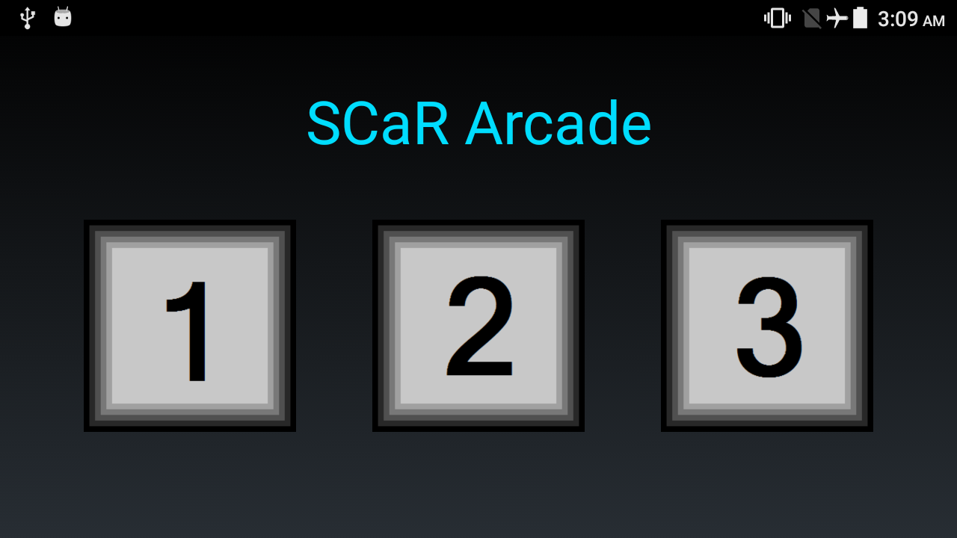
SCAR ARCADE GAME Selection INTERFACE
Game Selection Interface details:
Game Selection Interface. Picture taken by Ryan.
Starting screen of the application.
Grid layout with clickable buttons to run a specific game.
Simple, informative, conveys all necessary information whilst cleverly using screen ‘real-estate’.

Slide 5
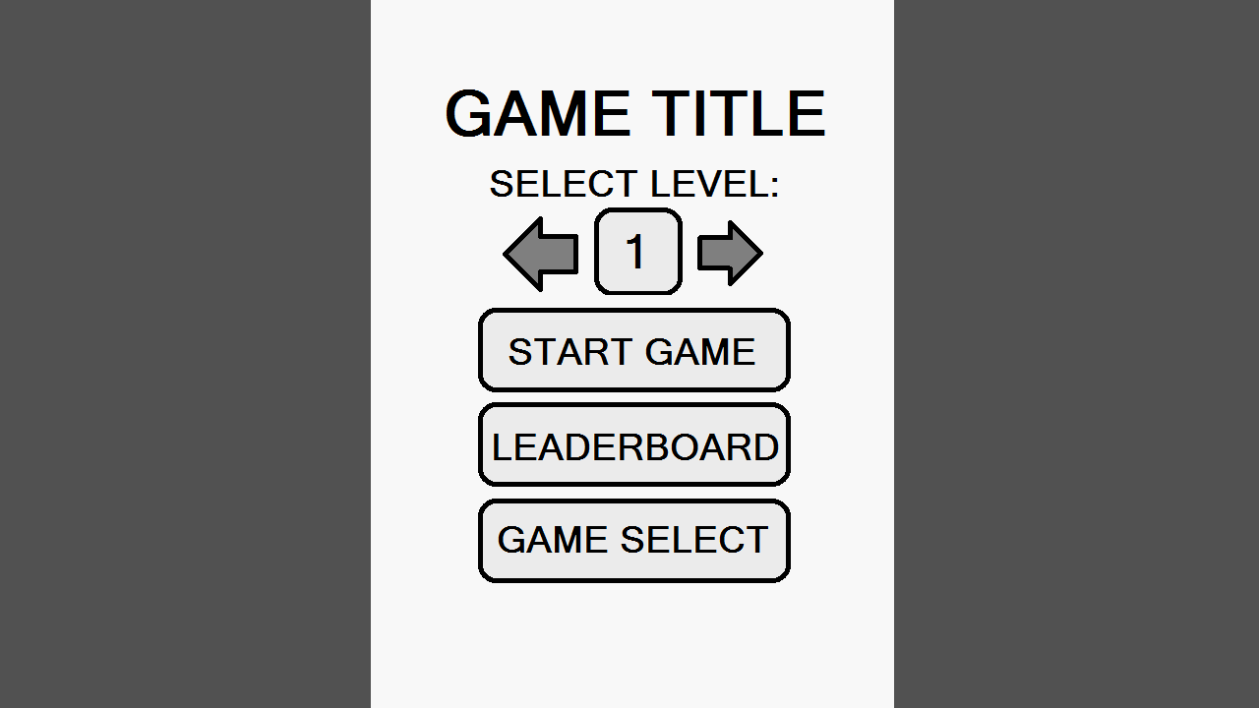
GAME INTERFACE: GENERIC MENU DESIGN
NOTES:
DESIGN CREATED BY CHARLES
Each game uses the same menu layout, providing a consistent look and feel across the application.
Aesthetic variations can be used to uniquely identify games (colour scheme, background, game title).
Each game will have 5 levels.

Slide 6
LEADERBOARD DESIGN

Slide 7
Tower Of Hanoi:

Slide 8
Memory Test (Deck of Cards)

Slide 9
Ball Maze (Gyroscope)

Slide 10
OPTIONAL FEATURE: CLOUD-BASED LEADERBOARDS

Slide 11
THANK YOU.

