Slide 1
Summary Extraction along with sentiment analysis
Group-2
Members:
Pooja Rani Nayak
Mrudulaiswarya Subha Vyakaranam
Venkata Sandeep Pesala
Sagar Mahadev Panchal
Mani Aditya Tellakula
Prabhu Kumar Sambar
Sandeep Kumar Balaga
Mentor
Karthik

Slide 2
Business problem
To extract Summary of E-books along with sentiment analysis.
Objective
To extract E-books of your choice and extract summary ,categorize summary as positive , negative or neutral. Build a NLP model to achieve the said objective with accepted accuracy of 75% and above.

Slide 3
PROJECT FLOW

Slide 4
Text Pre Processing

Slide 5
Stop Words:
The words which are generally filtered out before processing a natural language are called stop words. These are actually the most common words in any language (like articles, prepositions, pronouns, conjunctions, etc) and does not add much information to the text.
Word Frequency:
Term frequency is commonly used in Text Mining, Machine Learning, and Information Retrieval tasks. As documents can have different lengths, it's possible that a term would appear more frequently in longer documents versus shorter ones

Slide 6
Tokenization :
Tokenization is the process of tokenizing or splitting a string, text into a list of tokens. One can think of token as parts like a word is a token in a sentence, and a sentence is a token in a paragraph.
Word Tokenization:
Tokenization is essentially splitting a phrase, sentence, paragraph, or an entire text document into smaller units, such as individual words or terms. Each of these smaller units are called tokens. Check out the below image to visualize this definition: The tokens could be words, numbers or punctuation marks.
Sentence Tokenization:
Sentence tokenization is the process of splitting text into individual sentences. For literature, journalism, and formal documents the tokenization algorithms built in to spacy perform well, since the tokenizer is trained on a corpus of formal English text.

Slide 7
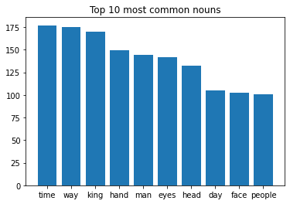
Top 10 Most Common Nouns:

Slide 8
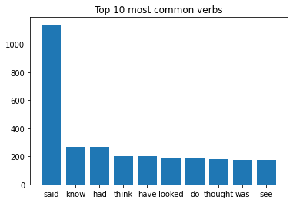
Top 10 Most Common Verbs:

Slide 9
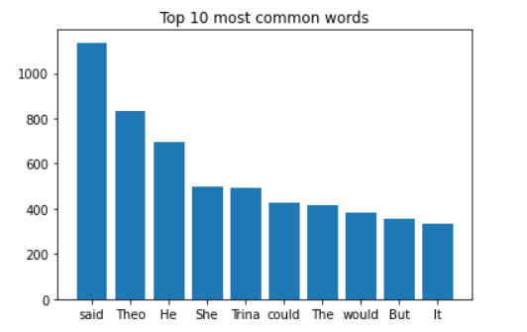
Top 10 Most Common Words:

Slide 10
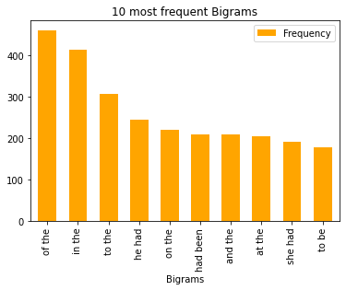
10 Most Frequent Bigrams:

Slide 11
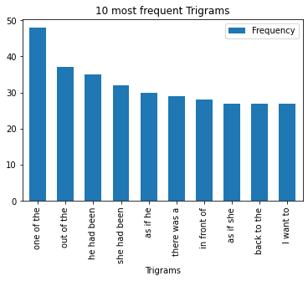
10 Most Frequent Trigrams:

Slide 12
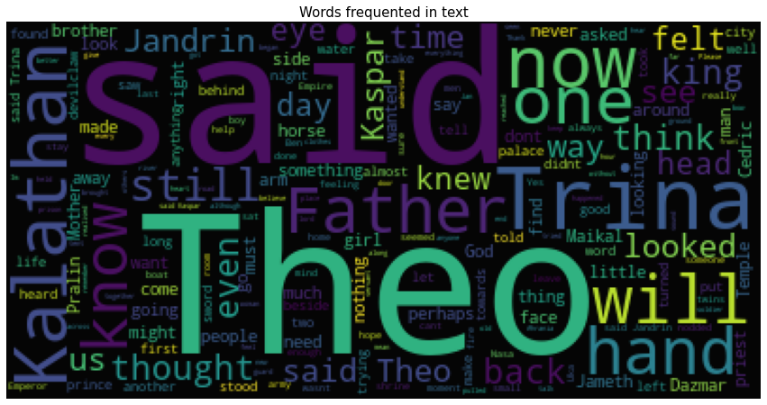
Word Cloud:

Slide 13
Sentiment Analysis

Slide 14
Vader:
VADER ( Valence Aware Dictionary for Sentiment Reasoning) is a model used for text sentiment analysis that is sensitive to both polarity (positive/negative) and intensity (strength) of emotion. It is available in the NLTK package and can be applied directly to unlabeled text data.
Polarity:
Polarity analysis takes into account the amount of positive or negative terms that appear in a given sentence. It is useful to some extent, since it does a good job of structuring data sets

Slide 15
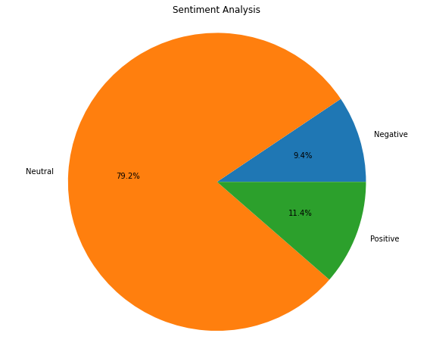
Sentiment Analysis:

Slide 16
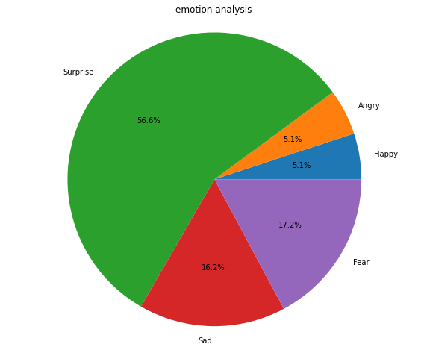
Emotion Analysis:

Slide 17
Model Deployment

Slide 18
Using Stream lit:

Slide 19
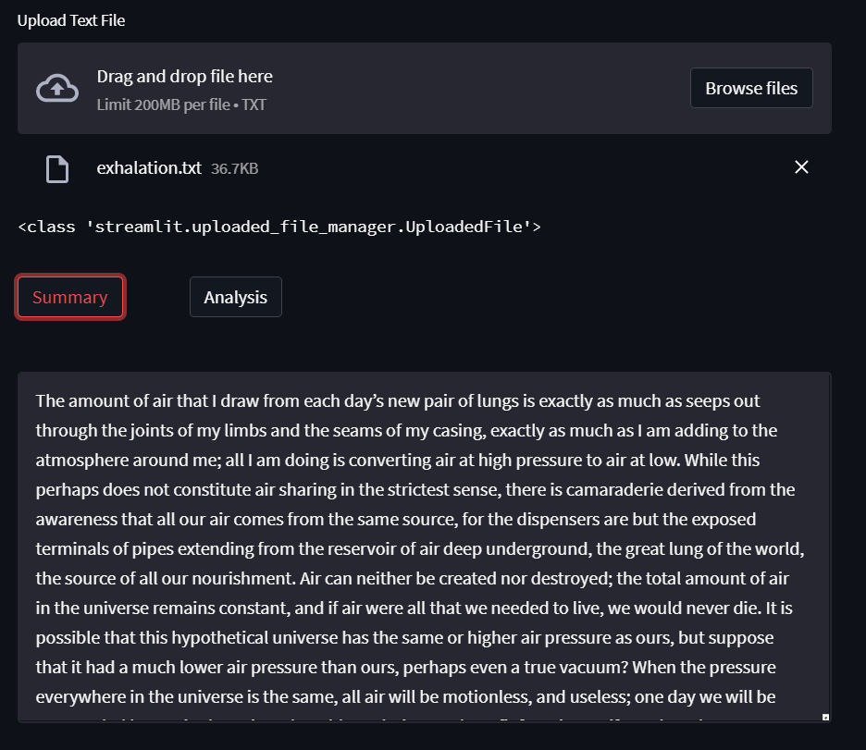

Slide 20
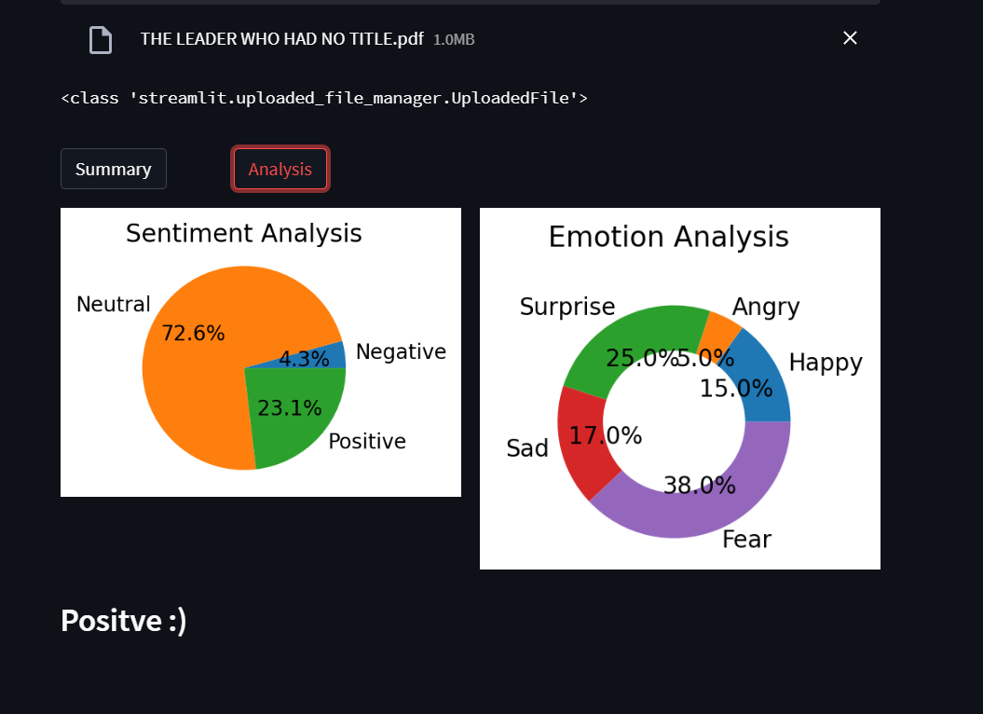

Slide 21
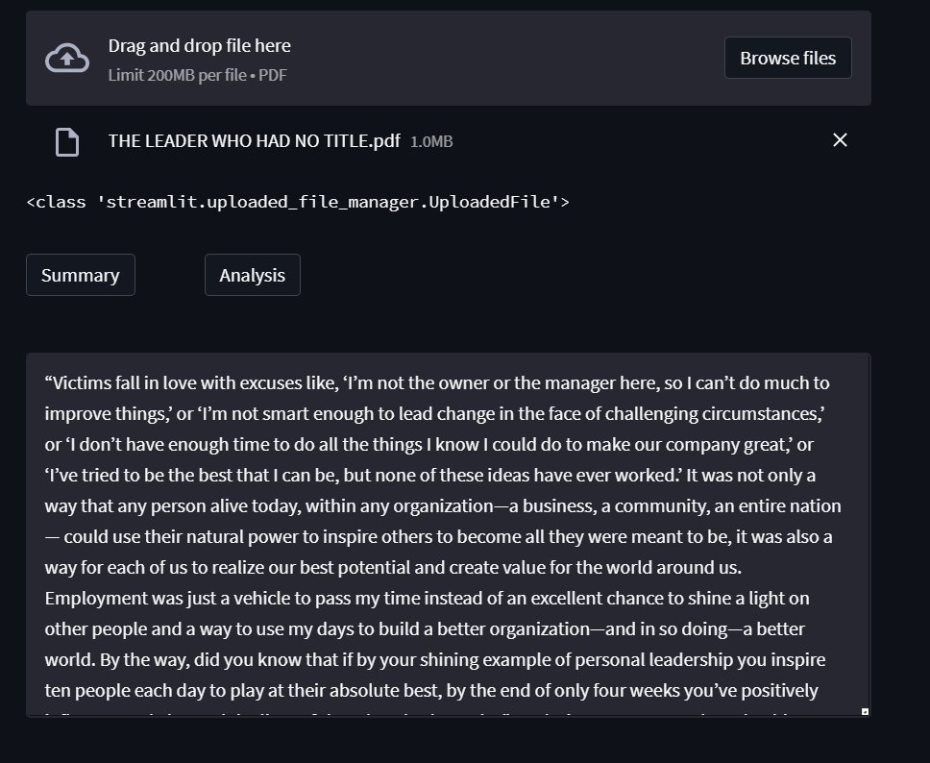

Slide 22
THANK YOU

