Slide 1
Text Summarizer
Presented by
DIVYA BHORIA 2210990293
GEETANSH SOOD 2210990323
OJAS GUPTA 2210990627
Under the supervision of
Dr. Jatin Arora
Department of Computer Science and Engineering
Chitkara University Institute of Engineering & Technology,
Chitkara University, Punjab

Slide 2
Introduction
Problem Statement:- In the current digital age, the sheer volume of news articles published daily across major news websites is overwhelming. Individuals and organizations often save extensive data of these articles on their systems for reference, research, or analysis. However, manually shifting through and extracting pertinent information from these vast repositories is time-consuming and inefficient.
Solution :- This challenge necessitates the development of an automated text summarizer built with machine learning in Python to efficiently and accurately summarize saved news articles. Such a summarizer would serve to:
Enhance Productivity: By quickly condensing lengthy articles into concise summaries, it allows users to grasp the essential information without spending excessive time reading through entire articles.
Improve Information Management: Summaries make it easier to manage and organize large datasets of news articles, aiding in quicker retrieval and better decision-making.
Support Informed Decision-Making: Timely access to summarized information can be crucial for professionals who need to stay updated on current events and trends without the noise of extraneous details.
Facilitate Research and Analysis: Researchers can focus on relevant articles and data points more efficiently, enhancing the quality and speed of their work.
Reduce Cognitive Load: With the increasing information overload, a summarizer can help mitigate the cognitive burden on individuals, allowing them to process and retain important information more effectively.

Slide 3
Motivation of Research
1. Too Much Information: There’s an overwhelming amount of news every day, making it hard for people to keep up. A summarizer can help by providing quick summaries.
2. Save Time: Professionals and researchers spend too much time reading articles. Automated summaries can save time and boost productivity.
3. Better Use of Archived Data: Organizations save many articles for future use. A summarizer can make it easier to find and use important information from these archives.
4. Help Decision-Makers: People in various fields need to stay informed to make good decisions. Summaries can provide the necessary information quickly and accurately.
5. Use New Technology: Advances in machine learning and NLP can be used to create an effective summarizer, showcasing the power of these technologies.
6. Reduce Mental Effort: Reading long articles can be tiring. Summaries can make it easier to understand and remember important information.
7. Personalized Content: A summarizer can provide summaries tailored to individual interests, making the information more relevant and engaging.
8. Academic and Real-World Benefits: This research will contribute to knowledge in NLP and provide useful tools for everyday use.
In short, this research aims to create a tool that simplifies information overload, saves time, improves data use, aids decision-making, leverages new tech, reduces mental effort, offers personalized content, and benefits both academia and practical applications.

Slide 4
Tools & Technologies
Python (Version 3.6 or higher): Python is required as the primary programming language for developing the text summarization tool.
NLTK (Natural Language Toolkit): NLTK will be used for natural language processing tasks such as tokenization, stemming, and lemmatization.
TextBlob: TextBlob, a Python library built on top of NLTK and Pattern libraries, will be utilized for sentiment analysis and other text processing functionalities.
Newspaper3k: The Newspaper3k library will be used for web scraping news articles from major news websites for training and testing the summarization model.
Pandas: Pandas, a powerful data manipulation library, will be used for data preprocessing, analysis, and manipulation tasks.
NumPy: NumPy, a fundamental package for scientific computing with Python, will be used for numerical computations and data manipulation tasks.
Matplotlib: Matplotlib, a comprehensive library for creating static, interactive, and animated visualizations in Python, will be used for data visualization tasks.
Seaborn: Seaborn, a Python visualization library based on Matplotlib, will be used for creating visually appealing and informative statistical graphics.
Plotly Express: Plotly Express, a high-level interface for creating expressive and interactive visualizations, will be used for advanced data visualization tasks, such as interactive plots and dashboards.

Slide 5
Model used
The Natural Language Processing (NLP) model used in the sentiment analysis and exploratory data analysis (EDA) of news articles relies on the TextBlob library, which offers a simplified API for performing various NLP tasks. TextBlob provides a versatile platform for text processing, including sentiment analysis, part-of-speech tagging, noun phrase extraction, and more.
While TextBlob itself is not a deep learning-based NLP model like those found in state-of-the-art frameworks such as TensorFlow or PyTorch, it implements lexicon-based approaches for sentiment analysis. This means that it leverages pre-built sentiment lexicons or dictionaries to assign sentiment scores to words and compute sentiment metrics for text data.
The sentiment analysis process in TextBlob involves tokenization, part-of-speech tagging, and lexicon-based sentiment scoring. TextBlob's sentiment analysis module assigns polarity scores to words based on their semantic orientation (positive, negative, or neutral) and computes sentiment polarity and subjectivity scores for the entire text.
Although TextBlob's approach may lack the complexity and sophistication of deep learning models, it offers simplicity, ease of use, and efficiency, making it suitable for quick sentiment analysis tasks and exploratory data analysis. It is particularly useful when deep linguistic analysis or extensive training data are not readily available or necessary.
In summary, while the NLP model used in this analysis may not be as advanced as deep learning models, TextBlob's lexicon-based approach serves as a practical and accessible tool for conducting sentiment analysis and gaining insights into the sentiment landscape of news articles.

Slide 6
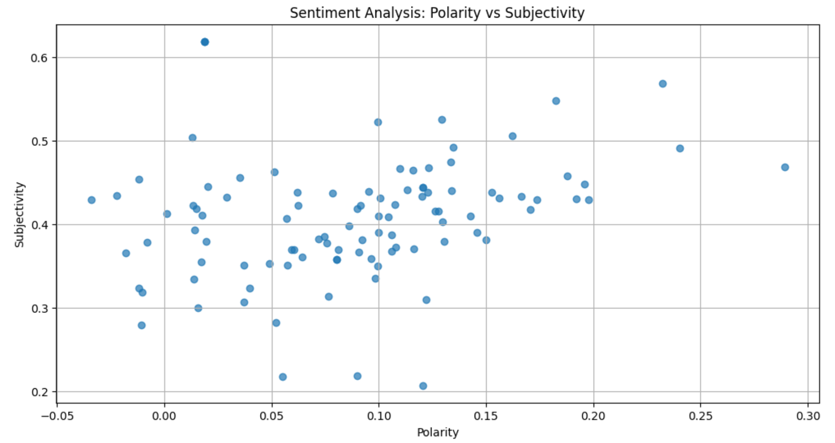
Results
The scatter plot shows the sentiment analysis on the articles, and visualizes the results using scatter plots to show the relationship between sentiment polarity and subjectivity.

Slide 7
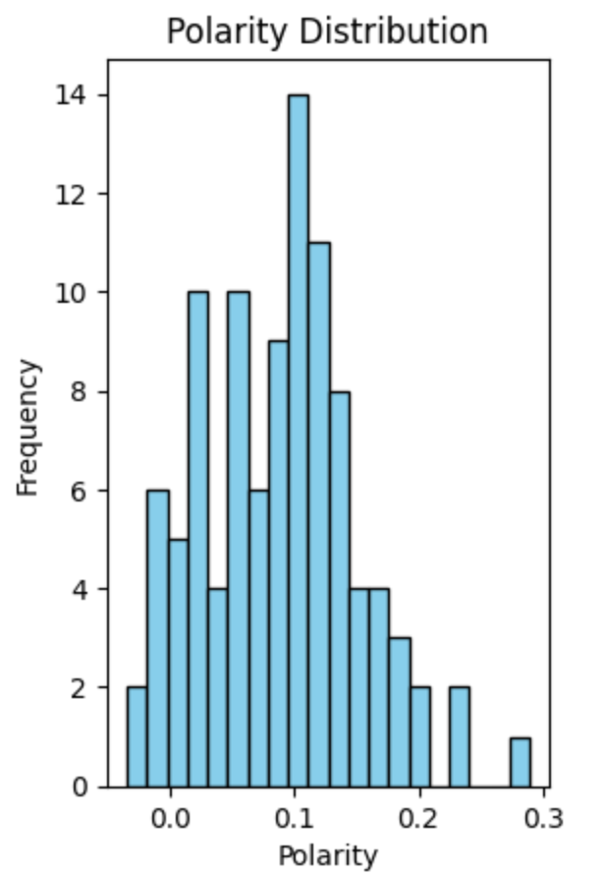
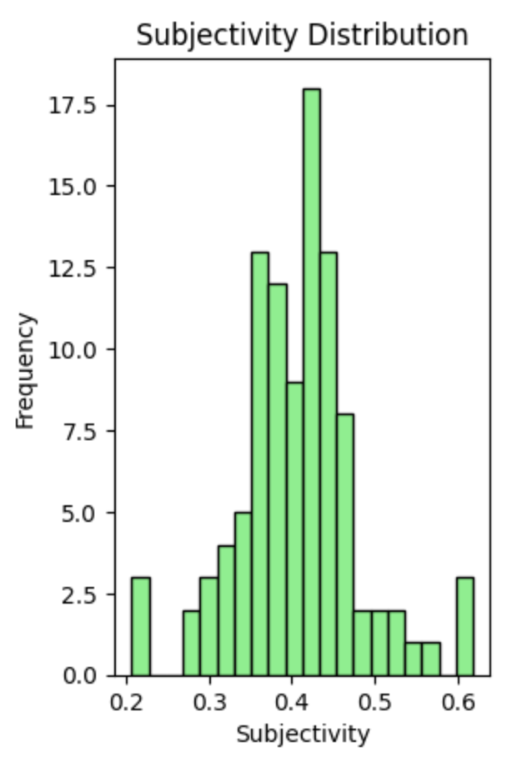
Results
helps visualize how the sentiment polarity scores are distributed across the news articles in your dataset.
helps visualize how the sentiment subjectivity scores are distributed across the news articles in your dataset.

Slide 8
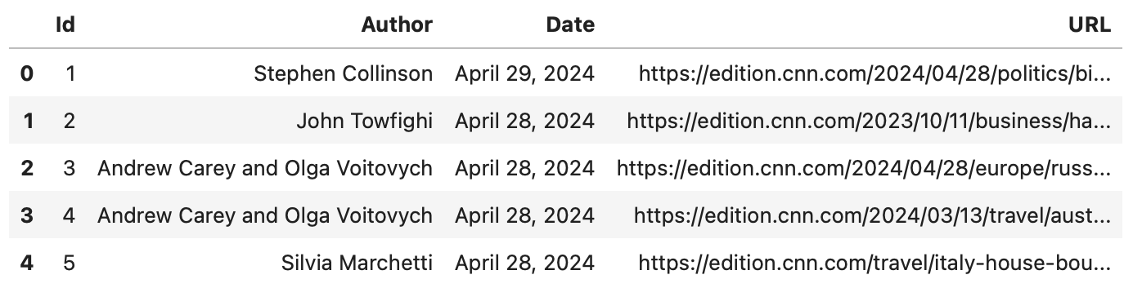
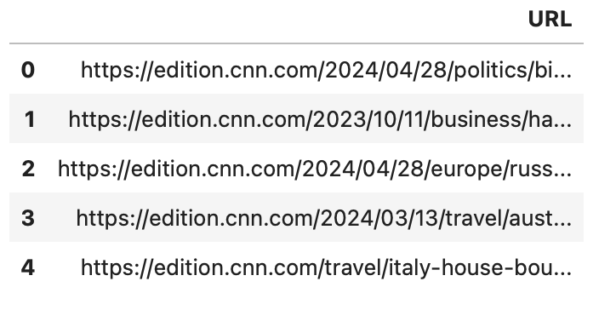
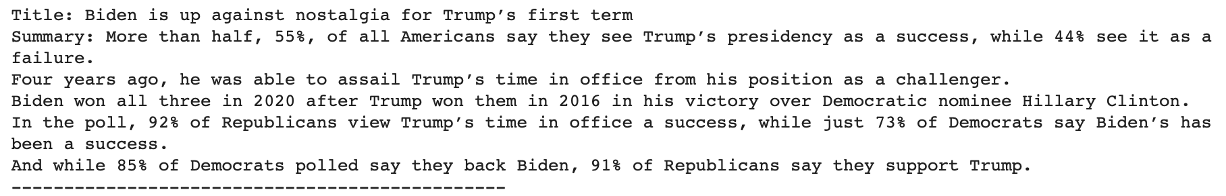
Results
shows the url after column id , author, date have been removed
shows the title and summary of each article specified by the URLs in your CSV file, separated by lines for clarity.

Slide 9
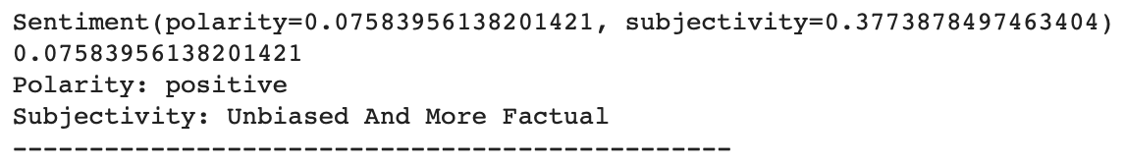
Results
shows the sentiment analysis results (polarity and subjectivity) for each article specified by the URLs in your CSV file, with human-readable interpretations and separators for clarity.

Slide 10
Reference
https://youtu.be/z4DQYprjPSs?si=hnozxqsxFphNkdEl

Slide 11
Thank You

