Slide 1
SpLATS:
SpLATS Lazy Automated Testing System
Ethel Bardsley
Caroline Glassberg-Powell
Christopher Keeley
Joseph Slade
Thomas Wood
Notes:
It is written in Ruby and ultimate aim is to remove the need for hand written unit tests for Ruby
Joe

Slide 2
The problem
Tests are necessary
Writing tests takes time
How do you test tests?
  Exhaustive
  Correctness
The client does often doesn’t understand the benefit
Notes:
Joe

Slide 3
Existing solutions
Manual/System testing
Hand written tests
  Test::Unit
Static Analysis
  Lint (various)
  ZenTest
Dynamic analysis
  Coverage
  Profiling Tools
  IRULAN (Haskell) / Randoop (Java)
Notes:
Joe/Chris

Slide 4
SpLATS features
Automatic generation of Ruby regression tests
Multiple methods of generation
Reproducible tests
Command Line & Graphical User Interfaces
Notes:
Chris?

Slide 5
SpLATS vs the World
Key differences
  Laziness allows more to be inferred
  Multiple Search Methods
Notes:
Chris?

Slide 6
Why Ruby?
JavaScript, Python, Ruby
Ruby
  Everything is an object
  Duck typing

Slide 7
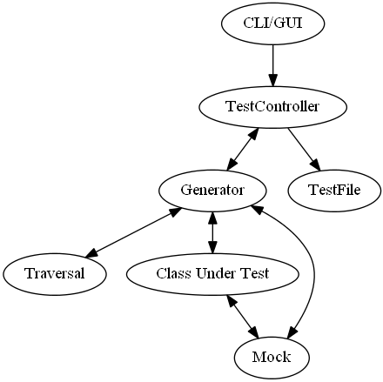
Design
Modular

Slide 8
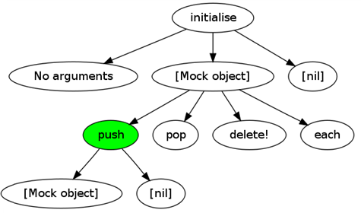
Search Space defined

Slide 9
Generation & Search Space
Select Method
Select Arguments
Execute
  Lazily Select Value
GOTO 10
…
def push(item)
if @item.nil?
@item = item
elsif @next.nil?
@next = LinkedList.new item
else
…

Slide 10
Mock
Schrödinger’s Duck - Quacks like every duck
Interface between search space and the CUT
Method_missing used to store method and argument

Slide 11
Traversal methods
Depth limited
Human
Random

Slide 12
Demonstration
Notes:
Show CLI being run with depth
Show tests generated
Run tests, find regression on example two versions!
Show reproducibility of random directed
Show coverage
Show GUI being run with human
Show graphs generated

Slide 13
Performance
Class Under Test | Search Depth (Mock Depth) | Generation Time/m:s | # Tests Generated | Lines Covered / Total Lines (%)
Addition | 2 | 0:00.051 | 6 | 3/3 (100%)
SimpleTest | 2 | 0:00.064 | 32 | 12/12 (100%)
LinkedList | 2 3 4 | 0:00.056 0:00.147 0:02.118 | 31 306 3859 | 35/47 (74%) 45/47 (96%) 46/47 (98%)
QuickSort | 2 (1) 2 (2) 2 (3) | 0:00.344 0:03.356 5:57.200 | 87 4272 351927 | 8/8 (100%) 8/8 (100%) Not testable
ISBN-Tools | 2 (1) 2 (2) 2 (3) | 0:00.056 0:00.072 Stopped after 30:00 | 13 57 341472 | 10/16 (63%) 10/16 (63%) Not testable

Slide 14
Challenges encountered
Outputting mock types
GUI library problems

Slide 15
Limitations
Only guaranteed to work on subset of Ruby
Exponentially increasing search space
  Currently open problem in academia

Slide 16
Future improvements
Pruning
  Currently only prunes on exceptions
More traversal options
  Genetic (fitness function is difficult to define)
  Feedback directed traversal
Distributable
Laziness
  Allows pseudo whitebox testing

Slide 17
Evaluation
Successfully shows that automatic testing can be done in Ruby
Modular, easy extensible

Slide 18
Questions?

