Slide 1






Gastronomix AI: CULINARY INSIGHT HUB
TEAM MEMBERS:
ADITYA
ADITI SHARMA
KAUSTHUB RAO MOHITE
ROHITH A
GUIDE: SHILPA HARIRAJ
Disclaimer: The content is curated for educational purposes only.

Slide 2
OUTLINE
Gastronomix AI: CULINARY INSIGHT HUB
Abstract
Problem Statement
Aims, Objective & Proposed System/Solution
System Design/Architecture
System Development Approach (Technology Used)
Algorithm & Deployment
Conclusion
Future Scope
References
Video of the Project
Notes:
Going through the outline of what topics are covered in this presentation, following are Abstract
Problem Statement, Aims, Objective & Proposed System/Solution, System Design/Architecture, System Development Approach (Technology Used), Algorithm & Deployment, Conclusion, Future Scope, References, Video of the Project.

Slide 3
ABSTRACT
Gastronomix AI: CULINARY INSIGHT HUB
Gastronomix AI is an advanced culinary intelligence platform designed to elevate the gastronomic experience. Combining state-of-the-art artificial intelligence with a rich culinary database, the platform offers real-time food recognition and categorization from images, empowering users to discover and understand the diverse world of ingredients. Gastronomix AI goes beyond image recognition, providing personalized recipe recommendations, nutritional insights, and dynamic suggestions for pairing ingredients to create delightful and health-conscious meals. With its intuitive interface and comprehensive culinary knowledge, Gastronomix AI redefines the way users engage with food, seamlessly blending technology, creativity, and nutritional awareness.
Notes:
The whole idea behind gastronomix Ai is that, Gastronomix AI is an advanced culinary intelligence platform designed to elevate the gastronomic experience. Combining state-of-the-art artificial intelligence with a rich culinary database, the platform offers real-time food recognition and categorization from images, empowering users to discover and understand the diverse world of ingredients. Gastronomix AI goes beyond image recognition, providing personalized recipe recommendations, nutritional insights, and dynamic suggestions for pairing ingredients to create delightful and health-conscious meals. With its intuitive interface and comprehensive culinary knowledge, Gastronomix AI redefines the way users engage with food, seamlessly blending technology, creativity, and nutritional awareness.

Slide 4
PROBLEM STATEMENT
Gastronomix AI: CULINARY INSIGHT HUB
Gastronomix AI aims to address the prevalent inefficiencies in kitchen inventory management, providing a solution to minimize food waste and enhance operational effectiveness.
Users currently face challenges in promptly and accurately identifying ingredients, hindering the optimization of resources in their culinary pursuits through Gastronomix AI.
The demand for a sophisticated and user-friendly solution, exemplified by Gastronomix AI, is evident, as it seeks to revolutionize culinary practices by minimizing food waste, streamlining user interactions, and promoting sustainable approaches to food consumption.
Notes:
The problem statement, to be specific the problems that are targeted to be solved by the system are;
To address the prevalent inefficiencies in kitchen inventory management, providing a solution to minimize food waste and enhance operational effectiveness.
Face challenges in promptly and accurately identifying ingredients, hindering the optimization of resources in their culinary pursuits
The demand for a sophisticated and user-friendly solution

Slide 5
Gastronomix AI: CULINARY INSIGHT HUB
AIM :
Developing Gastronomix AI, an innovative food inventory management system, the project aims to seamlessly identify and organize ingredients using cutting-edge technology, ultimately minimizing food waste, enhancing user convenience, and promoting sustainable culinary practices through optimal resource utilization.
Notes:
The aim of the project, overall is to develop an innovative food inventory management system, the project aims to seamlessly identify and organize ingredients using cutting-edge technology, ultimately minimizing food waste, enhancing user convenience, and promoting sustainable culinary practices through optimal resource utilization.

Slide 6
Gastronomix AI: CULINARY INSIGHT HUB
OBJECTIVE:
Advanced Ingredient Recognition Implementation:
Streamlined Kitchen Inventory Management Interface:
Minimization of Food Waste and Promotion of Sustainability:
Notes:
Our objectives to be kept in mind and covered during the development of our project are,
Advanced Ingredient Recognition Implementation:
Streamlined Kitchen Inventory Management Interface:
Minimization of Food Waste and Promotion of Sustainability:

Slide 7
Gastronomix AI: CULINARY INSIGHT HUB
PROPOSED SOLUTION
Cutting-Edge Ingredient Recognition: Implement state-of-the-art technology to enable precise identification of ingredients, ensuring accuracy and efficiency in culinary endeavors.
Intuitive Interface Design: Develop a user-friendly interface within Gastronomix AI for seamless kitchen inventory management, enhancing the overall user experience and efficiency.
Sustainable Culinary Practices: By optimizing resource utilization, Gastronomix AI aims to minimize food waste and promote sustainable culinary practices, contributing to a more environmentally conscious approach in food consumption.
Notes:
In order to battle the problems, we have come up with some solutions. These also cover and adhere to our objectives.
These solutions are shown on the screen.

Slide 8
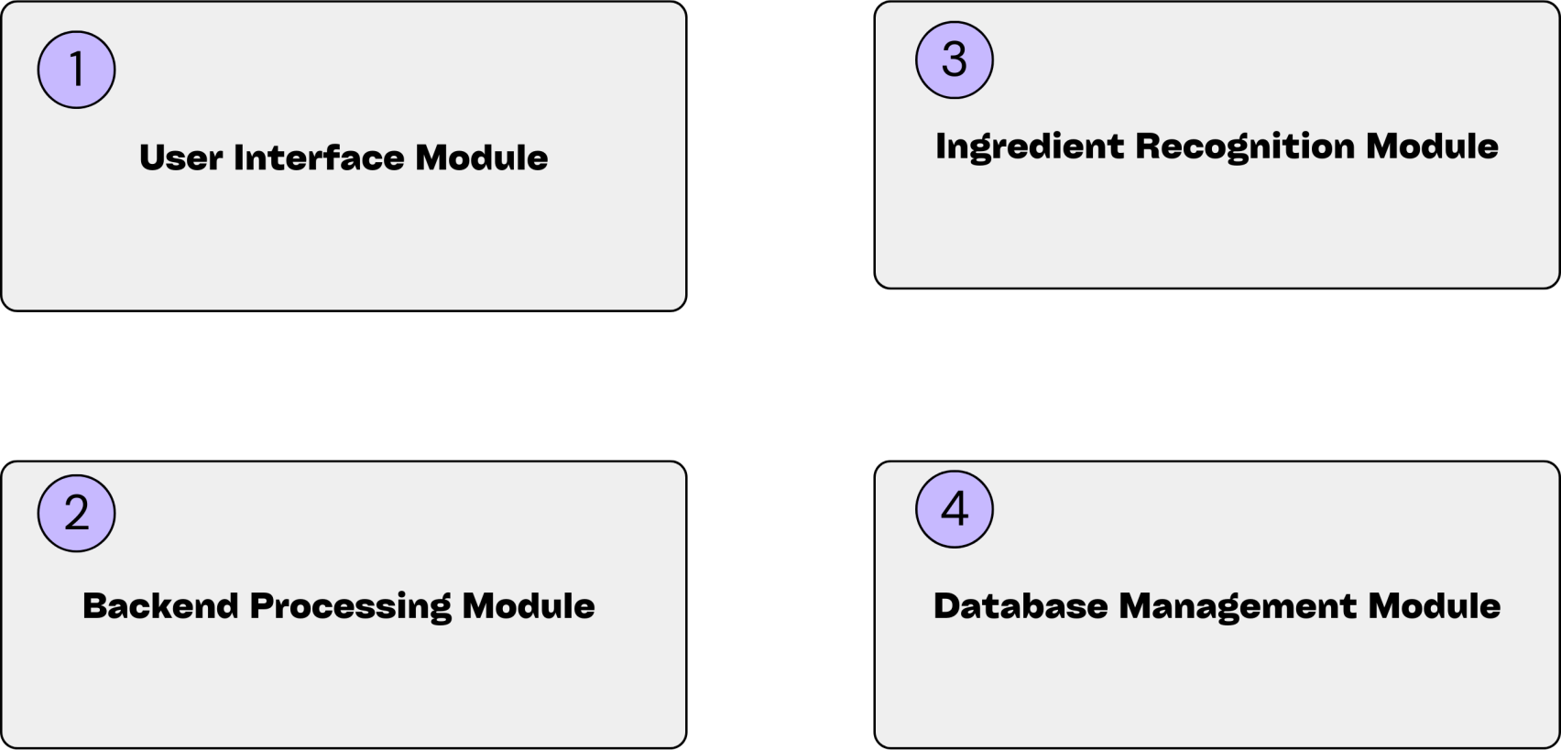
Gastronomix AI: CULINARY INSIGHT HUB
SYSTEM ARCHITECTURE
Fig 1. System architecture
Notes:
The whole idea behind on “how our project has been put along together” is described by the figure on your screen.
Consisting of 4 modules namely, UI module, backend processing module, Ingredient recognition module and Database management module.
All of these work in harmony in order for the system to work.

Slide 9


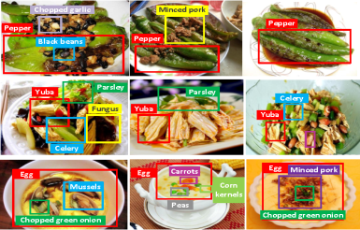

Gastronomix AI: CULINARY INSIGHT HUB
SYSTEM ARCHITECTURE
1. Handles user input and image capture, facilitating communication with the Backend Processing Module.
2.Conducts extensive data processing, integrating with the Ingredient Recognition and Database Management Modules.
3.Utilizes advanced algorithms for ingredient recognition, connecting with external services to identify user inputs.
4.Manages efficient storage and retrieval of user and ingredient data, supporting Gastronomix AI's overall functionality.
Fig 2. System architecture functionality
Notes:
Going into each module specifically is what we cover here. Each of their functionality is given in a much specific but yet shorter way to help understand.

Slide 10
SYSTEM DEPLOYMENT APPROACH
Gastronomix AI: CULINARY INSIGHT HUB
1.Infrastructure Setup:
Establish the required infrastructure, configure hosting environments, and set up servers and databases to create a robust foundation for Gastronomix AI's deployment.
2.Module Deployment and Integration:
Deploy each module systematically, starting with the Database Management Module, followed by the Backend Processing Module and Ingredient Recognition Module. Ensure seamless integration and rigorous testing at each stage.
3.User-Focused Rollout:
Prioritize user experience by deploying the User Interface Module with responsive design for web and mobile platforms. Implement security measures, conduct end-to-end testing, and gradually roll out the system to a limited user base for feedback and refinement.
Notes:
The method used to develop our project follows 3 main approaches, Infrastructure Setup, Module Deployment and Integration and User-Focused Rollout.
All about these are given on the screen.

Slide 11
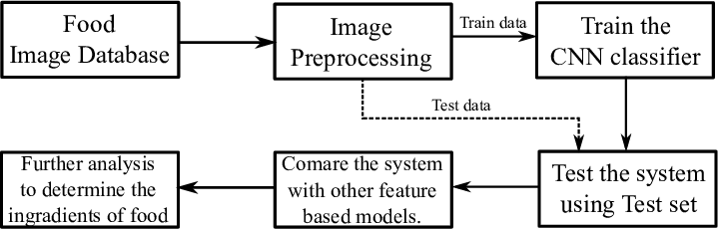
Gastronomix AI: CULINARY INSIGHT HUB
ALGORITHM
Fig 3. Algorithm flowchart

Slide 12
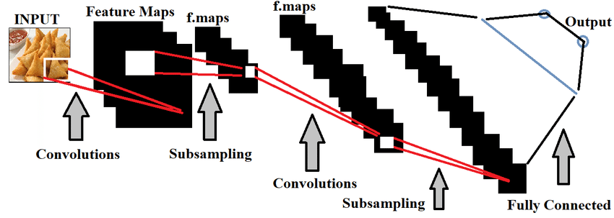
Gastronomix AI: CULINARY INSIGHT HUB
Fig 4. The role of convolutional neural networks in the proposed food classification system.

Slide 13
CONCLUSION
Gastronomix AI: CULINARY INSIGHT HUB
In conclusion, Gastronomix AI emerges as a comprehensive and innovative solution to address the challenges of kitchen inventory management and food waste reduction. By incorporating cutting-edge technology for precise ingredient recognition, providing a
user-friendly interface, and promoting sustainable culinary practices, the system aims to revolutionize the way users interact with their kitchen inventory. Gastronomix AI is poised to enhance efficiency, reduce food waste, and elevate the overall culinary experience, contributing to a more sustainable and environmentally conscious approach to cooking.
Notes:
As coming to an end, we come to a conclusion, this is that our system, “Gastronomix AI” is poised to enhance efficiency, reduce food waste, and elevate the overall culinary experience, contributing to a more sustainable and environmentally conscious approach to cooking.It emerges as a comprehensive and innovative solution to address the challenges of kitchen inventory management and food waste reduction. By incorporating cutting-edge technology for precise ingredient recognition, providing a user-friendly interface, and promoting sustainable culinary practices.

Slide 14
FUTURE SCOPE
Gastronomix AI: CULINARY INSIGHT HUB
1. Smart Ecosystem Integration: Enabling seamless connectivity with smart kitchen appliances for enhanced coordination, elevating Gastronomix AI to a central hub for intelligent cooking processes.
2. AI-Driven Personalization: Harnessing machine learning algorithms to deliver highly personalized recipe recommendations, considering individual preferences and dietary restrictions, ensuring a tailored culinary experience.
3. Collaborative Culinary Community: Fostering a vibrant Gastronomix AI community with collaborative features, facilitating recipe sharing, culinary tips, and ingredient recommendations, creating an engaging and supportive culinary ecosystem.
Notes:
The scope for expansion brings in the addition of newer features to our system, some of these are Smart Ecosystem Integration, AI-Driven Personalization and a Collaborative Culinary Community.

Slide 15
Reference
Gastronomix AI: CULINARY INSIGHT HUB
A data-driven approach to reducing household food waste https://www.sciencedirect.com/science/article/pii/S2352550921003171
The role of reducing food waste for resilient food systems https://www.ncbi.nlm.nih.gov/pmc/articles/PMC7392851/
How A POS Solution Helps Restaurants Deal With Their Challenges https://www.connectpos.com/pos-solution-for-restaurants-deal-with-challenges/
The Management of Meals in Food Service Establishments in the Context of Food Waste—Results of Focus Group Interviews with Employees and Owners“ https://www.mdpi.com/2071-1050/14/15/9258
AI cannot taste the way a chef can’: are chat bots a threat to fine dining? https://www.theguardian.com/environment/2023/aug/16/ai-fine-dining-chefs-restaurants
Notes:
These are the reference materials we went through to bring about magic in our system, and ones that helped us in our development journey.

Slide 16

Gastronomix AI: CULINARY INSIGHT HUB
Notes:
Here’s a video of our system working.

Slide 17
THANK YOU!
Gastronomix AI: CULINARY INSIGHT HUB
Notes:
We deeply thank you for viewing through our presentation!

