Slide 1
Sources, Shadows and Shading
Jasper van Turnhout
Computer Vision - A Modern Approach
Set: Sources, shadows and shading
Slides by D.A. Forsyth

Slide 2
Overview
Introduction
Sources
Shading Models
Photometric Stereo

Slide 3
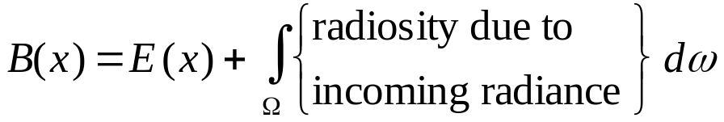
Introduction
How bright are objects?
Qualitative radiometry
Definition: Exitance of a source is the internally generated power radiated per unit area on the radiating surface
similar to radiosity: a source can have both
  radiosity, because it reflects
  exitance, because it emits
General idea:

Slide 4
Sources

Slide 5
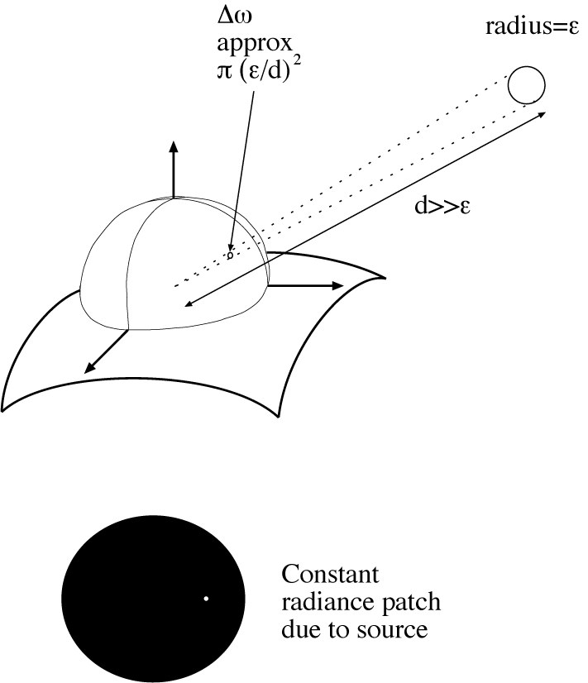
Point Sources

Slide 6
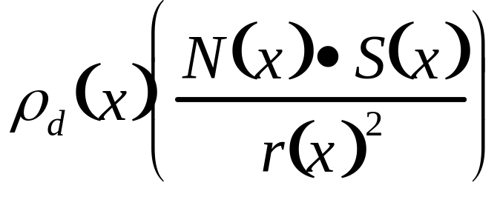
Point Sources
Nearby point source:
rho is diffuse albedo
N is the surface normal
S is source vector - a vector from x to the source, whose length is the intensity term
r is the distance to the source

Slide 7
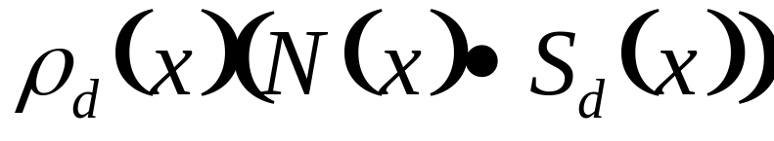
Point Sources
Distant point source:
Issue: nearby point source gets bigger if one gets closer
  the sun doesn’t for any reasonable binding of closer
Assume that all points in the model are close to each other with respect to the distance to the source. Then the source vector doesn’t vary much, and the distance doesn’t vary much either, and we can roll the constants together to get:

Slide 8
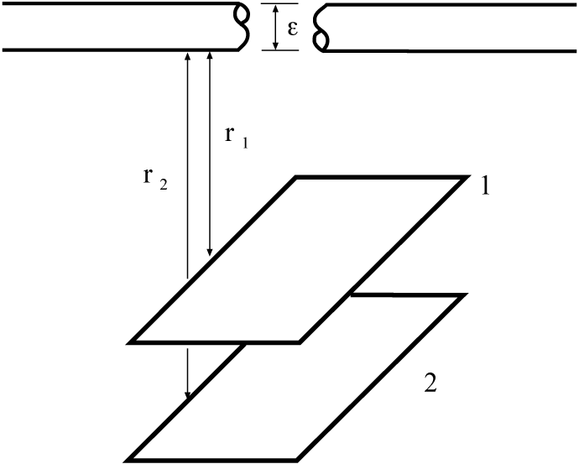
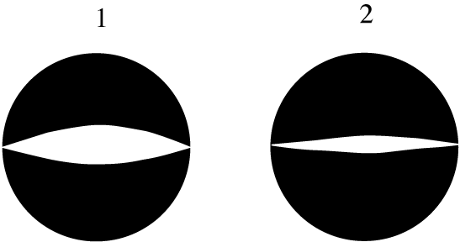

Line Sources

Slide 9
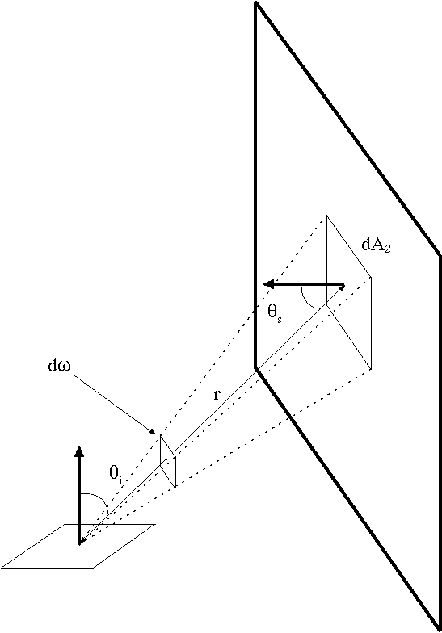
Area Sources
Examples: overcast sky, fluorescent light boxes
The radiosity at a point due to an area source is obtained by adding up the contribution over the section of view hemisphere subtended by the source

Slide 10
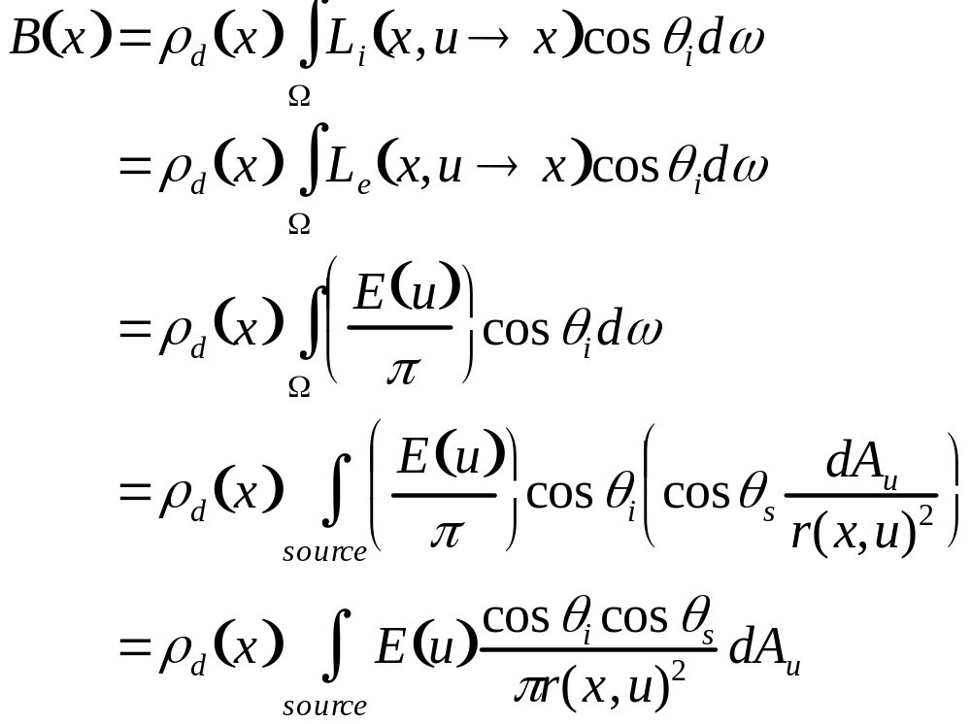
Area Sources
rho is albedo
E is exitance
r(x, u) is distance between points
u is a coordinate on the source

Slide 11
Shading models

Slide 12
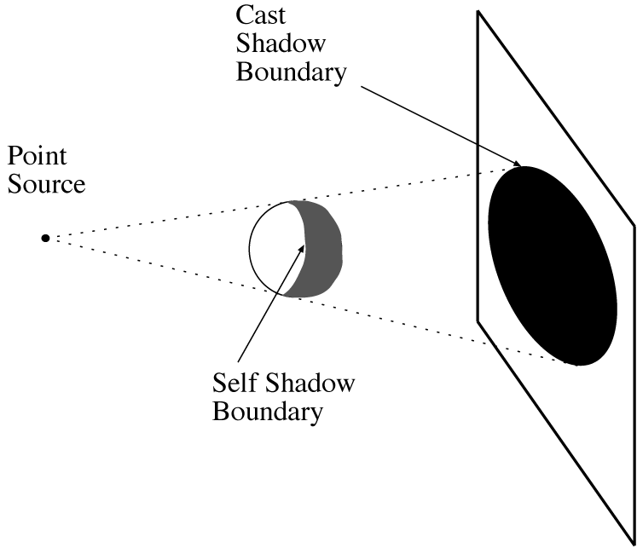
Local Shading Model
A point that can’t see the source is in shadow
For point sources, the geometry is simple

Slide 13
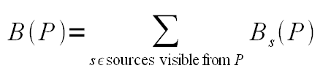
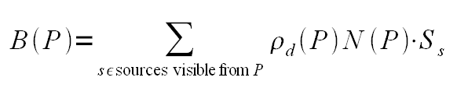
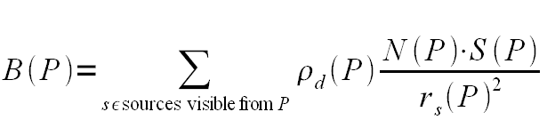
Local Shading Model
Simple model:
Point source at infinity:
Point source not at infinity:

Slide 14
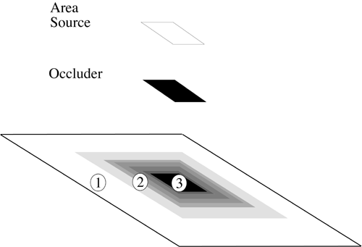
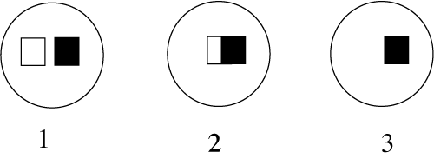
Local Shading Model

Slide 15
Ambient Illumination
Problem with local shading model: shadows can be arbitrarily dark
In almost every case shadows are illuminated by light from other diffuse surfaces
Solution: add ambient illumination term to each surface patch

Slide 16
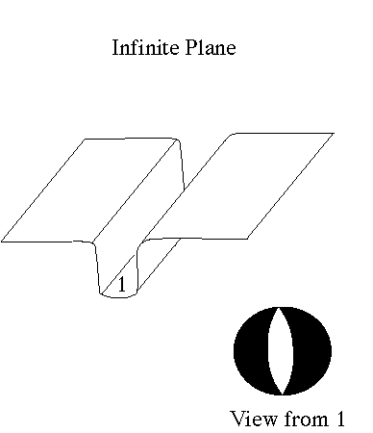
Ambient Illumination
Add constant term to each patch – magnitude usually guessed
Check what parts of the world a surface receives

Slide 17
Global Shading Model
Local shading model far from correct
Interreflections: illumination from other surface patches contribute significantly

Slide 18
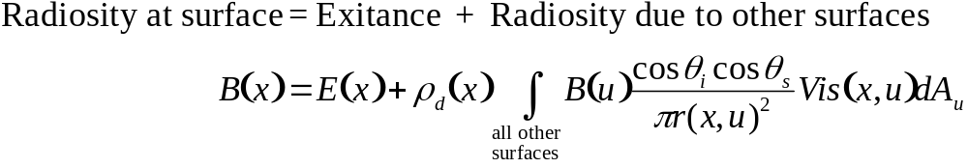
Global Shading Model
Other surfaces are now area sources - this yields:
Vis(x, u) is 1 if they can see each other, 0 if they can’t

Slide 19
Photometric Stereo

Slide 20
Photometric Stereo
Recovering a patch of surface from multiple pictures under different illuminants
Assume:
- local shading model
- set of point sources at infinite distance
- set of pictures under same conditions using different sources

Slide 21
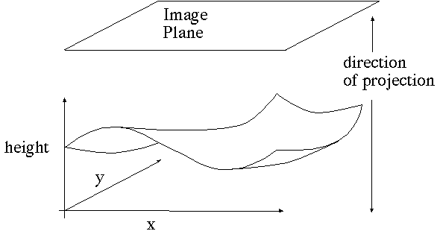
Photometric Stereo
Surface recovery – also called a Monge patch

Slide 22
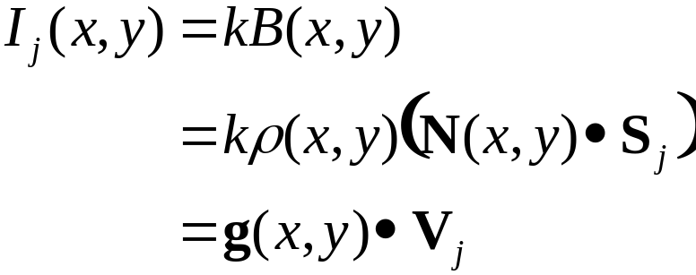

Photometric Stereo
Image model
For each point source, we know the source vector (by assumption). We assume we know the scaling constant of the linear camera. Fold the normal and the reflectance into one vector g, and the scaling constant and source vector into another Vj
Out of shadow:
In shadow:

Slide 23
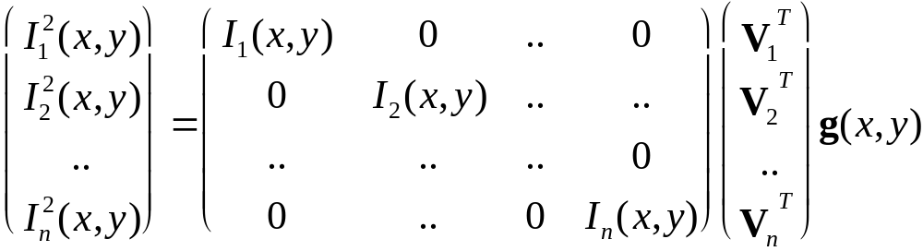
Photometric Stereo
Dealing with shadows
Known
Known
Known
Unknown

Slide 24

Photometric Stereo
Recovering normal and reflectance
Given sufficient sources, we can solve the previous equation (most likely need a least squares solution) for
g(x, y)
Recall that N(x, y) is the unit normal
This means that (x,y) is the magnitude of g(x, y)
This yields a check
  If the magnitude of g(x, y) is greater than 1, there’s a problem
And
N(x, y) = g(x, y) / (x,y)

Slide 25
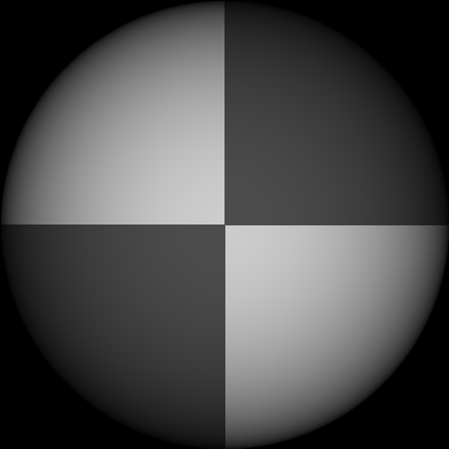
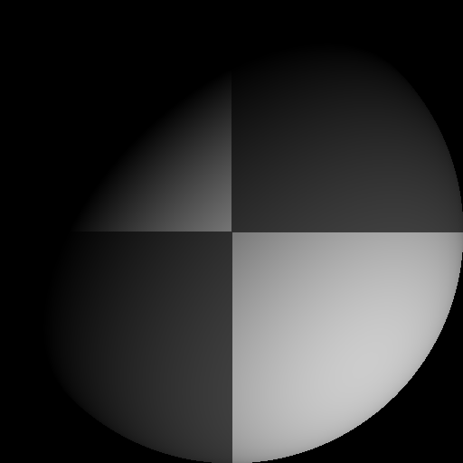
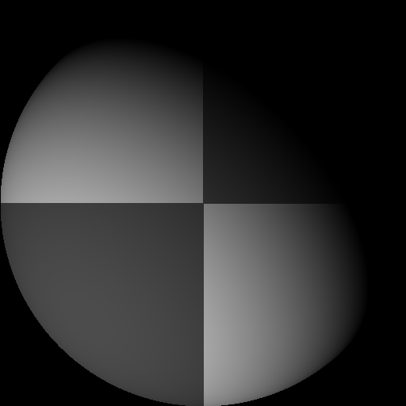
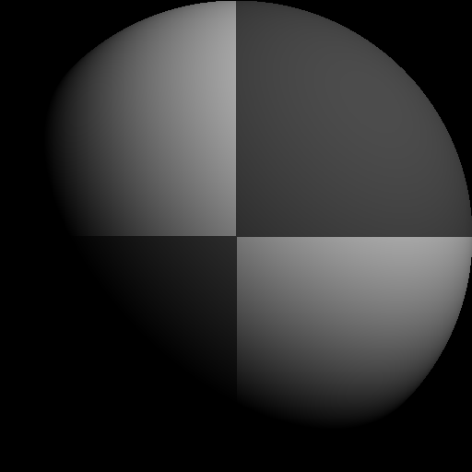
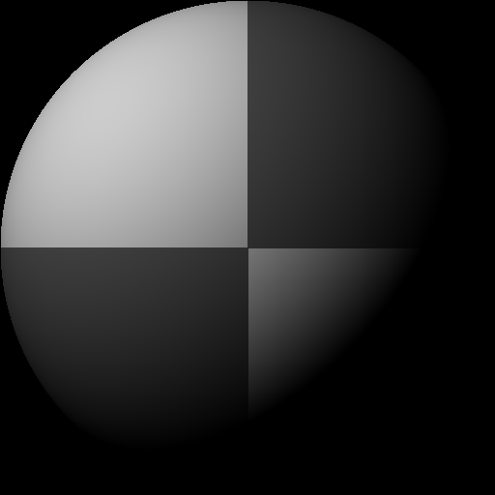
Photometric Stereo
Example images

Slide 26

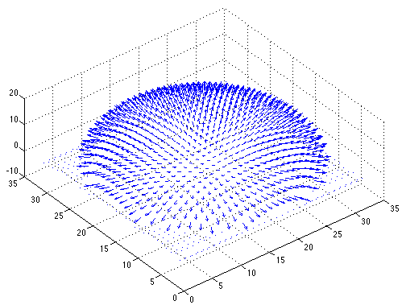
Photometric Stereo
Recovered reflectance: Recovered normals:

Slide 27

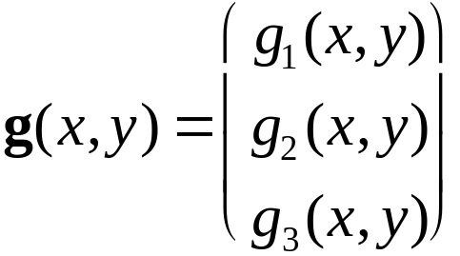
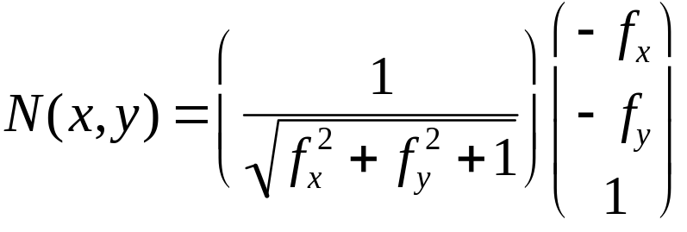


Recovering a surface from normals - 1
Photometric Stereo
The surface is written as
This means the normal has the form:
If we write the known vector g as
Then we obtain values for the partial derivatives of the surface:

Slide 28
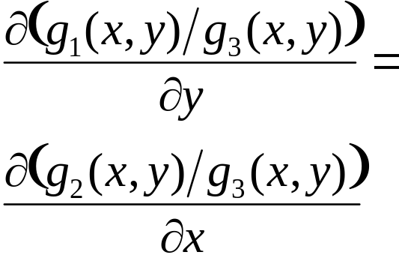
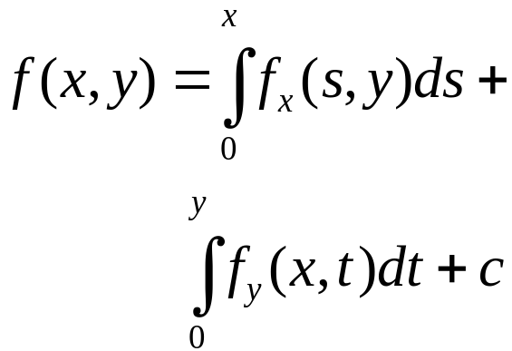
Recovering a surface from normals - 2
Photometric Stereo
Recall that mixed second partials are equal --- this gives us a check. We must have:
(or they should be similar, at least)
We can now recover the surface height at any point by integration along some path, e.g.
Notes:
Usually, I point out that this is a line integral, and that the curve chosen is irrelevant; then I ask why the second point is true. This gives students a sense of the main essence of integrability, which we don’t deal with in much detail in the book.

Slide 29
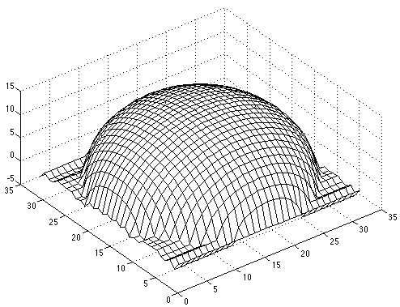
Surface recovered by integration

Slide 30
Any questions?

Slide 31
Assignment
Implement photometric stereo
Images on staff.science.uva.nl/~ieverts/cv/spheres.zip
Algorithm on page 85

Slide 32
Known
Known
Known
Unknown
Actually: [I1(x,y),I2(x,y),…,IN(x,y)]’ = [V1’,V2’,…,VN’] g(x,y)
- Guess the directions of the light sources (the V’s) up to a scale factor k
(i.e. experiment with different k values)
Albedo = |g|
Normal N = g/|g| (generate image from this using quiver in matlab)
p = N1/N3
q = N2/N3
Integrate over p and q values to reconstruct surface
staff.science.uva.nl/~ieverts/cv/spheres.zip

