Slide 1

Assessment Self-presentation
JavaScript L3
Ihor Harnyk
September 2021
CONFIDENTIAL | © 2021 EPAM Systems, Inc.

Slide 2
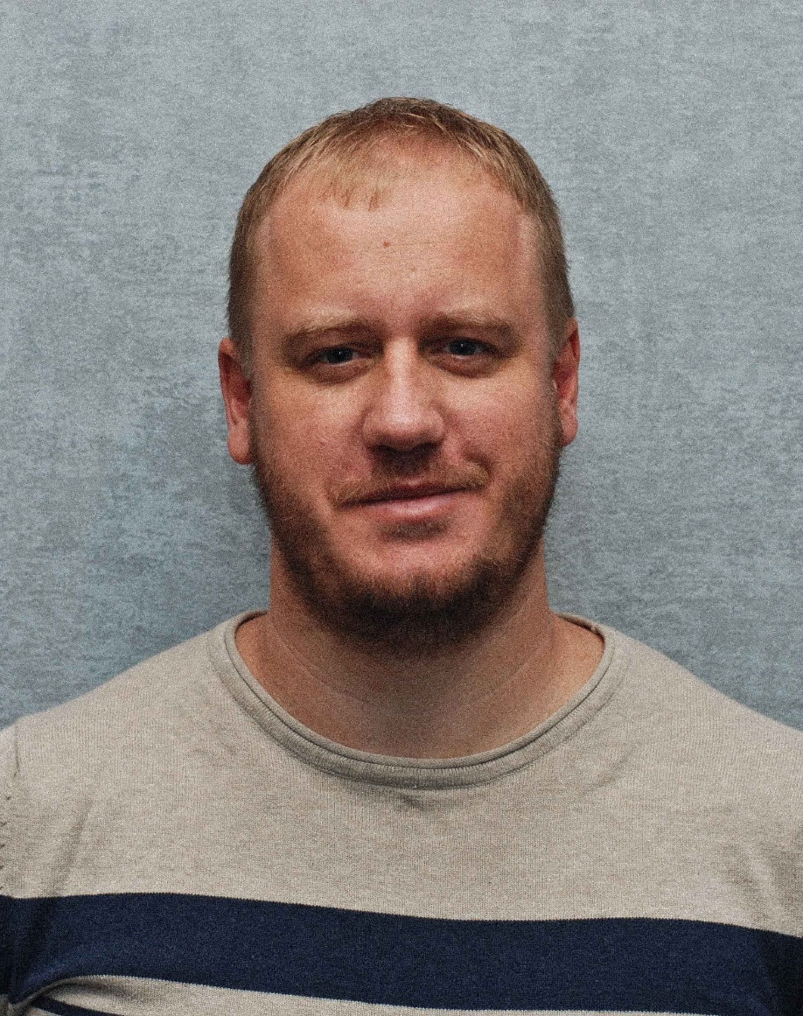
Introduction
POSITION: Software Engineer
WORK EXPERIENCE:
3 years in front end area
participated in 3 production projects in total
English: B1
SKILLS
Advanced | JavaScript TypeScript Angular RxJS NgRx OOP Jasmine Git HTML/CSS | Intermediate | Npm Yarn Webpack Karma Scss/Sass/Less Flexbox/CSS Grid Angular Material

Slide 3



Career path
September 2018
TASCOMBANK
Junior software engineer
August 2019
Smart Box
Software engineer
October 2020
EPAM
Software engineer

Slide 4

Project experience(Previous Project)
Project:
Zum – Transporting service for junior school students. Maintaining and developing and creating sub project from scratch
Period:
1.3 years
Role:
Developer
Used technologies:
Angular/TypeScript/RxJs/Ngrx
Sass/Flexbox/CSS grid/Angular Material/BEM
Jasmine/Jest/Karma/Cypress
Main responsibilities:
developing new business features
code maintaining, optimizing and refactoring
bug fixing
participation in daily meeting
taking part in code review
writing unit and e2e tests
Key achievements:
learned NgRx and implemented it in a new application
learned Cypress and creating e2e tests
created a structure of nested components through content projection in new application
participated in story decomposition
took part in meeting with customer

Slide 5

Project experience(Current Project)
Project:
- provides a platform for Buy-side firms(typically Asset Management company) to evaluate the quality of research provided by Sell-Side firms(typically research organizations)
Period:
10 months
Role:
Developer
Used technologies:
Angular/TypeScript/RxJs/Ngrx
Sass/Flexbox/Bootstrap
Ag-Grid
Jasmine/Karma
Main responsibilities:
code maintaining, developing, optimizing and refactoring
participation in scrum daily meeting
taking part in code review
writing unit tests
Key achievements:
migrated Angular version from 7 to 11
played a mentor role for a one developer
implemented pre push and pre commit git hooks
implemented karma parallel and reduced time of tests execution around 30 percents
participated in spring demo with customer as reporter
migrated from angular services store architecture to NgRX component store

Slide 6

Non-project activities
Being an interviewer for EPAM lab

Slide 7
Prospect
Take part in a certification program and become a certified interviewer
Participate in mentoring program as a mentor
Play the role of RM at least for one developer
Complete grow program to become a lead

Slide 8
Key characteristics and qualities to become L3
Experience
Technical knowledge
Understanding the bigger picture
Recognizing what you don’t know and being able to learn
Leadership skills
Problem solving skills
Demonstrating self-management skills, being independent

Slide 9
Thank You

