Slide 1

rollup.js
Rollup is a module bundler for JavaScript which compiles small pieces of code into something larger and more complex, such as a library or application.

Slide 2
Rollup overview
Rollup uses the new standardized format for code modules included in the ES6 revision of JavaScript, instead of previous idiosyncratic solutions such as CommonJS and AMD. ES modules let you freely and seamlessly combine the most useful individual functions from your favorite libraries. This will eventually be possible natively everywhere, but Rollup lets you do it today.

Slide 3
Why Rollup?
Developing software is usually easier if you break your project into smaller separate pieces, since that often removes unexpected interactions and dramatically reduces the complexity of the problems you'll need to solve, and simply writing smaller projects in the first place isn't necessarily the answer. Unfortunately, JavaScript has not historically included this capability as a core feature in the language.
This finally changed with the ES6 revision of JavaScript, which includes a syntax for importing and exporting functions and data so they can be shared between separate scripts. The specification is now fixed, but it is only implemented in modern browsers and not finalised in Node.js. Rollup allows you to write your code using the new module system, and will then compile it back down to existing supported formats such as CommonJS modules, AMD modules, and IIFE-style scripts. This means that you get to write future-proof code, and you also get the tremendous benefits of…

Slide 4
What advantages does Rollup have?
Rollup has the smallest bundle size for ES import (676 Bytes)
Rollup + GCC has the smallest bundle size for ES Source Import (332 Bytes)
Rollup + GCC has the biggest bundle size for ES import.
Rollup has a very good documentation.
Rollup has a lot of third-party plugins.

Slide 5
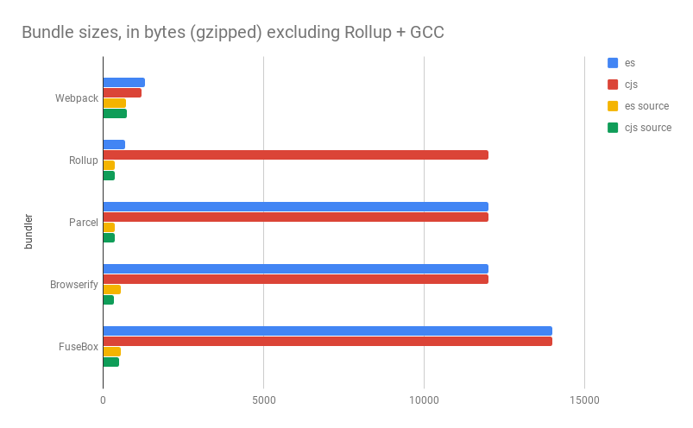

Slide 6
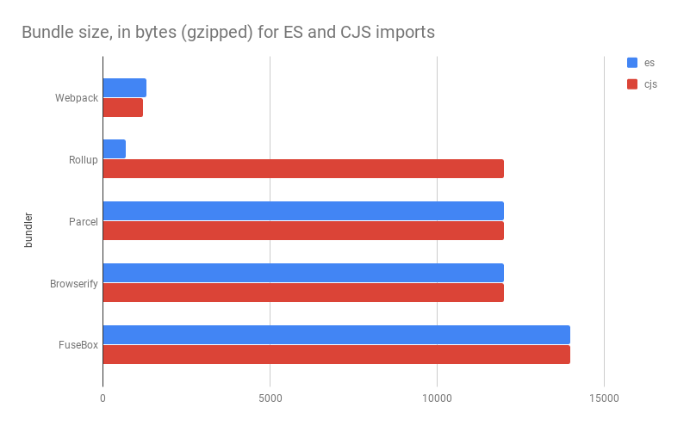

Slide 7
I would categorize Rollup as a “light” bundlers because it doesn’t do a lot of the box which I think is a good thing. It’s a good thing because it is lightweight and focus on small tasks and it does them well. However, it can become more challenging as you try to bundle larger client-side apps. Because then you will need to install a lot of plugins and wire up all of them yourself. Also shimming because another challenge that you will need to address.

