Slide 1
xMOOC online judge system of sequential courses
Igor Amashukeli
Student number: 3108361
Supervisor : Osama Abushama

Slide 2
What is it?
What are the goals?
How it was implemented?

Slide 3
What is it?
xMOOC
online judge
math and programming course
course problems

Slide 4
What are the goals?
consequent course
from first principles
the new tasks require no more than knowledge of the old ones

Slide 5
How it was implemented?
The details on the next slides!

Slide 6
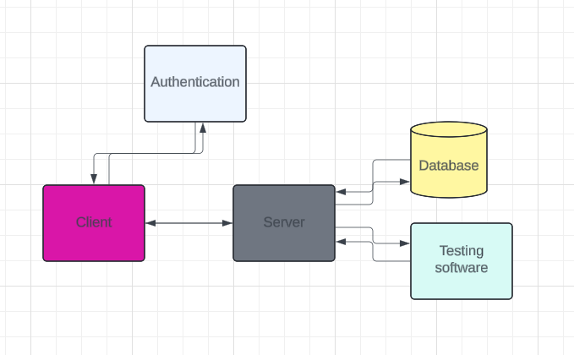
High level diagram

Slide 7
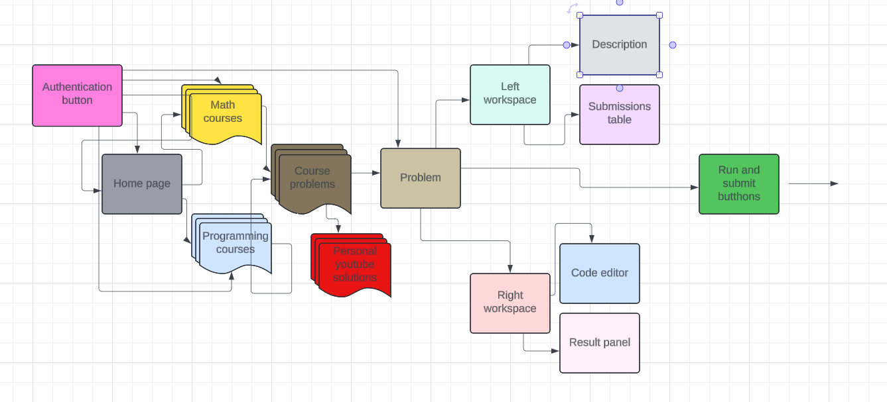
High level client diagram

Slide 8
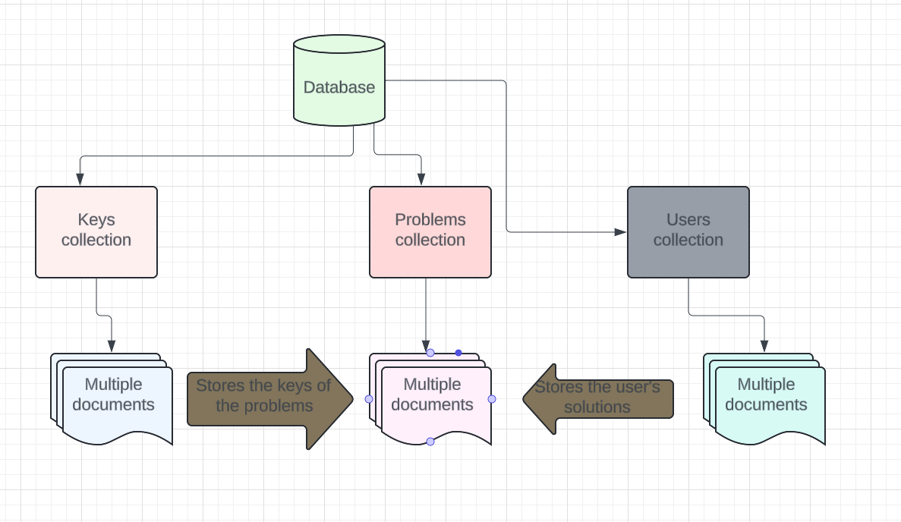
High-level data model

