Slide 1
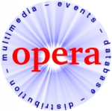

Event-Based Middleware:
A New Paradigm for Wide-Area
Distributed Systems?
Peter Pietzuch
Peter.Pietzuch@cl.cam.ac.uk
February 2002 – Cabernet Workshop

Slide 2
Motivation
Invocation-based middleware (CORBA, Java RMI) is a useful abstraction for building DS
BUT: does not work well for large-scale, internet-wide systems
  Tight-coupling because of synchronous RPC paradigm
  One-to-one communication does not scale
  Bad model for unreliable and dynamic environment
Message-oriented middleware:
    “Low level” abstraction
    Weak language integration
The Event-Based Communication Paradigm is a possible solution to the problem.

Slide 3
Overview
Event-based systems
Event-based middleware requirements
Hermes – A Distributed Event-Based Middleware
  Design
  Algorithm
  Architecture
Open Questions
Conclusions

Slide 4

Event-based Systems
Notion of an Event:
  Asynchronous occurrence in time
  Contains data that describes the occurrence
  Can be implemented as message
Event sources publish events; Event sinks subscribe to events with a filter expression (subscription)
Properties:
  Asynchronous notification of events
  Publishers/Subscribers are decoupled in space and time
  Many-to-many Communication
  Anonymity, fault-tolerance, …?
publish
notify
Pub
Sub
subscribe

Slide 5
Event-Based Middleware Requirements
Integration with app programming language
  Language-bindings
  Type-checking of event types
  Higher-level abstractions like composite event subscriptions
    Patterns of primitive events
Scalable and fault-tolerant design & algorithms
  Distributed event matching and composite event detection
  No centralised repositories (event types, event publishers, …)
“Proper” middleware functionality required
  Reliability, QoS, Security, Discovery
  Transactions, Persistence, Mobility support, …
We need a “CORBA for Events”.

Slide 6
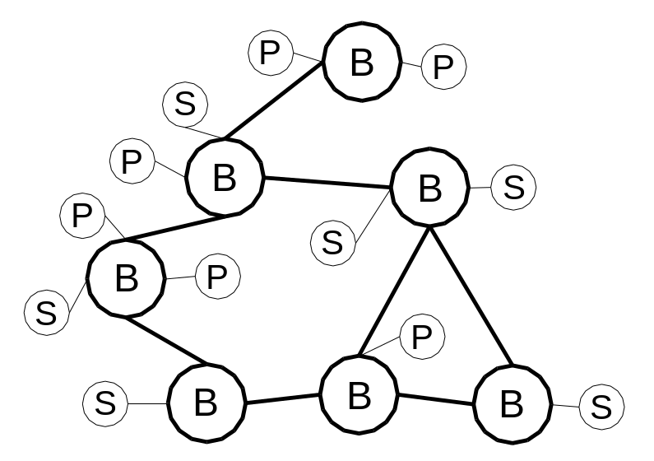
Hermes - Overview
Event Clients (Sources/Sinks)
  Lightweight and simple
Event Brokers (Event-based middleware service)
  Peer-to-peer Overlay Network
  Content-based routing of events
  Filtering and composite event detection is distributed
  Communication using asynchronous message-passing (XML)

Slide 7
Hermes - Design
Events:
  are typed objects expressed in XML Schema or ODL
  are part of an event type hierarchy
  Example: class PrinterFinishedEvent extends PrinterEvent {
  attribute int jobNumber;
  attribute string userID;
  }
Type- and attribute-based publish/subscribe
  Subscription = event type + attribute filter
  Manage thousands of event types
P2P overlay network (e.g. Pastry)
  Provides abstraction for routing algorithms
    route (message, destinationID)
  Deals with link and node failure
  Easy to deploy

Slide 8
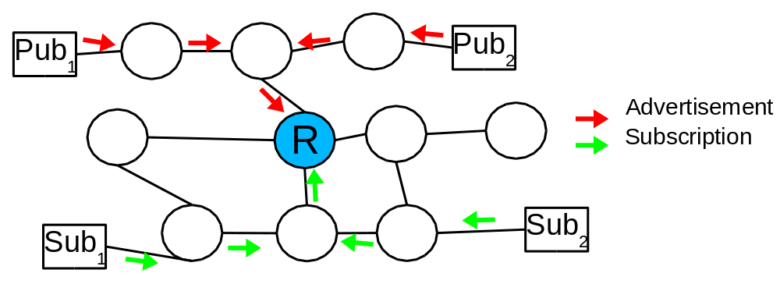
Hermes - Algorithm
Event dissemination algorithm:
  Set up routing and filtering state for events
  (Type)/Advertisement/Subscription/Publication messages
  Reverse Path Forwarding (source side filtering)
    Publications (events) follow reverse path of subscriptions
Rendezvous Nodes (no global state/broadcast)
  Ensure that advs and subs meet in network
  Use P2P network to set up RNs on a per type basis

Slide 9
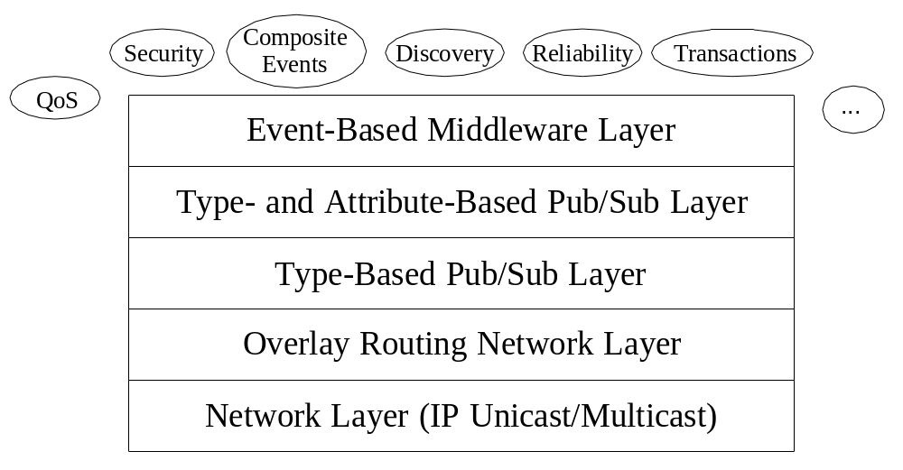
Hermes - Architecture
Event Brokers have layered architecture:
  Pub/Sub functionality split into two layers
  Middleware services must be supported throughout the layers

Slide 10
Open Questions
How much middleware functionality is required?
  Transactions? Mobility support? QoS levels?
One subscription language for everybody?
Composite Event Detection
  How complex? What about temporal ordering?
  What kind of algebra?
How do you evaluate such systems?
  Large scale network simulations? 10⁶ nodes?
  Realistic event source/sink behaviour?

Slide 11
Conclusions
Traditional middleware is not ready for the Internet
Event-based systems give
  loose coupling between pub/sub
  asynchronous, many-to-many communication
Need for type- and attribute-based pub/sub
P2P networks give a useful abstraction
Scalable content-based routing algorithms for events are crucial (→ no global state/broadcast)
Additional middleware functionality
 We must not forget the lessons from middleware research!

