Slide 1
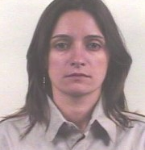
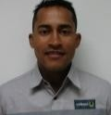
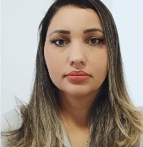
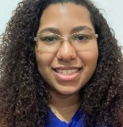
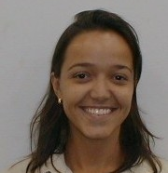
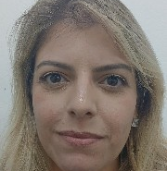
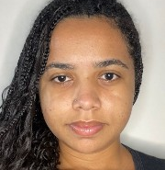
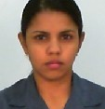
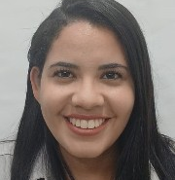

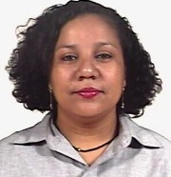

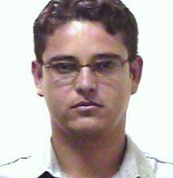
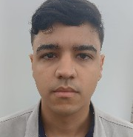
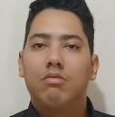
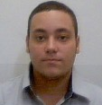

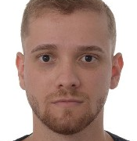
TITULO
SUBTITULO
NOME COMPLETO
CARGO | IDADE
CEO3
FERNANDO CARVALHO FERREIRA
MECANICO MANUTENCAO I | 39
Hot Roller Workshop (O) - IPA
JULIANE HOSANA SILVA
PROCUREMENT ANALYST II | 39
Procurement Services I - USI
BARBARA GOMES DOS SANTOS
ENGINEERING GLOBAL PROFESSIONAL| 31
Maintenance & Byproducts Indu Plan - USI
GABRIELA NOGUEIRA FERNANDES LEMOS
PROCESS ANALYST IV | 51
Energy, Utilities & Managem System - USI
KAROLINE RODRIGUES PINHEIRO
COMPLIANCE SPECIALIST | 37
Fraud & Forensic - USI
BRENDA CAROLINE CAMPOS SILVA
UNIVERSITY INTERN | 24
Supplier Quality & Safety Manag - USI
GLACE KELLY SOARES DE OLIVEIRA
COMMERCIAL MANAGEMENT ANALYST II | 39
Industrial & Infrastruture OM - USI
LEIDIANE DE SOUZA OLIVEIRA
HUMAN RESOURCES ANALYST II | 23
HRBP - IPA
CAROLINE ALVES ANICIO
PROGRAMADOR PRODUCAO II| 26
Outbound Transport- IPA
GLAUCE RIBEIRO DA PENHA
INFORMATION TECHNOLOGY SPECIALIST| 55
IT Systems Industrial - USI
LETICIA EVANGELISTA DE OLIVEIRA
HUMAN RESOURCES ANALYST II | 23
HRBP - IPA
CLEYSSON DE ANDRADE SOUZA
COORDENADOR PRODUCAO I | 47
Refractories & Steelmaking Serv - USI
GUSTAVO HENRIQUE VIEIRA LUNA
GLOBAL TRAINEE | 23
Environment, Health & Safety - USI
LUCAS CASSIANO LEITE
APRENDIZ | 27
Unid Aprendiz
FELIPE MARTINS FERREIRA
OPERADOR PONTE ROLANTE | 26
Temper, Finsh Lines & Inspec (O) - IPA
JULIANA KIE SANTANA ALICAWA
GLOBAL TRAINEE | 26
Maintenance Engineering (M) - USI
LUIS FELIPE FERREIRA CAMPOS SILVA
GLOBAL TRAINEE| 31
Supply Chain Process - USI

