Slide 1


Your Linux Passwords Are in Danger: MimiDove Meets the Challenge
Svetlana Golub
Igor Korkin

Slide 2
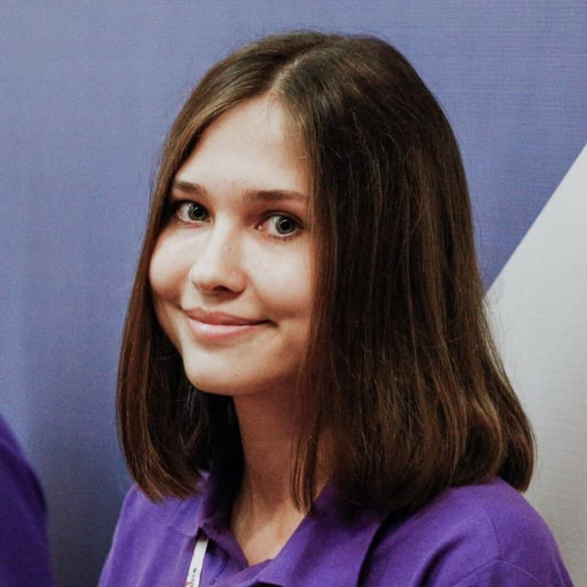
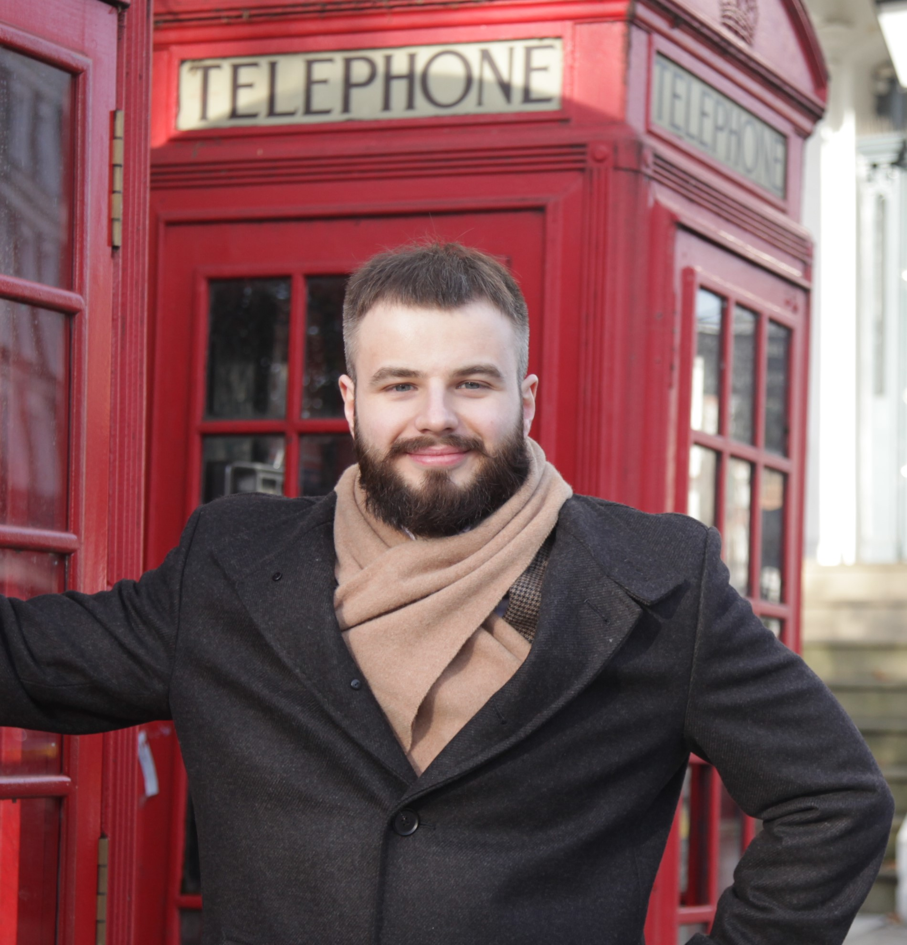
Who we are
Svetlana Golub
Bachelor of Cyber Security
alumni of NRNU MEPhI (Moscow Engineering Physics Institute)
Cryptology and Cybersecurity Department
Igor Korkin, PhD
Supervisor
Speaker at BlackHat, HITB, CDFSL
Independent Researcher
2

Slide 3
Clear text passwords in process memory:
gnome-keyring-daemon
apache2
vsftpd
sshd
gdm-password
memset ( )
Seong-Joong Kim – “Credentials located in gnome-keyring can be compromised easily”
3

Slide 4
MimiPenguin
by Hunter Gregal
“A tool to dump the login password from the current Linux desktop user”
4

Slide 5
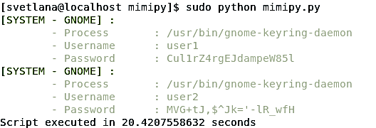
MimiPy
by Nicolas Verdier
It can locate passwords in memory and overwrite them to prevent their leakage
5

Slide 6
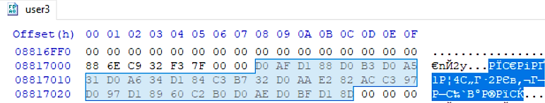
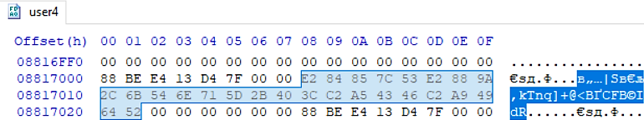
Let's try some Unicode in passwords:
ЯшгХ1Ц4ф÷2Ъ€×Зщ`°Юпэ
0xd0afd188d0b3d0a531…
℅|S√,kTnq]+@<¥CF©IdR
0xe284857c53e2889a2c…
6

Slide 7


The downsides of
MimiPenguin and MimiPy
— They cannot dump passwords with Unicode,
only the ASCII characters are supported:
— They are so slow ...
7

Slide 8
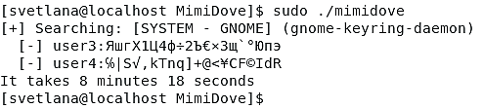
MimiDove Can Tackle both challenges!
— Now Unicode symbols will be located:
— Work time is 8 min. How to reduce it?
8

Slide 9

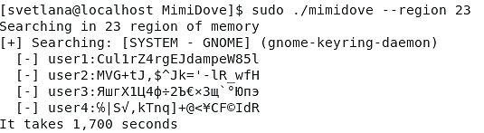
Why search everywhere?
— First, we determine the memory area
— Second, we search only through this area
9

Slide 10
MimiDove Algorithm
Research of ‘gnome-keyring-daemon’ revealed that
users’ passwords are located in stack, which is mapped via anonymous regions (i.e. not file backed) with enabled RW access.
MimiDove fast algorithm:
Extract user hashes from /etc/shadow.
Dump “gnome-keyring-daemon” using /proc/PID/maps.
Locate possible passwords: for each memory chunk extract the strings of 4-256 symbols.
Calculate hash(string) and check if match with users’ hashes.
Zeroing extracted passwords.
9

Slide 11

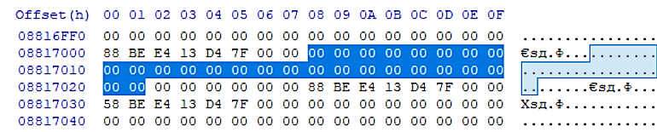
Keep your passwords safe.
Overwrite them!
before
after
10

Slide 12
Time to compare: technical features
Tool Name | Can it locate passwords? |  | Can it remove passwords?
 | ASCII | Unicode | ASCII | Unicode
MimiPenguin | + | ‒ | ‒ | ‒
Mimipy | + | ‒ | + | ‒
MimiDove | + | + | + | +
Example of tested passwords:
Cul1rZ4rgEJdampeW85l
MVG+tJ,$^Jk='-lR_wfH
ЯшгХ1Ц4ф÷2Ъ€×Зщ`°Юпэ
℅|S√,kTnq]+@<¥CF©IdR
Example of tested OSes:
CentOS 7.8.2003, GNOME Keyring 3.28.2
Ubuntu 18.04.4 LTS, GNOME Keyring 3.28.0.2
Ubuntu 20.04.2 LTS, GNOME Keyring 3.36.0
Kali GNU/Linux Rolling, GNOME Keyring 3.36.0
11

Slide 13
Time to compare: work time
github.com/SvetlanaGolub/MimiDove
12

Slide 14
Thank you
Svetlana Golub glb.svtln@gmail.com
Igor Korkin igor.korkin@gmail.com
github.com/SvetlanaGolub/MimiDove
igorkorkin.blogspot.com
13

