Slide 1
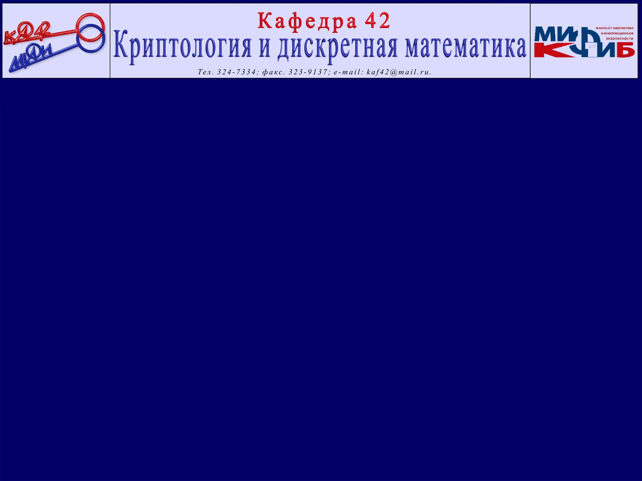

APPLYING MEMORY FORENSICS TO ROOTKIT DETECTION
Igor Korkin Ivan Nesterov
CDFSL 2014

Slide 2

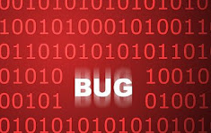


Goals of memory forensics
Passwords, crypto keys and etc. revealing software
Software reverse engineering
Rootkits analysis & detection

Slide 3
Agenda
1. | Review of dump & analysis tools in rootkit conditions
2-3. | MASHKA ─ Malware Analysis System for Hidden Knotty Anomalies:
Memory Dump System
RPI for drivers
DBS for processes

Slide 4
Review of rootkits techniques
Rootkits techniques – malware hiding from OS & AV
object manipulation
(byte modification)
function hooking
func_A
EPROCESS structures
func_A
hook
func_B
func_B

Slide 5
Dump approaches classification
Virtual memory
Physical memory
Software
Hardware
Ease of distribution?
Vulnerable?

Slide 6

Dump approaches are either vulnerable or non applicable in enterprises
 | Hooking resilience | Ease of distribution
Software | − | +
Hardware | + | −

Slide 7
Why are software approaches vulnerable?

Slide 8
Details of dump & analysis tools
Typical dump & analysis tool
J.Stuttgen, M.Cohen (`13)
Memory mapping routines
Hook
L.Milkovic (`12)
ZwWriteFile or analogue
Hook
T.Haruyama, H.Suzuki (`12)
Analysis of kernel OS structures
Byte Modification

Slide 9
What can we do under these circumstances?

Slide 10
What can we do under these circumstances?
Let's omit the functions!

Slide 11
What can we use instead?
What can we do under these circumstances?
Let's omit the functions!

Slide 12

Virtual and Physical memory
Virtual memory
Physical memory
calc.exe
kernel
word.exe
word.exe
user mode
?
?
calc.exe
kernel
kernel mode

Slide 13
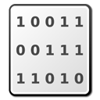
How does addresses translation work?
Virtual address
ACCESS
Page Directory & Page Tables
Table’s entry:
FLAGS
PFN
Physical memory
Address = PFN*0x1000

Slide 14
How does addresses translation work?
Virtual address
ACCESS
Is it possible to use paging in a dump?
Page Directory & Page Tables
Table’s entry:
FLAGS
PFN
Physical memory
Address = PFN*0x1000

Slide 15
How does addresses translation work?
Virtual address
ACCESS
Is it possible to use paging in a dump?
Page Directory & Page Tables
Table’s entry:
FLAGS
PFN
Physical memory
Let’s run addresses translation in reverse!
Address = PFN*0x1000

Slide 16
MASHKA’s memory dump algorithm

Slide 17
MASHKA’s memory dump algorithm

Slide 18
MASHKA’s memory dump algorithm

Slide 19
MASHKA’s memory dump algorithm

Slide 20
MASHKA’s memory dump algorithm

Slide 21
MASHKA’s memory dump algorithm

Slide 22
MASHKA’s dump algorithm details

Slide 23
MASHKA’s dump algorithm details
How should new files be used?

Slide 24
MASHKA in memory forensics tasks
Loaded Dump File
ODUF
".sys"
VALF
2E 73 79 73 00
VALF | Virtual Address in the Loaded dump File
ODUF | Offset in DUmp File

Slide 25
MASHKA in memory forensics tasks
Loaded Dump File
ODUF
".sys"
VALF
2E 73 79 73 00
Struct File
ODUF
VAOM
VAOM | Virtual Address in the Original virt. Memory
VALF | Virtual Address in the Loaded dump File
ODUF | Offset in DUmp File

Slide 26
MASHKA in memory forensics tasks
Loaded Dump File
Original Virt. memory
ODUF
2E 73 79 73
".sys"
VALF
2E 73 79 73 00
VAOM
Struct File
ODUF
VAOM
VAOM | Virtual Address in the Original virt. Memory
VALF | Virtual Address in the Loaded dump File
ODUF | Offset in DUmp File

Slide 27
How is VAOM etc used?

Slide 28


Use MASHKA in drivers forensics
SERVICES.EXE
SCM structures list:
user mode
PsLoadModuleList:
kernel mode
DRIVER_OBJECT

Slide 29
Use MASHKA in drivers forensics
CreateService( ServiceName, DisplayName, BinaryPath,...)
SCM structure, DRIVER_OBJECT and others will be added
ServiceName
DisplayName
+
ServiceName
BinaryPath

Slide 30
Use MASHKA in drivers forensics
CreateService( ServiceName, DisplayName, BinaryPath,...)
SCM structure, DRIVER_OBJECT and others will be added
ServiceName
DisplayName
+
ServiceName > VAOMs of ‘SN’
ServiceName
BinaryPath

Slide 31
Use MASHKA in drivers forensics
CreateService( ServiceName, DisplayName, BinaryPath,...)
SCM structure, DRIVER_OBJECT and others will be added
ServiceName
DisplayName
+
ServiceName > VAOMs of ‘SN’
ServiceName
VAOMs of ‘SN’ > VAOM of DRV_OBJ
BinaryPath

Slide 32
Advantages of MASHKA
Uses only two functions: KeAttachProcess and ZwWriteFile
Finds different memory templates fast
Resilient to hooks due to low-level OS calls usage
Protects the stored data by run-time encryption

Slide 33
How to apply MASHKA to processes detection?

Slide 34
OS processes list handling
ZwQuerySystemInformation hooking
how can the process be hidden?
or
PsActiveProcessList modifying
How to detect a hidden process?

Slide 35
Process detection approaches review
Heuristic analyzer
hooking functions such as SwapContext or KiFastCallEntry
Object structure lists
a processes’ list from CSRSS.EXE
a processes handle table list
Static signature scans
● static signatures by Schuster (‘07)
● robust signatures by Dolan-Gavitt (‘09)
● structures location by Grizzard (‘10)

Slide 36
Process detection approaches review
Heuristic analyzer
hooking functions such as SwapContext or KiFastCallEntry
Object structure lists
a processes’ list from CSRSS.EXE
a processes handle table list
Static signature scans
● static signatures by Schuster (‘07)
● robust signatures by Dolan-Gavitt (‘09)
● structures location by Grizzard (‘10)

Slide 37
Analysis of static signature scan
GMER, PowerTool and XueTr use it
Scan is based on | Disadvantages
some EPROCESS fields values are either known or exceed the constant, e.g. 0x8000_0000 | vulnerable to field modifications
 | difficult to achieve portability

Slide 38
Analysis of static signature scan
GMER, PowerTool and XueTr use it
Scan is based on | Disadvantages
some EPROCESS fields values are either known or exceed the constant, e.g. 0x8000_0000 | vulnerable to field modifications
 | difficult to achieve portability

Slide 39
How can we improve signature scans?

Slide 40
Objects structures typical design

Slide 41
Objects structures typical design

Slide 42
Process detection with Dynamic Byte Signature
Create Dynamic Byte Signature by using EPROCESS structures in PsActiveProcessList
Use byte to byte DBS search to find all EPROCESS structures
Compare a new list with NtQuerySystemInformation list

Slide 43
Bit signature = thorough analysis
87
Downscale from bytes to bits
1
0
0
0
0
1
1
1
84
1
0
0
0
0
1
0
0

Slide 44
Bit signature = thorough analysis
87
Downscale from bytes to bits
1
0
0
0
0
1
1
1
84
1
0
0
0
0
1
0
0

Slide 45
Bit signature = thorough analysis
87
Downscale from bytes to bits
1
0
0
0
0
1
1
1
84
1
0
0
0
0
1
0
0
Dynamic bit signature:

Slide 46
Dynamic Bit Signature Analysis
DBS features | Advantages
Automatic learning | Easily portable
Bit based analysis | More thorough analysis
Probabilistic check | Able to recognize structures even without full pattern match

Slide 47
What about hidden drivers and their detection?

Slide 48
Hidden drivers have similar cases
 | List view | Activity to hide
Processes | TaskMgr.exe | PsActiveProcessList modification
Drivers | DriverQuery.exe | PsLoadedModuleList modification
ZwQuerySystemInformation hooking leads to processes & drivers hiding

Slide 49
Drivers detection approaches review
Object structure lists
ObjectDirectory lists
Service Control Manager list
Schuster’s signature approach has adapted by W.Tsaur and L.Yeh (‘12) to drivers detection
Signature scans

Slide 50
Is it possible to adapt DBS for driver detection?

Slide 51
Is it possible to adapt DBS for driver detection?
DBS only can detect structures with a lot of fields

Slide 52
Is it possible to adapt DBS for driver detection?
DBS only can detect structures with a lot of fields
EPROCESS
DRIVER_OBJECT

Slide 53
Rating Point Inspection (RPI)
RPI improvements over DBS
RPI utilizes additional weight matrix for precise pattern matching
RPI use selective matching algorithm
If one of the checks is true
DBS | RPI
add 1 point | 1, 2 or etc. points are added to the final score

Slide 54
Description of weight matrix for DRIVER_OBJECT is in the corresponding paper

Slide 55
How does RPI detect drivers?
weight matrix
DRV_OBJ list
A
B
C

Slide 56
How does RPI detect drivers?
weight matrix
DRV_OBJ list
A
B
C
threshold value

Slide 57
How does RPI detect drivers?
weight matrix
DRV_OBJ list
A
B
C
threshold value
byte to byte probabilistic search
complete list of DRV_OBJ
A
B
C
D

Slide 58
How does RPI detect drivers?
weight matrix
DRV_OBJ list
A
B
C
threshold value
byte to byte probabilistic search
complete list of DRV_OBJ
A
B
C
D
─
A
B
C
Hidden DRV =
D

Slide 59
MASHKA’s achievements
Reveals rootkits:
Deliberately hidden processes and drivers
Virus.Win32.Sality.q
Trojan.Win32.VB.aqt
Hidden drivers by ATSIV

Slide 60
MASHKA’s achievements
Reveals rootkits:
Deliberately hidden processes and drivers
Virus.Win32.Sality.q
Trojan.Win32.VB.aqt
Hidden drivers by ATSIV
Existing anti-rootkits PowerTool, TDSSKiller, Xuetr fail, but MASHKA can detect them
Demo: bit.ly/win8t6st

Slide 61




What is the pie filling?
?

Slide 62

What is the pie filling?
?

Slide 63
Igor Korkin, Ph.D
igor.korkin@gmail.com
sites.google.com/site/iykorkin

Slide 64
ADDITIONAL

Slide 65
WHAT IS IT MASHKA?
Malware Analysis System for Hidden Knotty Anomalies
Memory Dump System (platform for forensic analysis)
DBS for EPROCESS detection
RPI for DRIVER_OBJECT detection
Other digital forensics tasks

Slide 66
MASHKA IN MEMORY FORENSICS TASKS
Various search signatures: char and wide char strings, byte fragments include addresses
As a result we receive:
What can we do with it?
Name | Definition
VALF | virtual address of the loaded dump file | read data
ODUF | corresponding offset in dump file | calculate offsets
VAOM | virtual address of the original memory | find value in dump

Slide 67
USE MASHKA TO RESEARCH DRIVERS
Run Windows under WinDbg control
Install a test driver with ‘ServiceName’, ‘DisplayName’ and ‘BinaryPath’
Hide this driver structure by unlinking from PsLoadedModuleList
Check the system with anti-rootkit tool
Dump memory with the help of MASHKA

Slide 68
USE MASHKA TO RESEARCH DRIVERS
Search strings from step 2 and save their ‘VAOM’
By WinDbg and strings VAOM change their content
Check the system repeatedly. Detection tools will give us a changed name.
\\Driver\\test_driver
...
test_driver.sys
\\Driver\\1est_driver
...
2est_driver.sys
By known ‘VAOM’ run further analysis

Slide 69
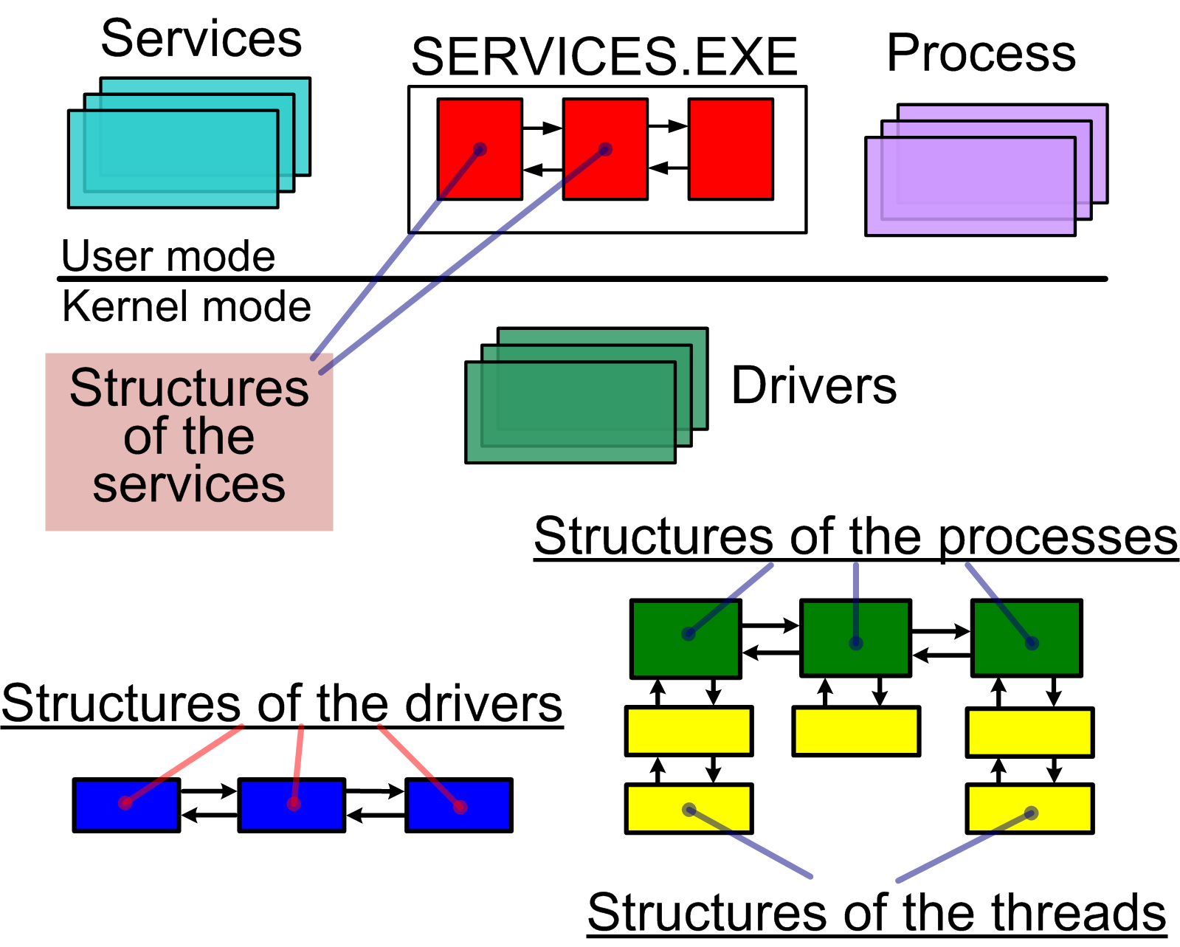
PROBLEM STATEMENT - ROOTKITS IN WINDOWS

Slide 70
Analysis of Current Approaches to Detection in Face of Oppositions
Cross-view detection is the main point for all tools
Low-level mechanisms:
Heuristic analyzer
Additional object structure lists
Signature scans are based on byte to byte search of fragments of objects structures in memory

Slide 71
ANALYSIS OF SIGNATURE SCANS
The fact that some fields’ values are either known or exceed the constant, for example 0x8000_0000
Parts of this method are implemented in the popular tools such as GMER, PowerTool, XueTr
Method’s disadvantages:
vulnerable to field modifications: If at least one byte does not match, the signature scan will miss the structure
difficult to achieve portability on different versions of Windows OS, as it requires a lot of manual work

Slide 72
RPI FOR DRIVER_OBJECT DETECTION
Condition | Score
if (DRIVER_OBJECT_32.Type == 0x04) | 1
if (DRIVER_OBJECT_32.Size == 0xa8) | 1
if (chk_unicode_string( &DRIVER_OBJECT_32.DriverName)) | 2
if (chk_unicode_string( DRIVER_OBJECT_32.HardwareDatabase)) | 2
if ((DRIVER_OBJECT_32.MajorFunction[0]) >> 31) | 2
if (max_same_major_functions( &DRIVER_OBJECT_32) >= min_major_function) | 2
check_function_prologue(addr) | 4
‘global_scope’ is a sum of points

Slide 73
THE ‘CHECK_FUNCTION_PROLOGUE (ADDR)’ FUNCTION
Condition | Res ult
If (((addr[i+0] == 0x55) && (addr[i+1] == 0x89) && (addr[i+2] == 0xe5)) || ((addr[i+0] == 0x55) && (addr[i+1] == 0x8b) && (addr[i+2] == 0xec)) || ((addr[i+0] == 0x53) && (addr[i+1] == 0x56)) || ((addr[i+0] == 0x56) && (addr[i+1] == 0x57)) || ((addr[i+0] == 0x56) && (addr[i+1] == 0x57)) || ((addr[i+0] == 0x8b) && (addr[i+1] == 0xff))) | true or false

Slide 74
RPI APPLYING
Calculate all values, such as ‘min_major_function’ and ‘global_scope’
Perform a byte-to-byte search by calculating the sum of points for each memory region
DRIVER_OBJECT structure is found if the probabilistic comparing of matching points with the ‘global_scope’ value is true
Compare the RPI-matching list with the drivers list, which has been obtained by ZwOpenDirectoryObject

Slide 75
FUTURE PLANS OF HOW TO USE & IMPROVE MASHKA
Detection Shadow Walker-like Rootkits
GPU Utilization in Memory Forensics
The Idea of Cloud Anti-Rootkit or Anti-Rootkit as a Service
The Center of Mass of Kernel Mode Structures
Digital Forensics in Education

Slide 76
TESTING RESULTS OF MASHKA
DBS approach has been successfully tested
deliberately hidden objects | real rootkits:
 | Virus.Win32.Sality.q (Kaspersky Lab) Trojan.Win32.VB.aqt (Kaspersky Lab)
RPI approach has been successfully tested
deliberately hidden objects | real rootkits | for hidden drivers which were loaded by ATSIV (Linchpin Labs)
In the latter case popular tools such as PowerTool, TDSSKiller, Xuetr cannot detect a hidden driver, but the RPI can
Demo - bit.ly/win8t6st

Slide 77
CONCLUSIONS
Level of sophisticated malware increases
Vulnerability of Windows OS
Popular dump systems are vulnerable to intruder attacks
Popular anti-rootkits are stopped by malware
To prevent a possible attack, continue to maintain systems

Slide 78
CONCLUSIONS
Use the page tables to memory dump
Dynamic bit signatures can detect structures which have a typical design with a lot of members
Rating point inspection can detect structure by detailed analysis of its members

