Slide 1
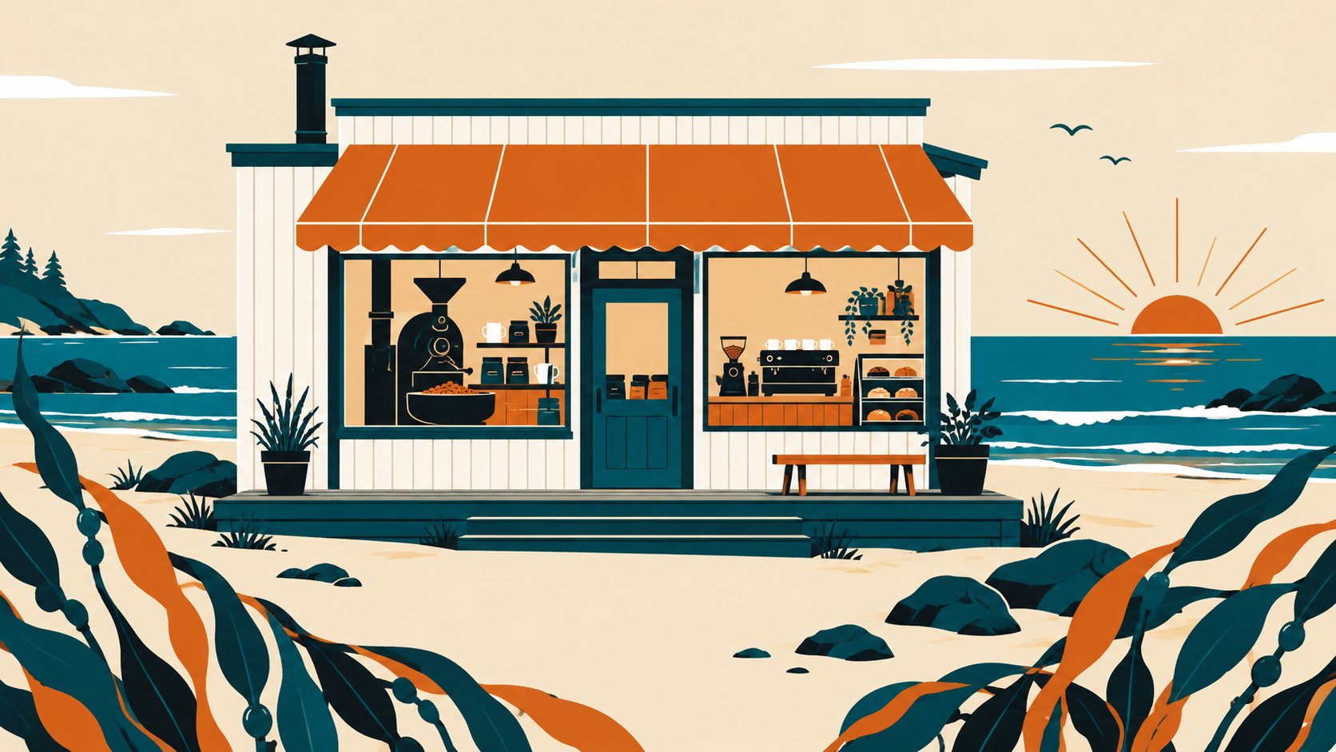

Roasted at the tide line.
Kelp & Co | Q4 wholesale overview

Slide 2
Three coffees this season
Low Tide
High Tide
Driftwood
Washed Ethiopian. Tea-like, citrus, light roast.
Colombian blend. Chocolate and orange peel, medium roast.
Sumatra. Heavy body, cedar and dark cocoa, dark roast.

Slide 3

Visit the roastery
Saturday and Sunday, 8:00 to 14:00. Bring a mug and we take 50 cents off.
Kelp & Co is a fictional demo brand.

