Slide 1
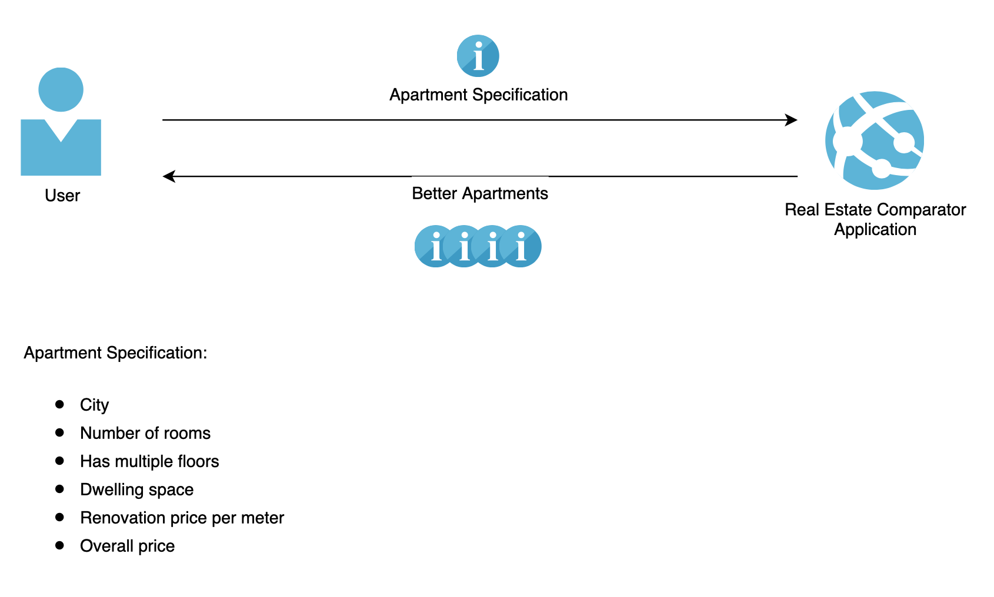
User Interaction

Slide 2
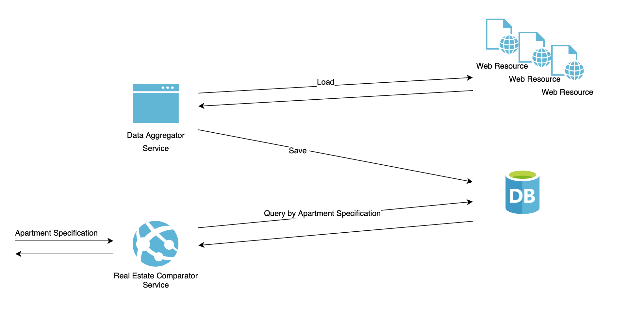
Application Interaction

Slide 3
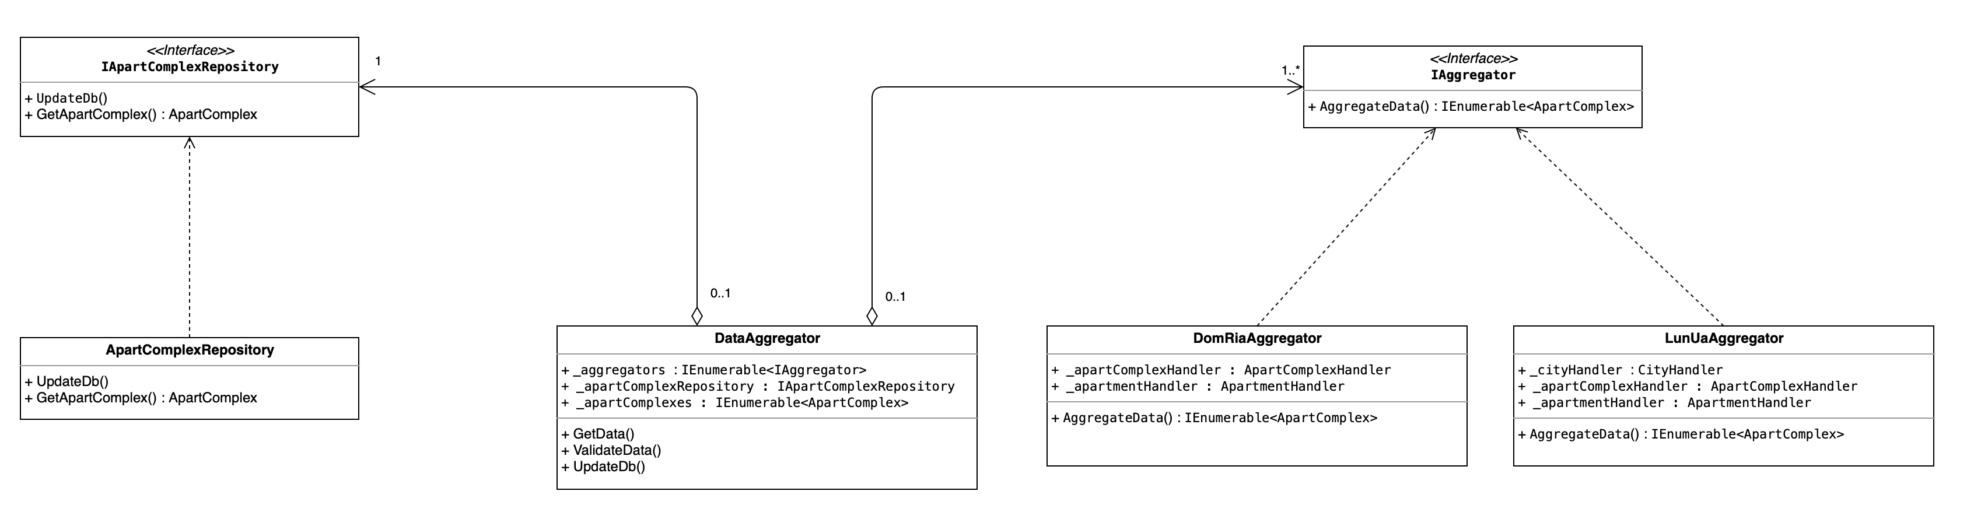
DataAggregatorService

Slide 4
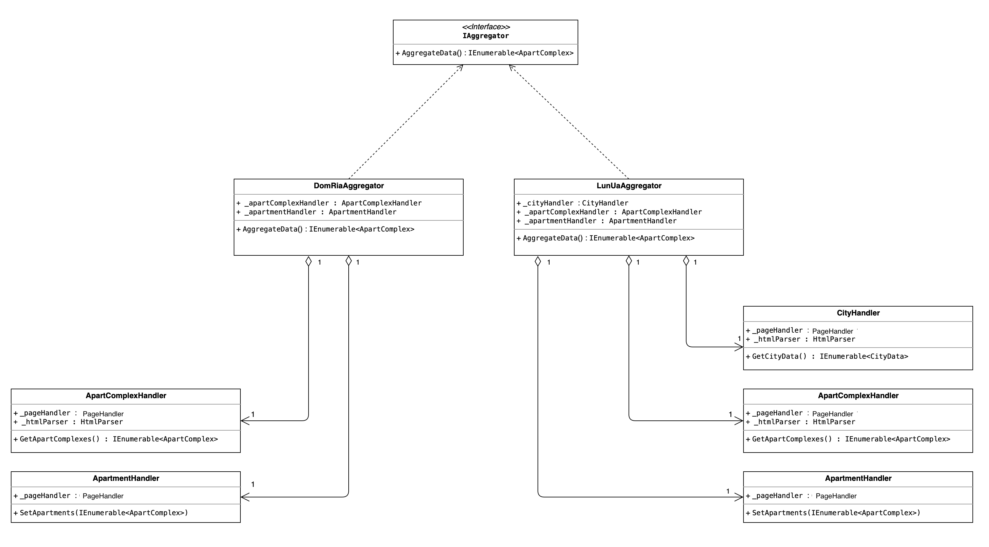
Data Aggregators

Slide 5
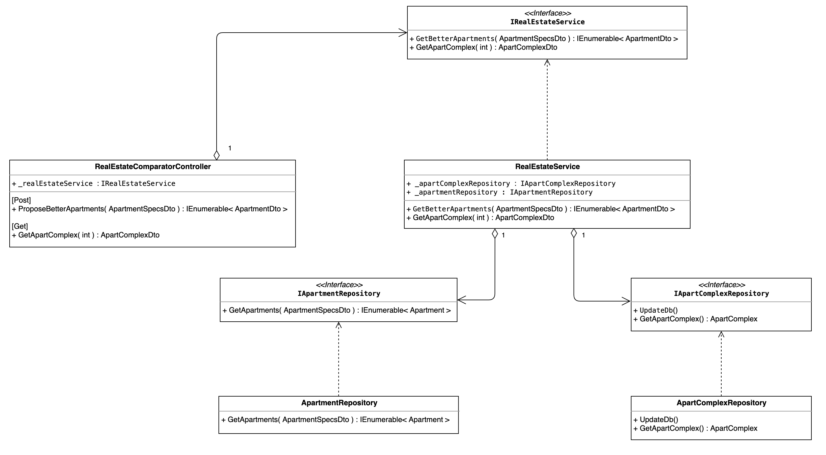
RealEstateComparatorService

Slide 6
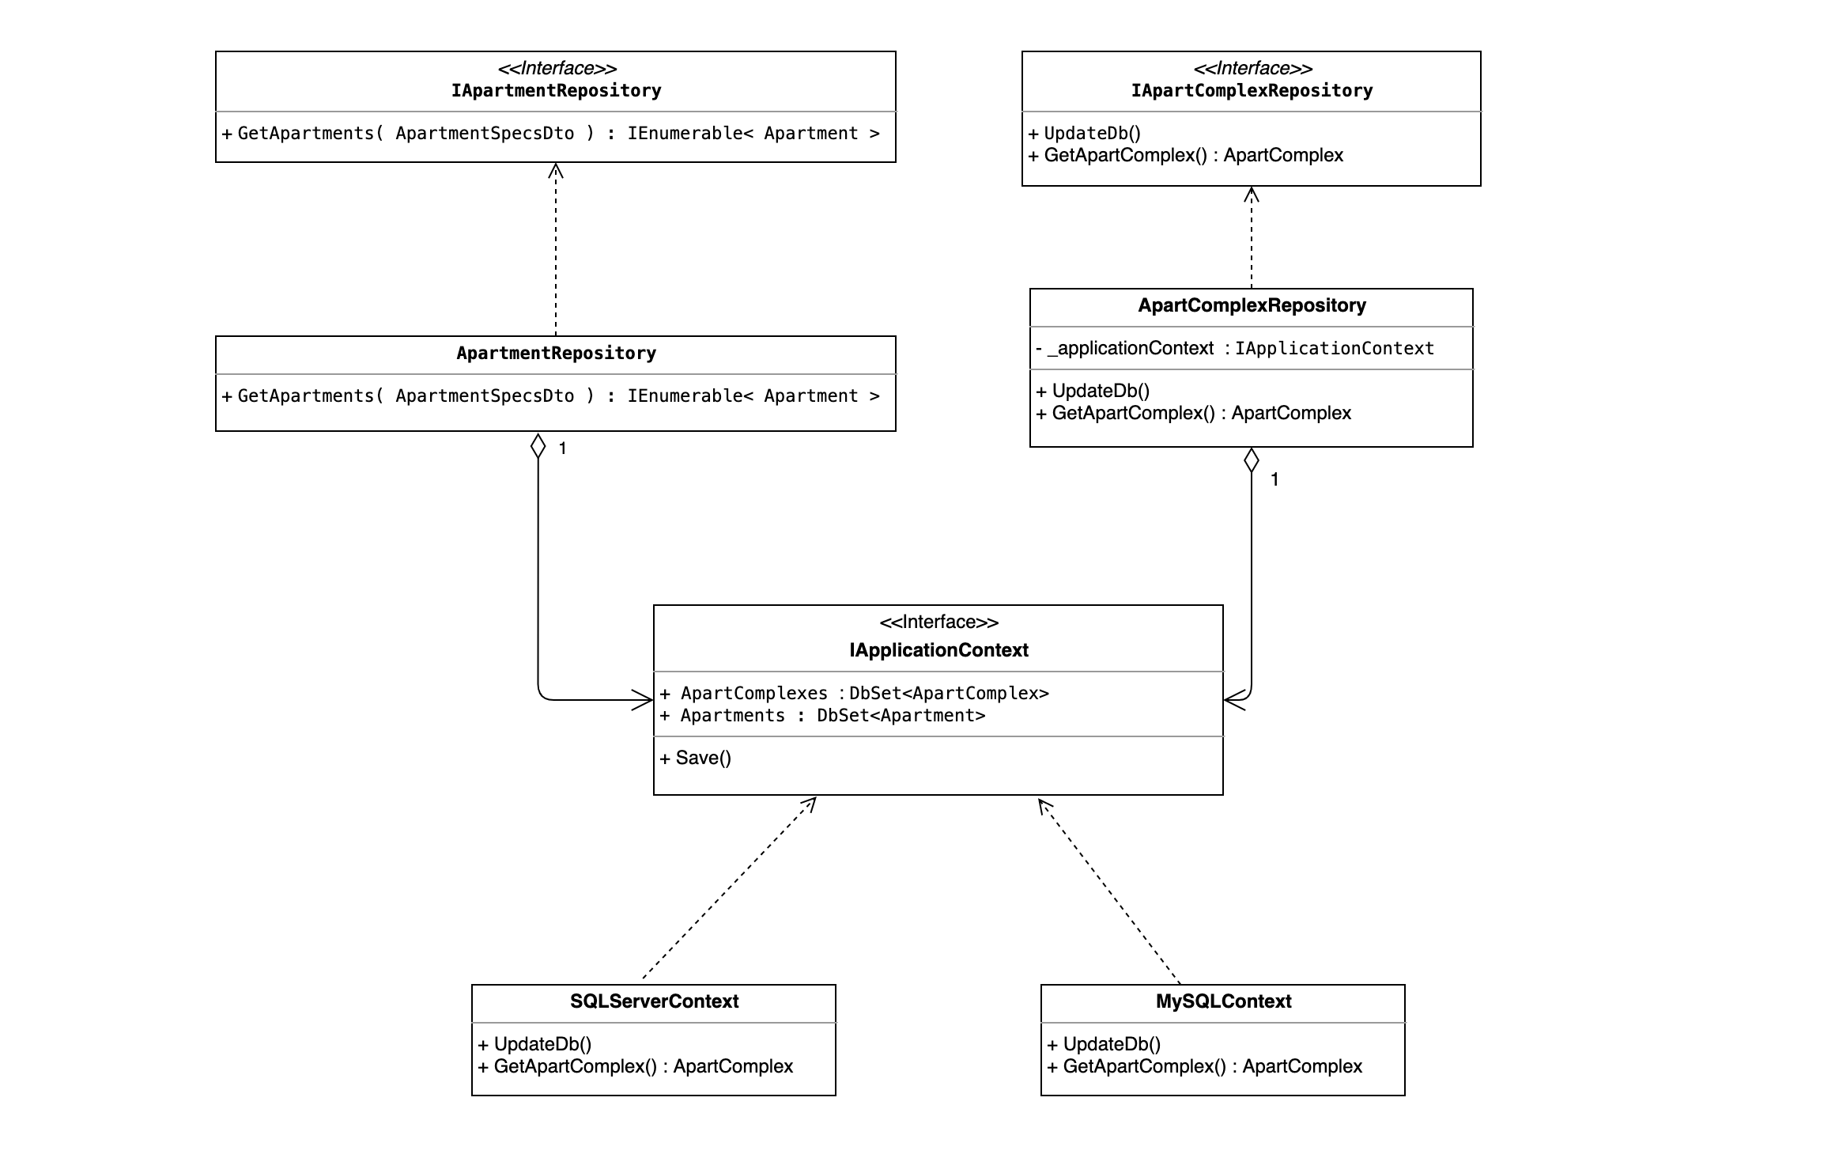
Repositories

Slide 7
Used Functionality
Frameworks
Dependency Injection Entity Framework (with Fluent API) XUnit
Project types
.NET Core Console Application .NET Core Web Application .NET Core Class Library .NET Core Unit Test Project
Patterns
Repository
Other tools
HtmlAgilityPack Swagger Fiddler Docker
Data Bases
SQL Server My SQL

