Slide 1
RESTful API: Members Service
Igor Shevchenko

Slide 2
Goals of the meeting
GOALS
Present and describe RESTful API
1
Have a discussion around the topic
2
Knowledge exchange
3
4
5

Slide 3
Task Specification
RESTful Web Service with Spring Boot
Domain model with one entity (member)
CRUD operations, plus list members
Accept JSON / XML
Produce JSON / XML
Error handling with HTTP Status Code
Architecture
Implementation
Testing

Slide 4
Used Technologies
Spring Boot
Spring REST / HATEOAS
Spring Data JPA with H2
Jackson
For testing / documentation
AssertJ
Mockito
Spring RestDocs with MockMvc

Slide 5
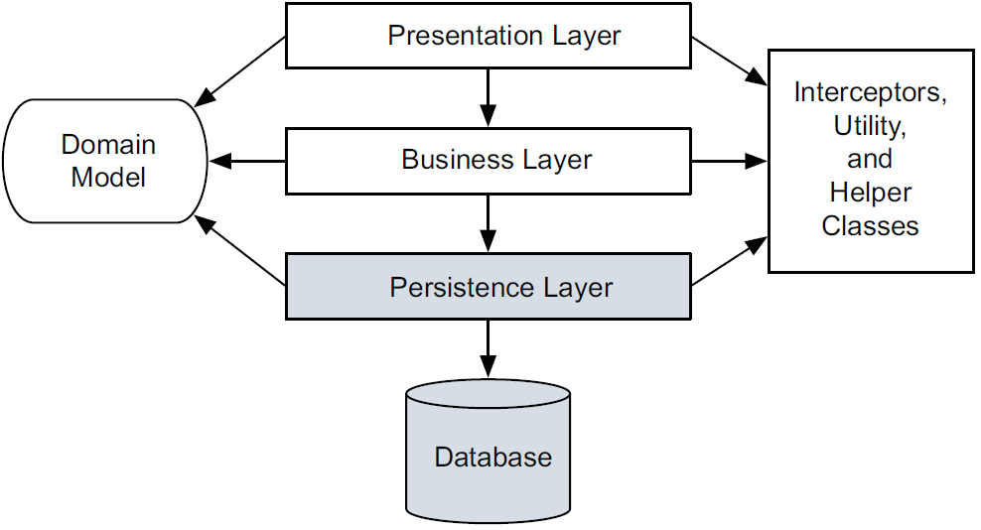
Layered Architecture

Slide 6
Domain Model
@Entity
public class Member
{
@Id
@GeneratedValue
private Long id;
@Column
private String firstName;
@Column
private String lastName;
@Column
private String zipcode;
@Column
@JsonFormat(pattern = "yyyy-MM-dd")
private LocalDate dateOfBirth;
}

Slide 7
API Mappings
Following mappings are implemented:
GET http://localhost:8080/
GET http://localhost:8080/members
GET http://localhost:8080/members/1
PUT http://localhost:8080/members/1
DELETE http://localhost:8080/members/1
GET http://localhost:8080/members?lastname=Musterman
These are described on the following slides

Slide 8
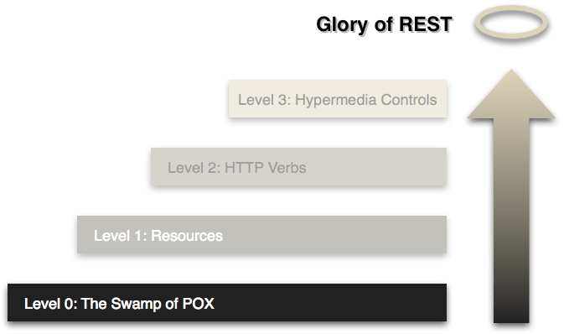
RESTful API Maturity Levels
HATEOAS belongs here:
“Swamp of POX” (plain old XML)
Notes:
Hypermedia as the engine of application state.

Slide 9
http://localhost:8080/members/1
HTTP Verb | CRUD | Status Codes | Headers
GET | READ | 200 (OK) 404 (Not found) | Accept: application/json
{
"firstName": "Ben",
"lastName": "Musterman",
"zipcode": "10141",
"dateOfBirth": "1990-10-15",
"_links": {
"self": {
"href": "http://localhost:8080/members/1"
},
"invitedBy": {
"href": "http://localhost:8080/members/999"
}
}
}

Slide 10
http://localhost:8080/members/1
HTTP Verb | CRUD | Status Codes | Headers
GET | READ | 200 (OK) 404 (Not found) | Accept: application/xml
<MemberResource>
<id>1</id>
<firstName>Ben</firstName>
<lastName>Musterman</lastName>
<zipcode>10141</zipcode>
<dateOfBirth>1990-10-15</dateOfBirth>
<links>
<links>
<rel>self</rel>
<href>http://localhost:8080/members/1</href>
</links>
<links>
<rel>invitedBy</rel>
<href>http://localhost:8080/members/999</href>
</links>
</links>
</MemberResource>

Slide 11
application/hal+json
Hypertext Application Language
Default media type served by Spring HATEOAS
Makes your API explorable
Two simple concepts: resources and links
“Except for simple fixed entry point to the application, a client does not assume that any particular action is available for any particular resources beyond those previously received from the server”
Notes:
Hypermedia as the engine of application state. Clients must know the API a priori. Changes in the API break clients and they break the documentation
about the service.

Slide 12
MembersController.java
HTTP Verb | CRUD | Status Codes | Headers
GET | READ | 200 (OK) 404 (Not found) | Accept: application/xml
@GetMapping(value = "/members/{id}")
@ResponseStatus(HttpStatus.OK)
public MemberResource getMember(@PathVariable long id) {
Member member = this.repository.findOne(id);
if (member == null) {
throw new NoSuchMemberException(id);
}
return new MemberResource(member);
}

Slide 13
MemberResource.java
Centralized place to keep link-building logic
public class MemberResource extends Resource<Member>
{
public MemberResource(Member member)
{
super(member);
// Add links to related resources and self
add(linkTo(methodOn(MemberController.class)
.getMember(member.getId())).withSelfRel());
// Add dummy link to member who invited this member
add(linkTo(methodOn(MemberController.class)
.getMember(999L)).withRel("invitedBy"));
}

Slide 14
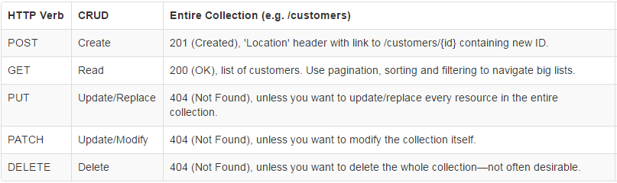
HTTP Verbs

Slide 15
Error Handling
HTTP Status codes on an exception
Controller based exception handling
Global exception handling
✓
✓

Slide 16
Error Handling Results
Build a totally custom error response
GET http://localhost:8080/members/999999
Response (with status 404, not found):
{
"url": "http://localhost:8080/members/1000",
"message": "Member with id '1000' does not exist."
}

Slide 17
NoSuchMemberException.java
Custom exception message
@ResponseStatus(HttpStatus.NOT_FOUND)
public class NoSuchMemberException extends NoSuchElementException {
private static final long serialVersionUID = 1268L;
private static final String MESSAGE_FORMAT =
"Member with id '%d' does not exist.";
public NoSuchMemberException(long id) {
super(String.format(MESSAGE_FORMAT, id));
}
}

Slide 18
DefaultControllerAdvice.java
Global Exception Handling

Slide 19
Consuming API: Option 1
Service side uses Spring HATEAOS to:
MemberResource -> json
Client side uses Spring HATEAOS to:
MemberResource <- json
Documentation is here
“Traverson” implementation

Slide 20
Consuming API: Options 2, 3
2. HAL / JSON parsers for Java and other languages:
https://github.com/mikekelly/hal_specification/wiki/Libraries
3. Direct parsing of objects from JSON is always an option

Slide 21
Testing Options
Start application context, plus server
Start application context, without server
Start only required WEB controller
✓
✓

Slide 22
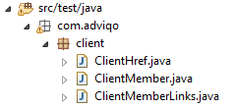
Integration Testing – MembersControllerIT.java
Starts an application like it would do in production. Assume you are a client, send an HTTP request and assert the response
@Test
public void shouldGetMember()
{
// Setup
String url = "http://localhost:" + port + "/members/1";
// Action
RequestInterceptors.autoSetJsonHeaders(this.restTemplate);
ClientMember member =
this.restTemplate.getForObject(url, ClientMember.class);
// Assertions
}

Slide 23
Unit Testing – MemberControllerTest.java
Starts only a specific WEB controller, mock everything else
@Autowired
private MockMvc mockMvc;
@MockBean
MemberRestRepository repository;
...
// Action
this.mockMvc.perform(put(url)
.content(requestJson)
.contentType(JSON_MEDIA_TYPE))
.andExpect(status().isOk());
...

Slide 24
http://localhost:8080/
HTTP Verb | CRUD | Status Codes | Headers
GET | READ | 200 (OK) | Accept: application/json
{
"_links": {
"members": {
"href": "http://localhost:8080/members"
},
"self": {
"href": "http://localhost:8080"
}
}
}

Slide 25
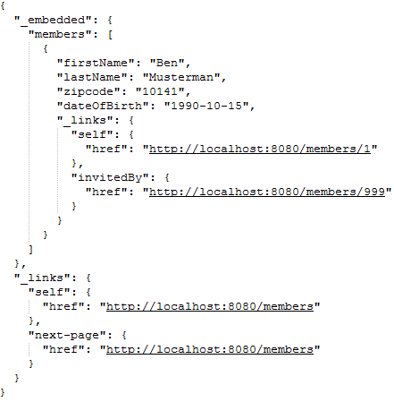
http://localhost:8080/members

Slide 26
Is it convenient to get invitedBy information?
API usage without hardcoding URLs will be:
Get index page
Follow link “members”
Get some member
Follow link “invitedBy”
Hurts performance on both sides

Slide 27
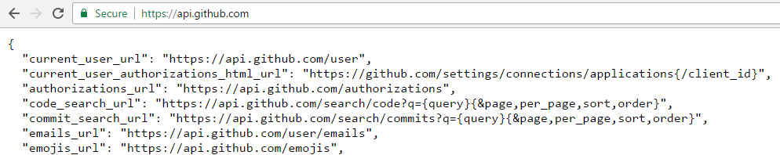
Github.com API
Templated URLs are provided

Slide 28
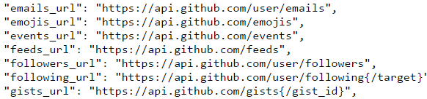
http://localhost:8080/ (next steps)
{
"_links": {
"members": {
"href": "http://localhost:8080/members"
},
"self": {
"href": "http://localhost:8080"
}
}
}

Slide 29
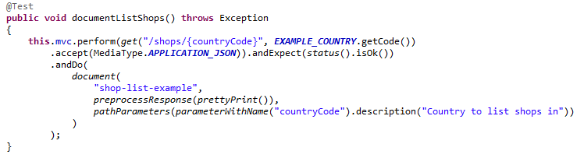
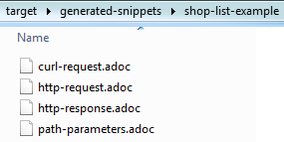
Documentation
Will create Asciidoc documentation:

Slide 30
Network Discovery
https://zookeeper.apache.org/
ZooKeeper is a centralized service for maintaining configuration information, naming, providing distributed synchronization, and providing group services

Slide 31
Q&A

