Slide 1

Changes applied to make MDK v2.01 work properly

Slide 2
medslik_II.sh

Slide 3
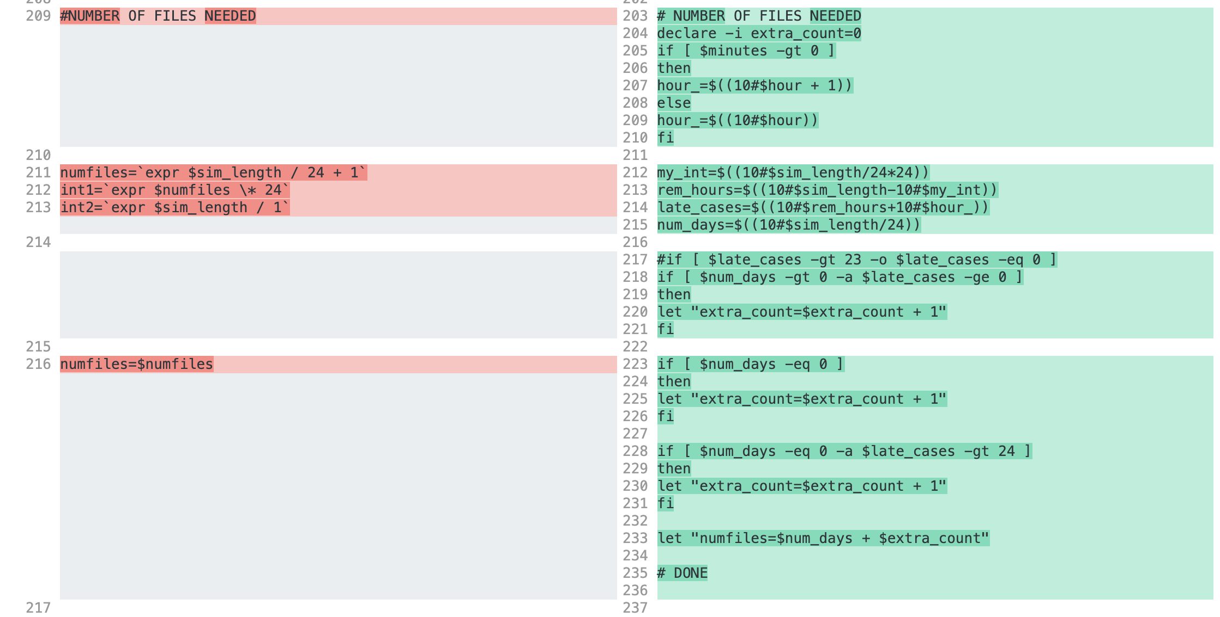
medslik_II.sh

Slide 4
medslik_II.sh

Slide 5
read_oil_data.py

Slide 6
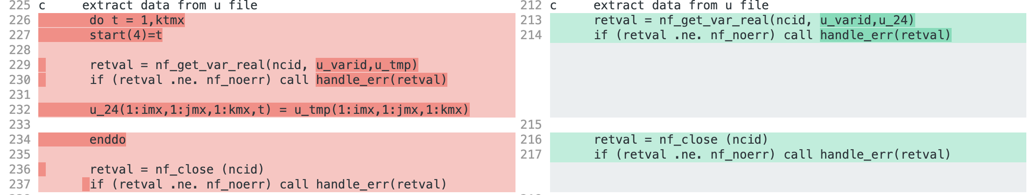
Extract_II.for
same for u, v and t

Slide 7
medslik_II.for
No changes applied

