Slide 1
Optimizing FMU Women’s Soccer Conference Carolinas Schedule Using Graph Theory and Linear Programming
By: Tauzhanee Spann
Advisor: Dr. Thomas Fitzkee

Slide 2

Just Why
This wasn’t my first research topic
Work with Recording Sports Games
LOVE MUSIC. Music is life.
Nebraska!!!!
Savannah Bailey, Furman University Linear Programming in ACC Women’s Basketball at Nebraska Conference for Undergraduate Wisdom in Mathematics (NCUWM)
Sponsor: Dr. Fitzkee

Slide 3
Goal
Optimize the FMU women’s soccer schedule
Minimize total travel distance for the 3 non-division games
Focus on non-division matchups only since divisional opponents must play each other twice.
Selected women’s soccer because all Conference Carolinas schools have a team
Not every school plays all non-division opponents, so scheduling is limited and uneven

Slide 4
Background: Graph Theory
Branch of Mathematics that studies graphs
Structures that model pairwise relations between objects
Vertices aka Nodes (points or circles)
Edges aka Links (lines connecting vertices)
Notes:
Branch of Mathematics that studies graphs
structures that model pairwise relations between objects
Vertices AKA Nodes (points or circles)
Edges AKA Links (lines connecting vertices)

Slide 5
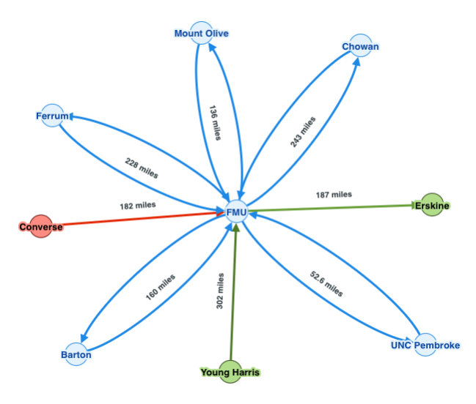
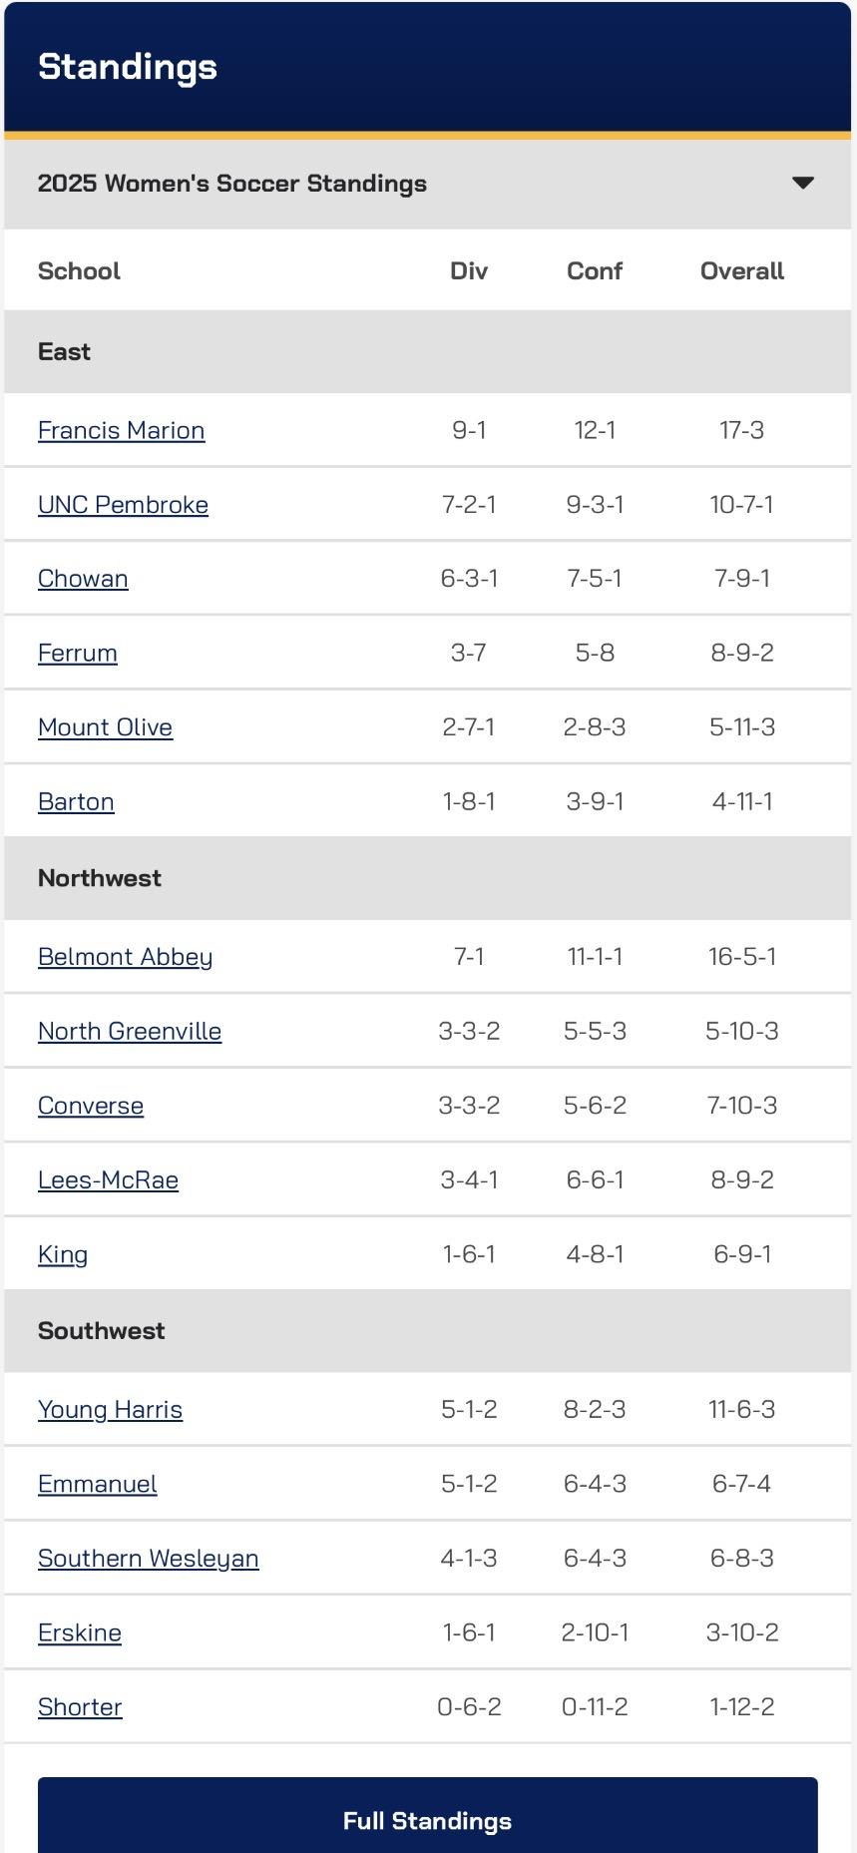
Methodology: Graph Theory
Notes:
The conference is modeled as a weighted graph. Each team is a node, and the travel distance between teams is represented as an edge. A star graph structure is used to simplify visualization, where one central node connects to all other teams.

Slide 6
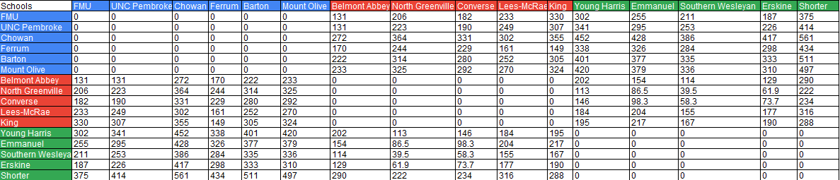
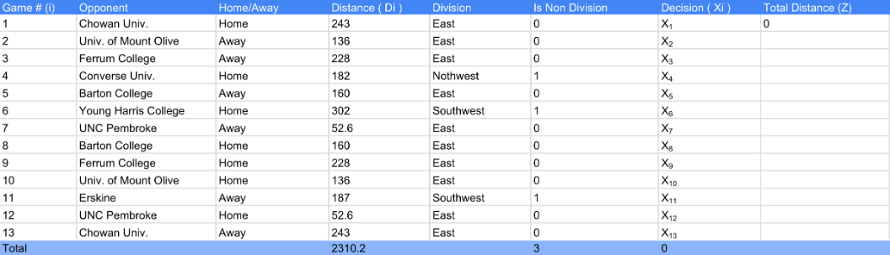
Data Collected

Slide 7

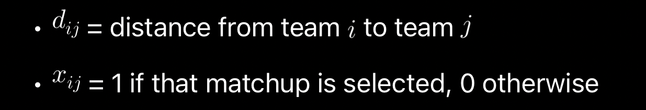
Background: Objective Function
Used to represent and solve the optimization problems of linear programming. The form is Z = ax + by, where x , y are the decision variables. The function can be used to maximize the profit, minimize the cost, etc.

Slide 8
Background: What is a Solver?
Excel Solver is an optimization tool used to find the best solution to a problem
•It adjusts decision variables automatically
•It works under constraints (limits or rules)
•Used for linear and integer programming problems

Slide 9
Why need a Solver?
• Real-world problems have many possible solutions
• Manual trial-and-error is inefficient
• Solver finds the optimal solution mathematically
• Ensures constraints are satisfied

Slide 10
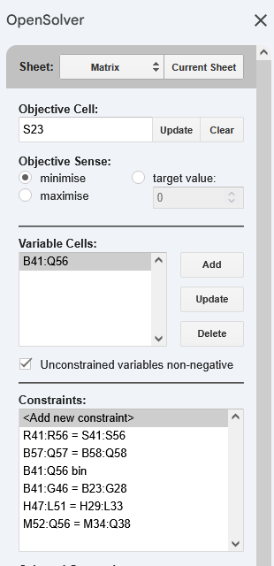
Methodology: Solver
Steps
objective: Total Mileage (Z) Cell (min)
=SUMPRODUCT(DistanceMatrix,DecisionMatrix)
Variables: Decision Matrix
Empty 16 x 16 Matrix
Constraints

Slide 11
Background: Branch and Bound
Branch and Bound is an algorithm used to solve integer programming problems
• It is used when decision variables must be 0 or 1 (binary decisions)
• It systematically explores possible solutions in a decision tree
• It eliminates solutions that cannot improve the best result

Slide 12
Why is Branch and Bound used?
Standard linear programming allows fractional solutions
Our model requires binary (0 or 1) decisions
Branch and Bound ensures an optimal integer solution
“Branch” = split into smaller decision cases (0 or 1)
“Bound” = eliminate worse solutions early

Slide 13
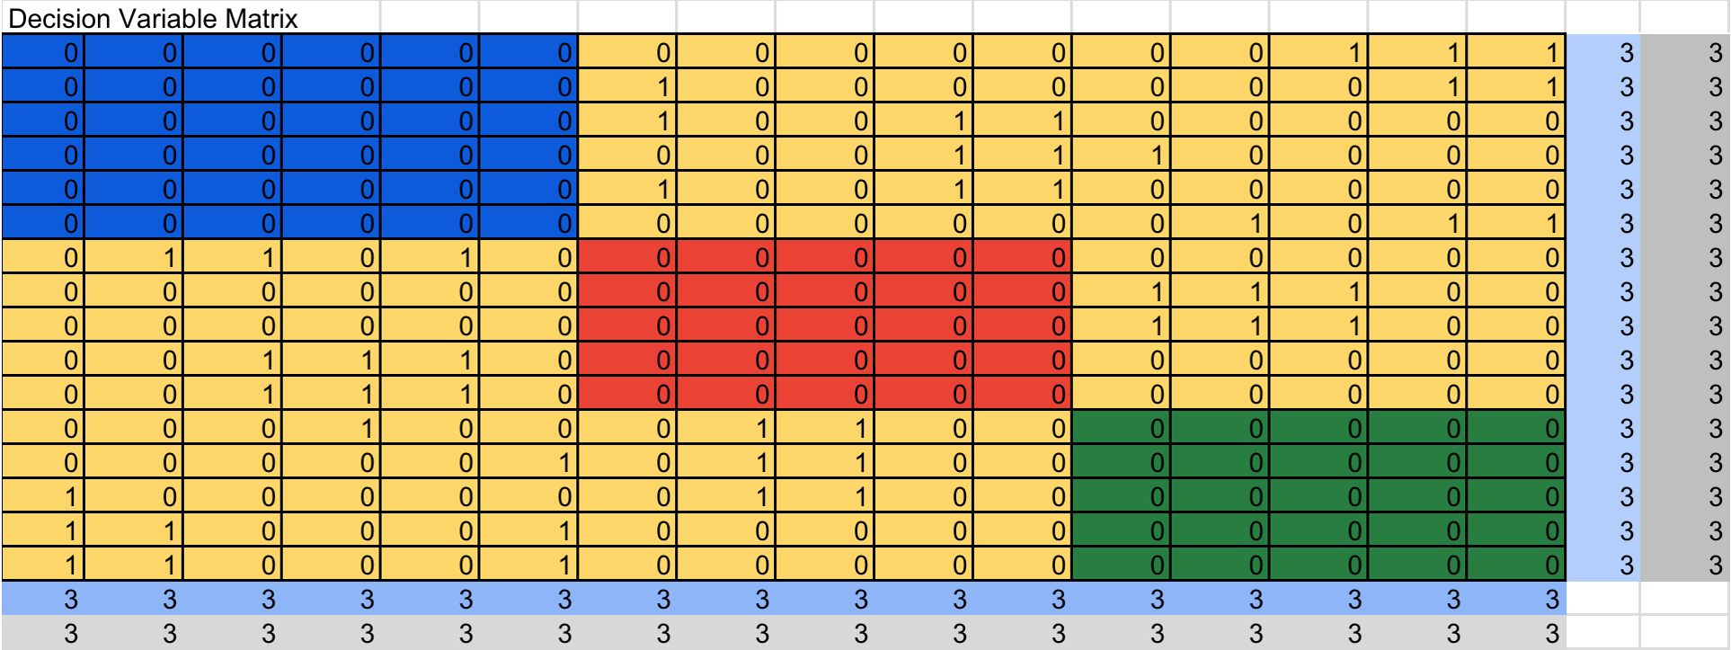
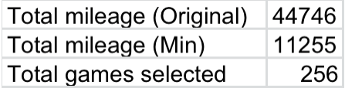
Results:Solver

Slide 14
Conclusion
Optimization improves scheduling efficiency
Travel distance can be minimized using mathematical models
Graph theory provides structure for the problem
Linear programming determines the best solution
Solver and Branch & Bound ensure optimal results

Slide 15
Future Work
Love to do it for all the sports at FMU
work for the games
noticed scheduling being hectic
Would like to incorporate Actuarial Sciences into it one day

Slide 16
Citations/ References
https://www.numberanalytics.com/blog/graph-theory-fundamentals-beginners-guide
https://www.cuemath.com/algebra/objective-function/
https://support.microsoft.com/en-us/office/define-and-solve-a-problem-by-using-solver-5d1a388f-079d-43ac-a7eb-f63e45925040
https://en.wikipedia.org/wiki/Branch_and_bound

Slide 17
Acknowledgements
Sponsor: Dr. Thomas Fitzkee
Mr. Phillips (Linear Programming)
Savannah Bailey, Furman University Linear Programming in ACC Women’s Basketball at NCUWM
MYSELF
Thanks. Any Questions?

