Slide 1

BUILDING A SOFTWARE RENDERING SYSTEM FROM SCRATCH
By Yufan Wang
wang.y51@northeastern.edu

Slide 2

CONTENT
Showcase 1 — Three-lamp Scene
Showcase 2 — Parallax Animation
Showcase 3 — Planet Solar System
Showcase 4 — Shading Comparison
Showcase 5 — Marble
Showcase 6 — Other
Reflection

Slide 3
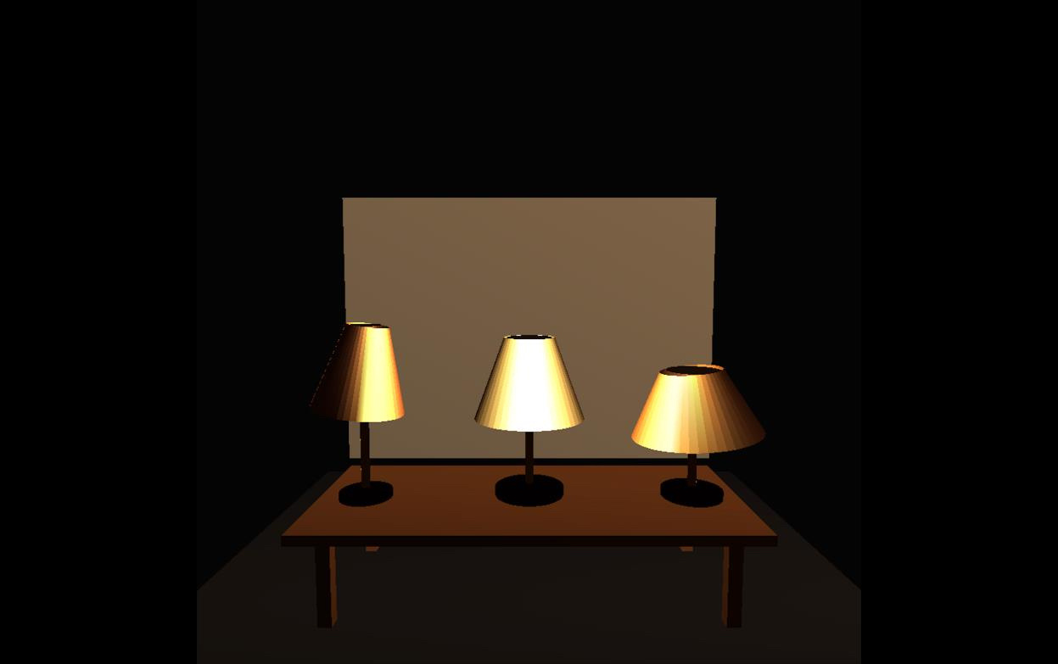
SHOW CASE 1
THREE-LAMP SCENE

Slide 4
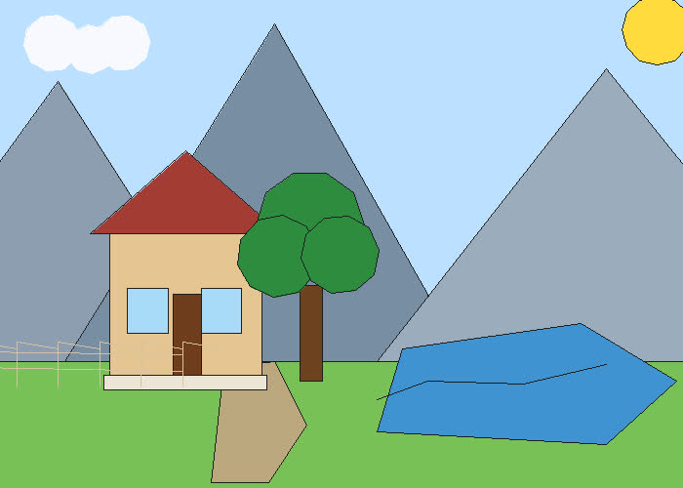
SHOW CASE 2
PARALLAX MULTI-LAYER ANIMATION

Slide 5
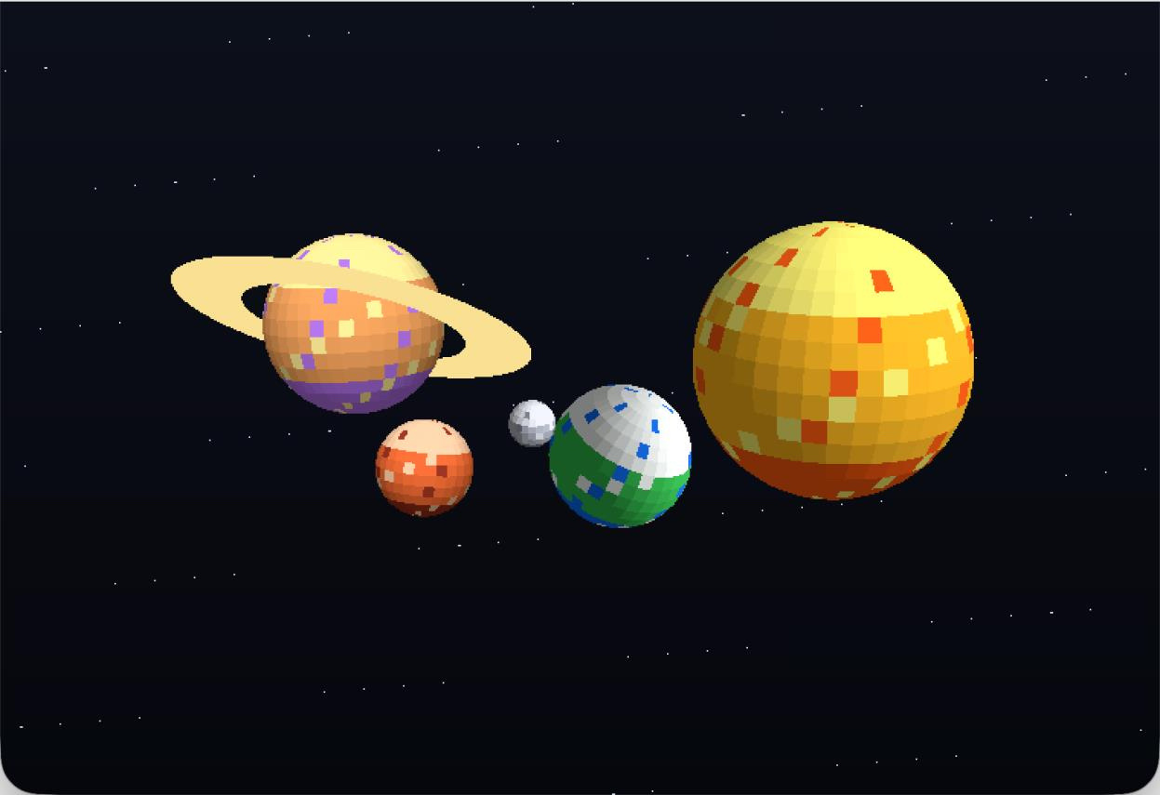
SHOW CASE 3
PLANET SOLAR SYSTEM

Slide 6
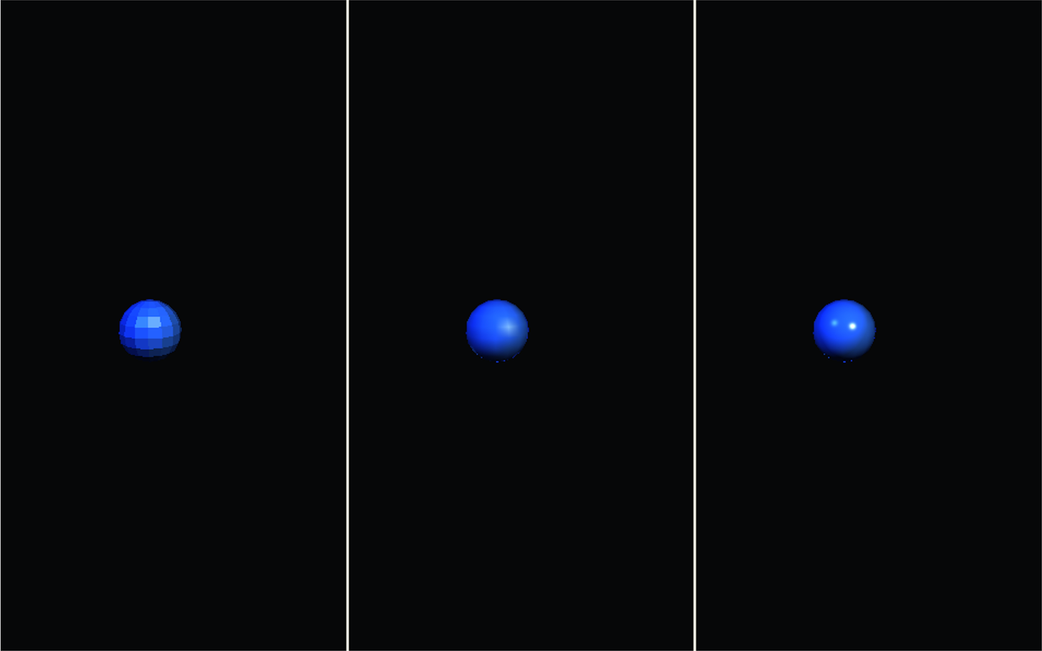
SHOW CASE 4
SHADING COMPARISON
Flat
Gouraud
Phong

Slide 7
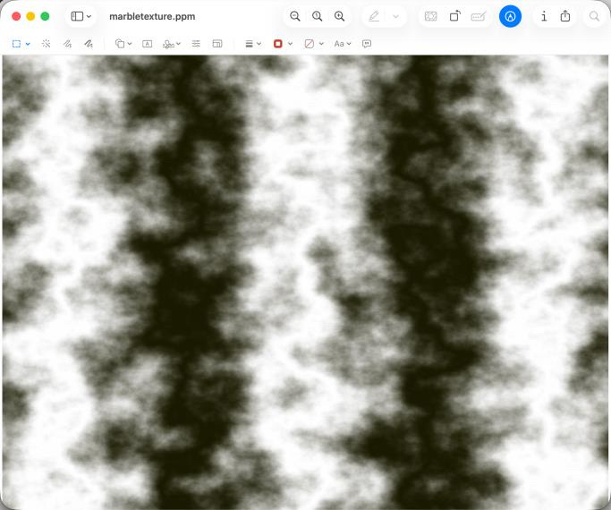
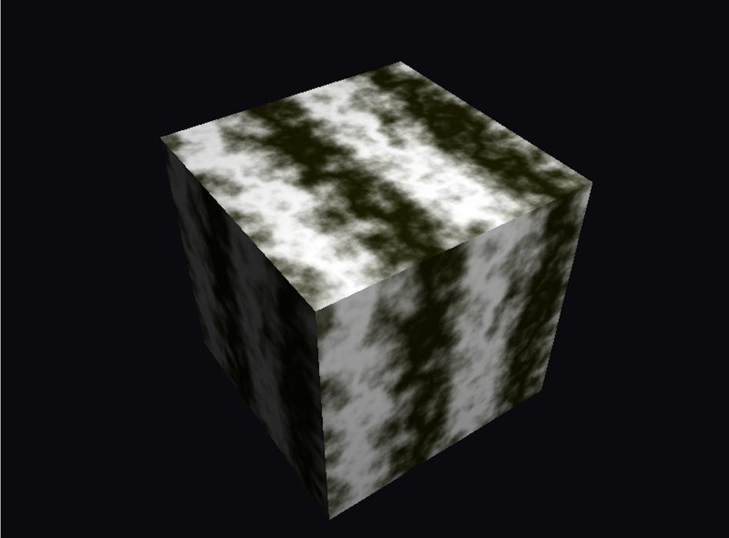
SHOW CASE 5
MARBLE
Fractal
Texture Mapping

Slide 8
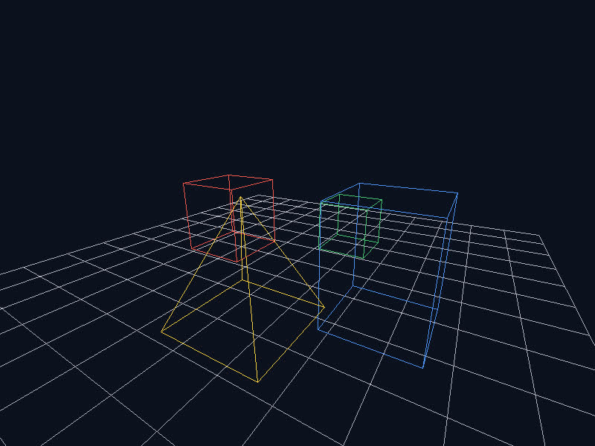
SHOW CASE 6
OTHER - 3D VIEW

Slide 9
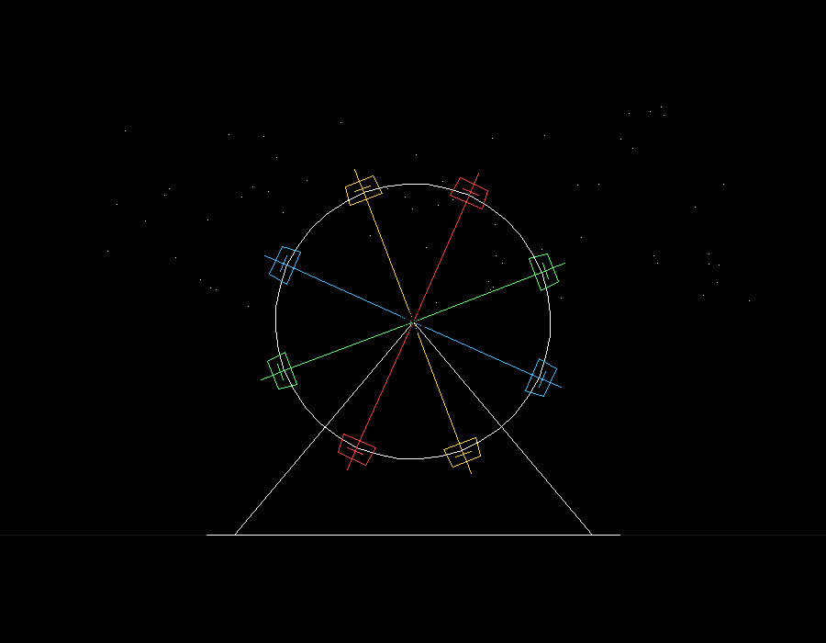
SHOW CASE 6
OTHER - HIERARCHICAL MODELING

Slide 10

SHOW CASE 6
OTHER - BEZIER SURFACE

Slide 11
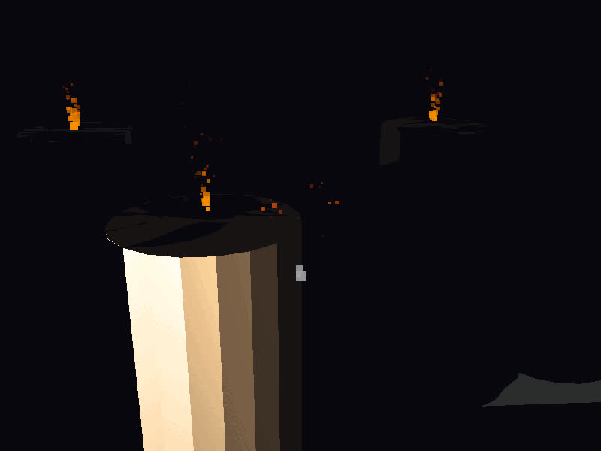
SHOW CASE 6
OTHER - PARTICLE SYSTEM

Slide 12
REFLECTION
Rasterization correctness is subtle
Triangle + barycentric pipeline is more robust
Depth handling depends on use case
Incremental system design is critical
From using graphics → understanding pipeline

Slide 13
THANK YOU

